Slide 1
LCHS4001
Academic and Employability Skills
Paragraphs, Coherence, and Cohesion

Slide 2
Aims
To be able to structure a paragraph
To recognise a topic sentence
To be able to write a strong topic sentence
To be able to recognise and use linking language to increase coherence and cohesion in your own writing

Slide 3
Paragraphs
Discuss:
How do you usually decide when to end/start a paragraph?
Do you know any tips or tricks for how to structure a paragraph when writing?

Slide 4
Paragraphs
Body paragraphs should follow certain academic conventions.
Each paragraph should:
begin with a topic sentence – a one sentence summary of the theme of the paragraph
focus on one theme only
connect directly to your report heading (or thesis statement if an essay)
use supporting evidence to demonstrate that your ideas are sound
include link and signpost words to help the reader navigate your ideas
Notes:
Abbreviations and symbols here before note taking practice?

Slide 5
Paragraphs: A Suggested Structure
When writing in an academic style, it can be useful to use a structure for individual body paragraphs.
The TEEL structure is a structure that can help you to organise your ideas effectively
Unlike the structure for a whole report, the TEEL structure should be repeated for each main body paragraph.

Slide 6
TEEL
T: Topic Sentence. This is the first sentence of the paragraph, which introduces the main idea or argument you will discuss. It provides the reader with a clear understanding of what the paragraph will be about.
E: Explanation. After the topic sentence, you provide an explanation or elaboration of the main idea. This is where you expand on your argument or topic, providing relevant details, examples, or evidence to support your point.
E: Evidence. In this part of the paragraph, you present specific evidence or examples to support the explanation you provided. This could include quotes from sources, data, statistics, or other forms of evidence that back up your argument.
L: Link. The final part of the TEEL paragraph is the link sentence. The link sentence explains how the evidence you presented relates back to the main point you're making in the paragraph. It ties everything together neatly.

Slide 7
Activity 1
Go to the worksheet and read the paragraph in Activity 1
After you read, discuss which part of each paragraph fits each part of TEEL with a partner. Label or highlight or colour the font to reflect each different part of the paragraph.
Topic Sentence Explanation Evidence Linking Sentence
Academic style is the way of writing used in educational settings, like schools and universities. In academic writing, it's important to follow certain rules and conventions to communicate ideas effectively. This includes using formal language, providing evidence to support arguments, and citing sources properly. For example, academic papers often use third-person perspective and avoid contractions like "don't" or "can't." Additionally, they include citations for any information or ideas taken from other sources to avoid plagiarism. Therefore, understanding and using academic style is essential for students to succeed in their studies and communicate their ideas clearly and professionally.

Slide 8
Activity 1 Answers
Topic sentence Explanation Evidence Linking Sentence
Academic style is the style of writing used in educational settings, like schools and universities. In academic writing, it is important to follow certain rules and conventions to communicate ideas effectively. This includes using formal language, providing evidence to support arguments, and citing sources properly. For example, academic papers often use third-person perspective and avoid contractions like "don't" or "can't." Additionally, they include citations for any information or ideas taken from other sources to avoid plagiarism. Therefore, understanding and using academic style is essential for students to succeed in their studies and communicate their ideas clearly and professionally.

Slide 9
Activity 2
Go to the worksheet and read both paragraphs
After you read, discuss which paragraph is the better example of TEEL. Write down at least 3 reasons why you believe the paragraph is better with examples from the text.

Slide 10
Activity 2 Answer:
Paragraph A is the better demonstration of TEEL. Here’s why:
Problems with Paragraph B:
T: The topic sentence "academic skills are important" is weak because it is overly broad and lacks specificity. It does not provide the reader with a clear indication of what the paragraph will discuss or what aspect of academic skills will be addressed. Additionally, it is a statement of fact rather than an argument or main point that can be developed and supported throughout the paragraph.
E: There’s no clear explanation or development of the main idea. Instead, it jumps from point to point without providing adequate explanation or support for each idea presented. It also includes lots of irrelevant information which does not relate to the topic sentence (e.g. about lecturers, student unions, workshops)
E: The evidence presented in the first example is weak and lacks specificity. It offers a generic example without supporting any of the explanation points or the claim of the topic sentence.
L: The link sentence doesn't effectively tie the evidence back to the main idea of the paragraph, includes new information (e.g. learning generally, and development) and includes an example which doesn’t fit the paragraph.

Slide 11
What’s right with Paragraph A?
T: the topic sentence is more focused and clearly establishes the main idea of the paragraph, which is the importance of academic skills in university success.
E: the explanation. is more comprehensive. It provides an explanation of why academic skills are important, specifically focusing on effective writing, paraphrasing, and referencing. It explains how these skills are essential for understanding complex course materials and articulating ideas clearly in assignments.
E: Paragraph B provides specific evidence in the form of a research study conducted by Johnson (2020). This adds credibility to the argument and demonstrates that the writer has conducted research to support their claims. The evidence is also directly relevant to the topic and reinforces the importance of academic skills for comprehension of materials.
L:. The last sentence links back to the main argument and summarizes the paragraph. It reinforces the importance of developing academic skills without necessarily repeating too much.

Slide 12
Things to Remember: Topic Sentences
A good topic sentence helps the reader to understand the paragraph they are about to read.
It is usually the first sentence of the paragraph.
A good topic sentence makes clear the paragraph topic, and what you want to say about the topic. E.g. Cats are better pets than dogs because they are cheaper. We now know the paragraph will explain and give examples/evidence of why and how cats are cheaper than dogs. It will not discuss anything else.
Everything in your paragraph should relate to the topic sentence.
Students often think that simple sentences are not academic. This is not the case. Keep it simple and clear!

Slide 13
Things to Remember: Explanation
Writing the development part of a paragraph involves expanding on the main idea presented in the topic sentence.
This is where you provide more context, explanation, analysis, and details to help the reader fully understand and appreciate your main point.
Avoid trying to show off how much you know by keeping everything on topic.

Slide 14
Things to Remember: Evidence
This is where you provide evidence from sources for the arguments you’ve made in the development or provide further examples to support your ideas made in the explanation.
Try to avoid using too much evidence. This may confuse the reader and bury the structure of the report or essay.
On the other hand, make sure you avoid giving too little evidence. Relying on your own ideas without any research to support them can result in a low mark.
It is a balance between your ideas and the evidence you provide, and this balance will take time and practice! Try not to be too discouraged by your first attempts. It takes time to get right, and that’s okay!

Slide 15
Things to Remember: Linking Sentences
Link sentences can summarise the main idea and remind the reader of the focus and purpose of each paragraph.
Try to avoid too much repetition. Instead offer a perspective that builds on what information you have provided.
Links can sometimes transition to the next point IF applicable, especially in essays which do not have headings to show one section from the next.
Use transition words (e.g. ‘therefore’; ‘consequently’) to show the paragraph is about to end and to signal the relationship between the evidence you have just provided and the main idea
Be concise: keep link sentences short and to the point. Keep it simple!

Slide 16
Things to Remember: Overall
Simple is best. Don’t overcomplicate things, especially for your first piece of writing
One topic per paragraph. If your topic sentence is “One significant method to take notes is the Mapping Method” do not start writing about the Tabular Method in the same paragraph. When you need to discuss a new topic, switch to a new paragraph
Generally, in academic writing, a paragraph should be roughly 150-200 words. This is NOT a hard and fast rule, but a ROUGH guide.
Leave yourself time to make changes and edit your work. Even your tutors can write paragraphs which are too long, include too many ideas, or need a lot of editing when they write their first draft of a paper! Editing makes good writing-get your ideas out in a rough draft, then edit, edit, edit to perfect paragraph structure!

Slide 17
Coherence and Cohesion
Coherence means that your writing is easy to understand because all the ideas are connected and flow logically from one to the next. Think of it as making sure your writing is clear and makes sense as a whole.
Cohesion refers to the way you link sentences and paragraphs together using words and phrases (linking language/devices) like "and," "but," "first," "next," and "however." These help your readers follow your ideas easily.

Slide 18
Activity 3
Go to the worksheet and read both paragraphs.
After you read, discuss with a partner which paragraph is the better example of coherent and cohesive writing. Underline or highlight the language that helps make this paragraph more coherent and cohesive.

Slide 19
Activity 3 Answers
Many students at university have different motivations that drive both their academic and extracurricular activities. For instance, some students are deeply interested in their subjects and have a strong desire to learn more. These students are motivated by their passion for knowledge and academic excellence. On the other hand, others are driven by future job prospects, seeing their studies as a critical step towards a successful career. Additionally, involvement in clubs and sports can be motivated by social reasons, as students seek to build friendships and engage in campus life. Finally, the support of friends and family is crucial in maintaining motivation, because motivation can often change overtime. In conclusion, universities should try to understand all the different ways students are motivated, so that they can help students achieve success.

Slide 20
Activity 4
Go to the worksheet and sort the devices into their function
Compare your answers with a partner

Slide 21
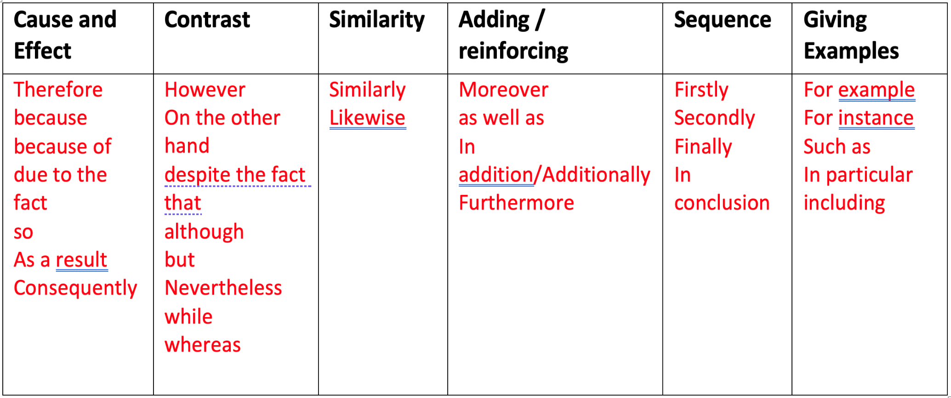
Activity 4 Answers

Slide 22
How to use cohesive devices in your own writing
If you can’t find any places in your writing where you think you could use cohesive devices, ask yourself if your paragraph needs more detail.
Could you…
Add another piece of evidence to support your point? (using ‘Moreover’, ‘Furthermore’, ‘In addition…’)
Give an example? (using ‘such as’, ‘For example’, ‘For instance’…)
Organise your ideas more clearly? (using ‘Firstly’, ‘Secondly’, ‘Finally’…)
Explain why something is important or significant? (using ‘Consequently’, ‘For this reason’…)

Slide 23
Activity 5
Your tutor will now give you back your writing from last week. They have not yet made comments or given feedback on this writing.
Using what you have learnt in this lesson, revise your writing so that it follows TEEL, and uses linking language to be more coherent and cohesive.

Slide 24
Extra Practice
You can find more practice activities through these websites:
​
https://www.eapfoundation.com/writing/cohesion/​
https://www.eapfoundation.com/writing/cohesion/transitions/
http://www.uefap.net/grammar/grammar-in-eap-cohesion/grammar-in-eap-introduction

