Slide 1

Preparing for research
BMHP4027
Dr Simona Ferraraccio
IM13
Week 5 – 23.02.2026

Slide 2
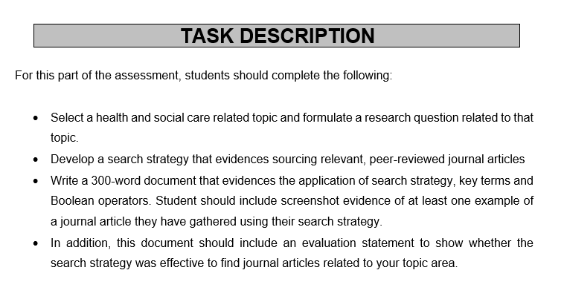
Assignment 1
Health and social care topic choice
Research questions
Search strategy
  Keywords
  Boolean operators
  Peer-reviewed articles
Evaluation statement

Slide 3
Contents
Recap of:
Research questions and FINERMAP framework
Search strategy
  Keywords
  Boolean operators
  Database
Workshop: research questions for Assignment 1.

Slide 4

What is a research questions
This Photo by Unknown Author is licensed under CC BY-NC

Slide 5

Research question: is considered the "backbone" of good research.
It defines:
the scope of your work,
guides your process,
ensures you are contributing something meaningful to your field.
According to academic standards, the most successful questions are narrowly focused and address specific parts of a complex problem rather than trying to solve everything at once.
(Ratan, et al., 2019)

Slide 6



Some examples
Dementia care
Childhood obesity
Post-Operative recovery
The complex problem (Too broad): “How can we improve care for people with dementia?”
The narrowly focused questions: “What is the impact of personalised music therapy on reducing agitation levels in residents with late-stage dementia in UK nursing homes?”
Why it works: it narrows the research question to:
the intervention (music therapy)
The outcome (agitation levels)
The population/context (late-stage dementia in UK nursing homes)
The complex problem (Too broad): “How do we stop children from becoming overweight?”
The narrowly focused questions: “Does the implementation of ‘daily mile’ initiative in primary schools lead to a measurable reduction in BMI among Year 6 students over a 12-month period?”
Why it works: instead of solving all of “obesity”, it looks at:
One specific initiative (daily mile)
A specific group (year 6)
A defined timeframe (12-months period)
The complex problem (Too broad): “How can we help patients recover faster after surgery?”
The narrowly focused questions: “How does early mobilisation within 6 hours of hip replacement surgery affect the length of hospital stay for patients over the age of 65?”
Why it works: it works because it focuses on:
A single procedure (hip replacement)
A specific action (early mobilisation)
A clear metric (length of stay)
A defined demographic (over 65s)

Slide 7
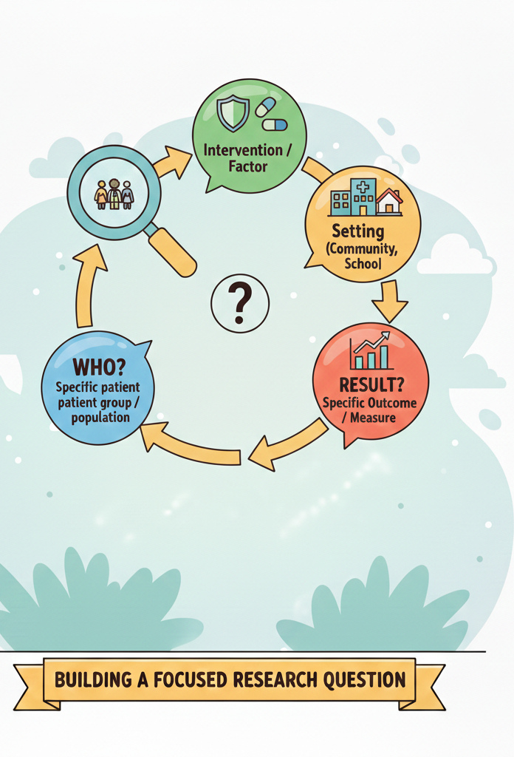
Summary of the “Narrowing” process
When refining your own question for the assignment, try to identify these four elements to move away from “solving everything at once”:
Who? Specific patient group or population
What? The specific intervention or factor you are looking at
Where? The specific setting (like hospital, community care, school)
Result? The specific outcome you are measuring

Slide 8

Individual activity
The broad topic: Write down your general area of interest.
The specific “Who”: Define exactly who you are looking at.
The “Where” & “What”: Add a setting and a specific factor or intervention.
The draft question: Combine these into one sentence that aims to fine a result.
You are now able to "break information down into parts" and "justify" the focus of their question.

Slide 9
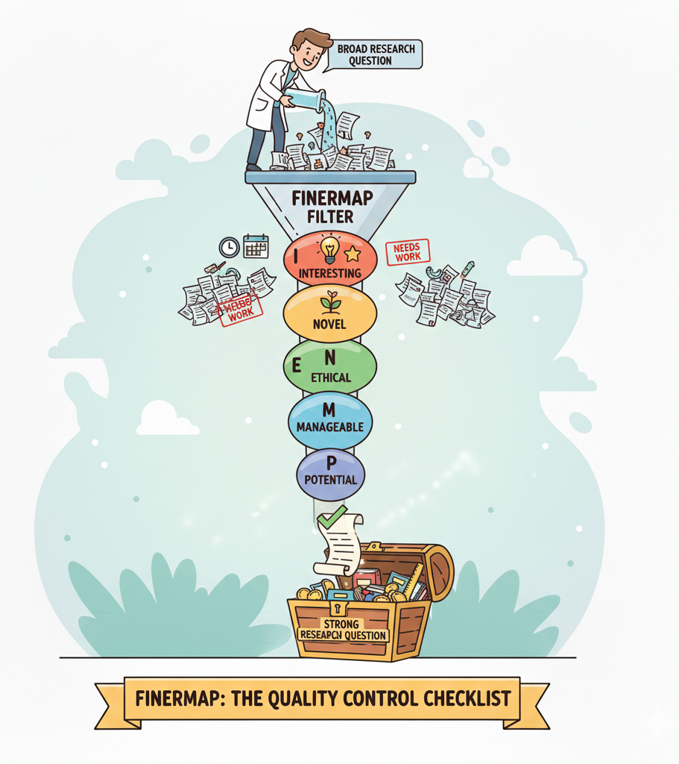
The FINERMAP method
Used to evaluate if a research question is strong enough to build an entire project (or assignment) around.
Think of it as a “filter” or “quality control checklist”: if your questions doesn’t pass these tests, it needs more work before you start searching for articles.

Slide 10

Feasible – “The reality check”
The research question is within the ability of the investigator to carry out
In general: Can this project actually be done with the resources I have?
In the context of assignment 1:
The Data check: Do I already know that enough books and articles exist on this topic, or am I just guessing?
The time check: If I start this today, can I realistically finish the reading and writing by the deadline?
The knowledge check: Do I understand the medical or social terms involved in this question well enough to explain them to someone else?
The Expert check: Does answering this require me to interview expert or visit a specific hospital, or can I find everything I need online?
This Photo by Unknown Author is licensed under CC BY-SA-NC

Slide 11

Feasibility example
A Fail on the Feasibility test is actually a good thing, t's a signal to narrow the "Who, What, or Where" of your question.
The Unfeasible question
The Feasible question
“What are the long-term effects of COVID-19 on every person in the world?”
“What are the common symptoms of ‘Long-COVID’ reported by frontline nurses in the UK?”
Why it fails: it is too broad. You cannot possibly find or read all that data. It isn’t “manageable” or “feasible”
Why it passes: it focuses on a specific group (nurses), a specific location (UK), and a specific outcome (symptoms).

Slide 12

Interesting – “The purpose check”
The research question bridges your personal curiosity with a professional need in the health and social care sector
In the context of assignment 1:
The personal connection: “When I read the title of my question, am I curious to see what the journal articles say, or do I already feel bored by it?”
The personal value: “If I showed this question to a manager in a care home or a hospital, would they say ‘that’s a really useful thing to know’?”
The “common sense” test: “Is the answer to my question already obvious? (for example, ‘Is exercise good for health?’). If the answer is just ‘yes’, it isn’t interesting enough for academic research.
The motivation check: “Can I imagine myself reading 3 or 4 different articles on this specific topic without losing focus?”

Slide 13
Interesting example
The Uninteresting question
The Interesting question
“Do elderly people in care homes feel lonely?”
“How does the use of ‘intergenerational playgroups’ impact the reported levels of loneliness in elderly care home residents?”
Why it fails: The answer is almost certainly “yes”. It doesn’t offer a new insight or a “puzzle” to solve. It lacks academic depth.
Why it passes: It looks at a specific solution to a known problem. It makes you wonder. Does it actually work? How does it work?

Slide 14

Novel – “The new perspective check”
The research question is novel when it moves beyond common knowledge or facts that can be found in a basic textbook.
You aren’t’ inventing the wheel, you are just looking at the wheel from a different direction (maybe focussing on a different group, a specific modern technology, or a specific local area)
In the context of assignment 1:
The Google test: “if a type this question in Google, does the first result give me the exact answer immediately?” (if so, it’s not very novel)
The gap check: “Am I looking at a well-known problem (like stress) but applying it to a group that isn’t talked about as much (like student paramedics)?”
The modern update: “Is there a new piece of technology or a recent law that changes how we look at this old problem?”
The local twist: “Has this been studies a lot in America or London, but not specifically in my local community or country (like Wales, Swansea)?”

Slide 15
Novel example
Don’t be afraid to be specific! The more specific you are with your ‘Who, Where, and What’ the more Novel your question becomes.
The Non-novel question
The novel question
“Does smoking cause lung cancer?”
“What are the barriers to using ‘vaping cessation’ apps among teenagers in South Wales?”
Why it fails: this is a proven fact. There is no mystery or “newness” to investigate. It is “textbook knowledge”, not research.
Why it passes: it takes a modern issue, vaping and apps, and looks at a specific challenge in a specific location. It offers a fresh perspective.

Slide 16

Ethical – The “safety and respect check”
A research question is ethical when it avoids causing harm, distress, or breaching the privacy of the people being studied. In academic research we have a duty of care.
In the context of assignment 1:
The vulnerability check: “Does my question target a vulnerable group (like children, people with disabilities) in a way that might be intrusive or insensitive?”
The harm check: “Could the answer to this question be used to discriminate against a specific group of people?”
The sensitivity check: “Am I using ‘person-first’ language? (like saying ‘people with obesity’ instead of ‘obese people’)”.
The privacy check: “Does my question focus on private, sensitive data that shouldn’t be shared, or is it looking at general trends in published research?”

Slide 17
Ethical example
The Ethical question
The Unethical/questionable question
“What are the cultural barriers that impact engagement with infection control protocols in diverse hospital settings?”
“Why do certain ethnic groups refuse to follow basic hygiene rules in hospitals?”
Why it passes: It uses neutral, professional language. It seeks to understand barriers rather than assign blame, which is a core ethical standard in healthcare.
Why it fails: It is biased, judgmental, and uses “blaming” language. It makes assumptions about groups of people that are harmful and unprofessional.

Slide 18


Slide 19

Relevant – The “professional value check”
A research question is relevant when its answer contributes to the knowledge base of your specific field. It shouldn’t be a random fact; it should be something that helps GPs, policymakers, doctors, nurses, patients, etc.
In the context of assignment 1:
The “So what” test: “If I find the answer to this question, who actually benefits? Is it doctors, nurses, social workers, or patients themselves?”
The curriculum check: “Does this question fall under the umbrella of “Health and social care”, or have I accidentally wandered into pure history, sports, or business?”
The future use: “Could I mention the findings of this research in a job interview to show I understand current challenges in the care sector?”
The alignment: “Does this question address a current priority in healthcare (like mental health, aging population, digital inclusion)?”.

Slide 20
Relevant example
It moves them from "I did a search because I had to" to "I did this search because this information is vital for better care."
The Relevant question
The Irrelevant question
“How does the ward layout in modern hospitals affect the response times of emergency nursing staff?”
“How has the design of hospital architecture changed since the Victorian era?”
Why it passes: it links the environment directly to staff performance and patient safety. This is highly relevant to healthcare management and clinical practice.
Why it fails: this is an architecture or history question. While interesting, it doesn’t directly help a health and care student understand care delivery or patient outcomes.

Slide 21

Manageable – The “boundary check”
A research question is manageable when you can realistically find, read, and summarise the relevant information within the constraints of your assignment/project. If your question is too broad, you will be overwhelmed by thousands of search studies. If it too narrow, you might find nothing at all.
In the context of assignment 1:
The population boundary: “Am I trying to research all the healthcare workers, or can I manage the focus better by looking only at palliative care nurses for example?”
The geography boundary: “is my search covering the whole world, or is it more manageable if I limit to the Uk or Wales?”
The “goldilocks” search: “ If I put main ideas into a database, am I getting 50,000 results (too big) or 5 results (too small)? How can I adjust my question to get to a manageable ‘middle ground’?”
The complexity check: “Does my question have too many ‘and’s? (like doctors and nurses and patients). Can I make it more manageable by picking just one perspective?”

Slide 22
Manageable example
The Unmanageable question
The Manageable question
“What are the barriers to healthcare for all minority groups in Europe?”
“What are the language barriers for Syrian refugees accessing primary care in Cardiff?”
Why it fails: Europe is too big. “All minority groups” is too diverse. You would need a whole book to answer this.
Why it passes: It specifies a who (Syrian refugees), a what (language barriers), and a where (Cardiff). This is a perfect size for a short assignment/project.

Slide 23

Appropriate – The “logic check”
A research question is appropriate when it fits the “scientific method. If your question is about “What is the meaning of life?” or “Is nursing a beautiful profession?”, those are philosophical questions, they aren’t appropriate for a literature search in a health database.
In the context of assignment 1:
The measurement check: “Can the answer to this be found in data, observations, or interviews, or is it just a matter of someone’s personal taste?”
The ‘How’ vs ‘Should’ check: “Does my question ask how something happens (appropriate) or should it happen (often moral debate rather than a research study)?”
The source match: “Will a database like Google Scholar, or the UWTSD Library actually have ‘Answers’ for this, or is this a question for a priest, an artist, or a politician?”
The academic tone: “Is my question written in a professional, neutral way that invites a study?”

Slide 24
Appropriate example
The inappropriate question
The appropriate question
The inappropriate question
The appropriate question
“Is the soul of a patient more important that their physical body in end-of-life care?”
“Is being a social worker the most stressful job in the world?”
“How do spiritual care interventions affect the reported well-being of hospice patients?”
“What is the prevalence of burnout among social workers specialising in child protection in the UK?”
Why it fails: this is a theological or philosophical question. While it’s a beautiful thought, there is no “scientific measurement” for a soul. You cannot find a peer-reviewed journal article with a graph or a data set that proves which one is more “important”.
Why it fails: this is a subjective opinion. “most stressful” is a value judgement that depends on who you ask.

Slide 25

Potential/Publishability – the “Impact check”
A research question has potential when it doesn’t just end with a “dead-end” answer. It should open doors to further thinking, recommendations for practice, or a deeper understanding of a health issue.
In the context of assignment 1:
The “Next steps” test: “Once I find the answer, can I make a recommendation?”
The Breadth of discussion: “Does this question allow me to compare different points of view, or is it so narrow that there’s only one thing to say?”
The professional growth: “Will researching this question help me develop a deeper expertise that I can use in my future career?”
The “Value add”: “does this question help fill a small gap in our understanding of health and social care?”

Slide 26
Potential example
The low-potential question
The high-potential question
“How does the quality of staff training in Welsh care homes correlate with the frequency of patient falls?”
“What year was the first care home opened in Wales?”
Why it fails: this is “dead-end” question. Once you find the date, the research is over. It doesn’t lead to any change in practice or further discussion.
Why it passes: this has huge potential. If the research shows a link, it could lead to better training policies, safer environments, and better patient outcomes.

Slide 27
Summary
Letter | Criteria | The question
F | Feasible | Can I find enough evidence and finish this within the deadline?
I | Interesting | Does this topic actually matter to me and the healthcare sector?
N | Novel | Does it offer a fresh angle rather than just “common sense”?
E | Ethical | Is the question respectful and professional toward all groups?
R | Relevant | Does it link directly to Health and Social Care practice?
M | Manageable | Is the scope small enough to handle in a short assignment?
A | Appropriate | Can it be answered with evidence rather than just opinion?
P | Potential | Does the answer lead to recommendations for better care?

Slide 28


Slide 29


Slide 30
Search strategy: finding evidences
DEFINITION:
Organised structure of key terms used to search a database.
The search strategy combines the key concepts of your search question in order to retrieve accurate results.

Slide 31
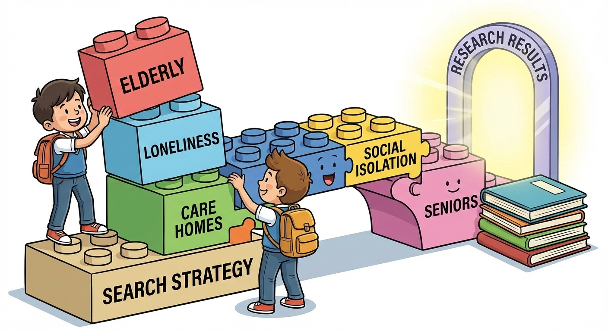
Key-terms/ Keywords
You can’t just type your whole question into a database. It will get confused; you need to break your question down into its core “building blocks”.
What keywords would you choose for this research question:
Does pet therapy improve the mental health of residents in nursing homes?
For example:
Pet therapy (the intervention)
Mental health (the outcome)
Nursing homes (the setting)

Slide 32


Use these key words on
Google Scholar
Let’s try it
Pet therapy:
Mental health:
Nursing homes:
2,730,000 results
Too many results, not enough time!
6,050,000 results
3,180,000 results

Slide 33

Boolean operators
Allow you to try different combinations of search terms.

Slide 34
AND
OR
NOT
Is used to find articles that mention both of the searched topics.
Is used to find articles that mention either of the searched topics.
Is used to exclude a search terms or concepts.
“Dementia” AND “music”
“Pet therapy” AND “mental health” AND “elderly”
“Elderly” OR “aged”
“Pet therapy” OR “animal assisted therapy”
“pet therapy” NOT “dogs”
“Elderly” NOT “adult”
When you put AND between your words, you are telling the database:
“Don’t show me an article unless it has ALL these words”.
With AND results start drop significantly.
We need to use OR when we are worried we might miss something because an author used a different word.
With OR results may increase, but it makes them more accurate because it covers different ways of saying the same thing.
When you put NOT between your words, you are telling the database:
“Show me ONLY the articles containing the first keyword”.
NOT should be used with caution you may inadvertently exclude relevant references

Slide 35
Google Scholar
Use these combinations on
“pet therapy”
OR
“animal assisted therapy”
(“pet therapy” OR “animal assisted therapy”) AND “care homes”
Let’s try it
17,000 results
1,480 results
(“pet therapy” OR “animal assisted therapy”) AND “care homes” AND “depression”
(“pet therapy” OR “animal assisted therapy”) AND “care homes” AND “depression” NOT “dogs”
1,160 results
506 results

Slide 36

Filters
GOOGLE SCHOLAR
Allow you to remove thousands of articles based on different criteria:
Data range: in healthcare, things change fast. A study from 1995 might be outdated. Setting filter for the last 5 or 10 years ensures your evidence is “current”.
Include/exclude citations: you only want to ready full papers.
Note: in your assignment 1, you need to describe your search strategy. After explaining keywords, Boolean operators, you should also write about the filters’ application.
Example: “I filtered the Google Scholar results to only include articles published between 2016 and 2026 to ensure the evidence was current.”

Slide 37
Apply filters on
Google Scholar
Let’s try it
Search for: (“pet therapy” OR “animal assisted therapy”) AND “care homes” AND “depression” NOT “dogs”
Apply Date filter from 2016 to 2026
How many results?
Exclude “citations”.
How many results?
386 results
385 results

Slide 38
Databases to use
Google Scholar
UWTSD Library Search
PubMed/MEDLINE:
The Cochran Library: Cochrane reviews | Cochrane Library
PubMed

Slide 39

Quick tutorial about:
This Photo by Unknown Author is licensed under CC BY-NC
PubMed

Slide 40
Search these combinations on
PubMed
“pet therapy”
OR
“animal assisted therapy”
(“pet therapy” OR “animal assisted therapy”) AND “care homes”
Let’s try it
381 results
4 results
(“pet therapy” OR “animal assisted therapy”) AND “care homes” AND “depression”
(“pet therapy” OR “animal assisted therapy”) AND “care homes” AND “depression” NOT “dogs”
1 result
1 result

Slide 42
References
Ratan SK, Anand T, Ratan J. Formulation of Research Question - Stepwise Approach. J Indian Assoc Pediatr Surg. 2019 Jan-Mar;24(1):15-20. doi: 10.4103/jiaps.JIAPS_76_18.
Kishore Jugal, Vasundhra Sumeena, Anand Tanu. “Formulation of research question”. Indian Journal of Medical specialities, 2011. Available at: filedownload-libre.pdf
Walk K. Asking an analytical question. [Class handout or worksheet]. Princeton University. In: White P, editor. Developing Research Questions: A Guide for Social Scientists. New York: Palgrave McMillan; 2009.
Jones, R. (2003) ‘Choosing a research question’, Asia Pacific Family Medicine, 2, pp. 42–44. doi:10.1046/j.1444-1683.2003.00050.x.

