Slide 1

Notes:
Welcome to the Presentation

Slide 2
Table of Contents
Introduction
Employee Engagement Perspective in Hotel Industry
Importance of Proper Employee Engagement in the Hotel Industry
Method and Strategies of Employees Engagement
The instance of Some Employee Engagement Techniques
Conclusion
Reference
Notes:
Contents

Slide 3

  Introduction
Employee management is a process that represents the degree of employee's effort in their emotional, behavioural and cognitive energies to obtain a positive result for the organization. It is also a human resource-related concept that determines the level of desperation and enthusiasm a worker gives and feels towards their duty (Macey, 2015). The success of an employee management system mainly depends on the organization that how they treat their employee to bring optimum outcomes.
Introduction
Notes:
Employee management is a process that represents the degree of employee's effort in their emotional, behavioural and cognitive energies to obtain a positive result for the organization. It is also a human resource-related concept that determines the level of desperation and enthusiasm a worker gives and feels towards their duty (Macey, 2015). The success of an employee management system mainly depends on the organization that how they treat their employee to bring optimum outcomes.

Slide 4

Employee Engagement Perspective in Hotel Industry
An employee is a person who works for an organization to get personal benefits and perform their duty to bring the best outcomes to the organization. An employee is hired to work sincerely and seriously for the organization. And the organization is obliged to provide their needs to ensure quality output from employees (Shuck, 2020).
The hotel industry is a flourishing sector that is service based. The success of a service-based industry is mainly depended on the quality of the employees and their experience to provide service. Trained and experienced employees are the key factor in the hotel industry to obtain profitability in the hotel business.
Notes:
An employee is a person who works for an organization to get personal benefits and perform their duty to bring the best outcomes to the organization. An employee is hired to work sincerely and seriously for the organization. And the organization is obliged to provide their needs to ensure quality output from employees (Shuck, 2020). The hotel industry is a flourishing sector that is service based. The success of a service-based industry is mainly depended on the quality of the employees and their experience to provide service. Trained and experienced employees are the key factor in the hotel industry to obtain profitability in the hotel business.

Slide 5

Employee Engagement Perspective in Hotel Industry
The hotel industry is a customer-based service-oriented industry which needs to focus on employee management significantly to increase its profitability ability. A well-trained and experienced employee team can provide quality service to the customers to satisfy their needs which helps to attain the hotel's predetermined goal (Barrio-Urdaneta, 2018).
Employee engagement determines the relationship between the industry and the employees and how they attempt to do their best to obtain customer satisfaction. It also indicates the seriousness, dedication and accountability of the employees to perform their duty in the industry.
Compatible Employee engagement reduces employee turnover, develops customer service orientation, trains the employees and improves efficiency along with productivity. The appropriate employee engagement can achieve customer satisfaction at the same time increase the efficiency of the employees as well as enhance the profitability ability of the hotel industry (Karatepe, 2016).
Notes:
The hotel industry is a customer-based service-oriented industry which needs to focus on employee management significantly to increase its profitability ability. A well-trained and experienced employee team can provide quality service to the customers to satisfy their needs which helps to attain the hotel's predetermined goal (Barrio-Urdaneta, 2018). Employee engagement determines the relationship between the industry and the employees and how they attempt to do their best to obtain customer satisfaction. It also indicates the seriousness, dedication and accountability of the employees to perform their duty in the industry. Compatible Employee engagement reduces employee turnover, develops customer service orientation, trains the employees and improves efficiency along with productivity. The appropriate employee engagement can achieve customer satisfaction at the same time increase the efficiency of the employees as well as enhance the profitability ability of the hotel industry (Karatepe, 2016).

Slide 6

Method and Strategies of Employees Engagement (cont’d)
The Zinger Model is the widely use employee engagement model that represents the connection between employees, recognizing employee energies and the employee management strategy to obtain the goal of employee satisfaction. With a satisfied employee team, the hotel industry can reach its organizational goal to achieve efficiency and profitability.
The Zinger Model is implemented by an acronym CARE which stands for Connection, Authentic relationship, Recognition of employee effort and Engagement of employee (Clifford, 2016).
Notes:
The Zinger Model is the widely use employee engagement model that represents the connection between employees, recognizing employee energies and the employee management strategy to obtain the goal of employee satisfaction. With a satisfied employee team, the hotel industry can reach its organizational goal to achieve efficiency and profitability. The Zinger Model is implemented by an acronym CARE which stands for Connection, Authentic relationship, Recognition of employee effort and Engagement of employee (Clifford, 2016).

Slide 7
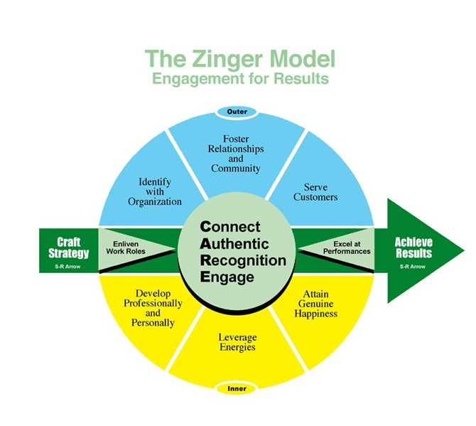
Method and Strategies of Employees Engagement (cont’d)
Connection refers to the ability of the hotel industry to build a proper relationship with the employees.
Recognition of employees determines the process of giving rewards and motivation for individual achievement.
Engagement determines the continuous relationship between the employee and the organization that improves over time.
Authentic relation represents the depth of the positive connection between the organization and the employee to perform the duty sincerely.
Notes:
Connection refers to the ability of the hotel industry to build a proper relationship with the employees. Authentic relation represents the depth of the positive connection between the organization and the employee to perform the duty sincerely. Recognition of employees determines the process of giving rewards and motivation for individual achievement. And lastly, Engagement determines the continuous relationship between the employee and the organization that improves over time.

Slide 8

Method and Strategies of Employees Engagement (cont’d)
Create a transparent and favourable working environment for employees to work safely and without any kind of hesitation. The working environment is depended on organizational culture, leadership, coordination of employees and a combination of organizational resources (Georgiades, 2015).
Understanding the need of employees and continuing training programs also help the hotel management to ensure efficient and productive employee engagement that drives the organizational goal to attain the objective of the hotel (Riley, 2014).
Notes:
Create a transparent and favourable working environment for employees to work safely and without any kind of hesitation. The working environment is depended on organizational culture, leadership, coordination of employees and a combination of organizational resources (Georgiades, 2015).
Understanding the need of employees and continuing training programs also help the hotel management to ensure efficient and productive employee engagement that drives the organizational goal to attain the objective of the hotel (Riley, 2014).

Slide 9

The instance of Some Employee Engagement Techniques
Hilton International Hotel company is integrating open communication and recognition of achievements of employees that encourage the employees and boost their confidence to perform their duty completely. Hilton also allows honest feedback to their employees for their duty that require a high level of satisfaction from customers.
Hilton hotel promotes and implements a transparent working environment that inspires employees to perform their duty accordingly to achieve a high level of customer satisfaction (Reidhead, 2020). By implementing above mentioned techniques Hilton achieved a high level of customer acceptance as well as appropriate employee engagement.
Notes:
Hilton International Hotel company is integrating open communication and recognition of achievements of employees that encourage the employees and boost their confidence to perform their duty completely. Hilton also allows honest feedback to their employees for their duty that require a high level of satisfaction from customers. And the hotel promotes and implements a transparent working environment that inspires employees to perform their duty accordingly to achieve a high level of customer satisfaction (Reidhead, 2020). By implementing above mentioned techniques Hilton achieved a high level of customer acceptance as well as appropriate employee engagement.

Slide 10

Conclusion
The hospitality industry is intended to thrive customer experiences by providing excellent service to achieve customer satisfaction that enhances their profitability. For providing excellent service it has to ensure skilled and experienced employees that will develop through proper employee engagement with the employees (Poonia, 2018). Employees are willing to provide maximum input if they get the required facilities from the management. To drive the profitability of the hotel industry, the hotel management must be implemented sound employee management to engage skilled and experienced employees.
Notes:
The hospitality industry is intended to thrive customer experiences by providing excellent service to achieve customer satisfaction that enhances their profitability. For providing excellent service it has to ensure skilled and experienced employees that will develop through proper employee engagement with the employees (Poonia, 2018). Employees are willing to provide maximum input if they get the required facilities from the management. To drive the profitability of the hotel industry, the hotel management must be implemented sound employee management to engage skilled and experienced employees.

Slide 11
Reference
Barrio-Urdaneta, E.C. (2018) Employee engagement.
Clifford, M.K. (2016) Employee engagement: Antecedents and consequences.
Georgiades, S. (2015) “Employee engagement implementation leading towards employee creativity,” Employee Engagement in Media Management, pp. 83–100. Available at: https://doi.org/10.1007/978-3-319-16217-1_5.
Karatepe, O.M. (2016) “Hotel employee work engagement questionnaire,” PsycTESTS Dataset [Preprint]. Available at: https://doi.org/10.1037/t25199-000.
Macey, W.H. (2015) Employee engagement: Tools for analysis, practice, and competitive advantage. Chichester: Wiley-Blackwell.
Poonia, V.S. (2018) Hotel Management. New Delhi: Aggarwal Book House.
Reidhead, C. (2020) “Impact of organizational culture on employee satisfaction: A case of Hilton Hotel, United Kingdom,” Journal of Economics and Business, 3(1). Available at: https://doi.org/10.31014/aior.1992.03.01.209.
Riley, M. (2014) “Managing employee relations in the hotel and catering industry,” Tourism Management, 17(4), pp. 312–313. Available at: https://doi.org/10.1016/0261-5177(96)87008-7.
Shuck, B. (2020) Employee engagement: A research overview. Abingdon, Oxon: Routledge, Taylor & Francis Group.
Notes:
References

