Slide 1

Workshop
Component 2
Case study
Week 10 – BMHP4003 Psychology for health and social care

Slide 2
So far we have:
Discussed:
Theories of cognitive development
Psychodynamic theories
Self concept and Social identity theory.
Attitude formation and Attribution Theory.
Behaviourist Approaches
The Humanistic Approach to psychology.

Slide 3



This week we will be:
Ensuring everyone understands the Component 2 Assignment Brief.
Using the guidance, planner and checklist
Revising each of the key theories

Slide 4

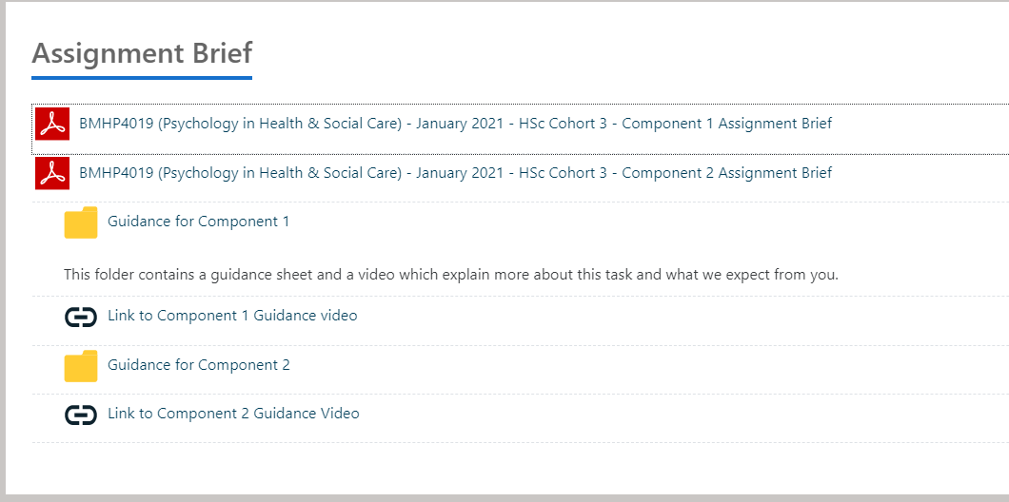
Assignment Brief and guidance
Your assignment brief for component 2 is found on BMHP4019/4003 Moodle page in the Assignment – in the Assignment Brief folder.
Your guidance can also be found in this folder.

Slide 5
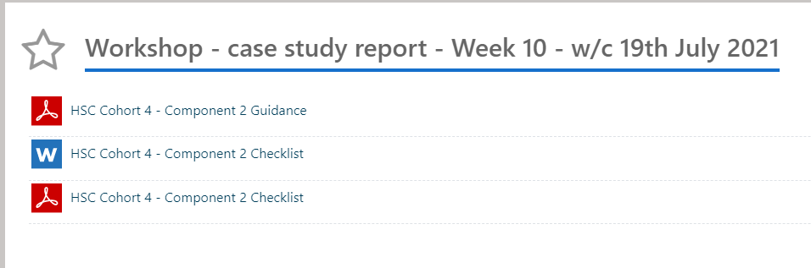
Week 10 Folder
Let’s look at these together now.

Slide 6
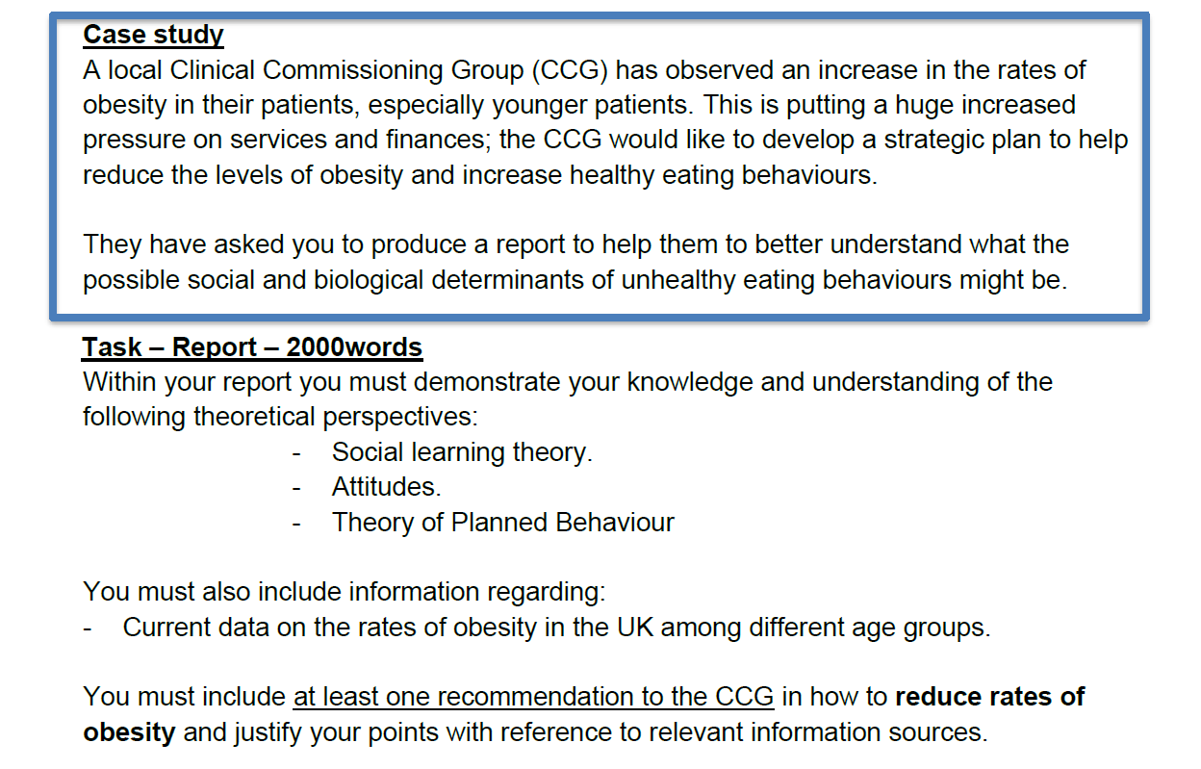
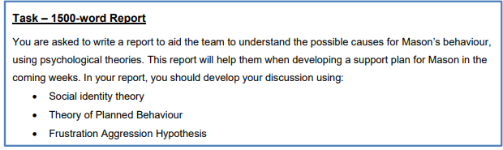
Revising the theories
Within your brief, it clearly states the three theories that must be included.
We will revise each of these now.

Slide 7
Social Learning Theory

Slide 8
Social learning theory
Albert Bandura agreed with Skinner that learning typically involved rewards. However, he argued that most everyday learning does not involve operant conditioning. (Eysenck, 2017)
Learning in a social context – learning from other through observation/watching the behaviour of other and copying behaviours that is rewarded and not copying punished behaviour.

Slide 9
Modelling:
There are 4 steps to this processes which is known as ‘modelling’
Attention – paying attention to all aspects of behaviour
Retention – remembering that behaviour
Reproduction – using the memories to reproduce actions/behaviour
Motivation – a reason for reproducing that behaviour

Slide 10
Attitude formation

Slide 11
The three-component model of attitude.
Affective
However, the Three component model became popular in the mid 20th century and actually comes from ancient philosophy. The three components of an attitude being: Thought (cognitive), Feeling (Affective) and Action (behavioural).
cognitive
behavioural
Attitude

Slide 12
How are attitudes formed?
Direct experience
Classic conditioning
Observational learning

Slide 13
Theory of Planned Behaviour

Slide 14
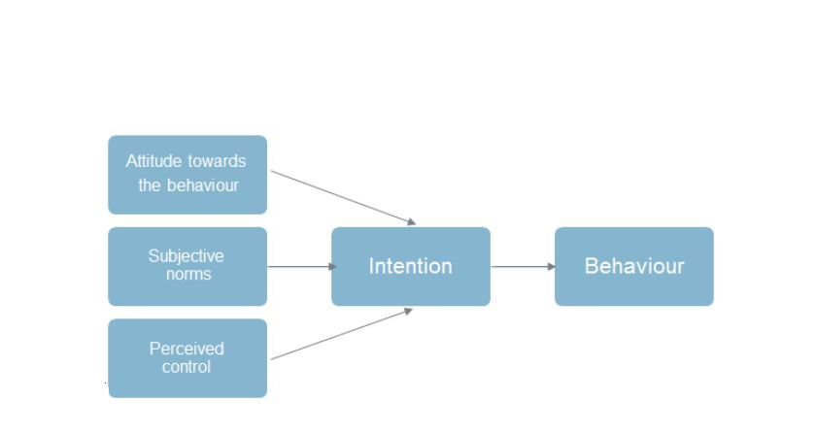
Theory of Planned Behaviour
Probably the best-known theory that examines our attitudes and behaviour is Ajzen' s (1991) theory of planned behaviour.
This theory suggests that there are a number of different factors that shape whether our attitudes are reflected in our behaviour.
The first factor that we need to consider is the actual attitude that we hold towards the behaviour, and it is important to note that it is the attitude towards the behaviour that is crucial,
Next, we have subjective norms, which are basically the beliefs of the people who matter to us, so, perhaps, our family and our friends, and whether they have a favourable attitude towards the behaviour.
Following this, we have perceived control, and this relates to whether the person believes they have the resources and opportunity to engage in the behaviour.
Each one of these three factors feeds into the intention, and this should be specific to one particular behaviour in order for it to carry through.
Finally, we have the actual behaviour itself.

Slide 15
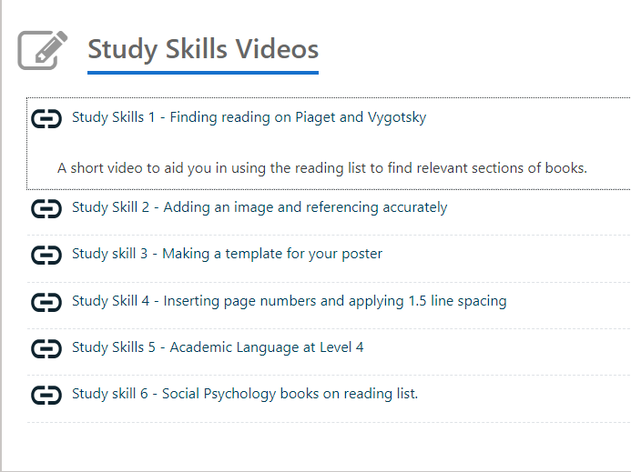
Study Skills Videos
Remember that short study skills videos are available on the module Moodle Page to help you too.

Slide 16
References
Ajzen, I. (1991). The theory of planned behaviour, Organizational Behaviour and Human Decision Processes, 50(2), 179-211.
Eysenck, M., (2017), Simply Psychology, Taylor & Francis Group, ProQuest Ebook Central.
Hogg, M. and Vaughan, G., (2017), Social Psychology, 8th edition, Harlow: Pearson Education.

