Slide 1
Introduction to Marketing
LCMB7024
Week 1 – Session 1

Slide 2
Content of the Session
What is Marketing?
Marketing definition
Marketing characteristics
Marketing process
  Needs, wants, and demand
  Market offerings, including goods, services, and experiences
  Value and satisfaction
  Exchanges and relationships
  Markets
Current trends in marketing
Future trends in marketing
Group activity

Slide 3
Testing your knowledge
| 10 minutes |
In your own words, what does marketing mean to you?
Take a piece of paper and write a short paragraph (4-5 sentences) explaining your understanding of marketing.
No research is needed – just share your thoughts based on your knowledge.

Slide 4

What is Marketing? (1 of 4)
If you ask several people what marketing is, they will respond with a variety of descriptions: ‘advertising’, ‘selling’, ‘conning people’, ‘targeting’, ‘packaging’.
Marketing encompasses many more activities than most people realise. Since it is practiced and studied for many different reasons, it has been and continues to be, defined in many ways, for academic, research or applied business purposes.

Slide 5
Marketing Definition
According to the UK Chartered Institute of Marketing, marketing is the management process responsible for identifying, anticipating and satisfying consumers' requirements profitably.

Slide 6
Marketing Definition
A rather different definition has been developed by the American Marketing Association (AMA) which defines marketing as the process of planning and executing the pricing, promotion, and distribution of goods and services to create exchanges that satisfy individual and organisational goals.

Slide 7
Marketing Characteristics
Individual and Organisational Level | Satisfying Exchanges | Activities and Markets
Marketing activities are undertaken by both individuals and organisations, ranging from small businesses to multinational corporations | Marketing facilitates the creation of mutually beneficial exchange relationships between buyers and sellers, where both parties perceive value from the transaction. | Marketing involves a range of activities, such as research, product development, pricing, promotion, and distribution. Its focus is on understanding and serving specific market segments.

Slide 8
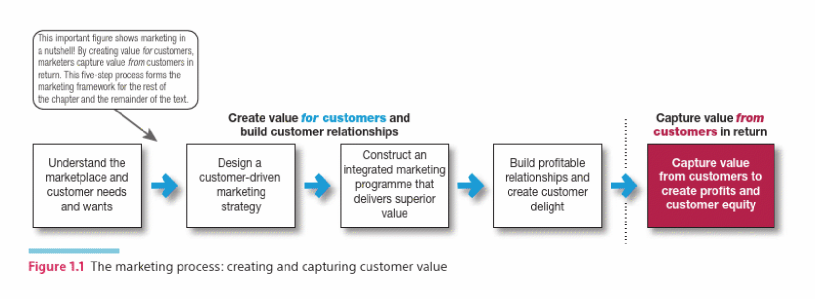
Marketing Process
(Kotler et al. 2020)
Notes:
This figure illustrates the marketing process, emphasizing how businesses create and capture customer value. It outlines a five-step approach:
Understand the marketplace and customer needs and wants
Companies must research and analyse customer preferences, behaviours, and market trends to identify needs and desires.
Design a customer-driven marketing strategy
Businesses develop a strategy to serve their target audience effectively, ensuring their offerings align with customer expectations.
Construct an integrated marketing program that delivers superior value
This involves creating a mix of products, pricing, promotion, and distribution channels that enhance customer satisfaction.
Build profitable relationships and create customer delight
Establishing long-term relationships by exceeding customer expectations leads to loyalty and brand advocacy.
Capture value from customers to create profits and customer equity
In return for the value provided, companies gain revenue, profitability, and long-term customer engagement.

Slide 9
Understanding Marketplace and Customer Needs
According to Kotler et al. (2020), marketers focus on understanding customer needs, wants, and the marketplace they operate in. There are five key concepts related to customers and the market:
  Needs, wants, and demand
  Market offerings, including goods, services, and experiences
  Value and satisfaction
  Exchanges and relationships
  Markets
The 5 elements are explained in the next slides

Slide 10

Discussion Question
In your opinion, what is the difference between a need and want?

Slide 11

1. Needs, wants, and demand
Understanding the difference between a need and a want is crucial in marketing because it shapes how businesses approach their marketing strategies.

Slide 12
Need
A requirement or necessity arising from circumstances essential for survival or well-being, such as food, shelter, or safety.
An unsatisfied need represents a gap between a person’s actual and desired states on some physical or psychological dimension.
This gap motivates individuals to seek solutions and engage in buying behaviour to bridge the discrepancy.

Slide 13
Want
A want reflect a person’s desires or preferences, often influenced by cultural, social, and personal factors.
A want shape individual aspirations and preferences, driving them towards specific products or services.

Slide 14

Demand
Demands refer to human desires that are supported by the ability and willingness to pay for them.
Notes:
While people may have many wants, not all of them turn into actual demands. A want becomes a demand when a person has both the financial resources and the intention to purchase a product or service. For example, many people may want a luxury car, but only those who can afford and are willing to pay for it create demand in the market. Businesses focus on understanding these demands to tailor their products and marketing strategies effectively.

Slide 15
2. Market Offerings (Goods, Services, and Experiences)
Businesses provide solutions to customer needs through market offerings, which include:
  Goods: Tangible products
  Services: Intangible activities
  Experiences: Businesses now focus on delivering memorable experiences
The key challenge for marketers is ensuring their market offerings provide real value and differentiation.

Slide 16
3. Value and Satisfaction
Value: The perceived benefit a customer receives relative to the cost of acquiring a product or service.
Satisfaction: How well a product or service meets or exceeds customer expectations. High satisfaction fosters customer loyalty, positive word-of-mouth, and repeat business, which are crucial for long-term success.
Notes:
Customer Value = Benefits Received − Costs Incurred | Marketers aim to enhance value through quality, pricing strategies, and additional services.

Slide 17
4. Exchanges and Relationships
Exchange: The core concept of marketing where something of value is traded between two parties.
Relationships: Businesses aim for long-term relationships rather than one-time transactions. For example: CRM.

Slide 18

5. Market
According to Cahill (2020), a market consists of individuals and organisations interested and willing to buy a particular product.
This is to obtain benefits that will satisfy a specific need or want, and who have the resources to engage in the transaction.

Slide 19
Individual Customers (B2C)
Ultimate customers purchase goods and services for their own personal use or the use of others in their immediate household.
These purchases are referred to as consumer goods and services that fulfil a want, need, or sometimes both.

Slide 20
Organisational Customers (B2B)
Organisational customers buy goods and services for resale, as inputs to the production of other goods or services, or for use in the day-to-day operations of the organisation.
These purchases are categorised as industrial goods and services.

Slide 21
Current Trends in Marketing
The Societal Marketing Concept
Mass Customisation
Online, mobile, and social media Marketing

Slide 22

Future Trends in Marketing
Virtual Reality
Green Marketing
Sustainable Marketing

Slide 23
Group Activity
Form groups and search for a company, organisation, or any brand’s website that has a link to Facebook, Google+, YouTube, and/or Pinterest.
Click on the links and describe in detail how that company is using social media to market its product.

Slide 24
References
Cahill, D.J. (1997) ‘Target marketing and segmentation: Valid and useful tools for marketing’, Management Decision, 35(1), pp. 10–13. Available at: https://doi.org/10.1108/00251749710160133.
CIM (2019) ‘Marketing qualifications, training and membership | CIM’. Available at: https://www.cim.co.uk/ (Accessed: 04 February 2025)
Dibb, S., Simkin, L., Pride, W.M. and Ferrell, O.C. (2019) Marketing concepts and strategies. 8th edn. Andover: Cengage Learning EMEA.
Kotler, P. and Keller, K.L. (2016) Marketing management. 15th edn. Boston: Pearson.
Kotler, P., Armstrong, G., Harris, L. and Piercy, N. (2020) Principles of marketing. 8th European edn. Harlow: Pearson.

