Slide 1
Your Personal Brand on Social Media
Week two

Slide 2
Objectives
Introduce why online presence matters
Determine your personal brand identity
What do you want to achieve?
Why social media to use

Slide 3
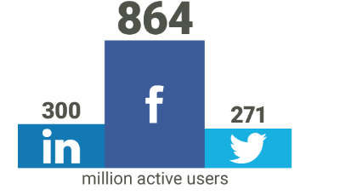
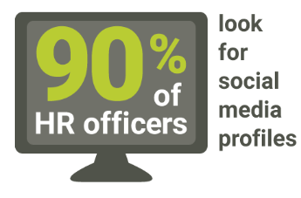
Introduction Why your online presence matters
Understanding the importance of online
reputation management
HR look for social media profiles
Notes:
Bullet one - The Internet has been a tool for connecting with others since its inception. In 1995, classmates.com was the first site to match today's definition of social networking, paving the way for thousands of sites to follow ("The History," 2014). Today, social media is more popular than ever and an integral part of people's everyday lives. In fact, people spend more time on social media sites than any other type of website – more than 121 billion minutes last year, to be exact (State of the Media, 2012).
Facebook triumphs as the most popular social media site with 864 million daily active users ("Facebook Reports," 2014). Two social network runner-ups are LinkedIn, a social networking site targeted for the job market with 300 million active users ("LinkedIn Announces," 2014), and Twitter, a forum for sharing short, 140-character messages with 271 million monthly active users ("Learn Twitter," 2014). As these sites continue to become increasingly popular, it is necessary for job seekers to examine how their online presence can help – or hurt – their chances of employment.
Bullet two -
In addition to being used to connect with others, the Internet is often used as a source of information. People rely on the Internet to tell them about everything from products to places. Likewise, human resource officers and hiring managers are using the Internet to discover more information about potential employees. One study indicates that 90 percent of human resource officers look for social media profiles when investigating job candidates, and almost 50 percent of them have refused a candidate based on what they found ("U.S. College," 2012).
The study also reports that the majority of people aged 18-25 have never inspected their own online profiles ("U.S. College," 2012). This is remarkable, considering that 71 percent of Internet users older than 18 have a Facebook account (Duggan, Ellison, Lampe, Lenhart, & Madden, 2015). The lack of inspection, however, isn't due to a shortage of time for perusing the sites. PC users spend 17 percent of their time on Facebook alone, and that doesn't include the time they spend on mobile devices and apps (State of the Media, 2012).

Slide 4
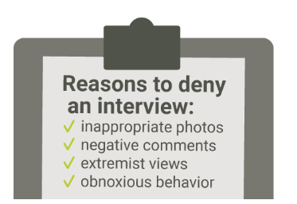
Introduction Why your online presence matters
Avoiding harmful behaviour online
Using Social Media to your advantage
Notes:
Bullet one - Avoiding harmful behaviour online
Social media users should be aware of everything they do and post online. Inappropriate photos and videos, bad grammar, controversial personal opinions, and questionable friends can all be detrimental to your online reputation. In fact, graduates who post inappropriate photos online – such as those that depict drunken, illegal, or unprofessional behavior – are 84 percent less likely to land an interview ("U.S. College," 2012). Posting negative comments about past jobs or bosses, extremist views on topics like race or politics, and "obnoxious behavior" such as pranks or profanity were among other reasons to almost always deny an interview ("U.S. College," 2012).
In addition to being aware of their own content, social media users should also be aware of the nature of content that is being posted by their online contacts, friends and connections. Depending on privacy settings, friends who upload photos or mention someone else's name may allow that information to be public (Parmar, 2011). For example, imagine a friend takes a photo of Beth drinking at a party and uploads it to Facebook. If that friend doesn't make the photo private, a potential employer could navigate from Beth's Facebook page to her friends list, and then to that friend's photos. Even if Beth untags herself from the photo, it's likely that the employer will recognize her face. Therefore, social media users should be cautious about who they connect with and vigilant about what others post.
Bullet two - Using social media to your advantage
While an untamed online persona can certainly hinder the job hunt, social media can also be used in a variety of ways to help job seekers. Candidates that use social media to engage with colleagues and show expertise in their profession are at a clear advantage. In fact, 29 percent of recruiters have offered jobs based on a positive online presence, including professionalism, creativity, and verification of skills or references (Smith, J., 2013). Additionally, association with a professional organization makes a candidate 80 percent more likely to land an interview (Kasper, 2012).
Along with using social media to build a professional image, many networking sites are being used as online job boards. More than one-fifth of job postings in the United States can be found on LinkedIn, Facebook, and Twitter, the most popular being LinkedIn with 77 percent of jobs posted there ("Bullhorn Reach," 2012). Likewise, in 2012 LinkedIn was used by 38 percent of job seekers to find job opportunities and build connections (Kasper, 2012).
As social media becomes more integrated into the job search and career professionalism, it is evermore vital for users to be aware of online presence. Online reputation management and self-marketing, like any type of marketing, begins by determining who you are, and what you have to offer.
More than one-fifth of job postings in the U.S. can be found on LinkedIn, Facebook and Twitter
Whether you are a job seeker, an entrepreneur or a career professional seeking advancement, the exercises in this toolkit will help you define your personal brand, set goals, choose social platforms, clean your existing presence and build a positive online persona. Enter your answers into the text boxes throughout the toolkit, using the examples as your guide. When you're finished, download your answers for future reference using the save buttons. Examples relate to a beginner food blogger.

Slide 5
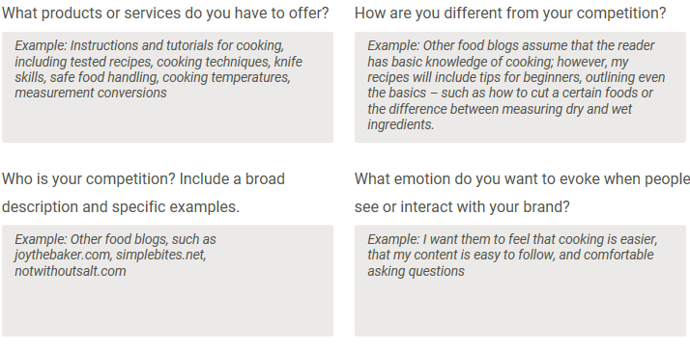
Who are you?
Determine your personal brand identity
Determine your brand identity
What is a online brand video
Step 1 Determine your focus and values
Notes:
Bullet one - Before you begin setting goals to reach through your online presence, it is important to determine your brand identity.
In general, when people think about branding, they first imagine logos, colours, typefaces, etc. But these visual elements – like all aspects of a brand – should reflect an important set of values known as brand identity (Holland, 2006, p. 5). Your identity is a feeling someone gets when they interact with you or your products (Deckers & Lacy, 2013, p. 7).
No matter what stage of personal branding you find yourself in, the steps below will help keep your brand identity focused. If you are just beginning, this exercise will help you develop and create your personal brand identity.
Bullet two - Step 1 Determine your focus and values
Record your answers to the following questions before proceeding to the next step.

Slide 6



Who are you?
Determine your personal brand identity
Step 2 Determine your brand identity
Label: Emotional Appeal
Label: Skills and Functions
Label: Descriptive Modifiers
Notes:
Bullet one - Step 2 Determine your brand identity
In this step, you'll determine what qualities and skills you want people to relate to your name. During this exercise, it's important to list all the words or phrases that come to mind. If you're writing your answers, divide a sheet of paper into three columns and label them appropriately.
Bullet two – Emotional Appeal label - List feelings or personality traits related to yourself and your product. How would you describe your personality? How would others describe you or your product? What feelings do you want others to have about you or your product?
List feelings or personality traits related to yourself and your product. How would you describe your personality? How would others describe you or your product? What feelings do you want others to have about you or your product?
Bullet three - Label: Skills and Functions - List terms that outline the services you provide and things you do. These can be things you haven't done yet, but plan to do in the future. If there are any services that you offer that your competition does not, be sure to include them.
Bullet four - Label: Descriptive Modifiers - List terms that describe how you do the skills and functions you outlined in the previous column. Do you create a certain type of art? Do you perform within a certain industry? Are you targeting a specific audience?
Related to all bullets above - These are the words that best describe your brand identity and your brand values. For example, the food blogger may determine from this exercise that she provides easy-to-use cooking skills in a fun and inviting way. Everything else you do should evoke those values - everything from logo, color and typeface; to blog entries, photos, tweets, and videos; to the way your conduct your day-to-day business offline (Marrs, 2012).

Slide 7




Who are you?
Determine your personal brand identity
Step 3 Write your brand story
  How would you describe your overall
  profession, as related to your brand?
  What do you do on a day-to-day basis
  related to your profession?
  What accomplishments make you an
  expert in your role or profession?
  Are there any other talents or qualifications
  that you think a potential employer, customer or client should know?
  Combine these four answers into one paragraph-style biography
Notes:
Bullet one- Your personal brand story, like all aspects of your brand, is an extension of the focus and values determined in Step 1. Your story should define and inspire what you are trying to accomplish. Keeping those values in mind, answer the following questions:
Sub See bulleted questions on slide.
Related to last sub bullet - The brand story you've just written will come in handy when branding your online profiles in Section 5. Now that you have a better idea of the values you want clients or employers to associate with your brand, move on to Section 2 to set goals and objectives for your online presence.

Slide 8
What do you want to achieve?
Step 4 Outline your objectives and goals
Now, outline at least three short-term goals that will help you measure your progress toward reaching your objectives.
Choose an action verb that describes how you will enact this goal and include as many details as possible:
Notes:
Bullet one – step 4 - Now that you've solidified your values, it is important to outline your objectives and goals before you begin eliminating or building content online. Having a defined strategy for your online presence keeps your efforts focused and purposeful ("Guide to Creating," 2014).
The terms objective and goal are often confused. An objective is an overarching, long-term result, such as finding a job, attracting freelance clients or establishing yourself as a leader in your industry ("Objective," n.d.). It is usually difficult to measure the progress of an objective until you have reached it. A goal, however, is a measurable, short-term step you take to reach your end objectives, such as landing an interview, making connections or creating online content ("Goal," n.d.).
This step uses a standard and often-used method of setting goals based on the S.M.A.R.T. acronym. According to this method, goals should be specific, measurable, attainable, relevant, and time-bound ("Locke's Goal-Setting," n.d.). Use the exercises below to outline your objectives and goals.
Step 4 Outline your objectives and goals - What do you hope to achieve through your online presence? Write down your overall objectives. Remember, objectives are long-term results that are reached by more specific goals.

Slide 9
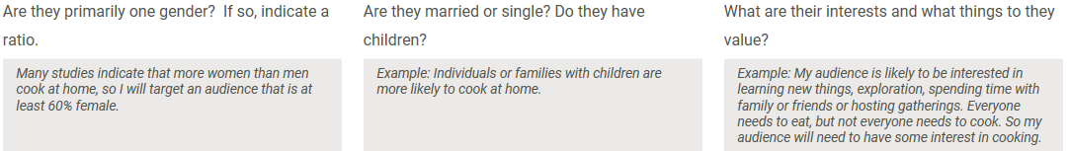
What social media are best for you?
Step 5 Determine your target audience
Refer back to Step 1 and Step 2, where you outlined what services, products and skills you have to offer. Think about whom you want to use or purchase your services or products. Then, answer the following questions.
Notes:
Bullet one - Choose platforms based on your target audience and goals
With objectives and goals in place, you probably have a better idea of what you want to achieve and the type of content you'd like to produce. With that information in mind, it's important to determine your ideal audience. Knowing whom you want to reach will help you decide which social media or online platforms to use.
Step 5 Determine your target audience
Target market identification is the act of determining the audience for your product or service using factors like demographics – age, gender and occupation – as well as income and broader characteristics, such as lifestyle or interests ("Target Market," n.d.).
Bullet two Refer back to Step 1 and Step 2, where you outlined what services, products and skills you have to offer. Think about whom you want to use or purchase your services or products. Then, answer the following questions.

Slide 10
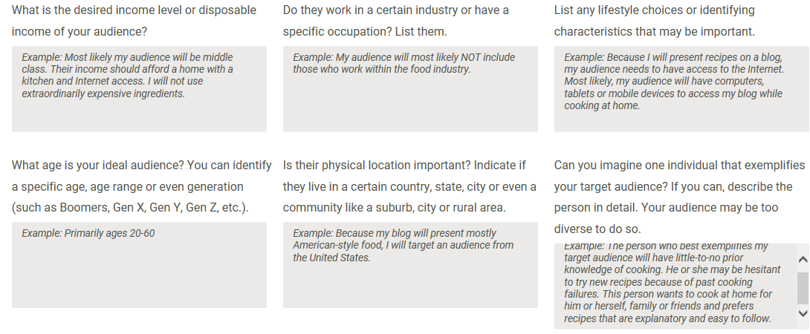
What social media are best for you?

Slide 11
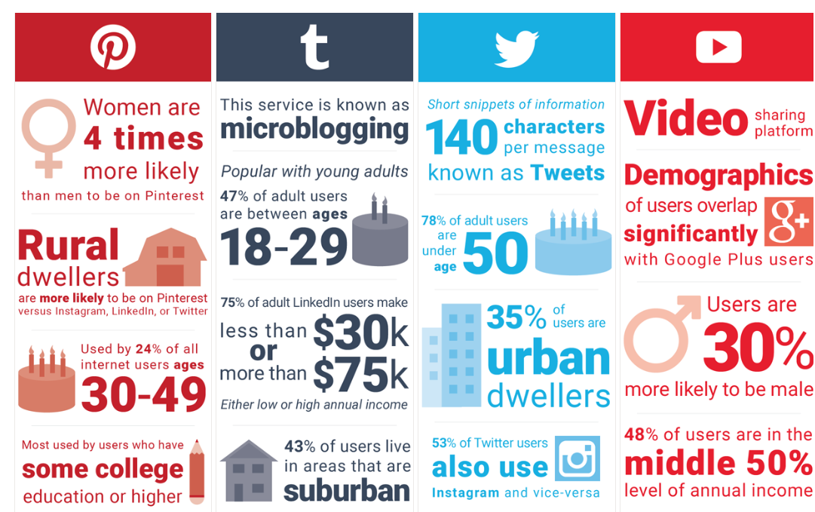
What social media are best for you?
Step 6 Determine which social media are the best fit
Notes:
There are hundreds of social media tools that are capable of sharing or curating all types of content, and the most popular social media sites are not always the best fit. When deciding which social media to keep, eliminate, or build, consider the type of content you'll share and where your target audience is. The best platforms for you will be the ones that meet both criteria (Levy, 2013). Also consider any social media you are currently using, and how they are working for you. If you are successful, keep doing what you're doing, but if you aren't, you may not be targeting the correct audience. Research what your competition (outlined in Step 1) is using, and if they are successful.
The eight U.S.-based social media sites below have the most monthly active users (Marcelo, 2013). Examine the chart, which outlines the audience statistics for each site. Based on your goals and target audience, determine whether one or more of these platforms is a good fit for your brand.

Slide 12
Build new content
Build & brand your profiles
  Use the same version of your name across all accounts
  Also use the same username across all your professional accounts
  Use the same profile picture across all of your professional accounts.
  Fill out all sections of your online profiles
  When networking and meeting others online, focus on gaining trust
  Refer back to the short-term goals you set in Step 4
Notes:
Bullet one - Step 12 Build and brand your profiles
Be consistent and accurate across all accounts and offline materials. Your printed resume should match your digital resume and your professional profiles, such as LinkedIn (Hulse, 2010). Optimize your existing accounts and build your new accounts using the guidelines below, keeping in mind the brand identity that you developed in Section 1 and the objectives you set in Section 2.
Sub bullet one - Use the same version of your name across all accounts. As a general rule of thumb, use your first and last name. If your name is William, but you always go by Bill, then use your commonly known name. Conduct an un-personalized Google search (see Step 11) for your first and last name, and see if anyone else online uses the same name. If so, you may want to consider including your middle initial or full first name. Whatever you choose, be consistent (Deckers & Lacy, 2013, pp. 200-201).
Sub bullet two - Also use the same username across all your professional accounts (but do not use your professional username on personal accounts), including social media accounts, email addresses, and maybe even website or blog URLs. Some suggested username formats are first and last name (janedoe), first initial and last name (jdoe), or your business name (mybusiness). If you want to be able to use the same username on Twitter or Pinterest, keep it limited to 15 characters or less. Using your name also makes it easier for others to find you (Ray, 2012).
Sub bullet three - Use the same profile picture across all of your professional accounts. Your picture should be professional, representative of you, and recognizable. Many times, your connections will associate you with your profile picture. You may even want to pay someone to take your picture if you don't have professional headshots (Deckers & Lacy, 2013, p. 126).
When sharing photos or uploading cover or profile pictures, be sure to use the recommended image dimensions that the site provides. This will keep your photos from being stretched or poorly cropped (Devaney, 2014).
Subbullet four Fill out all sections of each of your online profiles entirely and consistently. Use your personal brand story from Step 3 in biography and about sections. Be sure to include relevant keywords as related to your brand identity. This will provide all the information needed by potential employers or customers and ensure that your accounts show up in search results (Peters, 2012).
Sub bullet five - When networking and meeting others online, focus on gaining trust by helping others rather than seeking help. Sharing your expertise, connections and influence can help build rapport, increasing the likelihood that connections will recommend or help you in the future (Deckers & Lacy, 2013, p. 265).
Sub bullet six - Refer back to the short-term goals you set in Step 4. Create an editorial calendar, marking the beginning, frequency, and end dates (unless it's ongoing) of each goal. Use this calendar to keep yourself on track for reaching your goals and objectives (Guide to Creating, 2014).
Because social media is organic and changes frequently, it's important to make a commitment to continually optimizing and monitoring your online presence. Take the time to reevaluate your approach annually, or as often as you see fit. If you aren't happy with your results, keep working on your strategy until you find a sweet spot. Objectives, audiences and platforms may change, but your identity – for the most part – should remain the same.

Slide 13
Summary
Introduce why online presence matters
Determine your personal brand identity
What do you want to achieve?
Why social media to use

