Slide 1
Engaging with Literature

Slide 2

Reading before action

Slide 3
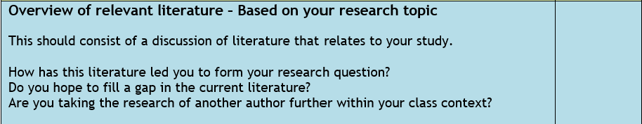
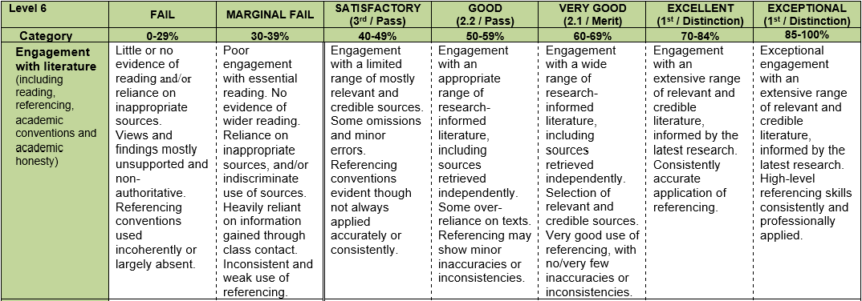
Engaging with literature
Notes:
Guidance specific to this assessment:
Your observation of a critical incident will allow you to identify 2-3 areas to research. These will guide your literature review. It is important, however, to demonstrate your reading throughout the assignment. This reading should include texts on learning theory, reflective practice, classroom observation and critical incident methodology.

Slide 4

Critical thinking when reading

Slide 5
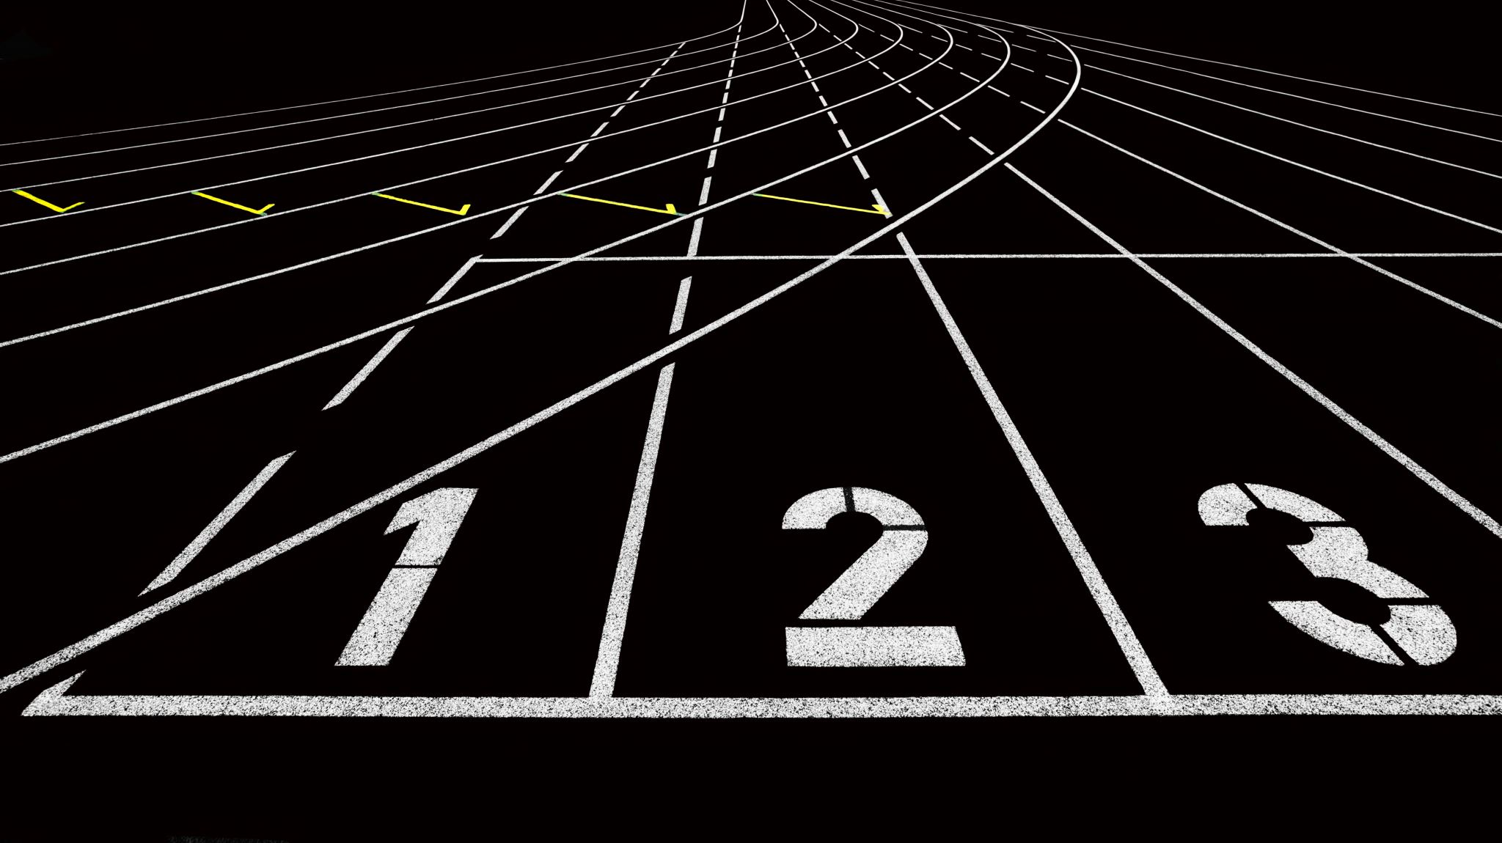
How to read a journal article
Three pass approach

Slide 6

Pass One: Skim/scan (5-10 mins)
Carefully read title, abstract and introduction
Read section and sub-section headings (ignore everything else)
Read conclusion
Check references
This Photo by Unknown author is licensed under CC BY.
Notes:
Need to decide if the article is worthy of your time – you can't read everything.
Further questions: is it peer reviewed? Who was it written for? What was its purpose? When was it written? Who is the author (credibility)?

Slide 7

Pass Two: Dig deeper (approx. 1 hour)
Read with greater care but ignore things like proofs at this stage
Mark relevant references for future reading
You should be able to summarise the main ideas
This Photo by Unknown author is licensed under CC BY-NC.

Slide 8

Decisions:
Set the paper aside
Return to it later
Persevere
This Photo by Unknown author is licensed under CC BY-SA-NC.

Slide 9

Third Pass: Analysis
Identify and challenge every assumption
You should be able to identify strengths and weaknesses of the article/study.

Slide 10
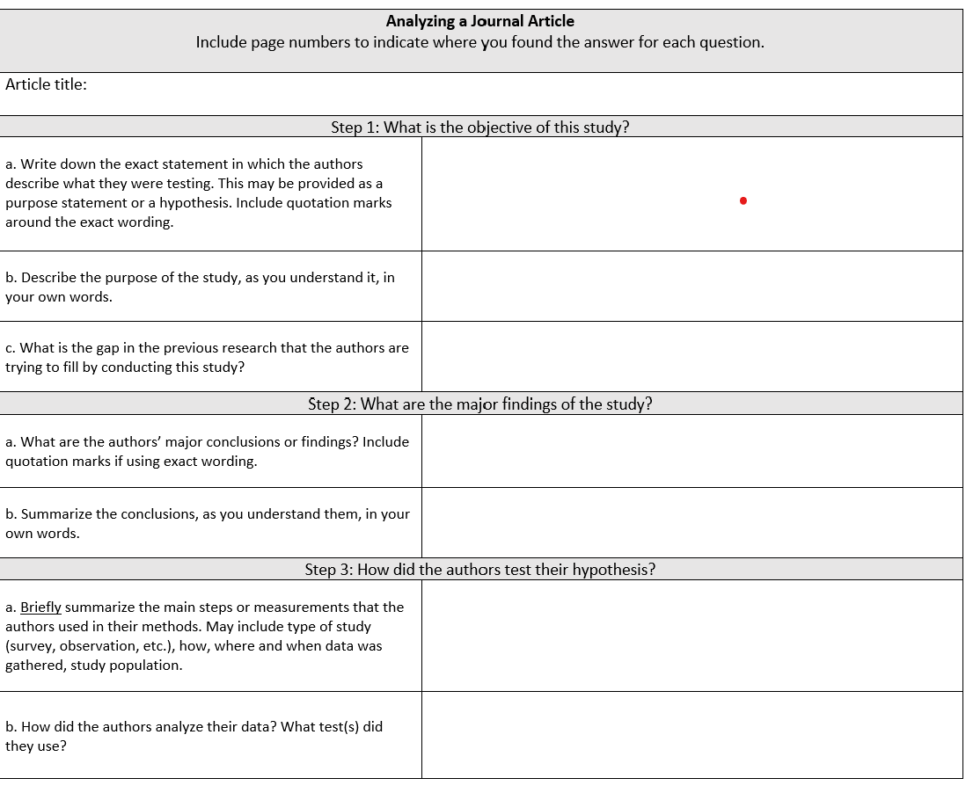
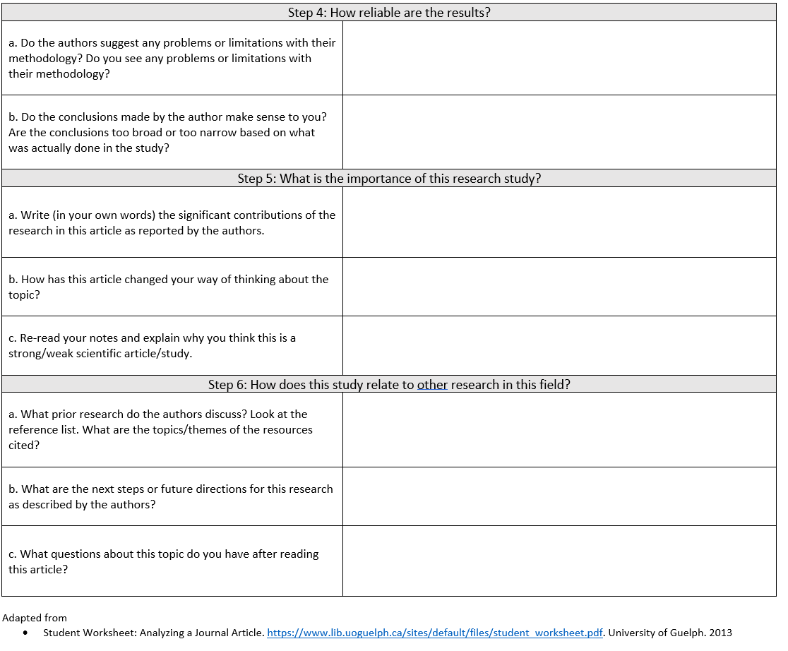
Analysing a Journal Article
Notes:
Refer students to worksheet to support them in this activity

