Slide 1

Assignment 2 Preparation
Criminal Law

Slide 2
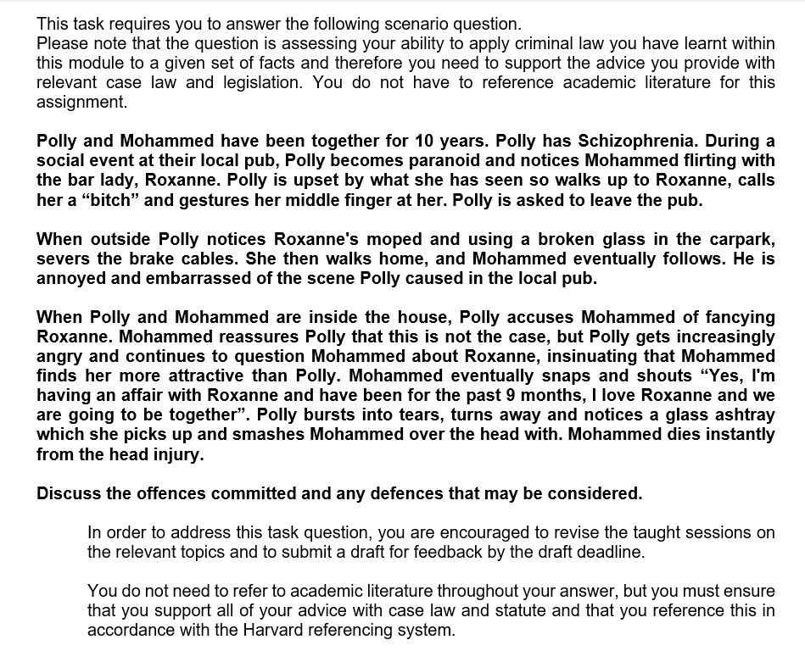
DUE:- 5th May 2023 @23:59pm
PLEASE READ THE FULL ASSIGNMENT BRIEF AS WE HAVE INCLUDED SOME RELEVANT CASE LAW TO HELP YOU!!

Slide 3

Now lets recap…….

Slide 4
Non- fatal offences against the person
Common law and s39 Criminal Justice Act 1988
Assault
Battery
Offences against the Person Act 1861 (OAPA)
S47: Assault occasioning actual bodily harm (ABH)
S20: Unlawful and malicious wounding or inflicting grievous bodily harm (GBH) – without intent
S18: Unlawful and malicious wounding or causing GBH with intent to cause GBH.

Slide 5

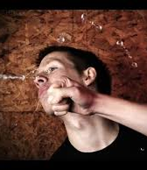
BATTERY
Battery is the intentional or reckless infliction of unlawful personal violence upon V
(Rolfe 1952).
Elements of the offence:
There was some conduct on the part of D;
V suffered unlawful personal violence;
This was inflicted as a result of D’s conduct;
D intended or was reckless to causing the unlawful personal violence

Slide 6

The actus reus of battery
Conduct
Fagan v MPC [1968]
DPP v K ( a minor)[1990]
Santana Bermudez [2004]
(2) V suffered unlawful personal violence
a)Unlawful – McMillan v CPS [2008], Kenlin v Gardiner [1967]
b) Personal – Day [1845]
c) Violence – Cole v Turner [1704] , Ireland; Burstow [1998]
(3) Violence was inflicted as a result of D’s conduct
Haystead v Chief Constable of Derbyshire [2002]

Slide 7
The mens rea of battery:
‘D intended or was reckless’
Venna [1975] – Battery ( and assault) can be committed recklessly and intentionally.
Pegram v DPP [2019]
Intention: it must be either Ds aim or purpose to apply unlawful personal violence (direct intention)
or
that it must be virtually certain that D’s conduct would result in the application of such violence and that D was aware of this (Indirect intention).

Slide 8
ASSAULT – s39 CJA 1988
D commits an assault where he intentionally or recklessly causes V to apprehend immediate unlawful personal violence –
Fagan v Metropolitan Police Commissioner [1968]
Elements of the offence:
There was some conduct on the part of D
V apprehended immediate unlawful personal violence (a battery)
This was caused as a result of Ds conduct;
D intended or was reckless to causing the apprehension of a battery

Slide 9
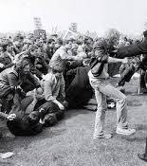
The actus reus of assault
There was some conduct on the part of D – Meade v Belt [1823]: Ireland: Burstow [1998]
V apprehended immediate unlawful personal violence (a battery)
Apprehension
Immediate –
Thomas v National Union of Mineworkers [1986]
Constanza [1997]
(3) This was caused as a result of D’s conduct
R v Lamb (1967)

Slide 10
The Mens rea of assault
D can possess the MR for assault in 3 ways:
Where it is D’s aim or purpose to cause somebody to apprehend immediate unlawful personal violence – DIRECT INTENTION
Where it is virtually certain that D’s conduct will cause somebody to apprehend immediate unlawful personal violence and D is aware of this – INDIRECT INTENTION
Where D realises the risk that his conduct might cause somebody to apprehend immediate unlawful personal violence (SUBJECTIVE RECKLESSNESS) – Cunningham [1957]

Slide 11
ASSAULT OCCASIONING ACTUAL BODILY HARM - S.47 OAPA 1861
S47 OAPA 1861:
Whosoever shall be convicted on indictment of any assault occasioning actual bodily harm shall be liable to imprisonment for not more than five years.
Elements of the offence
D committed an assault or battery
V suffered actual bodily harm (ABH)
The assault or battery occasioned the actual bodily harm

Slide 12
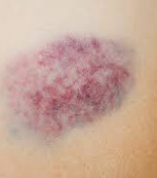
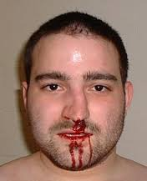
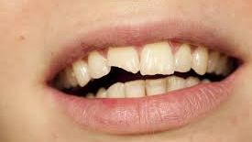
The actus reus of Assault occasioning actual bodily harm
D committed an assault or battery
V suffered actual bodily harm
Miller [1954]
T v DPP [2003]
Chan-Fook [1994]
Saunders [1985]
Smith [1985]
Jones [1981]
DPP v Smith [2006]
Taylor v Granville [1978]
The assault or battery occasioned the actual bodily harm

Slide 13
WOUNDING AND INFLICTING GRIEVOUS BODILY HARM WITHOUT INTENT: S20
S20 OAPA 1861: Whosoever shall unlawfully and maliciously wound or inflict any grievous bodily harm upon any other person, either with or without any weapon or instrument, shall be guilty of a misdemeanour, and being convicted thereof shall…. Be liable to imprisonment for not more than five years.
Elements of the offence:
There was unlawful conduct on the part of D;
Another person suffered a wound or grievous bodily harm (GBH);
D maliciously inflicted the wound or GBH.

Slide 14
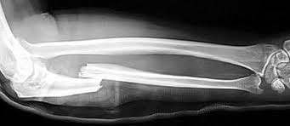

The actus reus of wounding and inflicting GBH without intent
Actus reus: With or without a weapon, D unlawfully causes either a wound or GBH to another person
There was unlawful conduct on the part of D
Another person suffered either a wound or grievous bodily harm
Wounding – C v Eisenhower (1984)
Grievous bodily harm (GBH) –
Smith [1961]
Wood [1830]
Bollom [2004]
D’s conduct caused the wound/inflicted the grievous bodily harm

Slide 15
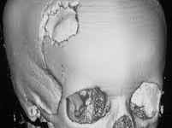
The Mens rea for wounding and inflicting GBH without intent
“Maliciously” – Savage, Parmenter [1991]
House of Lords held that the mens rea for s20 is that D must foresee that as a result of his conduct:
“some physical harm to some person, albeit of a minor character, might result.”

Slide 16
Wounding and causing grievous bodily harm with intent: s18 OAPA 1861
Whosoever shall unlawfully and maliciously by any means whatsoever wound or cause any grievous bodily harm to any person, with intent to do some grievous bodily harm to any person, or with intent to resist or prevent the lawful apprehension or detainer of any person, shall be guilty of felony, and being convicted thereof shall be liable to be kept in penal servitude for life (IMPRISONMENT).
Elements of the offence:
There was unlawful conduct on the part of D (by any means)
A person suffered a wound and/or GBH
D’s conduct caused the wound and/or GBH
D maliciously brought about the result;
D intended to cause GBH or to resist or prevent the lawful apprehension or detainer of any person

Slide 17
S18 OAPA 1861 provides one offence, but there are 4 ways of committing it
(1) Wounding with intent to resist/prevent lawful apprehension/detainer of a person
(2) Wounding with intent to cause some GBH
(3) Causing GBH with intent to resist/prevent lawful apprehension/detainer of a person
(4) Causing GBH with intent to cause some GBH
The offence carries a maximum sentence of life imprisonment

Slide 18
The actus reus of s18
The AR requires that D, unlawfully and by any means, causes a wound or GBH to any person
There was unlawful conduct on the part of D (by any means)
Unlawful
Conduct
By any means
A person suffered a wound and/or grievous bodily harm
D’s conduct caused the wound and/or grievous bodily harm

Slide 19
The mens rea of s18
D intended GBH to any person
Guilty if causes GBH to someone other than intended V
Taylor [2009] – D must intend GBH not wound
Mowatt [1968] – ignore “maliciously”
2) D will not need to have intention to cause GBH
D will have the intention either to
Resist arrest, or
Prevent the lawful arrest or detainer of any person

Slide 20
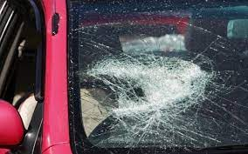
Criminal Damage

Slide 21
Criminal Damage
The basic offence is defined in s1(1) Criminal Damage Act 1971:
  A person who without lawful excuse destroys or damages any property belonging to another intending to destroy or damage any such property or being reckless as to whether any such property would be destroyed or damaged shall be guilty of an offence
The elements of the offence are:
  There is property
  That belongs to another
  D’s conduct
  Destroys or damages the property
  D does not have a lawful excuse
  D intends or is reckless to destroying or damaging property

Slide 22
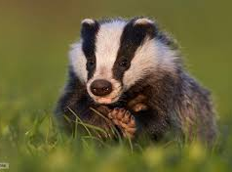

Criminal Damage – Actus reus
ACTUS REUS: D without lawful excuse, destroys or damages property belonging to another
Property
S10(1) CDA 1971- defines property. Includes:
  Tangible items, real or personal
  Land
  Wild creatures that have been tamed
  Creatures reduced to possession (Cresswell v DPP; Currie v DPP [2006])
It does not include:
  Mushrooms and fungi growing wild
  Flowers, fruit, foliage, shrubs or trees growing wild on any land
  Intangible property such a copyrights and patents

Slide 23
Criminal Damage: Mens Rea
D must:
  Intend to destroy or damage property, or be reckless to this;
  Know or be reckless to the fact that the damage or destruction is to property belonging to another
  Intention
    Can be direct or oblique. D’s good motive is irrelevant
  Recklessness
    Subjective – G and Another [2003] overruled Caldwell [1982] - now only SUBJECTIVE recklessness
  Know or be reckless to the fact that the damage or destruction is to property belonging to another
    Destruction/damage under a mistaken belief is insufficient Smith [1974]

Slide 24
Criminal Damage- The aggravated offence
s1(2) CDA 1971:
  A person who without lawful excuse destroys or damages any property, whether belonging to himself or another –
    (a) intending to destroy or damage any such property or being reckless as to whether any such property would be destroyed or damaged , and
    (b) intending by the destruction or damage to endanger the life of another or being reckless as to whether the life of another would be endangered
  The elements of the offence:
    Without lawful excuse
    D destroys or damages
    Property
    Belonging to himself or another
    Where D intends or is reckless as to destroying or damaging the property
    And where D intends by the destruction or damage to endanger the life of another, or is reckless to this

Slide 25
Criminal Damage
The aggravated offence
  ACTUS REUS
    The two defences of lawful excuse in s5(2) do not apply to the aggravated offence
    “Destroy” and “damage” have the same meaning as under s1(1)
    The aggravated offence can be committed where D destroys or damages his own property
  MENS REA
    (a) Intent to destroy or damage property, or be reckless to this; and
    (b) Intend by the damage to endanger life, or be reckless to this
    Ulterior intent as part of the MR goes beyond the AR
    (a) Intention/recklessness as in simple offence
    (b) Intend by damage to endanger life or be reckless to this
      Must be intend to endanger life by the damage caused Steer [1987]
      Intent can be direct or indirect Woollin [1998]
      Recklessness is subjective G and Another [2003]
      No requirement that life was actually endangered or that the damage/destruction even created a risk of this Dudley [1989], Sangha [1998]
      The danger of life must come from the property -R v Wenton (2010)

Slide 26

Murder

Slide 27
Define murder
Murder is where D kills V and D intends to kill or intends to cause GBH. The offence takes place under the Kings peace.
What is the Actus Reus of Murder?
D unlawfully kills another person under the Kings peace and V is a person.
Gibbins and Proctor [1918]
What is the mens rea of murder?
Malice aforethought: intention to kill or to cause GBH
Notes:
Actus reus requirements:

Slide 28
Specific partial defences to murder
Killing with diminished responsibility: a statutory defence under s. 2, Homicide Act 1957
Killing under loss of control ss54 and 55 Coroners and Justice Act 2009 (formerly provocation): a common law defence modified by s. 3, Homicide Act 1957
Killing in pursuance of a suicide pact (where all participants are meant to die): s. 4, Homicide Act 1957
These defences, if successful, reduce what would otherwise be murder (because of D’s intent) to ‘voluntary manslaughter’

Slide 29
Specific defences to murder: DIMINISHED RESPONSIBILITY
Section 2, Homicide Act 1957 provides for the defence:
“Where a person kills or is party to the killing of another, he shall not be convicted of murder if he was suffering from such abnormality of mind (whether arising from a condition of arrested or retarded development of mind or any inherent causes or induced by injury or disease) as substantially impaired his mental responsibility for his acts or omissions in doing or being a party to the killing.”

Slide 30
Diminished responsibility
Recognised medical conditions include functional mental illness:-
  Clinical depression (Gittens [184])
  Schizophrenia (Moyle [2008])
  Battered women’s syndrome (Hobson [1998], Ahluwalia [1992])
  Premenstrual tension and post natal depression (Reynolds [1988])
  Paranoia (Simcox [1964])
  Personality disorders (Haddon [2003])

Slide 31
Loss of control
S54 (1) Coroners and Justice Act 2009
  Where a person (D) kills or is a party to the killing of another V), D is not to be convicted of murder if
  D’s acts and omissions in doing to being a party to the killing resulted from D’s loss of self control
  the loss of self control had a qualifying trigger and
  a person of D’s sex and age, with a normal degree of tolerance and self restraint and in the circumstances of D, might have reacted in the same or in a similar way to D

Slide 32
Loss of control
Elements of the defence:
  One of two qualifying triggers applies
  This causes D to lose self control
  This led to an act or omission resulting in D killing or being party to a killing
  A person of D’s sex and age, with a normal degree of tolerance and self restraint and in the circumstances of D, might have reacted in the same or in a similar way to D
  D did not act in a considered desire for revenge

Slide 33
Loss of control – qualifying trigger
Requires a qualifying trigger s 54(1) (b)
Two qualifying triggers (ss55(3) and (4))
  S55(3) – 1st qualifying trigger
    D’s fear of serious violence from V against D or another identified person Pearson [1992].
    Test is subjective – fear need only have been genuine, not reasonable
    S55(6) – court is to disregard D’s fear if it was caused by something which D incited to be said or done for the purpose of providing an excuse to use violence

Slide 34
Loss of control – qualifying trigger
S55(4) applies where loss of control was caused by things said/done which:
  Constituted circumstances of an extremely grave character, and
  Caused D to have a justifiable sense of being seriously wronged
    Dawes, Hatter and Bowyer [2013] – judged objectively
    R v Clinton (2012)- Sexual infidelity cannot be a qualifying trigger

Slide 35
Loss of control
Caused D to lose self-control
  Qualifying trigger must lead to loss of control – s54(1)(b)
  Loss of control does not have to be sudden - s54(2)
  Need not be from a “one off” incident- Humphreys [1995]- can be cumulative
Notes:
Once the qualifying trigger has been identified, it must be assessed whether this led to a loss of self control s54(1)(b).
S54(2) removes the requirement that the loss of control must be sudden. A requirement for a sudden loss of self control meant that sufferers of domestic violence meant that sufferers of domestic violence, who killed following a slow burn reaction, could often not rely on the defence of provocation (Ahluwalia [1992]).
Although the removal of the suddenness requirement by s54(2) does seem to relax the law, it is important to read this provision in conjunction with s54(4), which states that D should not act out of a considered desire for revenge.
In Humphreys [1995] it was held that the provocation could be cumulative.

Slide 36
Loss of control
Sex, age, degree of tolerance and self restraint in D’s circumstances – s54(1)(c)
  Objective test:
    Person of D’s sex and age
    With a normal degree of tolerance and self restraint
    And in the circumstances of D
    Might have reacted in the same… way to D [and killed]
    Or in a similar way [and killed]
Notes:
This is very similar to the reasonable person test under the old law of provocation. The test is objective and the jury must be satisfied that:
A person of D’s sex and age
With a normal degree of tolerance and self restraint
And in the circumstances of the D
Might have reacted in the same …way to D
Or in a similar way.
According to s54(4) D cannot rely upon the defence where he acted in a “considered desire for revenge”. It will be remembered that the loss of control no longer has to be sudden for the defence to apply. However, this section seems to suggest that a time-gap or cooling-off period between the qualifying trigger and the killing may be fatal to D’s defence.

Slide 37

Insanity
1) It may make the D unfit to stand trial- I.e. the illness may have developed after the commission of the offence
2) It may excuse the D from liability because it operated at the time of the commission of the offence to deprive them of legal responsibility.
- Insanity overlaps with diminished responsibility and automatism:
Insanity is the appropriate defence where D's mind has been affected by an INternal factor e.g. epilepsy/diabetes
- burden is on the D to prove that they were legally insane
- Medical evidence will be required

Slide 38
Test for insanity: m’Naghten rules
M’Naghten[1843] D had been found to be suffering from delusions and was acquitted of murdering Sir Robert Peel’s secretary.
Everyman is presumed sane, but this can be rebutted by evidence that he was ‘labouring under such a defect of reason, from disease’
The elements of the defence are:
- D has a disease of the mind
- which leads to a defect of reason
- which in turn means that D does not know the nature and quality of his act, or that if he does, he does not know that the act is wrong

Slide 39
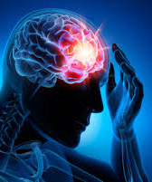
D has a disease of the mind
- A disease of the mind will be established where an internal factor causes a malfunctioning of mind (Kemp [1957])
(a) INTERNAL FACTORS
- Mental disorders
- some degeneration or changed physical state – Sullivan [1984]
- sleep walking – Burgess [1991]
- Diabetes – Hennessy [1989]
B) Does a disease of the mind have to result in violence?
Bratt v Attorney General For Northern Ireland [1963] – a disease of the mind is any mental disorder which manifests itself in violence and is prone to recur.
Quick [1973] - a person can have a disease of the mind and not be violent
Notes:
Sullivan (1984) D committed actual bodily harm while suffering from an epileptic seizure. Insanity was the appropriate defence because the malfunctioning of the mind had been caused by an internal factor, amounting to a disease of the mind.
Burgess [1991] – It is now clear that sleepwalking is due to an internal cause and the appropriate defence is insanity
Hennessy [1989] – a diabetic who had been disqualified from driving took a car and drove it while in a hyperglycaemic state (too much blood sugar). Insanity was the appropriate defence because the malfunctioning of the mind had been caused by this diabetes, an internal factor (he had failed to take his insulin).

Slide 40

Please remember….
Due on Turnitin by the 5th May 2023 @ 23:59pm
Read the question carefully to include ALL offences and possible defences
Ensure to include relevant case law to support your answer
Provide a discussion surrounding your choice of offences/ defences to justify why you feel they apply to this case
Include a cover page and reference list at the end of your work

