Slide 1
Religion in Roman Britain
Roman Britain – Celtic Studies
Natalie Boyd

Slide 2
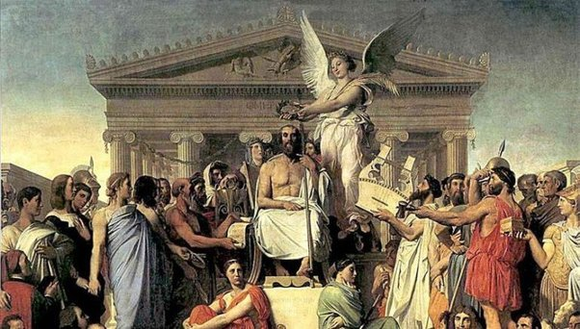
Pre-Christianity, both Rome and Britain had polythestic religions.
Wide-ranging – from the official cults of the Emperor, Jupiter, Juno, Minerva (Capitoline triad) to the gods/spirits of springs, rivers, cross-roads, lakes, woods, etc.
Romans favoured syncretism, merging beliefs across their multi-faith empire.
Lots of written records, temples, statues, etc. to inform on Roman religion.

Slide 3
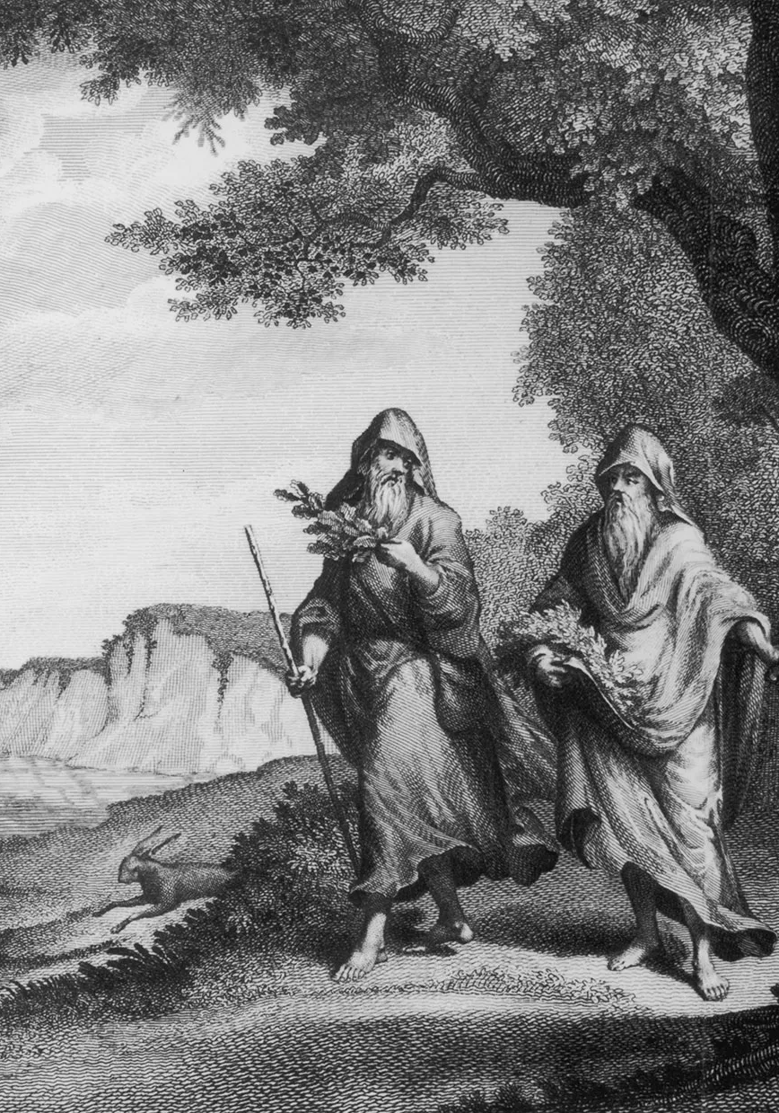
Religion in Britain before the arrival of the Romans is more elusive.
We hear from external sources about the Druids.
Earliest mention C1st BC, druidae in Gaul and Britain.
Word is a Latin transcription of a Celtic word relating to people involved in prophecy and ritual.
While in Gaul, in the 50s BC, Caesar described the Druids as ‘in charge of all religious matters, superintending public and private sacrifices, and explaining superstitions.’.
He also noted their interest in astronomy, education, and valour.
Young men flocked to them for teaching.
Druids were responsible for giving advice/judgement on disputes, crime and punishment.
Caesar describes how they elect their leaders.

Slide 4
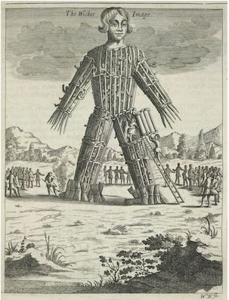
Caesar also wrote about the Wicker Man.
Pliny the Elder wrote of mistletoe and human sacrifice:
“To murder a man was to do the act of highest devoutness and to eat his flesh was to secure the highest blessings of health”.
Tacitus described a battle in Wales, where Druids “[covered] their altars with the blood of captives and [consulted] their deities through human entrails”.
Was this an accurate record? Or a way to justify the suppression and slaughter of the Druids during the invasion?

Slide 5
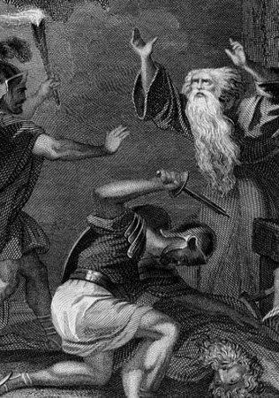
In Britain and Gaul the land was fragmented. Lots of tribes, kings and chiefs, but no central political authority.
Druids considered as possible ‘national consciousness’ and capable of raising support for anti-Roman uprisings.
Diodorus Siculus tells of Druids with enough respect to intervene in a battle and cause an immediate cessation of hostilities.
Three aspects of Druidic practice which Romans feared:
Intensely secretive
Divination
Human sacrifice
The Druids therefore became one of only two religious groups that the Romans tried to destroy rather than incorporate.

Slide 6
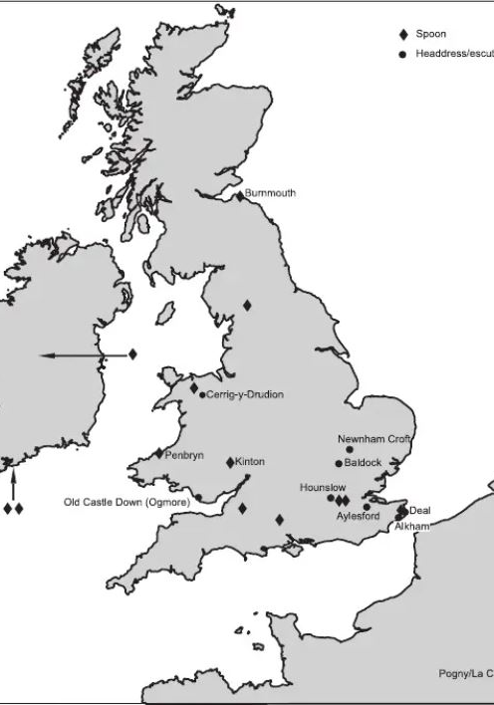
Archaeology gives us a different view of the Druids.
Archaeologists such as Cunliffe and Aldhouse-Green have been working towards providing a more balanced view of the evidence for many years.
Aldhouse-Green’s recent work considers that Wales may have been the centre or origin for the Druids.
Fitzpatrick (2007) considers evidence from a series of Iron Age finds which may indicate a ritual function, possibly relating to Druids or their forebears.
Pairs of spoons, shallow, mismatched, incised with a cross. Some in graves, some in small hoards or watery places.
Headdresses were also included in his study. Usually from grave contexts. Some of these had been previously mislabelled, e.g. a bucket binding, or chariot fittings.
Appears they were worn directly on the head, no leather cap/helmet between.

Slide 7
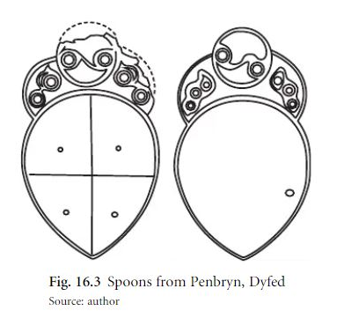
Penbryn Spoons
Found ‘under a heap of stones’ within the hillfort Castell Nadolig in c.1829.
Suggested they were from a grave but no evidence for this.
First published 1862 when ‘Augustus Wollaston Franks had “accidentally discovered another pair of these spoon-shaped articles in the Ashmolean Museum where they had been lying unnoticed since the year 1836”.’.
Plug found in tiny hole made of gold. Spoons made of brass.
Re-examination suggests these weren’t holes, but inlays. Probably each one a different colour/metal.
Use still unclear. Too shallow really for liquids, maybe oil or powder.

Slide 8


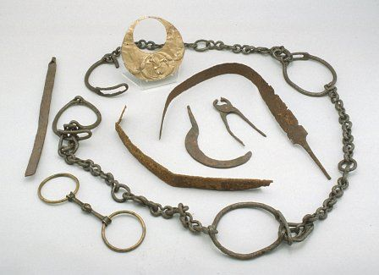


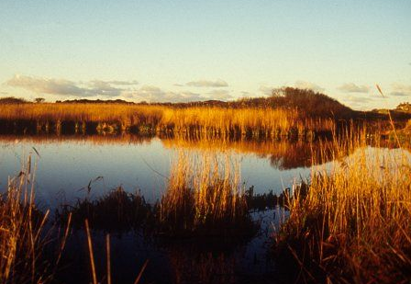

Llyn Cerrig Bach
This site on Anglesey illustrates the tradition of offering gifts to the gods.
Between 300BC and 100AD: chariots, weapons, tools, decorated metalwork items, slave chains, currency bars, cauldrons and a trumpet were cast into the small lake from an island or causeway.
Tacitus’ description of the crushing of a Druidic stronghold on Anglesey leads some to believe that Llyn Cerrig Bach was therefore a Druidic site.
The items were deliberately rendered useless before deposition.
Associated bones may indicate animal sacrifice.

Slide 9
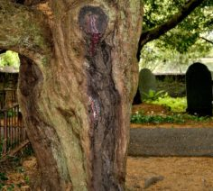
Archaeology and modern readings of the ancient texts indicate the Druids practiced a religion that was based on nature.
Celtic place name evidence, such as ‘Nemeton’ and ‘Llanerch’ are associated with Celtic religious centres but have a meaning that relates to clearings in the woods.
The title Druid links to the Welsh Derwyddon which has a meaning related to ‘oak knowledge’ and supports the idea that trees, especially oaks and yews (mentioned in an ancient poem by Lucan), were important.
This idea has continuity, as the yew continued in the traditions of the ‘Llan’, enclosures or churchyards. The name, the tree and the idea of religion all remaining together.

Slide 10
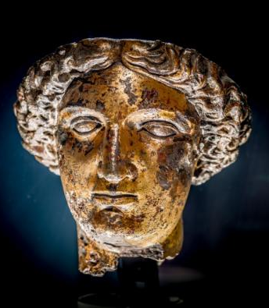
Both the Romans and most Britons believed that there were supreme or general gods and local gods or spirits (genii) in every person or place.
On the whole, it was therefore quite simple to merge the belief systems.
Worth bearing in mind that the invasion initially brought an influx of men into Britain, which may have skewed some of the religious figures adopted.
At Bath there was a local shrine to the goddess of the hot springs, Sul.
Linked to Minerva for healing qualities, but other gods and goddesses were included in the temple, such as Diana.
Romans built a bath complex here.
Over 6,000 coins were cast as offerings into the waters of Bath, along with a large quantity of lead or bronze curse tablets.

Slide 11
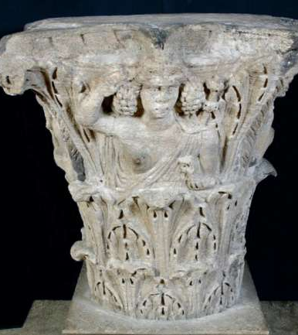
Minerva was one of the Capitoline Triad, worship of which was demanded by the Roman State.
Most of the evidence for worship of the Triad, Jupiter, Minerva and Juno, comes from military sites in Northern Britain, although some elsewhere, including a highly decorated column from Corinium (Cirencester).
2nd/3rd century AD part of Jupiter Column.
Shows Bacchus, the god of wine.
Would have stood at the forum in the centre of Corinium.
Corinium has evidence suggesting a workshop producing limestone religious sculptures, including Fortuna, Diana and Mercury. There is evidence in the town of mosaics and sculpture representing Oceanus and Vulcan.

Slide 12
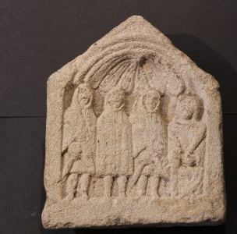
Corinium also provides a lot of evidence for the continued worship of native deities during the Roman-British period.
There seems to be a river god, although this may be Neptune or a hybrid.
A Genus Loci for the town/area is found.
Also representations of Cernunnos, ‘horned one’, a deity of the wild things.
In wider Gloucestershire, the mother goddess seems to have been the most popular cult (dea mater), linked to fertility and often accompanied by three hooded male spirits personifying the locality, the Genii Cucullati.

Slide 13
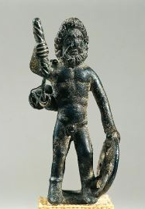
As with Sulis, other Celtic figures became Romanised.
Julius Caesar equated the Celtic god Lugus with Mercury, both believed to bring light and enlightenment.
Cocidius was equated with Mars, both equipped with shields and helmets. Representations are found near Hadrian’s Wall.
Similarly, Celtic battle gods Loucetius and Belatucadrus appear to have been linked to Mars.
Taranis is a more universal Celtic figure and was compared to the genii loci of hilltops and streams. Taranis is thought to have been a god of thunder, often depicted with a hammer and wheel. Sometimes compared to Jupiter.

Slide 14
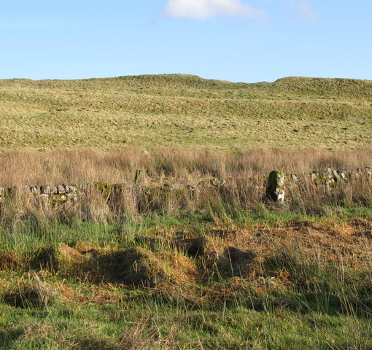
The merging and blending of the Celtic and Roman gods can make it difficult to work out in some instances which gods pre-date the Romans in Britain and which were carried in from elsewhere in the empire.
We can look to areas of Northern Britain and Ireland for some clues, as they were likely largely unaffected.
In Northumberland and at Hadrian’s Wall (Carrawburgh) there was a well and carvings to the river goddess Covetina.
The well contained votive deposits and was excavated in 1876 by John Clayton.
The wall doesn’t deviate around the well, so the well itself may post-date the construction of the wall and help to manage the water in a marshy area.
Nearby Roman religious sites including a mithraeum.
Coin hoards indicate an abrupt end to its use around 388AD.

Slide 15
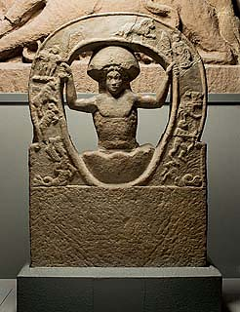
The cult of Mithras was largely associated with the military and merchants.
Originated in Persia and spread with these groups across the empire.
Represented the constant battle between good and evil/light and darkness.
Surrounded by mystery and may have been treated cautiously by the superstitious Britons.
Series of initiation tests required and life had to be lived by a code.
London was the centre for Mithraism in Britain, but instances and inscriptions found in Caernofon, Housesteads and Carrawburgh.

Slide 16
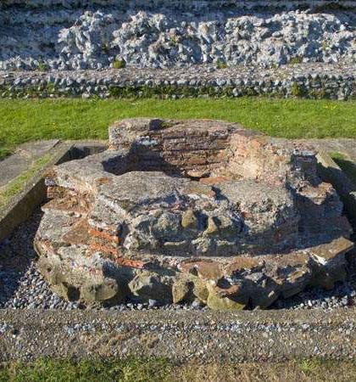
It is not clear when Christianity was introduced to Britain.
Increasingly popular among the elite in the C4th AD following the conversion of Constantine.
Christian iconography appears in the decoration of villas, such as mosaic at Hinton St Mary and wall paintings of Lullingstone Roman Villa.
Evidence that at the time, pagan traditions remained strong. Shrines were built and embellished in large numbers in Southern Britain (e.g. Jordan Hill and Maiden Castle). At Lullingstone, there is evidence that pagan traditions continued despite the Christian artwork.
Things seem to start changing after the decrees of Theodosius I between 389 and 391.

Slide 17
Summary
Romans and Ancient Britons polytheistic
Druids people of knowledge and influence, living outside of tribal ‘norms’
Druids targeted by Romans as powerful threat. Propoganda? Or truth?
Archaeology still looking for firm evidence of the Druids to tell both sides
Druidic/Celtic elements carried forward through language, place and tradition
Syncretism of British and Roman religions
Introduction of Christianity late in the Roman occupation, but older practices continue

