Slide 1
MODULE NAME problem solving and decision
MODULE CODE Lcm4004
STUDENT NAME julio cesar Lerbours moreta
STUDENT ID 2537862
LECTURER anita nan
Assignment 1: Presentation

Slide 2
OVERVIEW
Introduction
Company background
Problem: nature and scope
PESTLE ANALYSIS: Basil’s Bakery
Cause and effect analysis: Fishbone diagram
Conclusion
References

Slide 3
Introduction
Basil’s Bakery: Analysis of sales issues
Objective
To identify the factors hindering a recovery in sales
Presentation structure: Business context, sales problem, analytical tools, and conclusions
PESTLE: Analysis of external factors influencing the business
Fishbone diagram: Organizing potential causes of a problem into categories
Notes:
Hello! In this presentation I will analyse the situation of Basil’s bakery and I will aim a simple question: why the bakery’s sales did not recover to the level of before pandemic?
I will start with a short presentation of the bakery and its problems. Then, I will use two tools. PESTLE analysis help to understand why is changing in the environment in which the bakery works/ Fishbone diagram helps to group the possible causes of low sales and see how it is connected to the problem.
At the final I will present the main conclusions. Therefore, let’s start with Basil’s business and its clients.

Slide 4
Company background
Basil’s bakery
Founded: 2015, in a retail park in Coventry, UK
Owner: Basil, an experienced baker
Products: bread, cakes, and pastries, made with high-quality organic ingredients
Customers: local residents and employees from nearby shops, offices, and warehouses
Strengths: tasty products and a convenient location
Performance: annual sales growth prior to 2020, followed by a partial recovery after the pandemic
Notes:
To begin with, let’s see how the business works. Basil opened the bakery in 2015, in a retail port in Coventry. He makes bread, cakes and pastries, using high-quality organic ingredients.
Clients are both residents nearby and people that work in shops, offices or warehouses. For them, the bakery is a convenient place from where they can buy their launch or something tasty.
The sales increased from one year to another until the pandemic. Therefore, it is noticeable that the business had a base of clients that appreciated the products. However, the dependency on people that are visiting the are makes it vulnerable when their habits change. This leads to the problem of the next slide.

Slide 5

Problem: nature and scope
What?
Sales have not returned to pre-pandemic levels
Who?
Basil and the customers who no longer visit the bakery regularly
Where?
The retail park in Coventry and the nearby business area
When?
A decline starting in 2020, with lingering effects through 2023–2025
Why?
Fewer visitors, store closures, and remote work
How?
Less frequent visits, a lack of delivery options, and phone-in pre-orders that are difficult to manage
How much? –
Sales volume, on average, is approximately 25% below 2019 levels for the 2023–2025 period
Problem analysis using 5W2H
(Luo, Hong and Zhong, 2024)
Notes:
In order to understand the problem, the seven questions from the 5W2H structure were used (Luo, Hong and Zhong, 2024).
The main figure is the drop of about 25% of the sales volume compared to 2019. This represents the average of the 2023-2025 period, so it is an issue that persists. What explains the situation? The closure of shops and work from home reduce the number of people that reach the area. Thus, Basil loses occasions to sell although its products are still appreciated.
At the same time, some clients demand delivery or pre-orders. The interest exists, but the bakery does not completely manage to answer these needs. Basil needs to prepare the products and cannot always answer to the phone.
Besides from that, the rising costs and unpredictable prices of ingredients put pressure on profitability. This aggravates the situation, but do not prove why the sales drop. Without additional financial data, we cannot say that the businesses has losses. Next, PESTLE analysis will examine the external factors.

Slide 6
PESTLE ANALYSIS: Basil’s Bakery
Factor | Idea 1 | Idea 2
Politic | Restrictions during the pandemic reduced the number of tourists | Reduction in business taxes can minimize costs if the bakery is eligible
Economic | Increasing utility, rent and insurances puts pressure on profitability | Shop closure and loss of jobs reduce the local base of clients
Social | Hybrid work means fewer visits from offices’ employees | Delivering and pre-ordering demands show the preference for more convenient shopping options
(Hayden, 2025; Lockwood and Tam, 2026; Office for National Statistics, 2025)
Notes:
PESTLE examines the external environment of the bakery. This groups the influences in six categories, but the focus is on political, economic and social factors (Hayden, 2025).
Starting with social factors. According to the study, restrictions from the pandemic contributed to the decrease of number of clients in 2020. However, they explain just the beginning of the problem because the sales remained low even after restrictions were lifted. Another aspect is the fiscal support. In UK, there are reduction of fees on commercial spaces for certain small businesses (Lockwood and Tam, 2026). These could reduce the Basil’s expanses, but it is not jure the bakery’s eligibility.
Regarding economic factors, two pressures are observed. On one hand, Basil pays more operating costs. On the other hand, the closure of shops means that some clients are no longer working nearby. Therefore, the costs increase while the local base of clients drops.
In terms of social factors, hybrid work changes the shopping routine. ONS shows that 28% of adults that worked in UK had a hybrid program in the first quarter of 2025 (Office for National Statistics, 2025). This offers national context for the change notices by Basil. Moreover, the delivery and pre-ordering demands suggest that some clients still want the products, but they need more comfortable ways to buy them. Therefore, the analysis shows a mismatch between the current routine of clients and the way in which the bakery serves them.

Slide 7
PESTLE ANALYSIS: Basil’s Bakery
Factor | Idea 1 | Idea 2
Technological | Online pre-ordering systems could reduce the phone dependency and waiting time | Delivery platforms could facilitate the access of clients that are not coming in the area anymore
Legal | Food safety and hygiene norms impose procedures to prepare and keep products | Remote sale require providing allergens before buying and on delivery
Environmental | Extreme weather can affect the crops and availability of ingredients | Reducing food waste can limit the impact on environment and cost of unsold products
(CIEH, 2019; European Commissions , 2023; Hayden, 2025; WRAP, 2021)
Notes:
We continue with technological, legal and environmental factors (Hayden, 2025).
On the technological part, there are tools that could help Basil to answer to clients’ demands. An online pre-ordering system would allow to place orders without interrupting the preparation of products to answer the phone. Platforms that also offer couriers could facilitate the delivery. However, Basil need to check the commissions and bakery’s capacity before choosing a solution.
Regarding legal factors, the bakery needs to respect the food safety and hygiene rules. If it introduces distance pre-ordering and delivery, the information on allergens needs offered before completing the shopping and on delivery (European Commissions, 2023). These obligations need included in service’s operations.
In terms of environmental factors, the extreme weather can affect the crops. For Basil, this is a relevant risk because it uses eco ingredients and already faces unpredictable prices. The Defra report confirms the influence of extreme weather on British agricultural production (CIEH, 2019).
Another aspect is the food waste. Its reduction limits the useless consume of resources and associated emissions. For the bakery, adapting the quantities to the demand could reduce the costs of unsold products (WRAP, 2021).

Slide 8
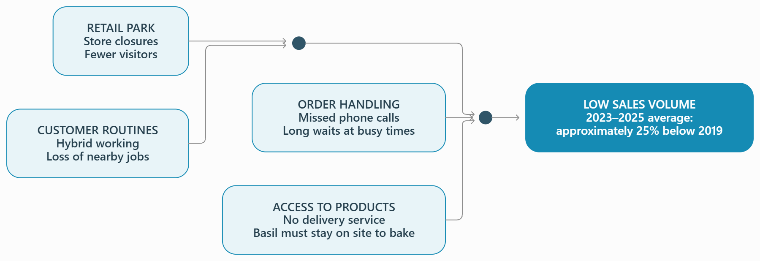
Cause and effect analysis (Fishbone diagram)
(Kumah et al., 2024)
Notes:
Fishbone diagram helps to group the possible causes of a problem (Kumah et al., 2024). In the right there is the analysed effect: the volume sales in 2023-2025 is, on the average, with about 25% under the level in 2019.
The first category is the commercial area. The shops are closing and the park attracts less visitors. Thus, the occasions in which people enter in the bakery drop.
The second category concerns clients’ routine. The hybrid work and loss of jobs nearby mean that a part of loyal clients no longer reach that area.
The third category is orders’ management. Basil cannot answer always to the phone and in peak periods, clients wait for too long. These difficulties can lead to lost orders.
The last category is the access to products. Some clients demands delivery, but Basil needs to stay in the bakery to prepare the products. The interest exists, but the buying becomes more difficult.
The analysis suggests that the problem combines the reduction of local flow of clients with delivery and order difficulties. The diagram organizes these explanations, but Basil needs additional data to check the importance of each one.

Slide 9
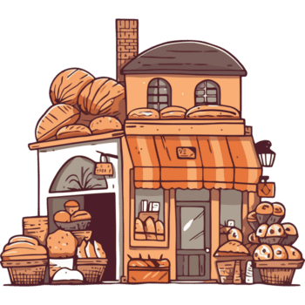
Conclusion
Persistent issue: sales volume from 2023–2025 remained, on average, approximately 25% below 2019 levels.
Fewer customers in the area: store closures and hybrid work reduce shopping opportunities.
Limited access: the lack of delivery options and difficulties with pre-ordering can hinder sales.
Financial pressure: rising costs and unpredictable ingredient prices complicate business operations.
Need for adaptation: online ordering and delivery should be evaluated in light of demand, costs, and the bakery's capacity.
Notes:
Therefore, Basil’s Bakery faces changes in the commercial area and clients’ routine. The products are appreciated, but people are visiting the bakery less frequently and the order options are limited.
The analysis suggests that basil should evaluate the online pre-ordering and deliveries, checking if these are financially and operationally profitable. The increased costs make this evaluation even more important. Therefore, the recovery of sales relies on adapting the business to the current needs of clients.
Thank you for attention!

Slide 10
References
CIEH (2019). Defra report shows “alarming vulnerabilities” in the UK’s food security. [online] CIEH. Available at: https://www.cieh.org/ehn/food-safety-integrity/2025/january/defra-report-shows-alarming-vulnerabilities-in-the-uk-s-food-security/ [Accessed 20 Oct. 2026].
European Commissions (2023). Distance selling. [online] Food Safety. Available at: https://food.ec.europa.eu/food-safety/labelling-and-nutrition/food-information-consumers-legislation/distance-selling_en [Accessed 20 Oct. 2026].
Hayden, D. (2025). PESTLE analysis. [online] CIPD. Available at: https://www.cipd.org/en/knowledge/factsheets/pestle-analysis-factsheet/ [Accessed 20 Oct. 2026].
Kumah, A., Nwogu, C.N., Issah, A.-R., Obot, E., Kanamitie, D.T., Sifa, J.S. and Aidoo, L.A. (2024). Cause-and-effect (Fishbone) diagram: A tool for generating and organizing quality improvement ideas. Innovations Journals, [online] 7(2), pp.85–87. doi:10.36401/JQSH-23-42.
Lockwood, B. and Tam, E. (2026). Impacts of taxation on small businesses: Business rates in the UK - post. [online] POST. Available at: https://post.parliament.uk/impacts-of-taxation-on-small-businesses-business-rates-in-the-uk/ [Accessed 20 Oct. 2026].
Luo, L., Hong, Q. and Zhong, M. (2024). The application of 5W2H management model in the construction of enterprise economic and strategic management system. Applied mathematics and nonlinear sciences, 9(1). doi:10.2478/amns-2024-0776.
Office for National Statistics (2025). Who has access to hybrid work in Great Britain? [online] Ons.gov.uk. Available at: https://www.ons.gov.uk/employmentandlabourmarket/peopleinwork/employmentandemployeetypes/articles/whohasaccesstohybridworkingreatbritain/2025-06-11 [Accessed 20 Oct. 2026].
WRAP (2021). Reducing food waste. [online] WRAP - The Waste and Resources Action Programme. Available at: https://www.wrap.ngo/what-we-do/future-proof-food/reducing-food-waste [Accessed 20 Oct. 2026].

Slide 11

Questions

