Slide 1
Modern Orthodox Judaism
By Alana Richards

Slide 2
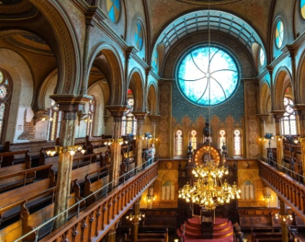
What is Modern Orthodox?
The term ‘orthodox’ first appears in a Jewish context in the first half of the 19th century.
The term has been used to reference a specific trend of orthodoxy, an example would be Modern Orthodox Judaism.
Modern Orthodox Judaism is a way to for Jews to maintain Jewish law, customs and obsservance, whilst allowing themselves to gain ‘secular knowledge, science, and modern ideas, this was a way to bridge orthodox Judaism and Modernity’.1
(Footnote in notes)
Notes:
1, BBC, Modern Orthodoxy, 2013, <https://www.bbc.co.uk/religion/religions/judaism/subdivisions/modernorthodoxy_1.shtml>[Accessed on 3rd June 2021].

Slide 3
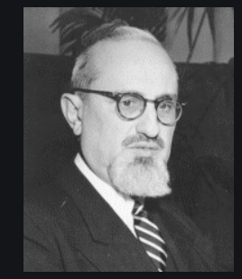
Rabbi Joseph Soloveitchik
Influencial in Modern Orthodox in 19th century.
Rabbi Soloveitchik developed Hirsh’s idea of Torah Im Derekh Eretz and produced Torah Umaddah.
Torah Umaddah translates to ‘Torah and Science’.
Due to his influence, Modern Orthodox Movement responds to new issues.

Slide 4
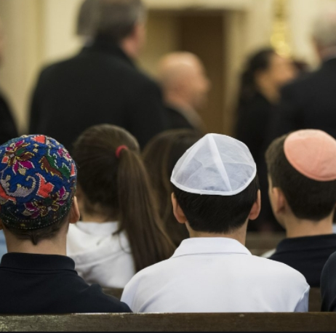
Beliefs
In the general beliefs, Modern Orthodox have similar beliefs to orthodox Judaism when it comes to the Torah,which was when the Torah was revealed to the Jewish people by God.
Follows some traditional beliefs such as eats Kosher foods, observe shabbat from Friday afternoon through Saturday evening.
They support equality for women as it says:
“I call upon heaven and earth to witness for me that whether one is a non-Jew or Jew, or whether one is a man or a woman, or whether one is a male or female, according to the actions of that person does the holy spirit (of God) rests on him/her” (Yalkut Shimoni to the Book of Judges, section 42).
Modern Orthodoxy tries to bring everyone together by makings its synagogues and homes welcoming.

Slide 5
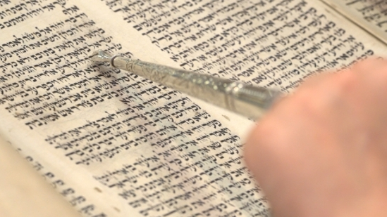
Challenges
There are some challenges that Modern Orthodox Judaism faces. Some of these challenges are
The idea of modernistation being added to an ancient, traditional religion.
There needs to be an appeal to the younger generation.

Slide 6
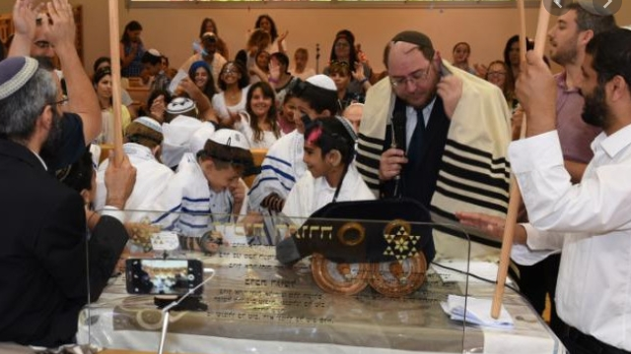
Conclusion
The engagement with the modern world for Modern Orthodox is not a way that would loose faith or decreasing the significance of the traditional ways, but modern concepts can help modern orthodox thrive and a sacred opportunity to expand for generations to come. Modern orthodox is significant as it applies modernity to traditional belief.

Slide 7
Bibliography
BBC, Modern Orthodoxy, 2013, <https://www.bbc.co.uk/religion/religions/judaism/subdivisions/modernorthodoxy_1.shtml>[Accessed on 3rd June 2021].
Chernick, Michael, Modern Orthodoxy: A Guide for the Perplexed — Orthodox Judaism and change, 2016, <https://blogs.timesofisrael.com/modern-orthodoxy-a-guide-for-the-perplexed-orthodox-judaism-and-change/> [Accessed on 3rd June 2021].
De Lange, Nicholas, An Introduction to Judaism, (Cambridge, Cambridge University Press, 2004) page 14.
Eleff, Zev, Modern Orthodox Judaism A Documentary History, (U of Nebraska Press, 2016),page 140
Neusner, J., and A. J. Avery Peck (eds.), The Blackwell Companion to Judaism (Oxford: Blackwell Publishers, 2000), part III
Rabbi Yonah Berman, What defines the Modern Orthodox Movement?,2014, <https://www.jewishboston.com/read/what-defines-the-modern-orthodox-movement/> [Accessed on 3rd June 2021].
Sales, Ben, Five key takeaways from a new survey about Modern Orthodox Jews, 2017, <https://www.jta.org/2017/09/29/united-states/what-a-new-survey-tells-us-about-modern-orthodox-jews> [Accessed on 3rd of June 2021].
Pictures
Slide 2- https://www.bl.uk/sacred-texts/articles/the-torah
Slide 3- https://en.wikipedia.org/wiki/Joseph_B._Soloveitchik
Slide 4- https://www.jweekly.com/2017/10/03/five-takeaways-new-survey-modern-orthodox-jews/
Slide 5- https://www.bl.uk/sacred-texts/articles/the-torah
Slide 6-https://archive.jewishagency.org/israel-your-community/partnership2gether/religious-streams/modern-orthodox-movement

