Slide 1
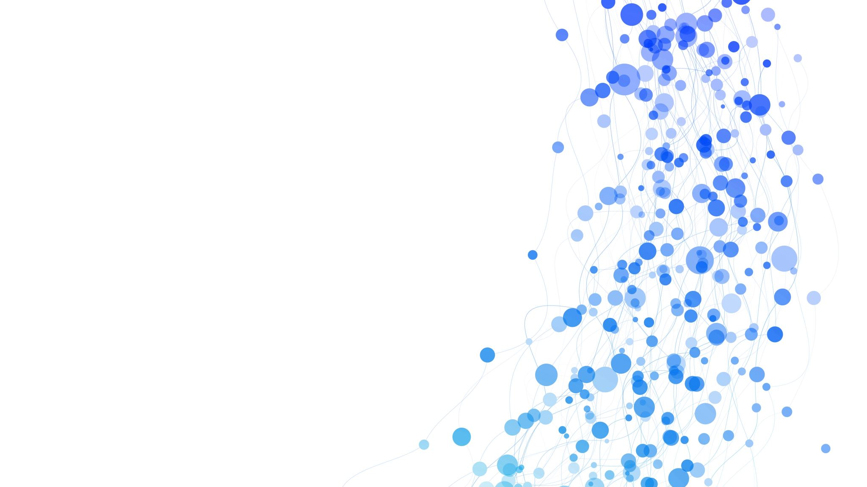

‘Describe A Range Of Current Legislation In Regard To Advocacy Practice’
ECAY4003 | Assessment 2
Jessica Molly Bassett-Davies | 2204967

Slide 2
Introduction:
‘Describe A Range Of Current Legislation In Regard To Advocacy Practice’
This presentation shall cover:
The Mental Capacity Act (2005)
The Social Services And Well-being Act (2014)
The Care Standards Act (2000)
The Well-being of future generations Act (2014)
Empowerment and Advocacy Theory
Coalition Formation Theory

Slide 3
Mental Capacity Act (2005)
Vulnerable individuals, that fall under a particular criteria, are eligible for the support of an IMCA (Independent Mental Capacity Advocate). This role has been defined in the mental capacity act (2005), and an IMCA provides independent safeguards for individuals lacking capacity to make informed, important decisions, so if they have no other support in doing so, the IMCA will take on this role to support and represent.
For example, an IMCA may be involved under the circumstances of:
When an NHS body / local authority propose to provide/withhold/stop serious medical treatment.
When an NHS body / local authority proposes to arrange or change accommodation.
Care reviews.
Adult protection services.
(Dewis Cymru 2023)

Slide 4
Social Services & Well-being Act, 2014 (Wales)
The code of practice regarding Advocacy (Under the section of 145 of the social services and wellbeing act, 2014) ensures that access to advocacy services is available to enable individuals to engage and participate when local authorities are exercising statutory duties in relation to them and to arrange an independent professional advocate to facilitate the involvement of individuals in certain circumstances.
Advocacy is a fundamental part of the act and focuses closely on the social care around individuals and their wellbeing. Advocacy has an aim to support people in understanding how they may be involved, how they can contribute and take part to lead or direct the process.
The act places the person and their well—being outcomes at the centre of this new framework, gives them an opportunity to use their voice and achieving their ideal outcomes, and contribute to support all areas of an individual's life including their families, other supporters, informal and formal services, and their wellbeing.
(Social Services and well-being (wales) act 2014 2022)

Slide 5
The Care Standards Act (2000)
The Care Standards Act (2000) was introduced with the aim to regulate/ensure that agencies are competent in their duties of care, and therefore develop a level ‘playing field’ for all service providers.
The main purpose of the act is to aid individuals to acquire their wanted outcomes and has a focus on the needs and goals of the individual putting them at the centre of all decisions.
Independent advocacy is about providing the person with as much control as possible over their life, which in turn allows them to understand information and have a voice.
Not everyone is entitled to advocacy under the care act, the two conditions are:
The individual has substantial difficulty in being involved with choices made about them.
There is no one appropriate or available to support and represent them.
(Care act advocacy 2014)

Slide 6
Well-being of Future Generations Act (Wales, 2015)
The well-being of future generations act provides society with the ambition, permission and legal obligation to improve all areas of our social, cultural, environmental and economic well-being. This act requires public bodies in Wales to consider the long-term impact on their decisions, in order to prevent problems such as poverty, health inequalities and climate change.
The Essentials, 2023

Slide 7
Empowerment & Advocacy Theory
The empowerment and advocacy theory is a broad theoretical framework that has the aim to embrace all aspects of the individual’s life, and seeks to support clients in building and maintaining power on decisions and actions in their own lives.
The theory has some attributes relating to critical, feminist and anto-discrimination theories, and the theory stems from tackling the barriers that people face whilst achieving their objectives (Grande, 2004)
Advocacy on the other hand is crucial in speaking for the people, as well as interpreting, and presenting the people needs to the authority. Advocacy incorporates protection of the vulnerable people, creation of support that enhances societal functioning, protection and advancing claims or appeals and cultivating identity and control. This approach stresses the importance of transforming the client from passive consumers to active participants in their lives (Howe, 2009).
(Empowerment/advocacy theory 2019)

Slide 8
Coalition Formation Theory
Advocacy coalitions are those defined by political actors who share mutual ideas and who can functionally coordinate amongst themselves. They work to suggest specific issues to the government and influence in decision making processes. Advocates who make use of said theory do believe that change occurs through coordinated activity amongst other individuals and other organizations outside of the government with the same core policy beliefs.
The theory highlights a framework based around policy making, which has been developed to deal with intense public policy problems. It can actually be seen as a ‘lens’ to understand and explain belief and policy change when serious disputes arise about goals and facts, with different professionals involved which either agree or disagree with each other and forming coalitions to gain power and influence.
(Coalition, 1997)

Slide 9
Reference List
Dewis Cymru (2023) Dewis. Available at: https://www.dewis.wales/ResourceDirectory/ViewResource.aspx?id=1640#:~:text=In%20Wales%2C%20certain%20vulnerable%20individuals,to%20make%20certain%20important%20decisions. (Accessed: 16 May 2023).
Social Services and well-being (wales) act 2014 (2022) Social Services and Well-being (Wales) Act 2014 Part 10 Code of Practice (Advocacy). Available at: https://www.gov.wales/sites/default/files/publications/2019-05/part-10-code-of-practice-advocacy.pdf (Accessed: 21 May 2023).
Care act advocacy (2014) Advocacy for All. Available at: https://www.advocacyforall.org.uk/one-to-one-advocacy/care-act-advocacy/#:~:text=The%20right%20to%20an%20advocate,enquiries%20or%20Safeguarding%20Adult%20Reviews). (Accessed: 28 May 2023).
AKWAABA (2019) Empowerment/advocacy theory, FATIMA MENSAH. Available at: https://fmensahjourney.weebly.com/empowermentadvocacy-theory.html#:~:text=Empowerment%20and%20advocacy%20theory%20is,%2C%20and%20anti%2Ddiscrimination%20theories. (Accessed: 28 May 2023).
Well-being of Future generations (wales) act 2015: The essentials [HTML] (no date) GOV.WALES. Available at: https://www.gov.wales/well-being-future-generations-act-essentials-html (Accessed: 30 May 2023).
(1997) Coalition formation theory. Available at: http://www.coalitiontheory.net/research-areas/coalition-formation-theory (Accessed: 30 May 2023).

