Slide 2
Introduction to EndNote Fusion Citation Manager
2026
Lisa Ellis

Slide 3


Referencing Styles
There are many different styles and formats of referencing. You must use one of UWTSD's approved versions (APA, Harvard, IEEE, or MHRA).
You should follow the format shown in the 13th edition of Cite Them Right.
Our referencing handbooks are available online and to download from the library website.
The Cite Them Right Database is available online via the library.
Notes:
So we know why, but how do we reference in UWTSD?
Consistency is key!

Slide 4
Citation Managers
Citation manager tools allow you to automatically:
Collect, store and manage bibliographic information from books, journals, and webpages you find during your research.
Insert in-text citations and references into a document (e.g. Word) in lots of different styles, including Harvard, APA, MHRA and IEEE.
We recommend choosing the UWTSD Institutional style, for Harvard and the 7th edition (Sentence Casing DOI: https:// )for APA.

Slide 5

EndNote Fusion (formerly RefWorks)
Institutional subscription, so freely available to all students and alumni of UWTSD.
Compatible with MS Word and Google Docs.
Direct export option within library catalogue.
Web-based software with unlimited storage.
Formerly known as RefWorks – some records may still refer to the platform as RefWorks.
YouTube Video Link

Slide 6
How do they work?
Storing the bibliographic information electronically, they help keep track of the sources you have used in your research.
They create a personal library of references which can be edited to correct errors, or to add in additional information.
You can use them to easily export citations you find in the online library and external websites. (Note, most are unable to export from an already created reference list in a PDF or Word document.)
Most citation managers offer a website integration tool to enable you to import bibliographic information from a website.

Slide 7
Should I use one?
Using a citation manager is a very personal choice. Only you can decide if it is right for you and which one to use for your task. You will have to invest some time to familiarise yourself with the tool to avoid problems later.
They cannot tell you where to insert citations into your document or remind you if you have missed one.
Just like any automated tool, errors do occur. You will still need an understanding of referencing and what information is required to be able to identify and amend imported errors and incomplete citations.

Slide 8
RefWorks is now EndNote Fusion
RefWorks has been renamed as EndNote Fusion as of October 6th 2026.
Existing RefWorks users will continue to sign in and work with their existing data and workflows and will see updated colours and a refreshed design.
RefWorks Citation Manager (RCM) will be renamed EndNote Fusion.
Users won’t need to do anything, as existing citation workflows in Word will be supported.
Users shouldn’t need to reinstall RCM in Word. If you have bookmarked RefWorks, the URL should automatically redirect to EndNote Fusion.
Some links or descriptors may still display as RefWorks for a while. E.g. RefWorks link in library catalogue records and database links, e.g. ProQuest.

Slide 9

Creating an account
Navigate to the Library website.
Click ‘Academic and Infoskills’ > ‘EndNote Fusion’.
Click ‘Create a new EndNote Fusion account’.
Confirm registration link in your staff / student outlook email account.

Slide 10
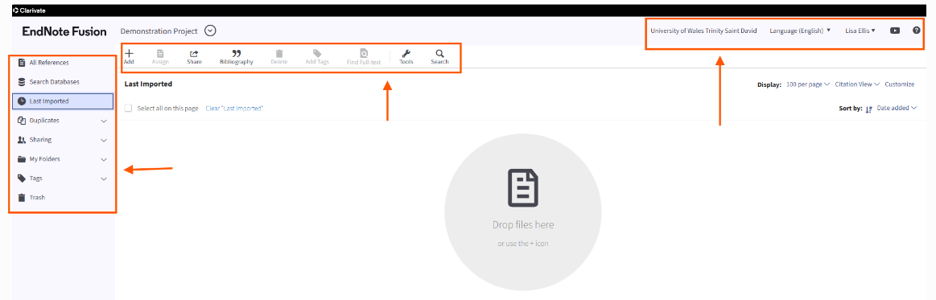
Interface
Reference Actions
Utility Toolbar
Reference Organisation
Reference details/ editor (currently hidden)

Slide 11
Interface
Utility Toolbar: Platform controls such as language menu, user menu (your user name), and help menu.
Reference Actions menu: Includes the main menu. Where most of the options for adding and interacting with your references are. The options that are available will also depend on the page you are currently working in (the tab you have selected in the left sidebar)
Center Pane: When you select a menu option or a sidebar tab, the page appears in this pane.
Reference Organisation: This sidebar contains tabs that provide quick access to your references and options for organizing and sharing them.
Right Sidebar (hidden unless a reference is in focus or you are creating a reference): This sidebar enables you to manually create a reference or to view the reference that is currently in focus. You can also edit the reference, if it is in your list of references.

Slide 12
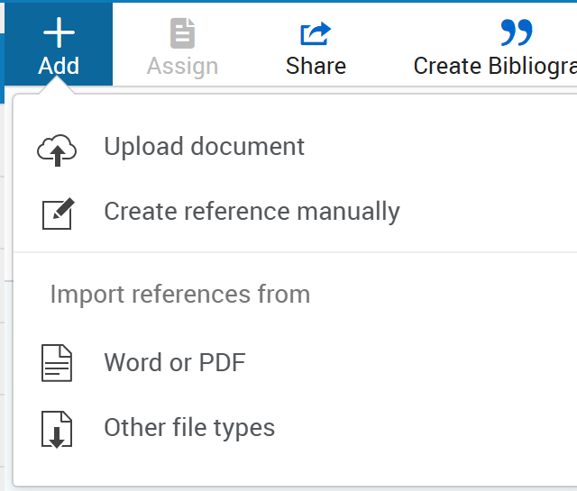
Reference Action: Adding sources
There are many ways in which you can add a reference to EndNote Fusion.
Click Add to view options.
From here you can upload documents (from your personal files. E.g. PDF, PPT, Word.
They can also be uploaded with drag and drop anywhere on the ‘import a reference page’), create a reference manually, or import from another file.

Slide 13
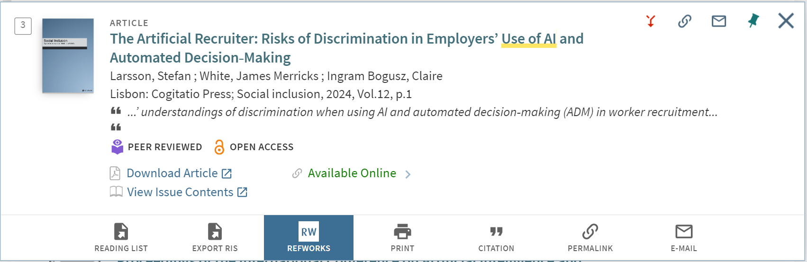
Adding via Library Catalogue
Use the RefWorks / EndNote Fusion tab in the item record

Slide 14
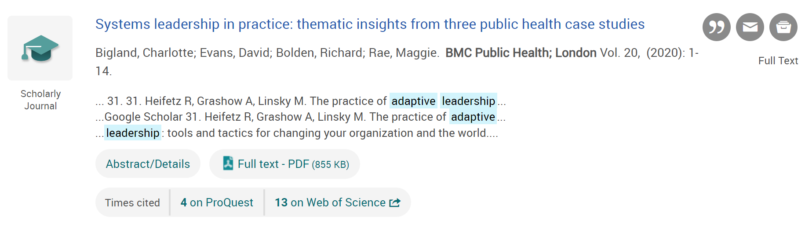
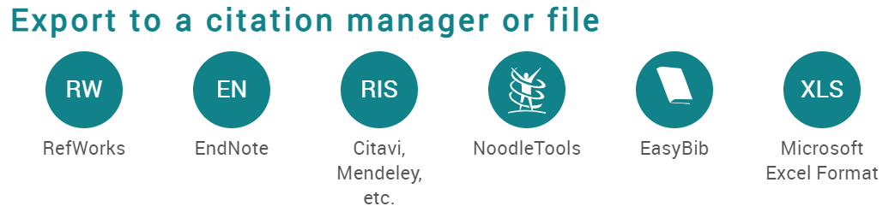
Adding from Library subscribed databases
Example: ProQuest

Slide 15
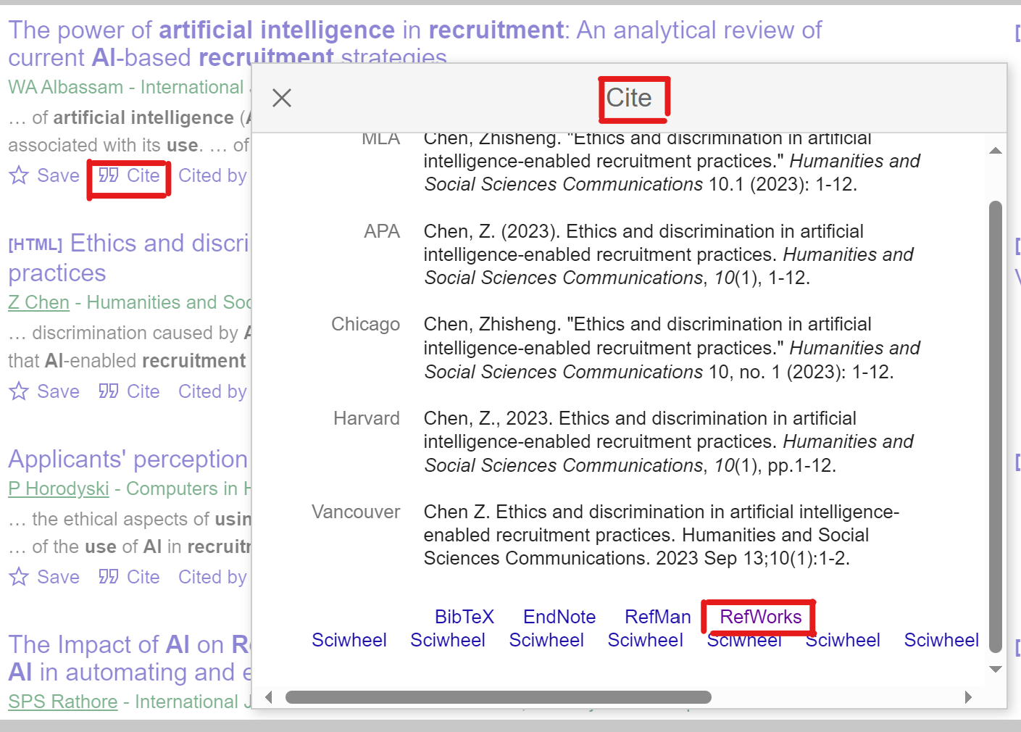
Save from Google Scholar
Use the cite option in Google Scholar.
Select EndNote Fusion

Slide 16
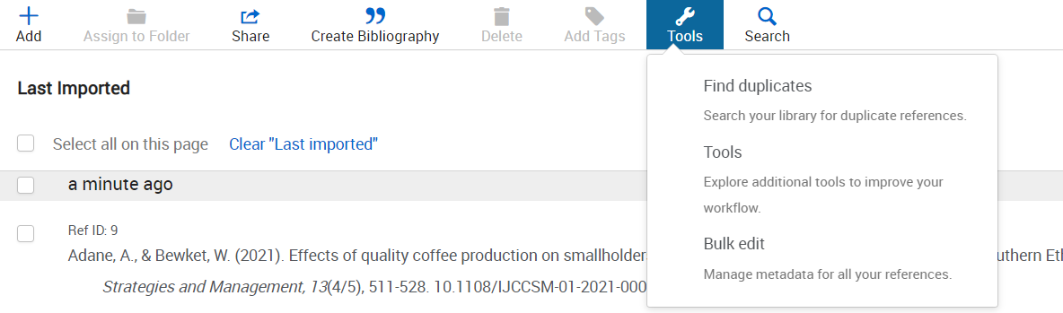
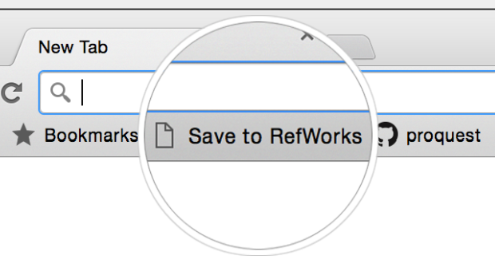

Save other web-based sources
Save web-based sources directly into your EndNote Fusion account…
Add the “Save to EndNote Fusion” button to your browser.
Ensure your browser's favorites toolbar is currently visible in your browser.​
In EndNote Fusion, select Tools > Tools > Install Save to EndNote Fusion.
Once installed, the ‘Save to EndNote Fusion link will appear in the favourites bar in your browser.

Slide 17
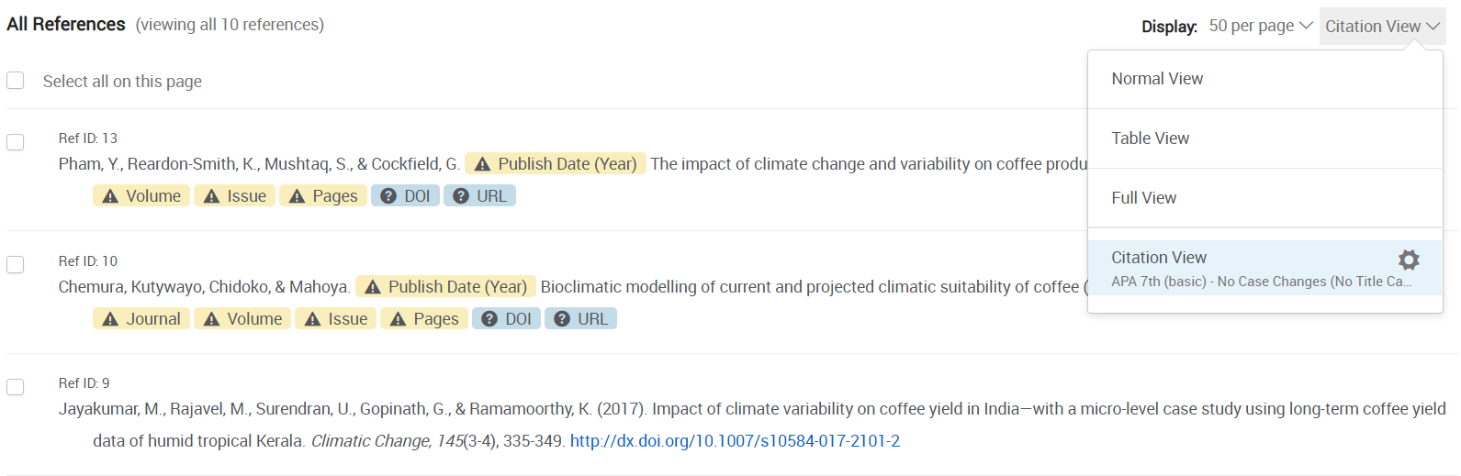
Viewing options
EndNote Fusion Link
Citation View shown
Missing fields highlighted that are required or recommended for the selected citation style.
Right click a highlight to open the right sidebar to edit that field.

Slide 18
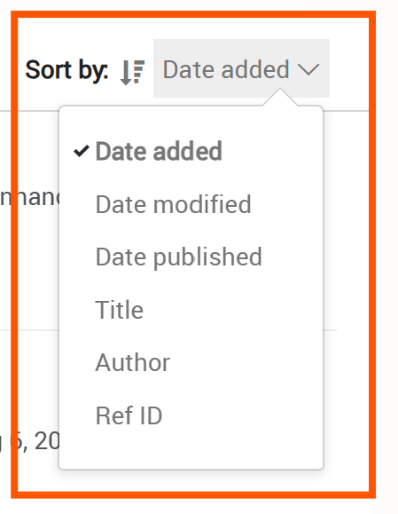
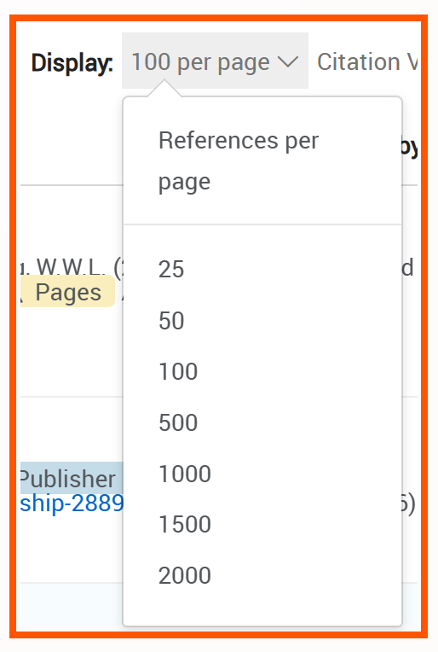
Viewing options
Sort by:
Select how you wish your references to be displayed. EndNote Fusion will remember your choice.
Number of references per page:
Choose how many references you wish to display.

Slide 19
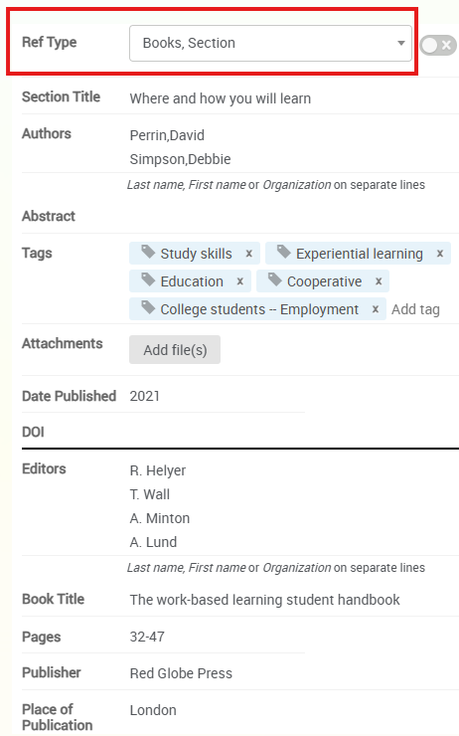

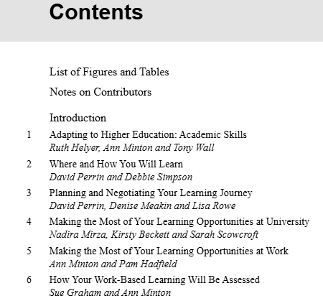
Check and edit your imported source
Example: Chapter in an edited book. Each chapter may be written by different author(s). Choose Books, section in ref type.
Manually check and edit fields to ensure accuracy.

Slide 20
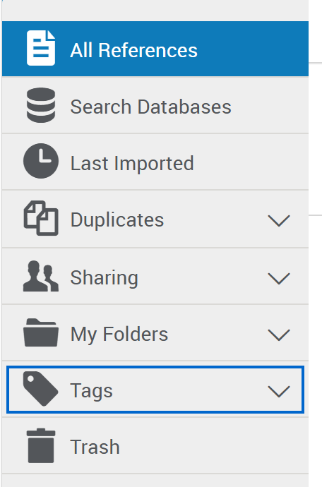
Reference Organisation
All References: Contains all references in the project.
Search Databases: Used to search content in external linked databases.
Last imported: Displays references imported in the last 30 days.
Sharing: View folders shared with you.
My Folders: Allows you to organise your references into folders and subfolders. A single reference may be in multiple folders.
Not in folder: Items not yest moved into a folder.
Tags: Tags already assigned or assigned by you.
Deleted: All items you have deleted.

Slide 21
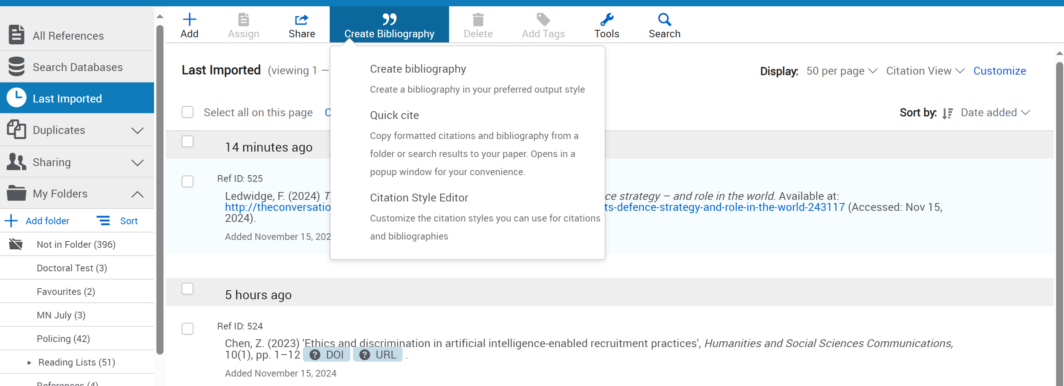
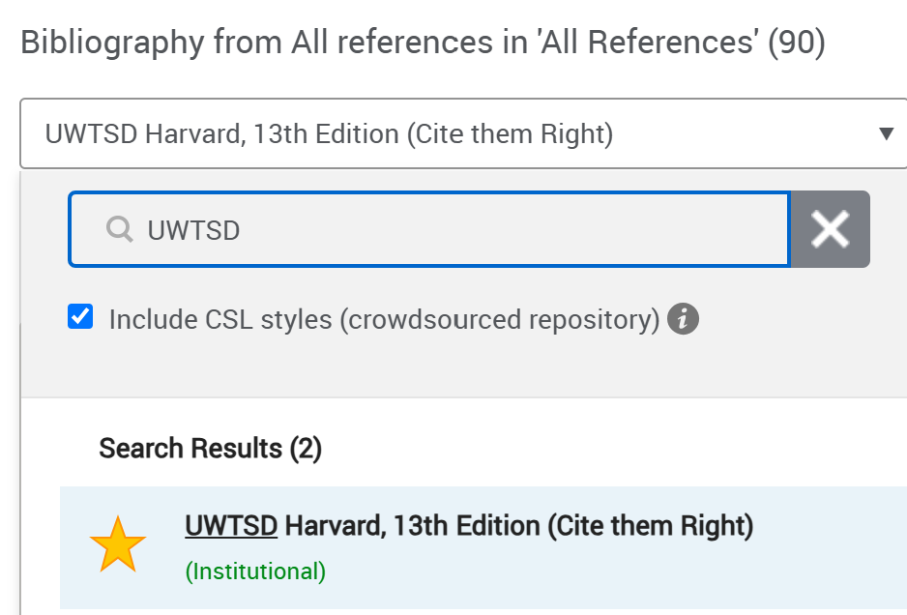
Select Bibliography style
EndNote Fusion Link

Slide 22
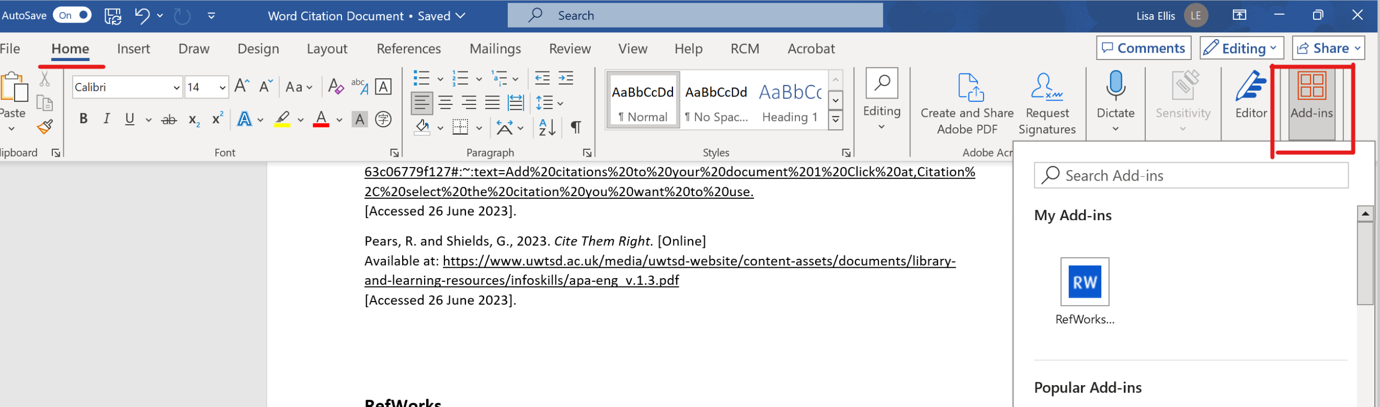
Installing EndNote Fusion (RCM) add in to Word

Slide 23
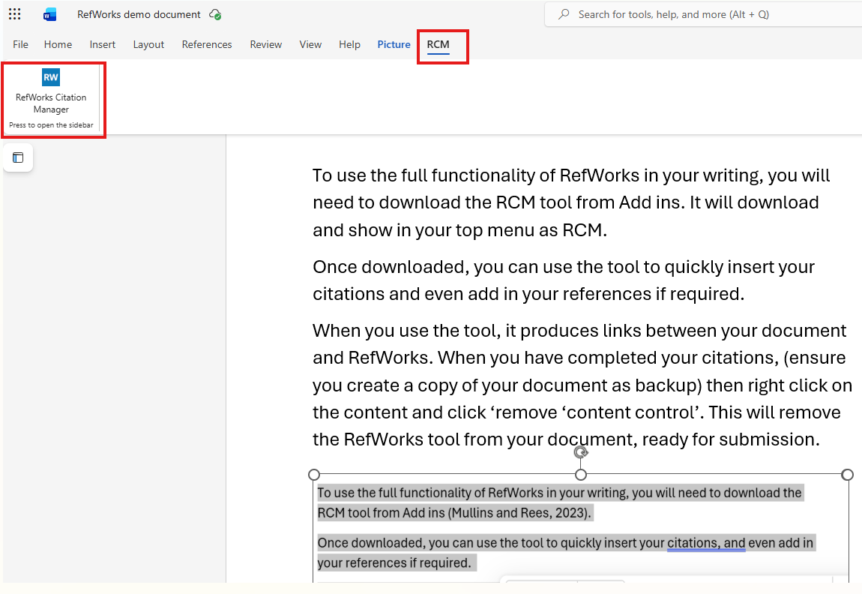
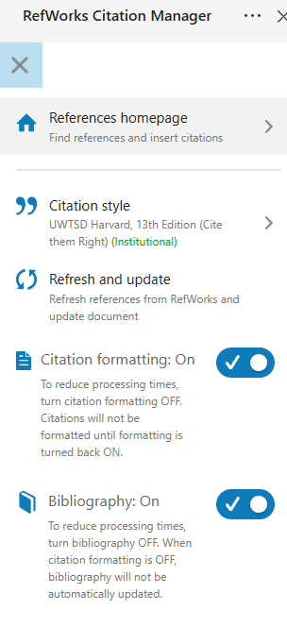
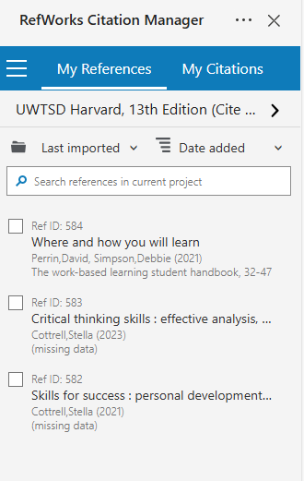
Inserting in-text citations
Menu

Slide 24
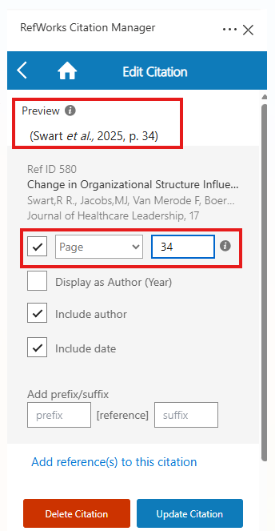
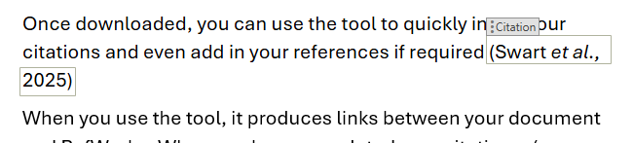
Inserting page numbers and more…
Click on your in-text citation to open the ‘edit citation’ box.
From here you can add page numbers, paragraph, figures and lots more.

Slide 25
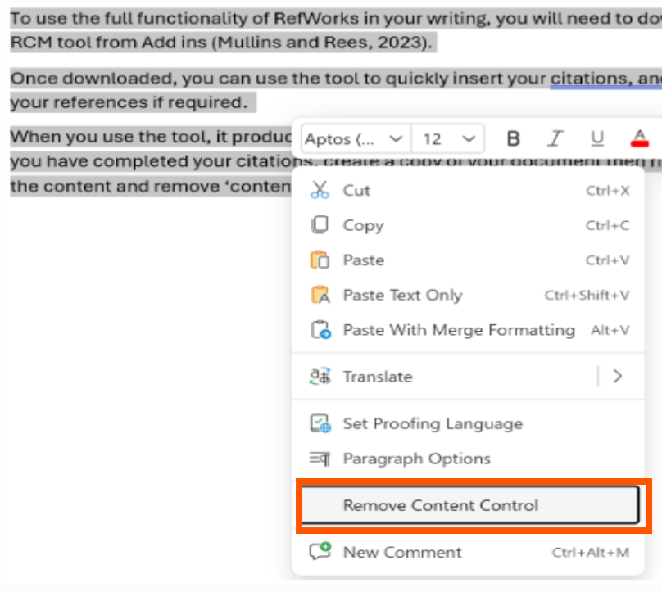
Removing the tool before submission
When you use the EndNote Fusion tool in Word, it produces a link between your document and EndNote Fusion.
On completion of your work, before you submit, it is important to:
Copy and create a new document as backup.
Highlight all your text
Right click and click ‘remove content control’.
This will remove the EndNote Fusion from your document in preparation for submission.

Slide 26

Useful Links
Useful YouTube videos
EndNote Fusion LibGuide
Knowledge Centre
Links to further information

Slide 27
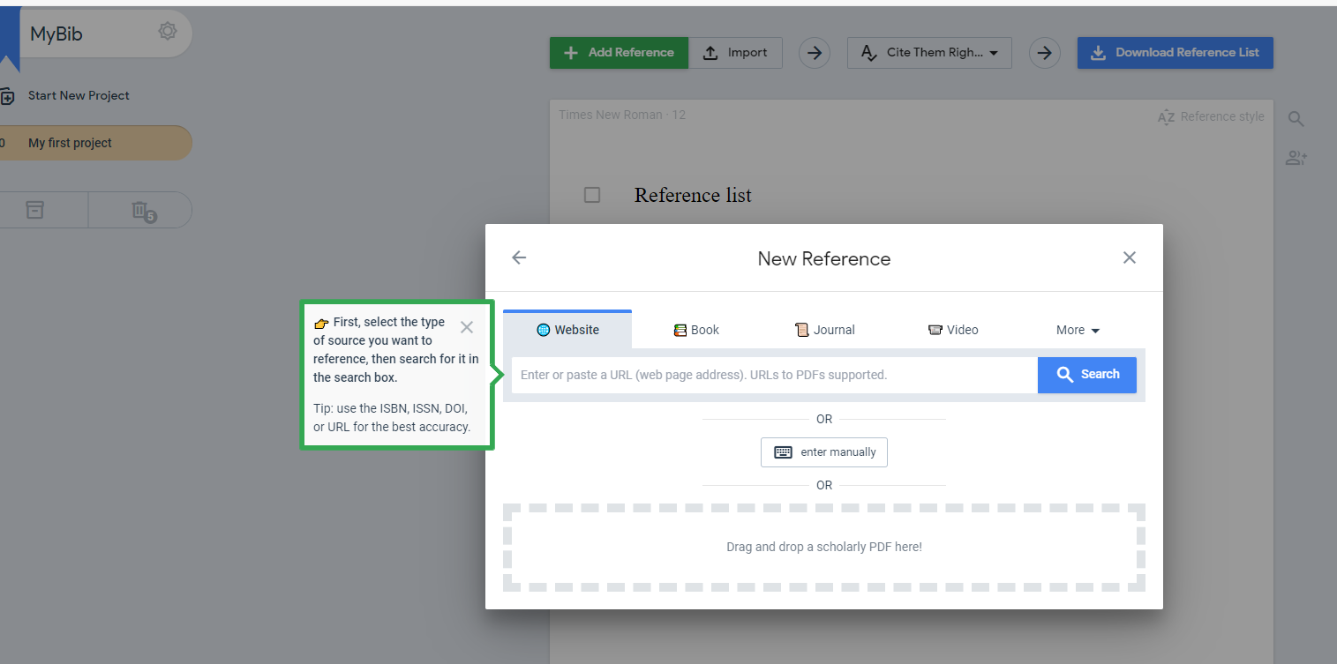
Other tools: MyBib
Access via MyBib.com
A free online reference manager.
Simple to use.
No sign-up required.
Hundreds of referencing styles available, including Cite Them Right.

Slide 28
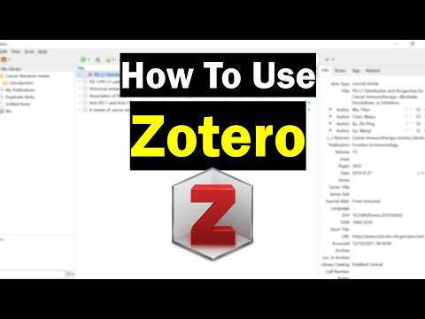
Other tools: Zotero
Access via Zotero.org
A free web browser extension tool run by a non-profit organisation.
Compatible with Word, Open Office and Google Docs.
Thousands of referencing styles available, including Cite Them Right.
Android and IOS compatible.
Video guides
Quick start guide
ZoteroBib
A simple online tool to help create a reference list using a title, URL, DOI or ISBN without creating an account.

Slide 29

Other tools: Mendeley
Access via Mendeley.com
A free desk-top based reference manager and academic social networking tool.
Extract data from imported PDFs
Allows collaboration with other researchers.
Highlight and annotate papers
Plug ins available to create in-text citations.
Beginners guide to Mendeley
YouTube Videos
Please note: We only provide support for EndNote Fusion and not any other tools!

Slide 30

Points to consider...
Does the software support the citation style(s) I need?
Can I edit the styles?
Does the software allow me to edit all the data fields I want?
Will I have enough space (or am I willing to pay)?
Can I install this software on the computers I use?
Which word processors does the software support?
Can I work on and off-line?
What sort of files can I import? (.ris, .bib etc.)
Can I easily export references from my favourite databases?
This work is licensed and adapted under a Creative Commons Attribution 4.0 International License. Attribution: Oxford University Bodleian Libraries

Slide 31

Citation Managers are useful for:
Collecting all the information from your reading in one place.
Quickly creating a large list of references in your preferred referencing format and style.
Helping to improve the accuracy of your references.
Sharing your references.

Slide 32

Limitations:
You will have to invest some time exploring and understanding your chosen tool.
Functionality or storage limitations may vary within the free options.
They do not always import the correct information; you must always check your references for accuracy.
They cannot extract references from existing publications.
No one tool works with every database.
This Photo by Unknown Author is licensed under CC BY-SA

Slide 33

Contact
Lisa Ellis: l.ellis@uwtsd.ac.uk
Library: library@uwtsd.ac.uk
Infoskills: infoskills@uwtsd.ac.uk
Source: Pixabay: image by Geralt
Notes:
Questions

