Slide 1
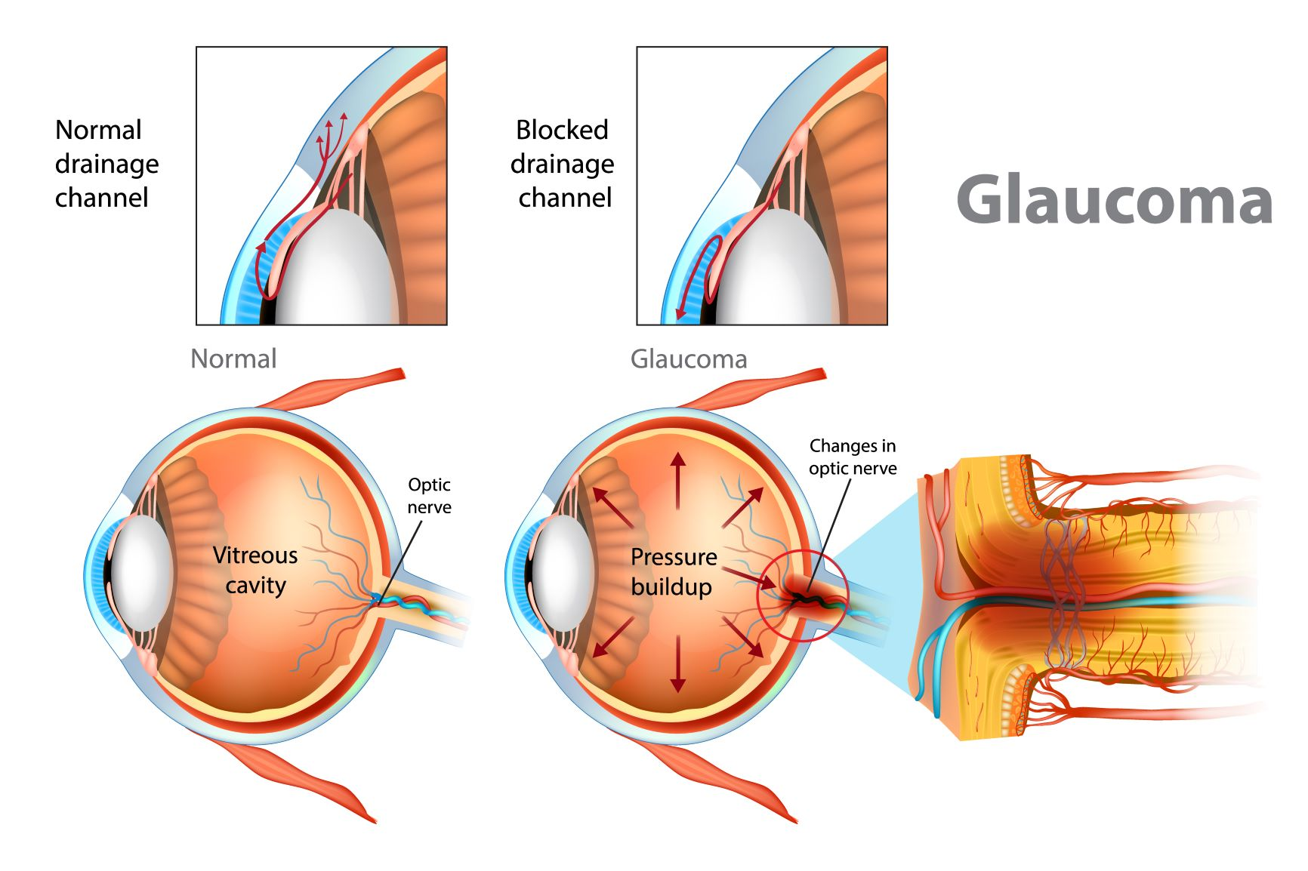
Exploring the Impact of Socioeconomic Factors and Health Literacy on Glaucoma
Medication Adherence in Adults Aged 60 and Over in the United Kingdom
Student: Rizwana
Student No: 2521764
Email: 2521764@student.uwtsd.ac.uk
Lecturer: Diola Bijhout
Programme: MSc Public Health & Social Care in Practice
LCHS7008 — Practice-Based Research · MSc Public Health and Social Care in Practice
PREVALENCE
RATIONALE
RESEARCH IMPACT
1,019,629
Adults, 60 years and older, are compounded vulnerabilities: they become less dextrous, experience polypharmacy, have a fixed income, and are literacy-impaired (Moore et al., 2023; Panagioti et al., 2018)
Low health literacy — the capacity to gain access to, comprehend and utilise health knowledge (Kickbusch et al., 2013) directly constraining medication self-management and raised dismissed appointments (Kang et al., 2022)
Socioeconomic deprivation can lead to financial barriers - poorer patients are much more prone to decrease or abandon treatment (Delavar et al., 2022)
Health inequality is exacerbated by ethnic minority adults experiencing elevated glaucoma prevalence and bigger socioeconomic obstacles to following treatment (Stein et al., 2021).
NICE NG81 (2022) mandates adherence monitoring but lacks specific guidance for socioeconomically disadvantaged or low-literacy older adults
While some studies identify health literacy as the primary barrier (Kang et al., 2022), others emphasise socioeconomic factors (Delavar et al., 2022) — no UK study has examined both in adults aged 60+, the critical gap this research addresses
FOR PATIENTS (60+)
Estimated UK adults aged 40+ currently living with glaucoma — nearly 50% higher than previously reported.
Projected to reach
1.6 million by 2060. Sources: Meliante et al. (2026); UCL (2026)
Enhanced adherence support will decrease the irreversible loss of visual impairment, increase the independence and quality of life of older glaucoma patients
FOR NHS SERVICES
111.8M
3.61M
2.2B
Evidence behind literacy sensitive interventions in NHS glaucoma clinics that can be implemented using NICE NG81 (2022) (Bott et al., 2024)
Projected global
cases by 2040
(Tham et al., 2014)
People blinded by glaucoma globally in 2020 (Vision Loss Expert Group, 2024)
People globally with vision impairment; glaucoma a major cause (WHO, 2023)
FOR POLICY & COMMISSIONERS
Reports to the NHS commissioning and health inequality strategies; promotes the Marmot principles of proportionate universalism (Marmot, 2020) to make glaucoma care equitable
Glaucoma is the leading cause of irreversible blindness worldwide (Stein et al., 2021)
In 2021, 5.34 million people aged 45+ globally were living with glaucoma; the burden was disproportionately higher in lower socioeconomic populations (Li et al., 2025)
Risk increases significantly with age — adults aged 60 and over represent the highest-burden group in the UK (Meliante et al., 2026)
The large number of undiagnosed glaucoma cases is attributable to the fact that the disease is mostly asymptomatic in the early stages (Stein et al., 2021)
By the time vision loss occurs, it is possible that up to 90% of optic nerve fibers are permanently damaged (NICE, 2022)
Socioeconomic deprivation is associated with higher disease burden as well as reduced treatment compliance (Li et al., 2025)
FOR HSC PROFESSIONALS
Provides clinicians and community health workers with evidence to provide customized education to low-literate and low-income older adults (Kang et al., 2022; Moore et al., 2023)
ETHICS & RESEARCH INTEGRITY (LO4)
No primary data collected — Ethical approvals from university will be needed in the analysis of secondary literature
PRISMA 2020 guidelines followed throughout for transparent reporting
Risk of bias assessed included studies determined with validated critical appraisal tools
Figure 1: Glaucoma diagram (Focus Eye Centre, 2026)
RESEARCH QUESTION, AIM & OBJECTIVES
REFERENCES
Sources: Meliante et al. (2026); UCL (2026)
“To what extent do socioeconomic factors and health literacy levels influence glaucoma medication adherence in adults aged 60 and over in the United Kingdom?”
Bott, D. et al. (2024) Ophthalmic and Physiological Optics, 44(1), pp.96–114.
Delavar, A. et al. (2022) JAMA Ophthalmology, 140(4), pp.354–361.
Focus Eye Centre (2026) Information about Glaucoma [online image]. Available at: https://www.focuseyecentre.co.uk/information-about-glaucoma/ (Accessed: 4 July 2026).
Kang, J.M. et al. (2022) Ophthalmology Glaucoma, 5(1), pp.26–31.
Kholdebarin, R. et al. (2008) Canadian Journal of Ophthalmology, 43(4), pp.454–461.
Kickbusch, I., Pelikan, J.M., Apfel, F. and Tsouros, A.D. (eds.) (2013) Health Literacy: The Solid Facts. Copenhagen: WHO Regional Office for Europe.
Li, X. et al. (2025) Frontiers in Public Health, 13, 1526061.
Marmot, M. (2020) 'Health equity in England: the Marmot review 10 years on', BMJ, 368, M693.
Meliante, L.A. et al. (2026) British Journal of Ophthalmology [Online ahead of print].
Moore, S.G. et al. (2023) Ophthalmology and Therapy, 12(6), pp.2863–2880.
National Institute for Health and Care Excellence (2022) Glaucoma: diagnosis and management. NG81. London: NICE. Available at: https://www.nice.org.uk/guidance/ng8 1 [Accessed: 25 June 2026].
Panagioti, M. et al. (2018) Quality of Life Research, 27(5), pp.1257–1268.
Salman, M. et al. (2020) American Journal of Ophthalmology, 216, pp.207–218.
Stein, J.D., Khawaja, A.P. and Weizer, J.S. (2021) JAMA, 325(2), pp.164–174.
Tham, Y.C. et al. (2014) Ophthalmology, 121(11), pp.2081–2090.
UCL (2026) Over 1 million estimated to have glaucoma in UK. UCL News, 21 Jan. Available at: https://www.ucl.ac.uk/news/2026/jan/ [Accessed: 27 June 2026].
Vision Loss Expert Group of the GBD Study (2024) Eye, 38(11), pp.2036–2046.
World Health Organization (2023) Blindness and vision impairment. Geneva: WHO. Available at: https://www.who.int/news-room/fact-sheets/detail/blindness-and-visual-impairment [Accessed: 30 June 2026].
MEDICATION NON-ADHERENCE
Suboptimal adherence also causes uncontrolled intraocular pressure and permanent sight impairment (Bott et al., 2024)
Poor drop technique, forgetfulness, and limited understanding are the most commonly reported barriers to adherence (Kholdebarin et al., 2008)
The non-adherence is severe in adults (60+) because of polypharmacy, lesser dexterity, and cognitive alterations (Moore et al., 2023)
Existing adherence interventions have had limited success — more patient-centred, evidence-based approaches are urgently needed (Bott et al., 2024)
Self-efficacy and social support are significant predictors of adherence outcomes in older glaucoma patients (Salman et al., 2020)
AIM: To conduct a systematic analysis of the literature on the role of socioeconomic issues and health literacy in influencing patients in managing glaucoma through adherence to medications.
To summarise available data on the impact of socioeconomic variables (income, education, deprivation) in predicting glaucoma medication adherence among UK adults aged 60 and above
1
To critically assess evidence on the role of health literacy in the self-management of treatment of adults with glaucoma aged 60+
2
3
To understand socioeconomically disadvantaged older adults in the UK with glaucoma, to address existing barriers and facilitators to adherence
To investigate NHS glaucoma service implications and health inequality policy implications to adults (60+)
4
LCHS7008 — Practice-Based Research · MSc Public Health and Social Care in Practice · 2026

