Slide 1
BA (HONS) MANAGEMENT AND LEADERSHIP – SKILLS FOR THE WORKPLACE
Managing Projects in the Workplace
BMSW 5104
Isaiah Oino
Cioranu Daniela Alina

Slide 2
In Stoke on Trent, the demand for nurseries is always high. In this city there are 120,900 people in employment and 61,000 children (Labour Market Profile - Nomis - Official Labour Market Statistics, 2021). Each working parent rely on a nursery to take care of its child/children while working. The average amount of fee that parents are paying to the nursery is around £750 per child, per month (Leohart, 2021) if they do not qualify for free hours that are offered by the government. When a child turns out 3 years, can access 15 or 30 free nursery hours (GOV UK, 2021).
This project management plan is for Rainbow Nursery that will provide 40 places for 0 to 5 years old kids. The Nursery will focus on middle working class families and on families that are entitled for benefits from the government. Moreover the nursery will provide a new program called “time to talk, time to listen” in order to motivate children to speck faster or, for the ones that may show any difficulties to help them learn to speak or listen.

Slide 3
Quad Chart
Is it used to describe an invention on a simply manner, briefly pointing what is the purpose of the invention, who will benefit from it, what is the desired result and what are the outcomes (Keenan, 2020).
Purpose:
Develop each child independence, development of friendship and sharing, create a fun and safe environment for the kids, develop their skills, language, imagination, etc.
Customers:
Children: friendship, learning and development, learning benefits, smooth transfer to school.
Parents: new location that for some is just around the corner, opportunity to choose from different nurseries, support.
Business: providing new jobs for the people, helping the infrastructure of the city, develop.

Slide 4
Desired end result:
Children that finish our preschool classes are ready for school and they have the discipline that they require when they are transferred from nursery to school.
Measures of success:
Positive feedback from the parents.
All the children has been approved to schools with no problem and they had no difficulties in adapting with the new requirements.
Our nursery will be located in the heart of Stoke on Trent, Stoke, on London Road in a beautiful Victorian building.
The main aim of Rainbow Nursery is to provide a safe environment where children can enjoy themselves, building friendships and experience a large varieties of learning activities. We offer to the children the opportunity to spend their day inside or outside where we prepared special areas for them to experience new games on different type of wheatear.

Slide 5
Stakeholder Analysis
A stakeholder of a company is represented by an individual or a group of individuals that can affect in any way that company, or the other way around, the individual or the group of individuals will be affected by that company (Brock, 2021).
STAKEHOLDER | INTEREST | IMPORTANCE | INFLUENCE
Parents | High | High | High
Childs | High | High | High
Administrators | Medium | Medium | Medium
Teachers | High | High | High
Kitchen Staff | Medium | Medium | Low
Maintenance team | Medium | Medium | Low

Slide 6
Work Breakdown Structure WBS
The nursery will provide full time and part time jobs, plus, the nursery will accept volunteers who want to develop a career working with kids. All staff will be trained in various speech and language programmes, attend regularly courses for training and development and they will be trained as first aid staff as well.
Managing Director
Deputy Manager
3 Teachers
level 3 qualified
full time
2 Teachers
up to level 2 qualified
full time
2 Teachers
up to level 2 qualified
part time
2 part time cooks
1 cleaner
1 maintenence

Slide 7
Cost/ Resources
Rainbow nursery will have a capacity for 40 children at once, but, before starting, some reparations needs to be done:
Nappy change area together with toilets (4): £8K
Patio doors for garden and entrance in the building: £3K
Kitchen repairs: $5K
Fence for all the play areas: £4K
Fixing the play area surface and building play area: £5K
Total cost for the building: £25K
Uniform cost, marketing and advertising, other cost: £15K
Essential equipment: £40K
Extra equipment: £10K
Total cost for everything to be in place: $90k
Some of the children places will be funded by the government, but the nursery offer the possibility to parents to pay for their children place. The average is around £950 per month for each child (Breathnach, 2019). The nursery require that the fee to be paid in advance.

Slide 8
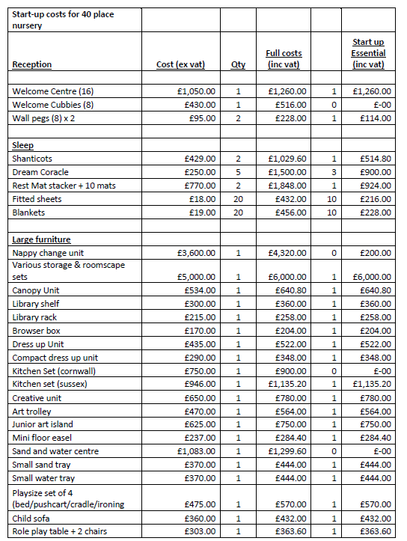
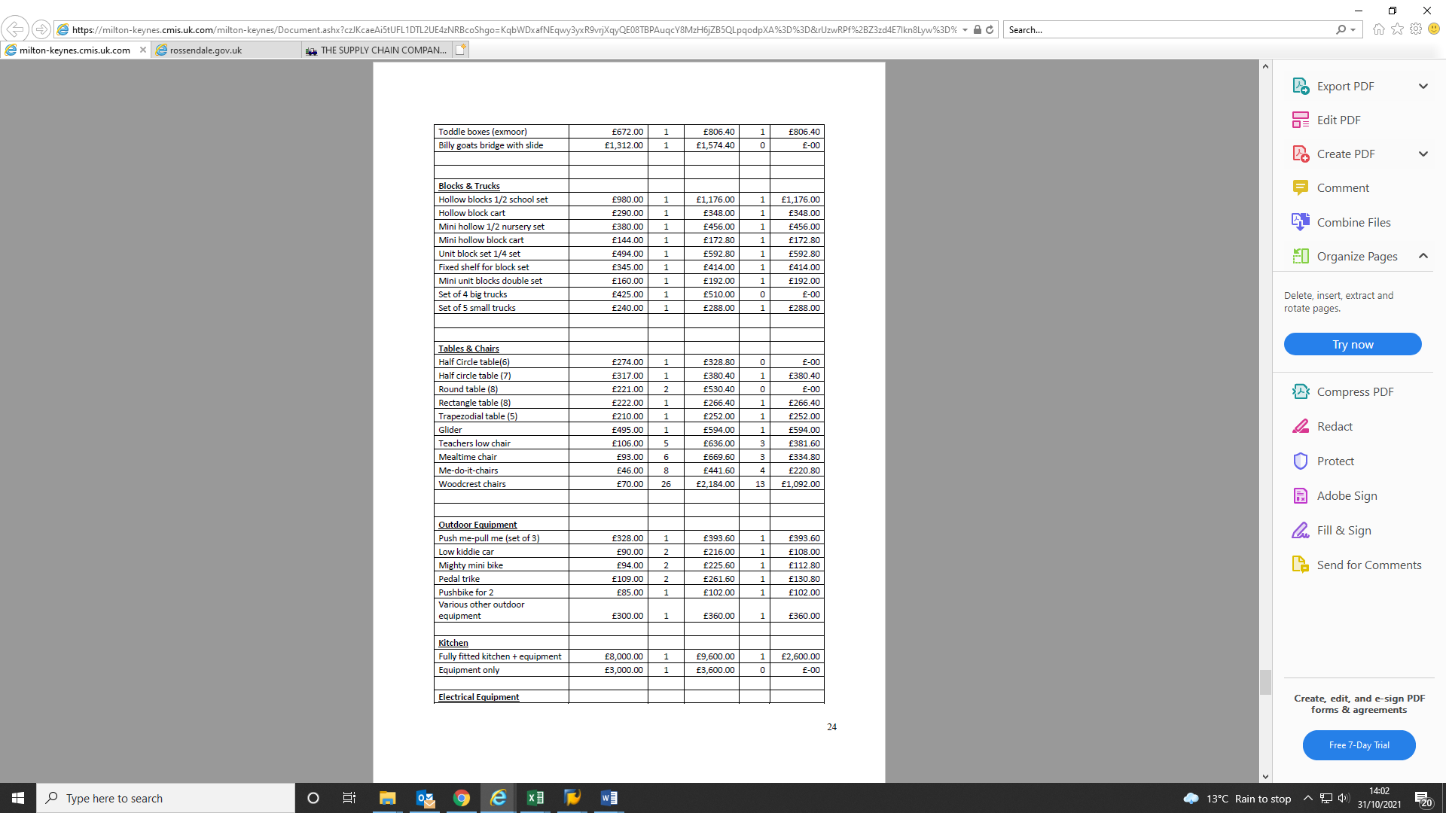

Slide 9
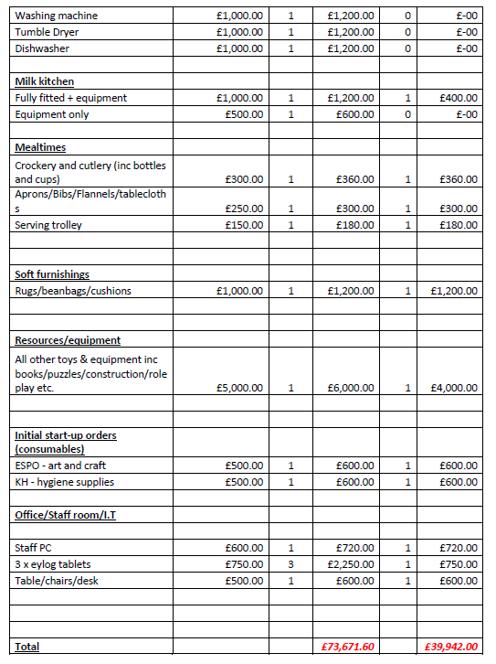
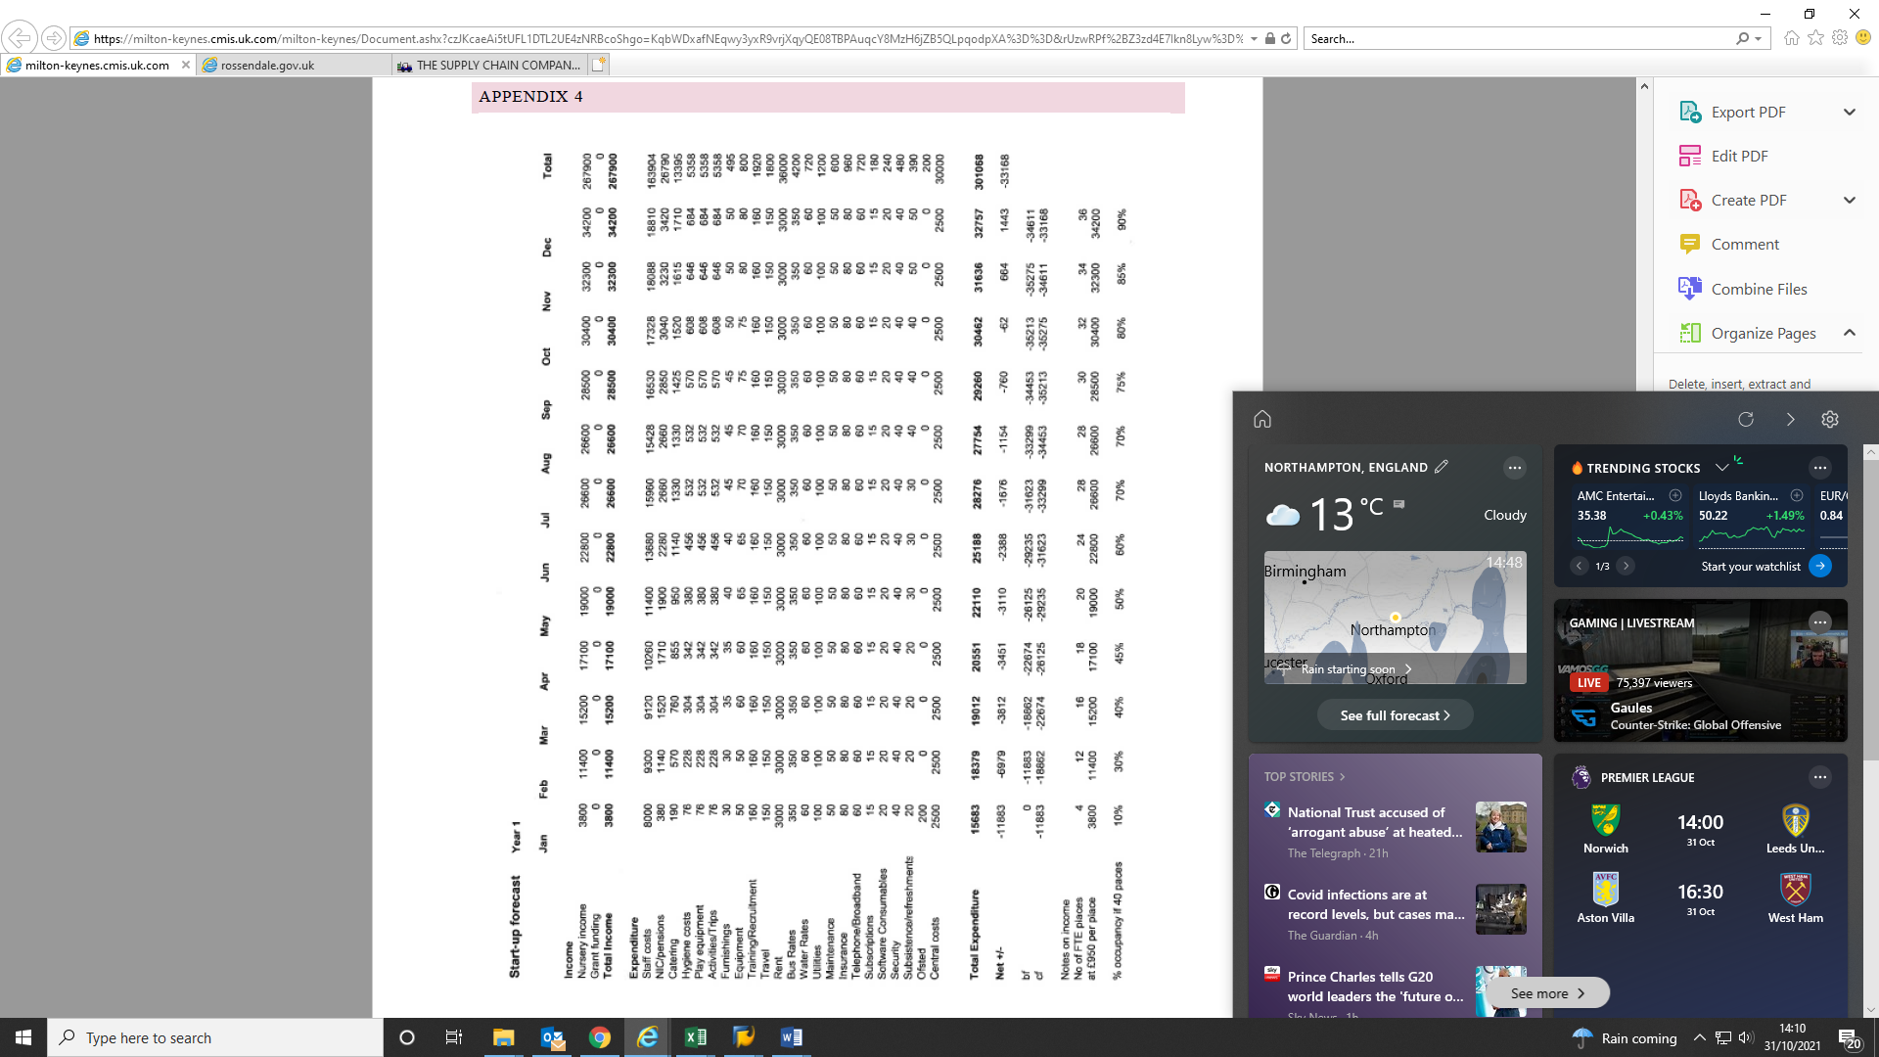

Slide 10
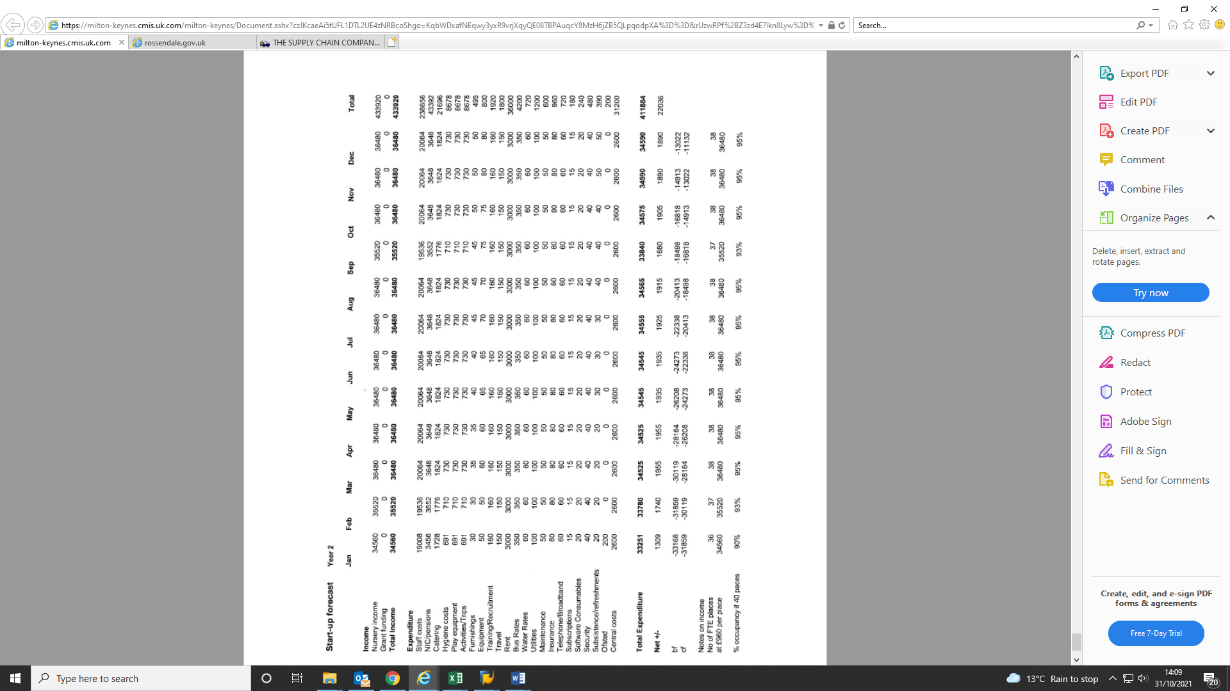
In the forecast cash flow is represented how the increase in occupancy will grow to 80% with a break even at 75%. The nursery is prepared to run the first year with a loss of £33K (based of previous experience), completing year two with a surplus and in year three to eliminate the deficit completely. To total initial investment of £40K is planned to be recouped by the end of year five.
Gantt Chart
A Gantt chart represent a graphic understanding and description of a project. Its showing the start and the finish dates for a task that need to be completed in that project (Grant, 2021).
Before the nursery can open its doors and start receiving children in care, there are some task that need to be completed in order to assure that everything is working, safe and at our standards. Below is a Gantt chart with all the processes that the nursery needs to complete before its big inauguration.

Slide 11
Task | Year 1 |  |  |  |  |  |  |  |  |  |  |  | Year 2
 | 1 | 2 | 3 | 4 | 5 | 6 | 7 | 8 | 9 | 10 | 11 | 12
Rental and space arrangement
Purchase of furniture and equipment
Transport and fitting of the furniture and equipment
Utility connection
Staff recruitment and employment
Technological test
Draft, Approvals
Nursery inauguration
Risk assessment
A Risk assessment is an important key in a company. Its role is to protect that company from potential harm on its employees, customers. By regularly complete a risk assessment each company is focused on the measures that they have in place to protect their staff and to keep digging for new ones (Rausand, 2013).
In the risk assessment should be presented the possible problem, what actions are applied to prevent that problem, future actions (if there are any), who is the person that need to take and apply the actions and when (Rausand, 2013).
A detailed risk assessment for Rainbow Nursery is presented below.
The director is putting lots of pressure on its employees to check and respect everything that is presented in that report with the aim of keeping everyone inside the nursery happy and save.

Slide 12
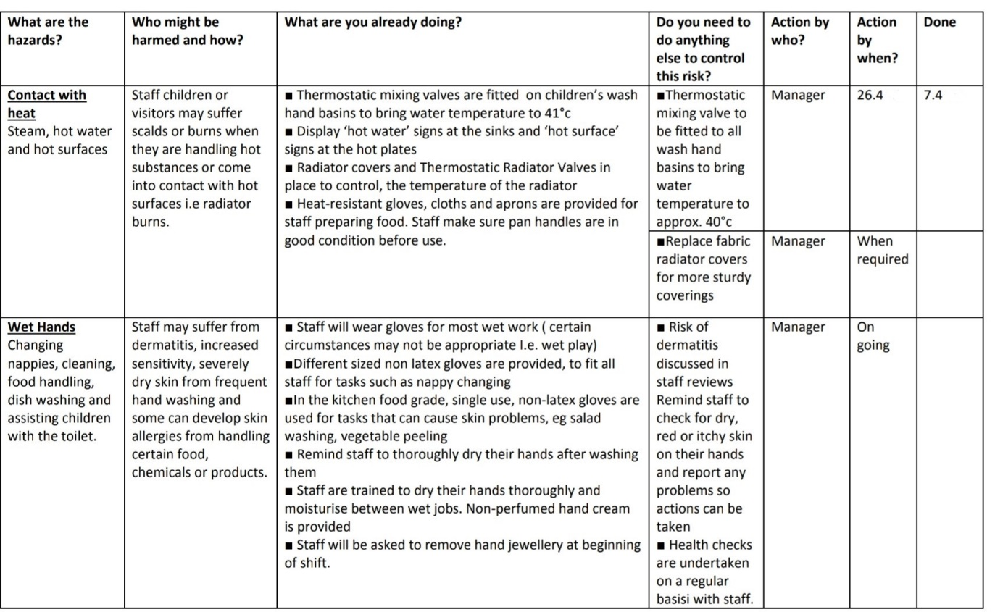
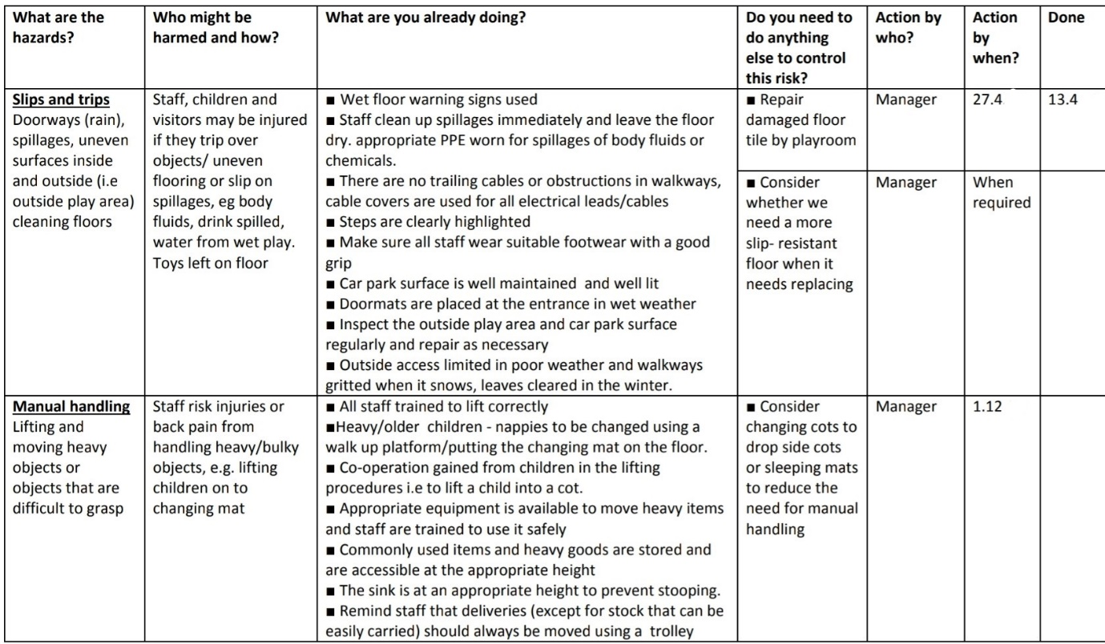
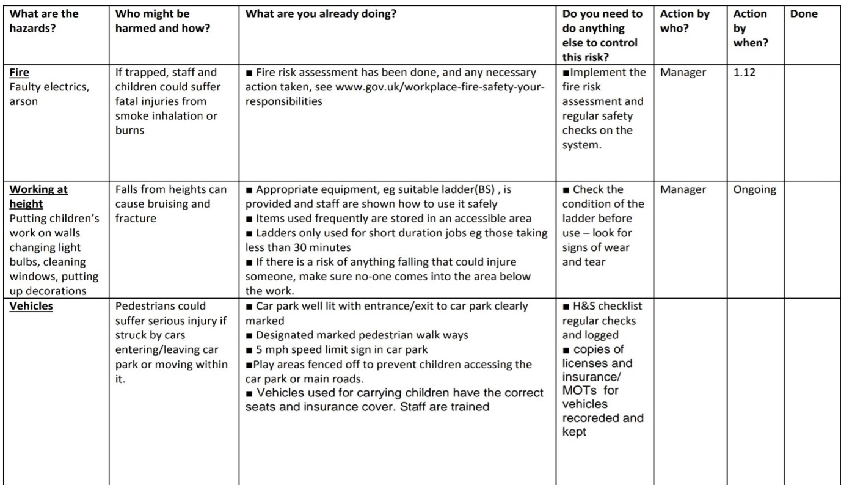
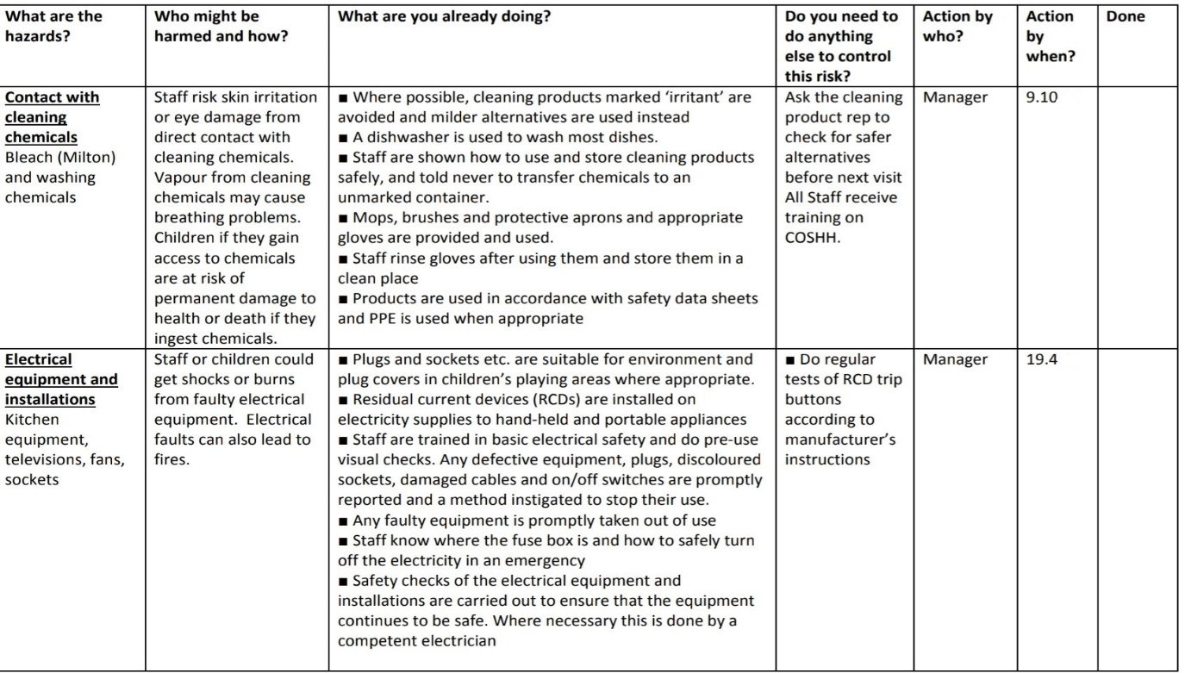

Slide 13
Pestle Analysis
When an individual decide that wants to open a business, the type of market he/she wants to join should be analysed just to make sure that the company will not become bankrupt. Pestle analysis provide an internal and an external analyse for six important factors that influence that business (Perera, 2017).
Political factors
Before the nursery will be open, different certifications and clearances need to be approved. In UK there are numerous agencies that help you obtain these documents, fact that help the nursery to get them faster. On the other hand, UK is not a very political stable country because in the last ten years they had about three different prime minister and three different elections. Also, from a political point of view, the nursery will not be under any danger because the level of corruption or the risk of military invasion, are both very low (Transparency International UK, 2021). The current minimum salary in UK since April 2021 is £9.41/hour and our nursery will pay at the beginning the same amount. Depends on the circumstances and on the nursery occupation the salary will increase (GOV.UK: National Minimum Wage, 2021). Until April 2022 the corporation tax will increase with 6% (from 25% to 31%) and the personal allowance will become £12.570/ year, also, from April 2023 a profit rate that will affect all business will be introduced. If the company profit is £50.000 or less/ year, that company will have to pay 19% from the profit, while a company that is making profit more than £50.000 until £250.000 will pay 25% of the profit (GOV.UK: Budget, 2021). Rainbow nursery will pay 19% in the beginning.

Slide 14
Economic factors
From June to August 2021, the unemployment rate decreased by 0.4 percentage points, to 4.5%, moreover, the employment rate increased with 0.5 percentage points, to 75.3% (ONS, 2021) which will have a great impact on our nursery. The more parents start a job, the more children we will have in our care. In 2021 the inflation rate went up to 1.6% from 1.09% in 2020, fact that forced all the companies to increase their prices (Binns, 2021).
Social factors
In UK there are at the moment 68,385,839 population, Saturday 27 November. Stoke on Trent is number thirteen with 372.264 people and 17.6% of this amount are between age 0 – 14, children that are in need of free spaces in nurseries and schools (ONS, 2021).
Another important social factor that will be implemented in our nursery is that no discrimination will be permitted. In UK there are about 6.2 million non-British people (Sturge, 2021) with children in all areas. They have different values, religion so the nursery will implement a set of moral principles to respect and support each other.
Technological factors
Technology is evolving very vast so the nursery will need to adapt as well. Rainbow nursery will deliver information through email, ask parents for feedback through different electronic surveys and also, a group chat will be created on Class Dojo, group that will allow parents to check what their children were doing during the day, what activities they practiced.

Slide 15
Environmental factors
UK is a very productive country on every market that can possibly exist. Around £20 billion are spend each ear because of the air and water pollution (Environmental Protection UK, 2021), fact that need to be resolved. In the nursery the equipment will be, as much as we can, electronic, to help with pollution. The meals will be cocked in our kitchen, so we will eliminate the packaging that is received when you collaborate with catering business and the children will not use plastic plates.
The weather is not always friendly in this country so the nursery will put in place lots of activities for indoor space, activities that can be moved to the next day or week if the weather allows us to spend time outside.
Legal factors
Our nursery will obey employment law and data protection exactly, so the nursery will not have to worry about being sued. Every children, parent, employee or stakeholder will be protected from discrimination with The Equality Act 2010 that will be put in place (GOV.UK: Discrimination, 2021).
Because at Rainbow Nursery the main concern is to keep everybody safe, most importantly because we will have a great deal of small children around, the Health and Safety at Work Act 1974 will be respected (GOV. UK : Health and Safety at Work, 2021).
Every time the nursery will plan an outside nursery trip, the parents will be informed and they will be asked to sign for their agreement, moreover, each day the children come and go from the nursery they will be checked for injuries or bumps.

Slide 16
Rainbow Nursery will be a great nursery that every children will love spending time over there. The prices of the nursery is between its competitors but they offer lots of spaces, fact that will bring to Rainbow Nursery great profit. When children have their holidays (Easter, Christmas, between terms or national holidays) the nursery will provide to parents the opportunity to pay extra so their children can attend at nursery. Not every employer understands or have the possibility to offer holiday to their parent every time they get time off from nursery.
Because in around five years the nursery will show potentially profit, my recommendation is for this project to start as soon as possible.

Slide 17
Binns, K., 2021. When will interest rates rise? - Times Money Mentor. [Online] Times Money Mentor. Available at: <https://www.thetimes.co.uk/money-mentor/article/interest-rates-rise/> [Accessed 30 May 2021].
Breathnach, T., 2019. How much do nurseries, nannies and childminders cost? [Online] Made For Mums. Available at: <https://www.madeformums.com/toddler-and-preschool/cost-of-nurseries-nannies-and-childminders/> [Accessed 31 October 2021].
Brock, T., 2021. Learn What Stakeholders Are and the Roles That They Play. [Online] Investopedia. Available at: <https://www.investopedia.com/terms/s/stakeholder.asp> [Accessed 31 October 2021].
Environmental Protection UK. 2021. Air Pollution Laws - Environmental Protection UK. [Online] Available at: <https://www.environmental-protection.org.uk/policy-areas/air-quality/air-pollution-law-and-policy/air-pollution-laws/> [Accessed 30 May 2021].
GOV.UK. 2021. Help paying for childcare. [Online] Available at: <https://www.gov.uk/help-with-childcare-costs/free-childcare-and-education-for-2-to-4-year-olds> [Accessed 10 October 2021].
GOV.UK. 2021. Budget 2021: Overview of tax legislation and rates (OOTLAR). [Online] Available at: <https://www.gov.uk/government/publications/budget-2021-overview-of-tax-legislation-and-rates-ootlar/budget-2021-overview-of-tax-legislation-and-rates-ootlar> [Accessed 30 May 2021].
GOV.UK. 2021. Discrimination: your rights. [Online] Available at: <https://www.gov.uk/discrimination-your-rights> [Accessed 30 May 2021].
GOV.UK. 2021. Health and Safety at Work etc Act 1974 – legislation explained. [Online] Available at: <https://www.hse.gov.uk/legislation/hswa.htm> [Accessed 30 May 2021].
GOV.UK. 2021. The National Minimum Wage in 2021. [Online] Available at: <https://www.gov.uk/government/publications/the-national-minimum-wage-in-2021> [Accessed 30 May 2021].
Grant, M., 2021. Gantt chart. [Online] Investopedia. Available at: <https://www.investopedia.com/terms/g/gantt-chart.asp> [Accessed 3 November 2021].

Slide 18
Keenan, R., 2020. A brief intro to Quad (rant) charts » Positioning Insights. [Online] Positioning Insights. Available at: <https://positioninginsights.com.au/quad-charts/> [Accessed 31 October 2021].
Leohart, M., 2021. Parents spend an average of $8,355 per child to secure year-round child care. [Online] Make IT. Available at: <https://www.cnbc.com/2021/05/19/what-parents-spend-annually-on-child-care-costs-in-2021.html> [Accessed 10 October 2021].
Nomisweb.co.uk. 2021. Labour Market Profile - Nomis - Official Labour Market Statistics. [Online] Available at: <http://www.nomisweb.co.uk/reports/lmp/la/1946157171/report.aspx#tabempunemp> [Accessed 10 October 2021].
ONS. 2021. Labour market overview, UK - Office for National Statistics. Available at: https://www.ons.gov.uk/employmentandlabourmarket/peopleinwork/employmentandemployeetypes/bulletins/uklabourmarket/october2021> [Accessed 28 November 2021].
Perera, R., 2017. The PESTLE analysis. Nerdynaut. [Online] Available at: <https://scholar.google.com/scholar?hl=en&as_sdt=0%2C5&q=pestle+analysis&oq=pestle+a> [Accessed 30 May 2021].
Rausand, M., 2013. Risk assessment: theory, methods, and applications (Vol. 115). John Wiley & Sons. Available at: https://scholar.google.com/scholar?hl=en&as_sdt=0%2C5&q=Risk+assessment+&btnG= [Accessed 31 October 2021].
Sturge, G., 2021. Migration Statistics. [Online] House of Commons Library. Available at: <https://commonslibrary.parliament.uk/research-briefings/sn06077/#:~:text=There%20are%20fewer%20foreign%20nationals, people%20who%20were%20born%20abroad.> [Accessed 28 November 2021].
Transparency International UK. 2021. Corruption and the UK. [Online] Available at: <https://www.transparency.org.uk/corruption-and-uk> [Accessed 30 May 2021].

