Slide 1
Module Name : Electronics II
Module Code : ACDA6001
Topic : FPGA
Lecture : 17
Lecture By,
Mrs. Jenifer Prince Devaraj,
Lecturer - Embedded Electronics,
Faculty of Applied Computing,
UWTSD
Email:j.prince-devaraj@uwtsd.ac.uk

Slide 2
FPGA
Field Programmable Gate Arrays
A field-programmable gate array (FPGA) is a programmable logic device that supports implementation of relatively large logic circuits.
FPGAs can be used to implement logic circuits of more than a million equivalent gates in size.
  Some examples of commercial FPGA products, from Altera and Xilinx.
UWTSD Lectures / ACDA6001 – Electronics 2

Slide 3
Why FPGA ?
Field Programmable Gate Arrays
  Improved density relative to discrete SSI/MSI components (within around 10x of custom ICs)
  With the aid of computer aided design (CAD) tools circuits could be implemented in a short amount of time (no physical layout process, no mask making, no IC manufacturing)
    - lowers NREs
    - shortens TTM
UWTSD Lectures / ACDA6001 – Electronics 2

Slide 4
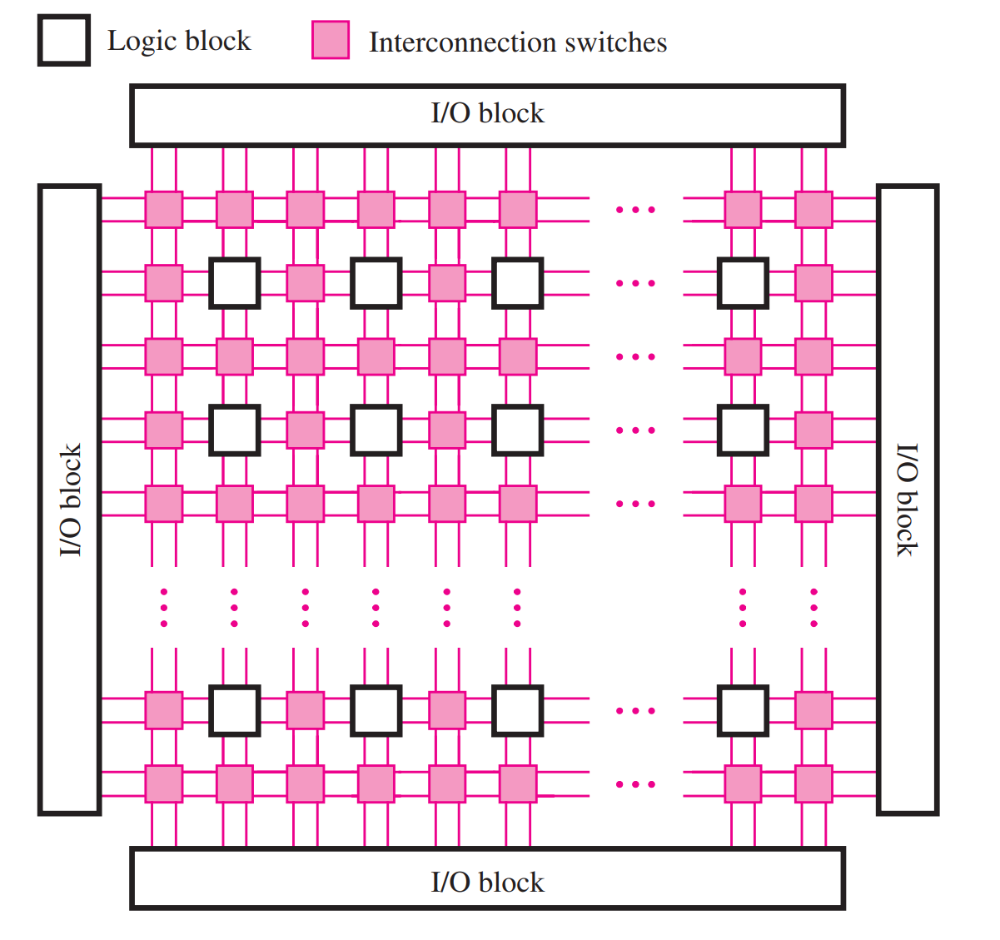
General Structure of FPGA
Field Programmable Gate Arrays
FPGA contains three main types of resources:
I/O Blocks
Logic Blocks
Interconnection Switches
UWTSD Lectures / ACDA6001 – Electronics 2

Slide 5
Structure of FPGA
Field Programmable Gate Arrays
I/O Blocks - for connecting to the pins of the package.
Logic Blocks - arranged in an array.
Interconnection Switches - organized as horizontal and vertical routing channels between rows and columns of logic blocks.
  - The routing channels contain wires and programmable switches that allow the logic blocks to be interconnected in many ways.
UWTSD Lectures / ACDA6001 – Electronics 2

Slide 6
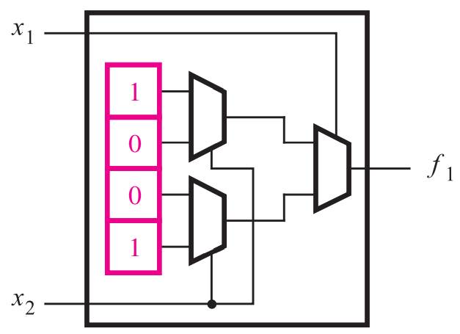
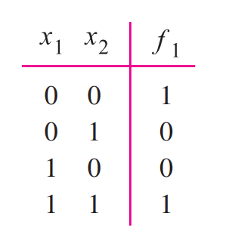
Look Up Tables (LUT)
Field Programmable Gate Arrays
The most used logic block is a lookup table (LUT), which contains storage cells that are used to implement a small logic function.
Each cell can hold a single logic value, either 0 or 1.
The stored value is produced as the output of the storage cell.
Figure : Two Input LUT’s
UWTSD Lectures / ACDA6001 – Electronics 2

Slide 7
Field Programmable Gate Arrays
Look Up Tables (LUT) – Construction and Operation
It has two inputs, x1 and x2, and one output, f .
It can implement any logic function of two variables.
a two-variable truth table has four rows, this LUT has four storage cells.
One cell corresponds to the output value in each row of the truth table.
The input variables x1 and x2 are used as the select inputs of three multiplexers, which, depending on the valuation of x1 and x2, select the content of one of the four storage cells as the output of the LUT.
UWTSD Lectures / ACDA6001 – Electronics 2

Slide 8
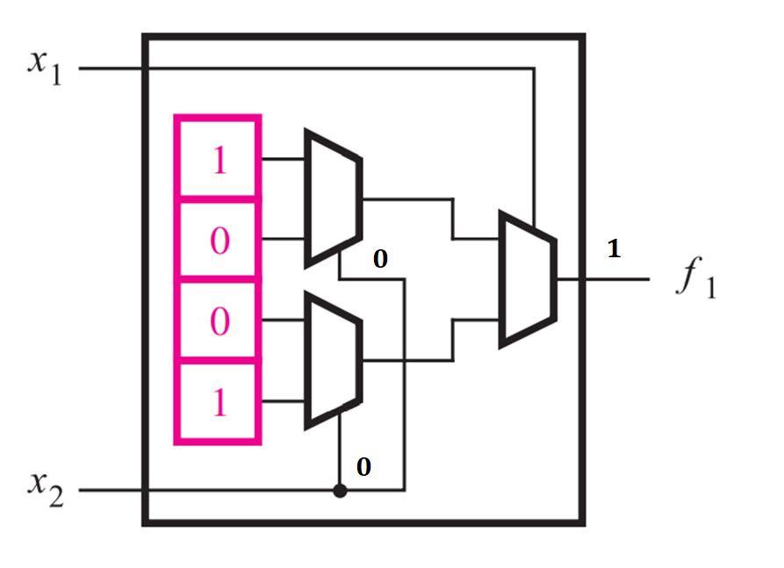
Field Programmable Gate Arrays
Look Up Tables (LUT) – Construction and Operation
When x1 = x2 = 0, the output of the LUT is driven by the top storage cell, which represents the entry in the truth table for x1x2 = 00.
Similarly, for all valuations of x1 and x2, the logic value stored in the storage cell corresponding to the entry in the truth table chosen by the valuation appears on the LUT output.
UWTSD Lectures / ACDA6001 – Electronics 2

Slide 9
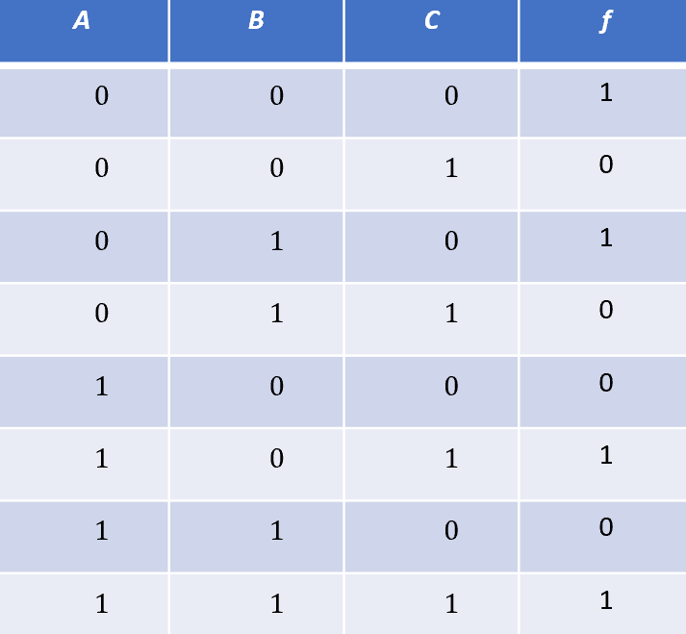
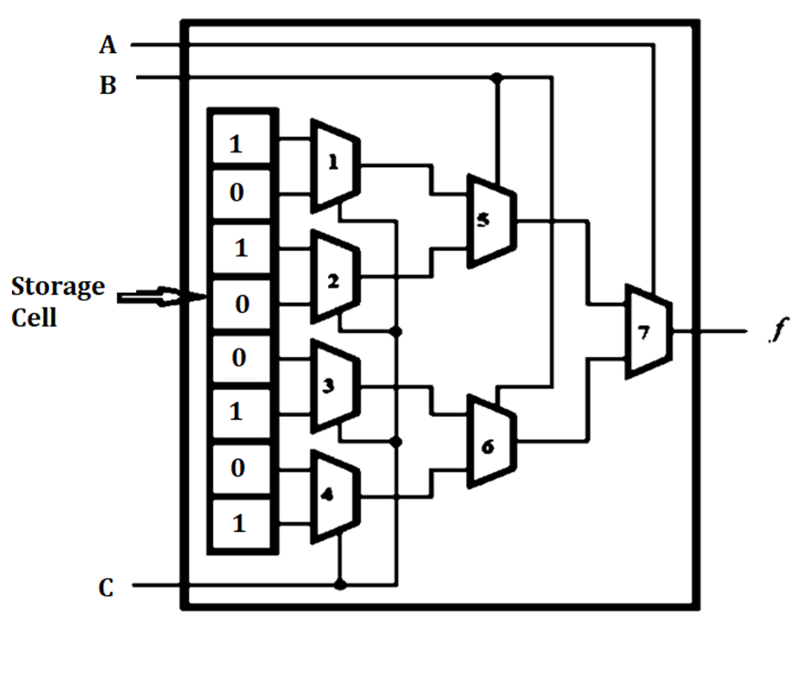
Field Programmable Gate Arrays
Look Up Tables (LUT)
Example of a 3 – input LUT
Determine the bits to be stored in its storage cell by using the function $f = \overline{A}\overline{B}\overline{C}+\overline{A}B\overline{C}+AC$
$f = \overline{A}\overline{B}\overline{C}+\overline{A}B\overline{C}+AC(\overline{B}$+B)
Truth Table
f$=\overline{A}\overline{B}\overline{C}+\overline{A}B\overline{C}+A\overline{B}C$+ABC
UWTSD Lectures / ACDA6001 – Electronics 2

Slide 10
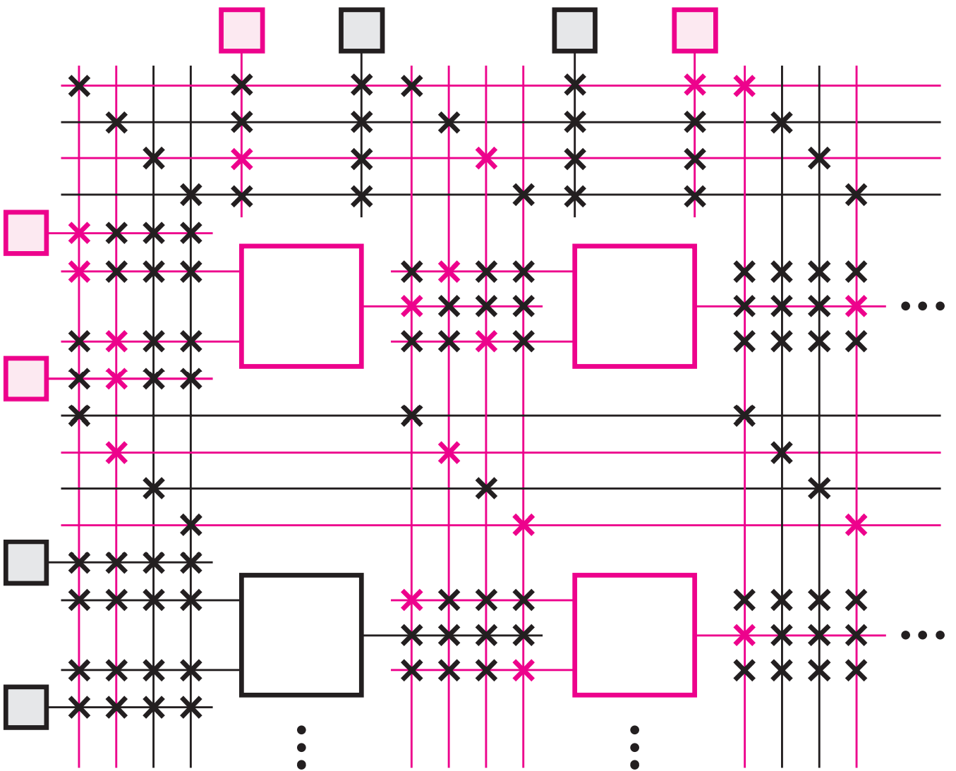
Field Programmable Gate Arrays
Programming FPGA
When a circuit is implemented in an FPGA, the logic blocks are programmed to realize the necessary functions and the routing channels are programmed to make the required interconnections between logic blocks.
The storage cells in the LUTs in an FPGA are volatile, which means that they lose their stored contents whenever the power supply for the chip is turned off. Hence the FPGA must be programmed every time power is applied.
UWTSD Lectures / ACDA6001 – Electronics 2

Slide 11
Field Programmable Gate Arrays
Programming FPGA
Often a small memory chip that holds its data permanently, called a programmable read-only memory (PROM), is included on the circuit board that houses the FPGA.
The storage cells in the FPGA are loaded automatically from the PROM when power is applied to the chips.
UWTSD Lectures / ACDA6001 – Electronics 2

Slide 12
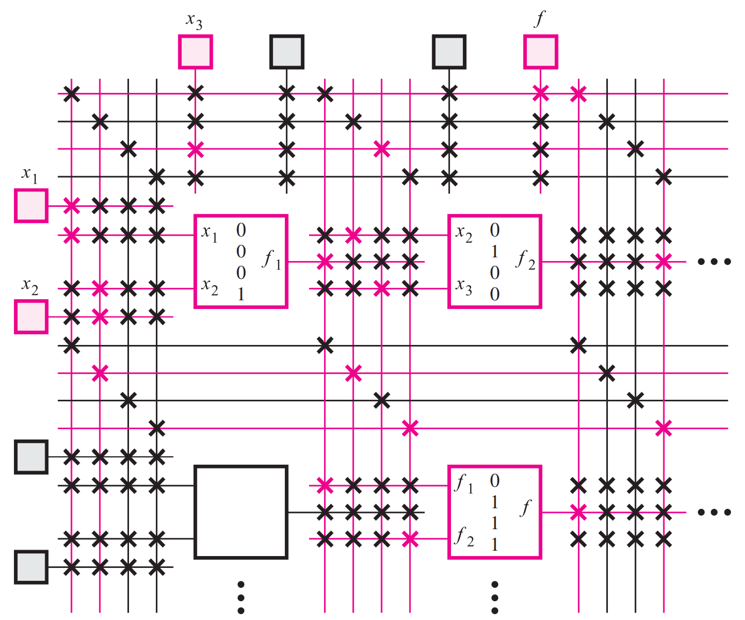
Field Programmable Gate Arrays
Programming FPGA
Program FPGA for the functions $f= f_{1}$+ $f_{2}$ by Considering ${ f}_{1}= x_{1}x_{2} andf_{2}= {\overline{x}}_{2}x_{3}$
The FPGA has two-input LUTs, and there are four wires in each routing channel.
Programmable wiring switches are indicated by an ‘X’. Each switch shown in pink is turned on and makes a connection between a horizontal and vertical wire.
UWTSD Lectures / ACDA6001 – Electronics 2

Slide 13
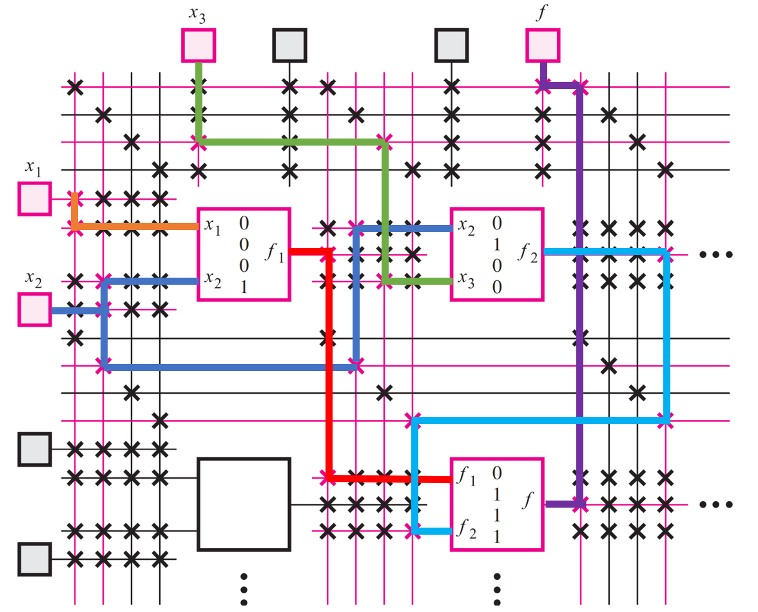
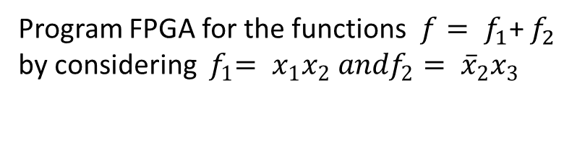
Field Programmable Gate Arrays
Programming FPGA
Program FPGA for the functions $f= f_{1}$+ $f_{2}$ by considering ${ f}_{1}= x_{1}x_{2} andf_{2}= {\overline{x}}_{2}x_{3}$
UWTSD Lectures / ACDA6001 – Electronics 2

Slide 14
Thank you

