Slide 1
Niche Tourism
EUROPEAN TOURISM FIELD STUDIES

Slide 2
NICHE TOURISM MARKETS
Counterpoint to Mass Tourism
Mass – Large Scale & Packaged – One fits all approach
Part of Niche Marketing
Democratisation of Tourism
Distinguish & Differntiate
Tourism Market
Needs
Macro / Micro

Slide 3
NICHE MARKETS
MACRO
SPECIAL INTEREST TOURISM
TRADITIONAL & CULTURAL BASED TOURISM
ACTIVITY BASED TOURISM
MICRO
IMPACTS OF TECHNOLOGY
IMPACTS OF TRAVEL DEVELOPMENT
IMPACTS OF MEDIA & SOCIAL MEDIA

Slide 4
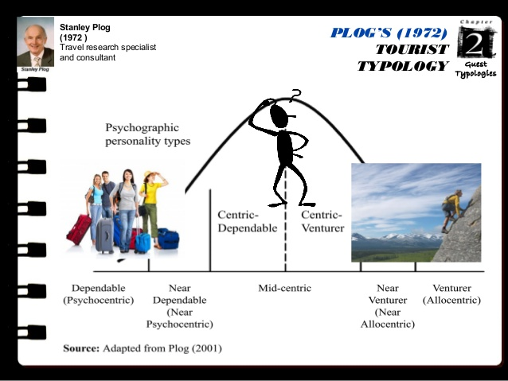
PLOG’S TOURIST TYPLOLOGY

Slide 5
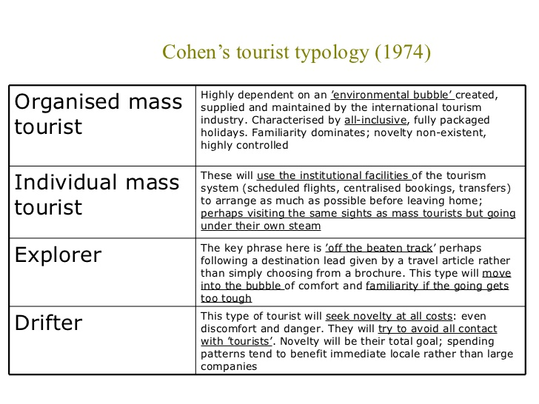
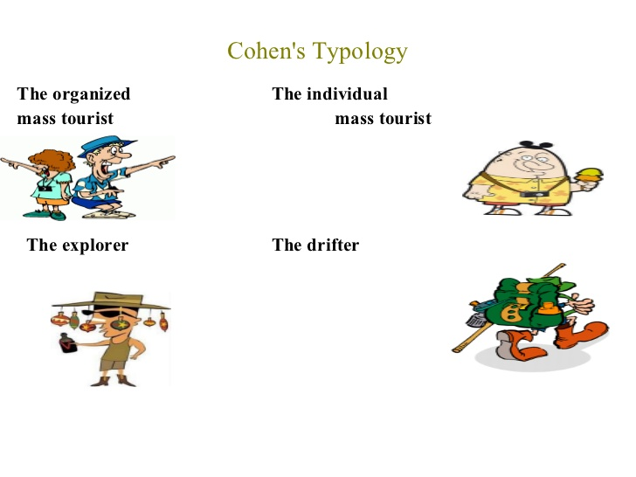
COHEN’S TOURIST TYPOLOGY

Slide 6
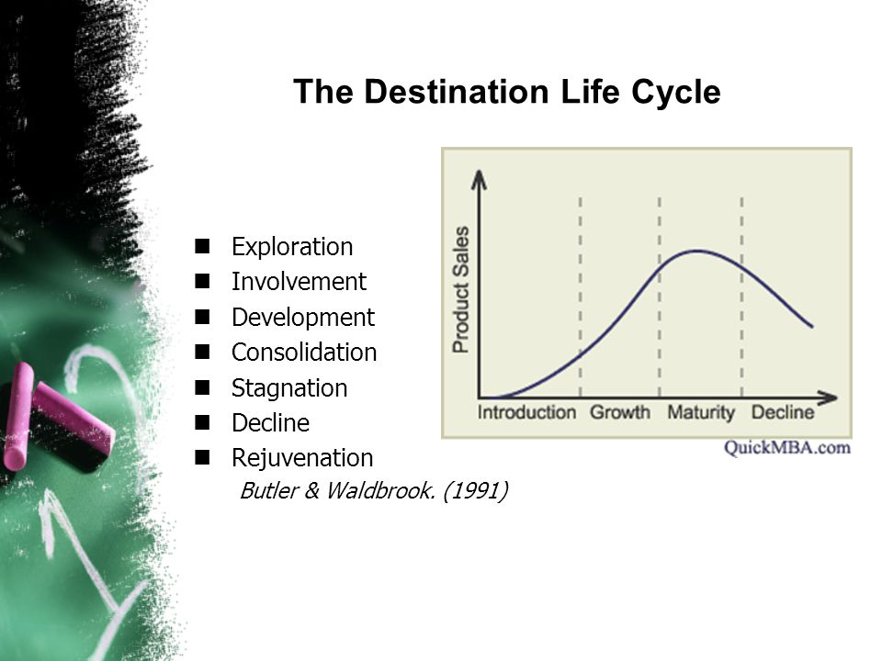
BUTLER’S TOURISM DESTINATION LIFECYCLE

Slide 7
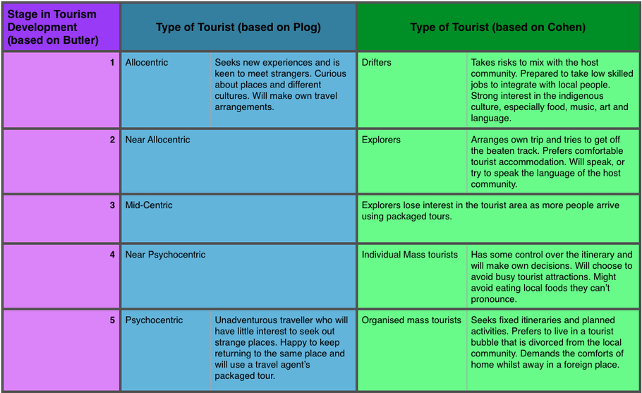
TOURISM DESTINATION DEVELOPEMENT

Slide 8
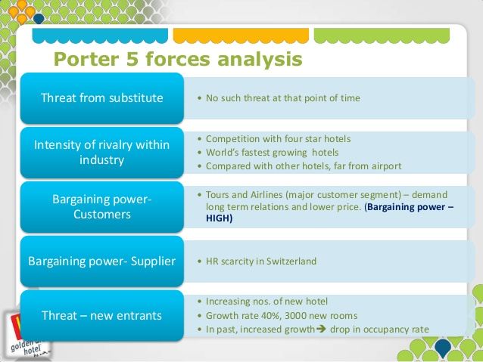
Porter’s 5 Forces of Competition

