Slide 1
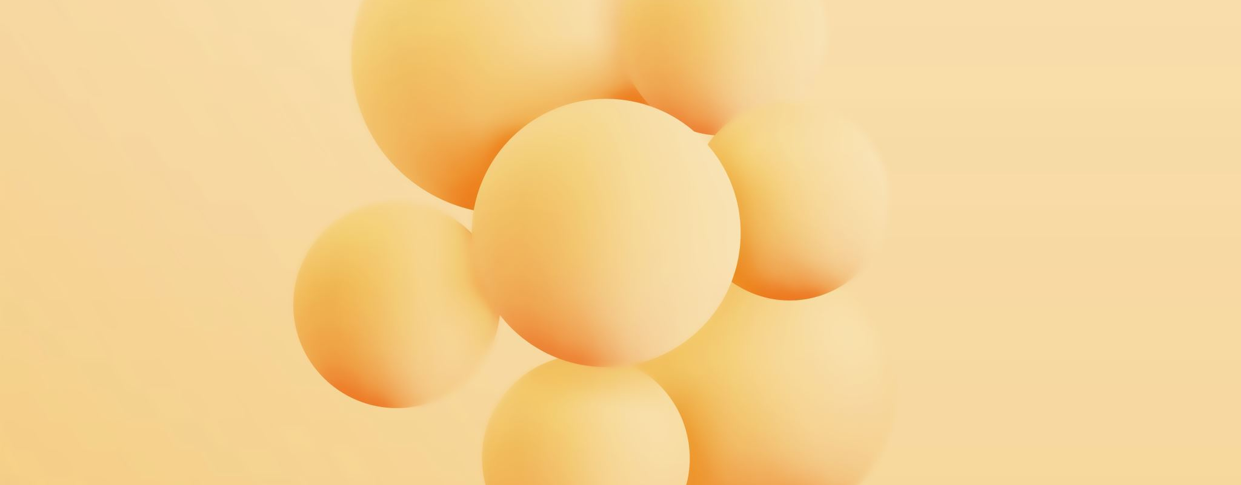
Leading Change Through Relationships
Building Influence, Resilience and Professional Networks

Slide 2
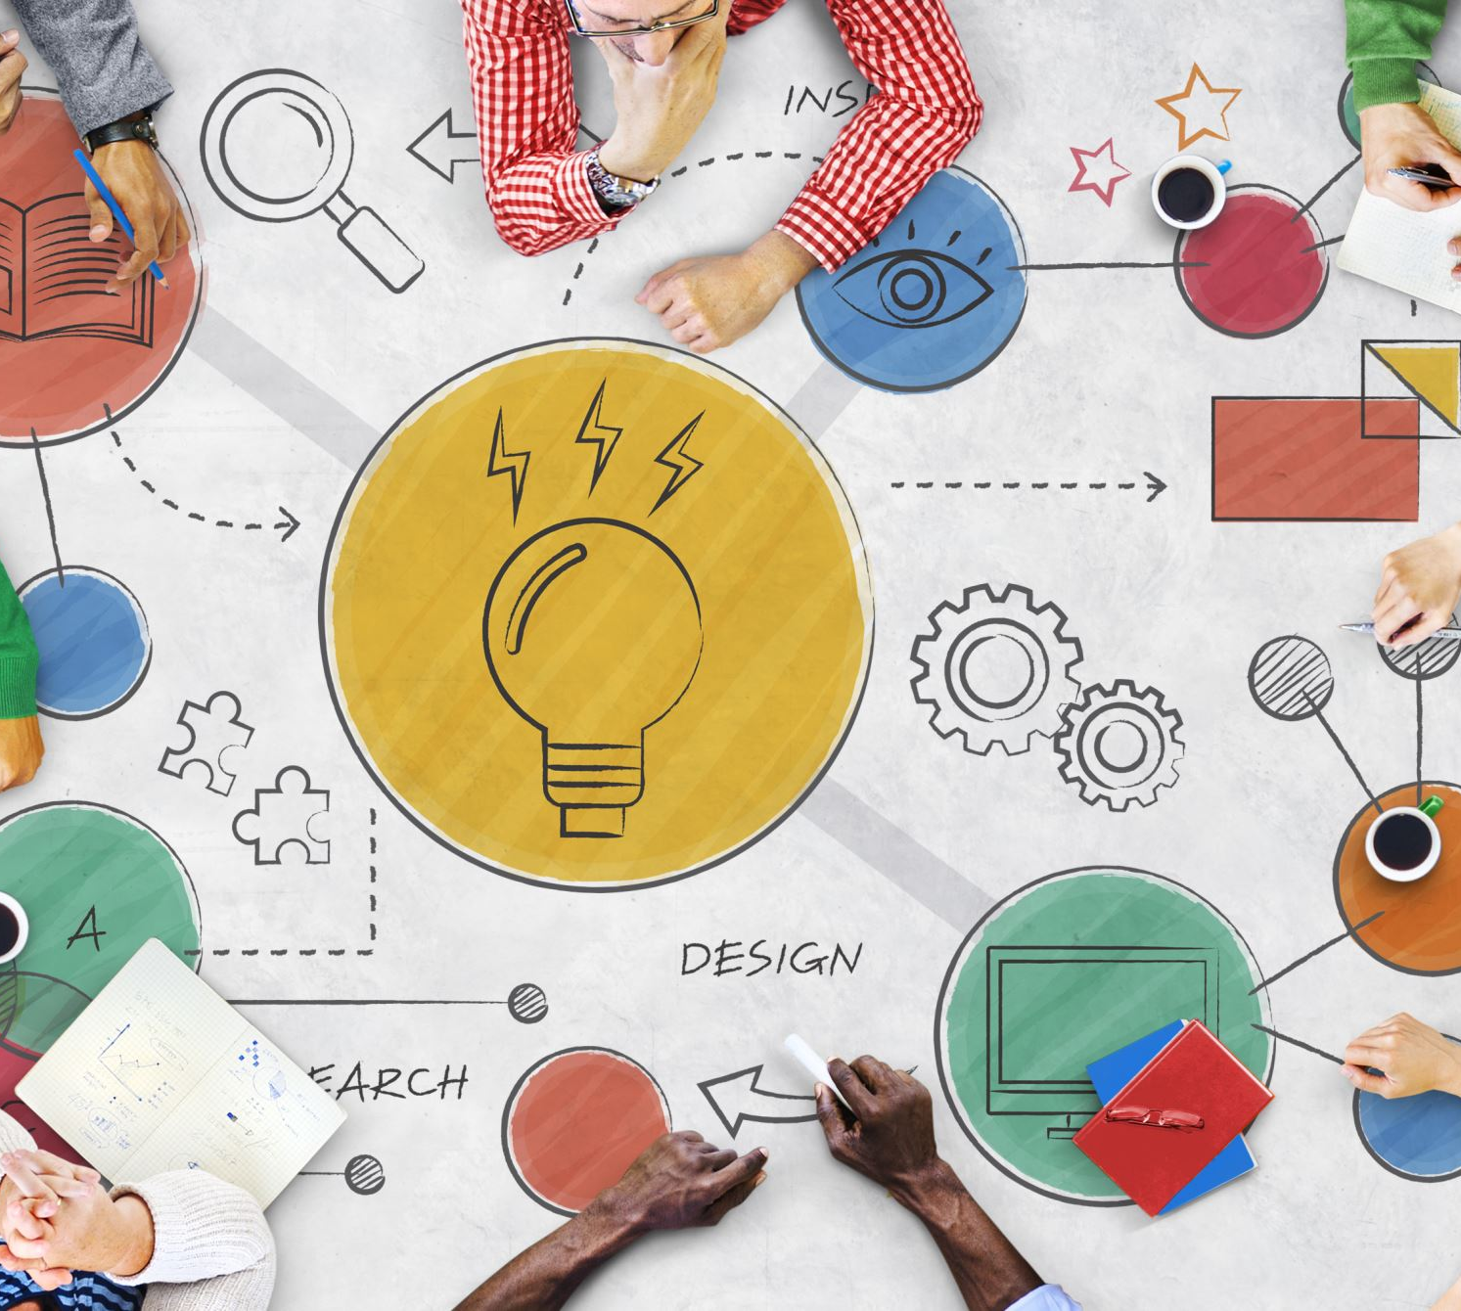
Aims and Objectives
Aim: To connect the changemaker methods of thought to networking and collaboration.
Explain the importance of networking and collaboration.
Understand emotional intelligence and its role in professional practice.
Identify strategies for influencing others.
Evaluate their own professional networks.
Recognise how resilience supports innovation and change.

Slide 3
Starter - Recap
Why do good ideas fail?
Imagine you have the perfect solution to your AC2 challenge. Why might it still fail?

Slide 4
Possible Answers
Nobody supports it.
Lack of funding.
Staff resistance.
Poor communication.
Lack of leadership.
No stakeholder buy-in.

Slide 5
Key Message
Change happens through people.
Not technology.
Not documents.
Not plans.
People.

Slide 6
Collaborative Practice
Who collaborates on a patient's case in health and social care?

Slide 7
Collaborative Practice
What happens when professionals do not work together?

Slide 8
Benefits of Collaborative Practice
There is emerging evidence that when interprofessional healthcare teams practice collaboratively it can enhance the delivery of person-centred care and lead to improved patient and health systems outcomes.
(Brandt et al., 2014; Sangaleti et al., 2017)

Slide 9
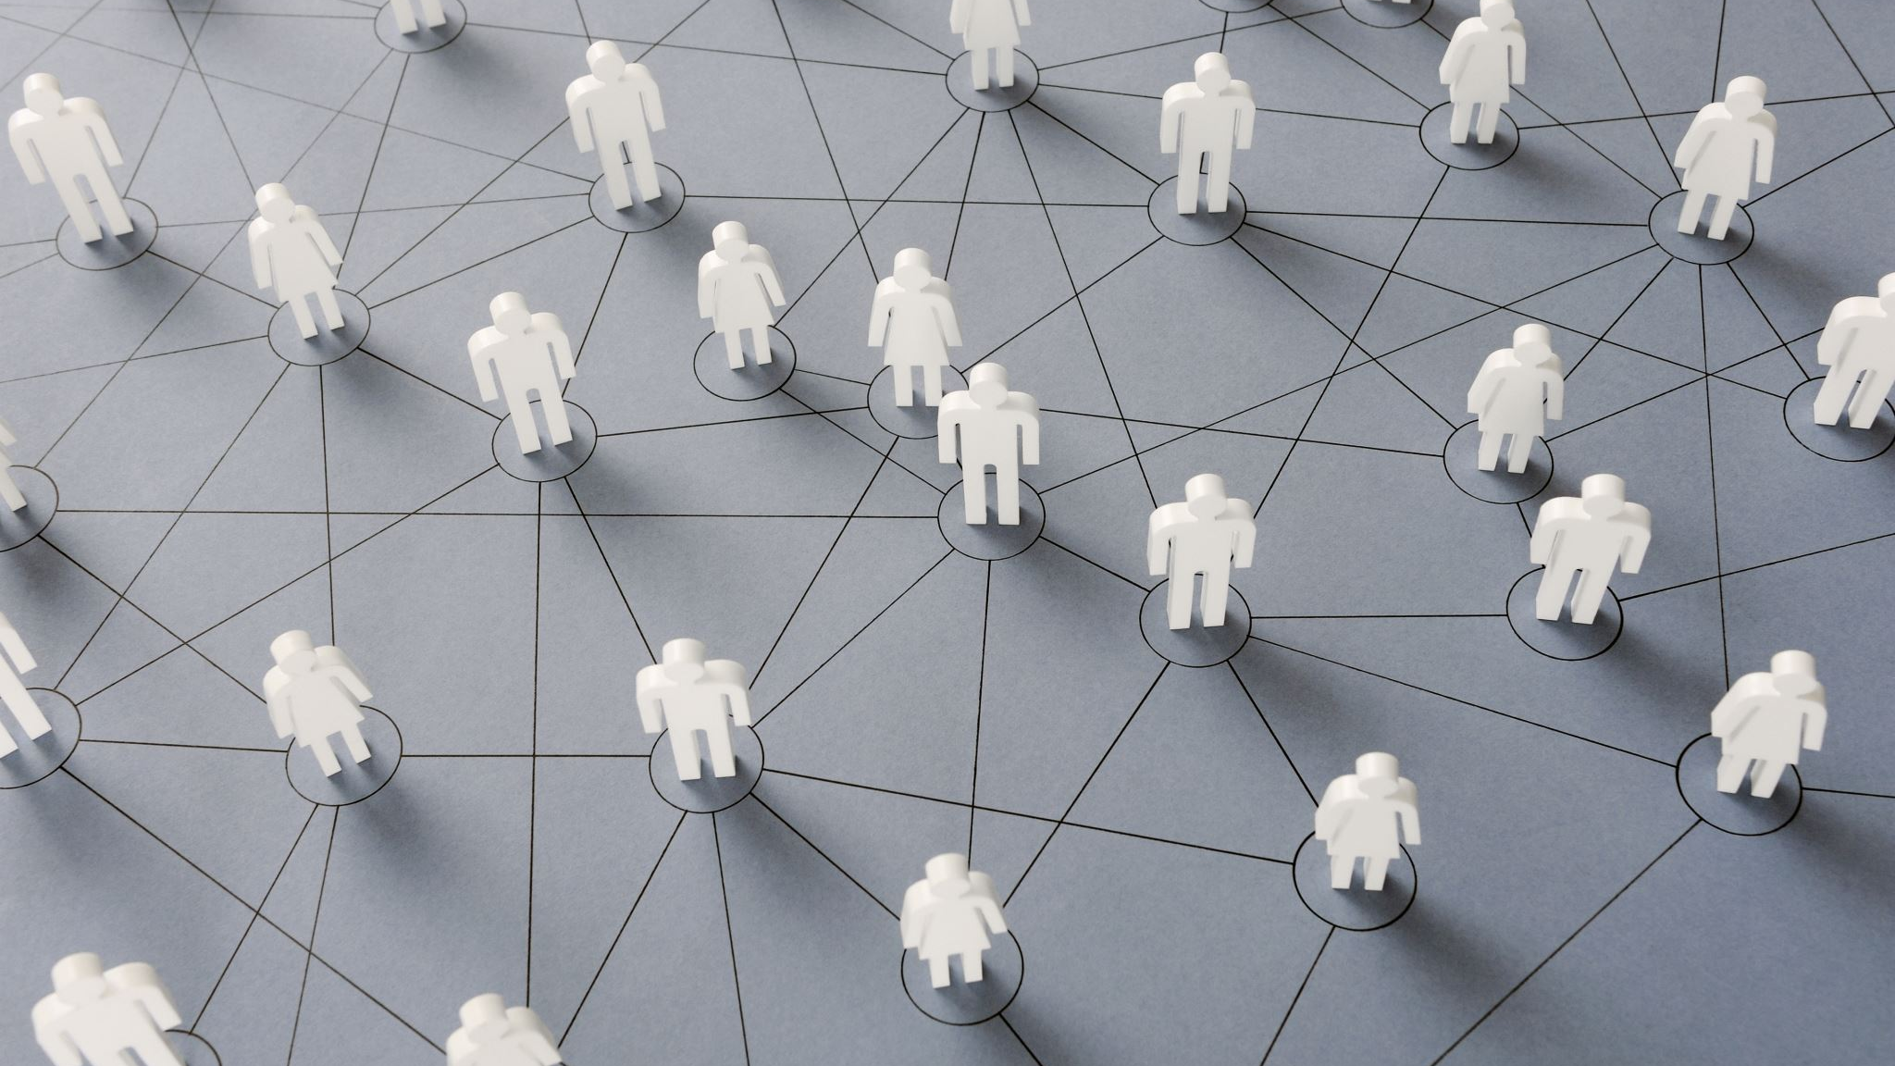
Networking
What is networking?

Slide 10
Networking
Building relationships
01
Sharing ideas
02
Learning from others
03
Accessing opportunities
04
Finding support
05

Slide 11
My Current Network
Draw yourself in the centre of the page. Then, place:
University contacts
Friends
Work colleagues
Placement contacts
Community groups
Online communities

Slide 12
My Current Network
Where are my strongest connections?
Where are gaps?
Who could help me achieve my goals?

Slide 13
Emotional Intelligence
The ability to manage your emotions and understand those of others around you.
This term was coined in 1964, but was popularised by the psychologist Daniel Goleman in 1995.
There are five facets to EI or EQ under Goleman's model, known as the Mixed Model.

Slide 14
Emotional Intelligence: Mixed Model (Goleman, 1998)
Self-awareness
Self-regulation
Motivation
Empathy
Social skills

Slide 15
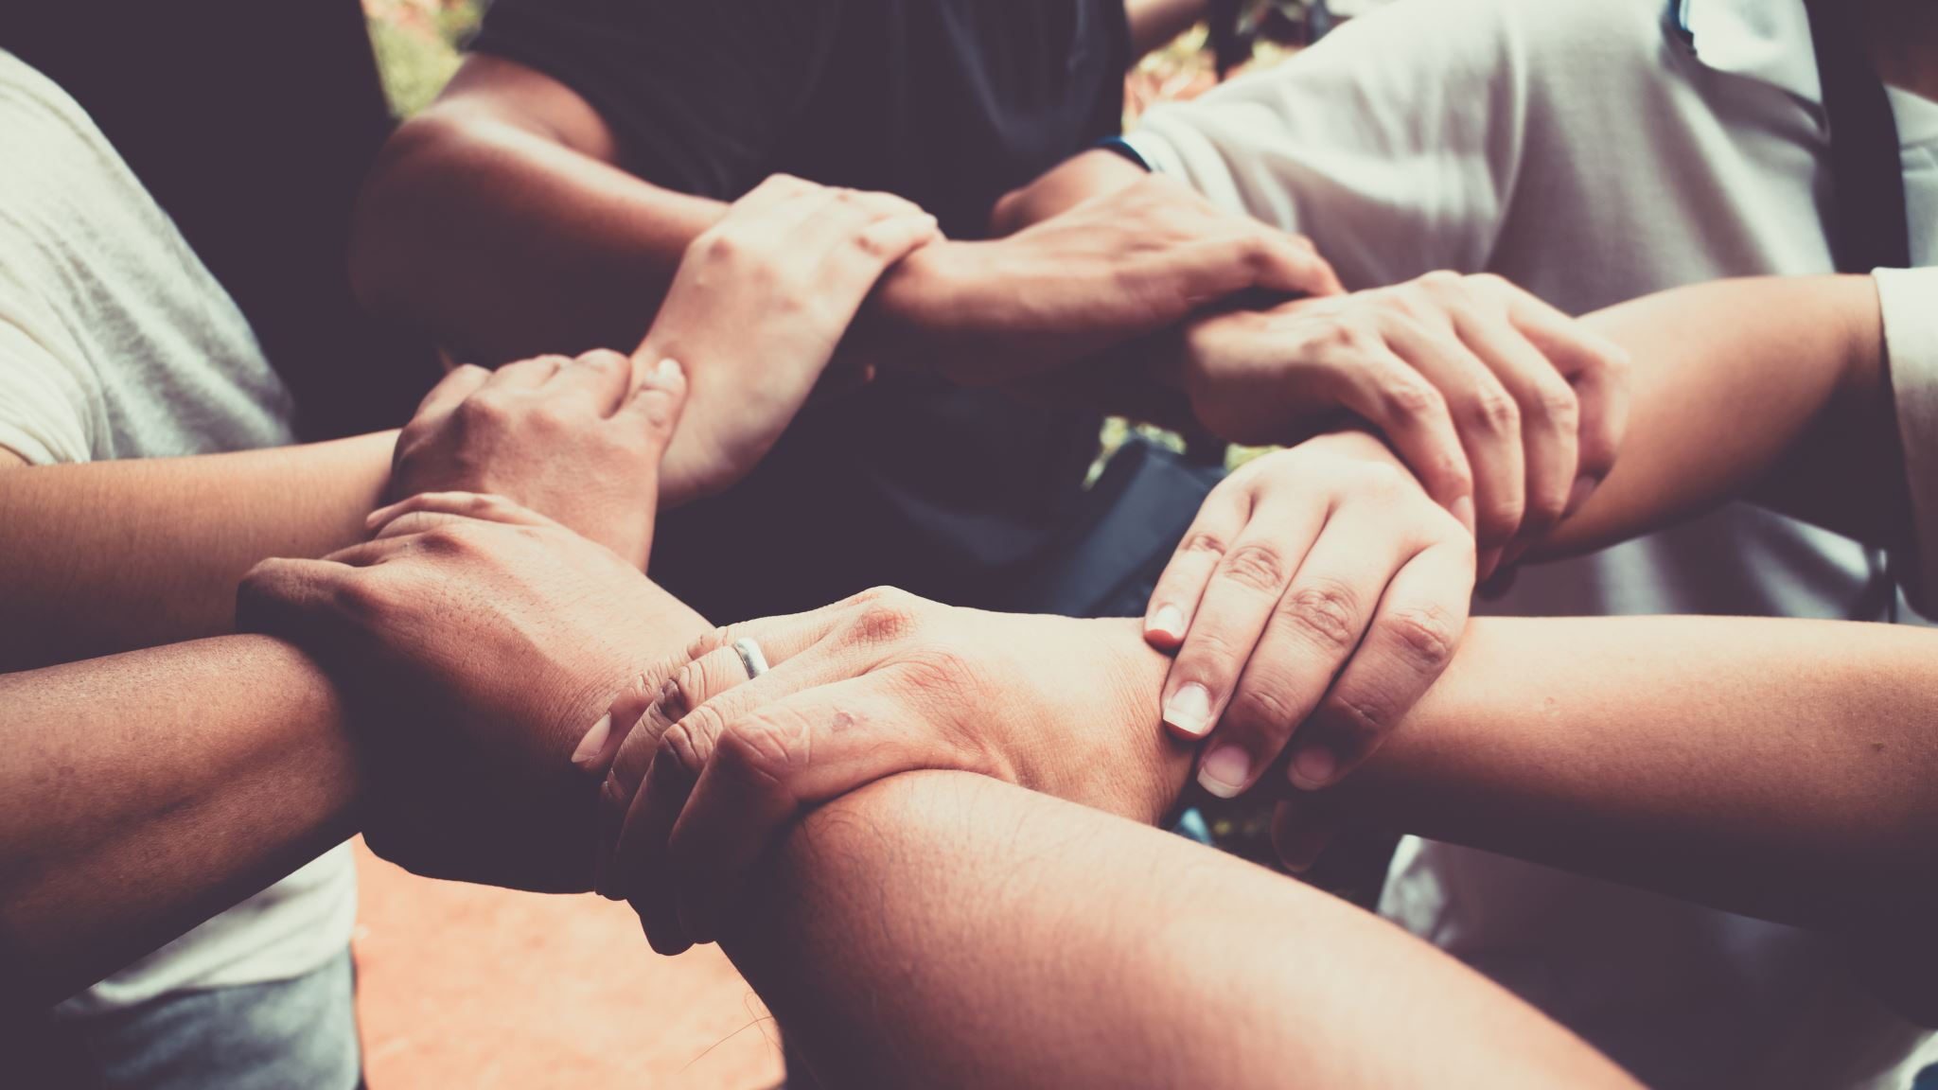
Emotional Intelligence
Emotional strength dates back to Maslow's days, and is debated in modern society as being more important than IQ in many cases.
Why might this be?
What do you think?

Slide 16
Emotional Intelligence
The Ability Model
The Trait Model
The Mixed Model

Slide 17
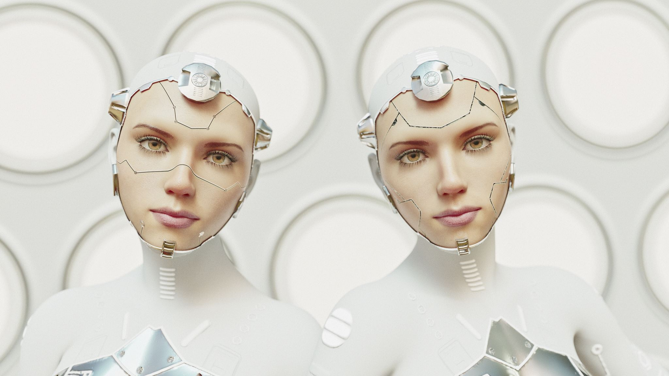
EI: Ability Model
This model by Mayer and Salovey (1997) aimed to create a 'new intelligence'.
Their definition evolved EI into the capacity to reason about emotions, and of emotions, to enhance thinking.
It includes the abilities to accurately perceive emotions, to access and generate emotions so as to assist thought, to understand emotions and emotional knowledge, and to reflectively regulate emotions so as to promote emotional and intellectual growth. (Mayer, Salovey and Caruso, 2004).

Slide 18
EI: Ability Model
There are four main abilities:
Perceiving emotions
Using emotions
Understanding emotions
Managing emotions

Slide 19
EI: Ability Model
Testing shows construct validity, using the MSCEIT – Mayer-Salovey-Caruso Emotional Intelligence Test.
Central to this model is the idea that EI requires attunement to social norms.
Therefore, consensus scoring is utilised, which is the observation that expertise can be approximately fairly closely by large numbers of people who may not be experts individually.
Other tests include the Diagnostic Analysis of Non-verbal Accuracy (DANVA), Situational Test of Emotional Understanding (STEU) and the Situation Test of Emotion Management (STEM) (Nowicki and Duke, 1994; MacCann and Roberts, 2008).

Slide 20
EI: Trait Model
Petrides proposed what was called a conceptual distinction between the ability models, developing a trait-based theory.
Trait EI is deemed as being a constellation of a person's own self perceptions of their own emotional abilities.
Therefore, when measuring EI, we should utilise a personality framework.
Does this make our emotional intelligence more an emotional personality trait?
(Petrides and Furnham, 2000)

Slide 21
Influence and Persuasion
How do you get people to support an idea?

Slide 22
Influence and Persuasion
Influence is a quiet power, changing thoughts and feelings
Persuasion is the active use of communication to turn the shift into actions/choices.

Slide 23
Influence and Persuasion
Reciprocity: People feel a deep need to return a favor or a gift.
Commitment: People strive to stay true to things they already said or did.
Social Proof: People look at what others do before making their own choice.
Authority: People trust clear experts and credible leaders.
Liking: People say yes more often to people they know and like.
Scarcity: People want things more when supply is low or time is short.

Slide 24
Influence and Persuasion
Think of your assignment.
Who needs to be persuaded?
How?

Slide 25

Resilience: What?
What is resilience?

Slide 26
Resilience: What?
Positive adaptation
Maintaining or regaining mental health
No set definition but some main components

Slide 27
Resilience: What?
Is it a personal trait or dynamic process?
Early definitions focused on association with intelligence
Are there protective factors involved?
Is there a breaking point?

Slide 28
Resilience
Where does it come from?

Slide 29
Resilience
Personal factors
Biological factors
Environmental-systemic factors
Interactions between factors?

Slide 30
Resilience – Personal Factors
Personality traits (OCEAN)
Internal locus of control
Self-efficacy
Self-esteem
Cognitive appraisal of events
Cognitive flexibility
Emotional regulation
Active coping
Optimism
Hope
Demographics

Slide 31
Resilience – Biological Factors
Early adversity is linked to changes in brain structure
Changes in brain size
Differences in neurotransmitter reuptake
Lowered sensitivity of receptors
HPA axis sensitivity
Cortisol levels

Slide 32
Resilience – Environmental-Systemic Factors
Social support
Family/friends
Secure attachments
Familial MH
Community factors
Good social policy

Slide 33
Resilience - Interactions
Genetic variations – polymorphism in MAOA and neurotransmitters
01
HPA axis polymorphism and exposure to childhood stress
02
Genetic heritage, gene-environment interactions, experiences, social support and culture
03

Slide 34

Resilience: Why?
Why do we care so much about building resilience?

Slide 35
Resilience: Why?
Reducing health sector load
Reducing intergenerational trauma
Cognitive reserve for dealing with stressors
Protects against mental health issues!

Slide 36
Barriers to Promotion
Coordination
Interruption of existing plans
Incentive
Facilitators
Potential cost

Slide 37
Final Message
Innovative ideas rarely succeed because they are brilliant.
They succeed because people collaborate, communicate, influence and persist long enough to turn ideas into meaningful change.

Slide 38
References
Brandt, B., Lutfiyya, M.N., King, J.A. and Chioreso, C., (2014). A scoping review of interprofessional collaborative practice and education using the lens of the Triple Aim. Journal of interprofessional care, 28(5), pp.393-399.
Sangaleti, C., Schveitzer, M.C., Peduzzi, M., Zoboli, E.L.C.P. and Soares, C.B., (2017). Experiences and shared meaning of teamwork and interprofessional collaboration among health care professionals in primary health care settings: a systematic review. JBI Evidence Synthesis, 15(11), pp.2723-2788.

