Slide 1
Chinese 8
阅读 写作
1th Apr WEEK 3-1

Slide 2
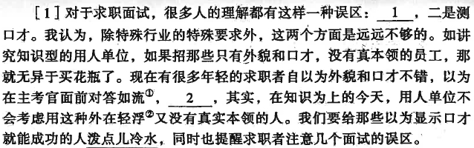
面试的误区
对于……，很多人的理解都有这样一种误区
一是……，二是……。
除……外，这两个方面是远远不够的。
招……的员工
招=招聘
讲究 pay attention to, stress
自以为 (-) vs 以为 (0)
自以为是 consider oneself (always) in the right; regard oneself as infallible
提醒 remind; call attention to; warn
误区 long-standing mistaken idea or concept

Slide 3
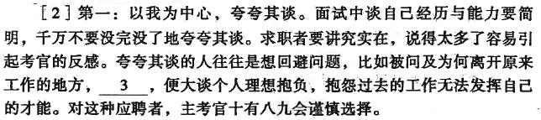
面试的误区
夸夸其谈 (of speaking or writing) indulge in exaggeration; indulge in verbiage
没完没了
十有八九
以自我为中心
引起……的反感/高感
发挥……的才能
应聘 accepted an offer of employment or interview
实在 n. (of work) well done; done carefully or in real earnest
回避 avoid; dodge
抱怨 complain; grumble
理想 (usu. Founded and reasonable, and different from dream or illusion) ideal
抱负 aspiration; ambition
谨慎 prudent; careful; cautious; circumspect

Slide 4
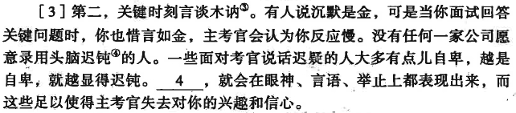
面试的误区
沉默 silent; quiet; reticent
沉默是金;惜言如金
木讷 simple and slow (of speech)
言谈木讷
迟钝 (of senses, thinking, movement etc.) dull; slow in response
头脑迟钝
迟疑 be unable to decide; hesitate
说话迟疑
这些足以使……失去对你的兴趣和信心/对你有信心
越是……越是/就越 the more … the more
大多
自卑 abject; feel oneself inferior (to others)
失去兴趣和信心

Slide 5
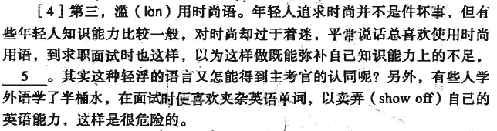
面试的误区
既……又…… both … and …; as well as
其实……又怎能得到……的认同呢？
过于 too (much); over; excessively
着迷 be fascinated; be captivated
滥用 abuse; misuse; use indiscriminately
另外 in addition; besides; moveover
夹杂 be mixed up with; be mingled with
卖弄 show off

Slide 6
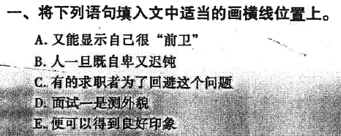
面试的误区
5
4
3
1
2

Slide 7
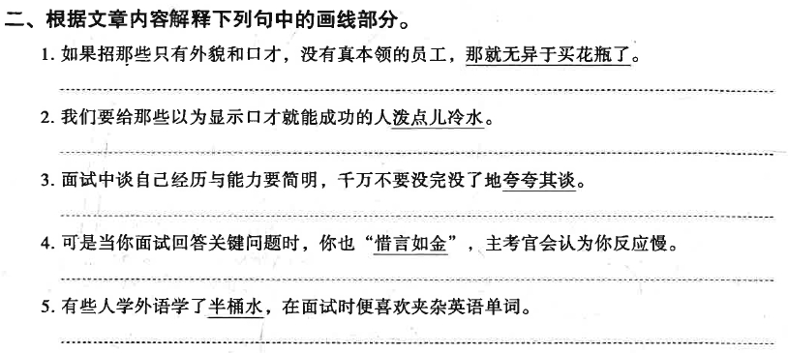
面试的误区

Slide 8
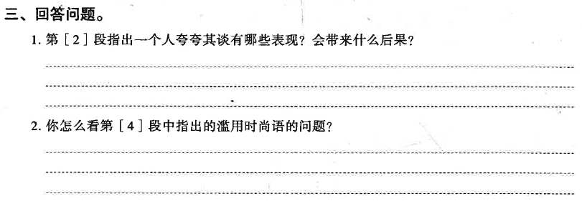
面试的误区

