Slide 1

Developing and Managing Individuals and Teams: Recruitment and Selection of a Financial Analyst at HSBC UK
Student name – Makram Seghira
Student ID – 2414998
Lecturer’s name – Mudassar Hasan
This Photo by Unknown Author is licensed under CC BY

Slide 2

Introduction
Recruitment is a major element in ensuring that organisations acquire, evaluate and retain candidates whose capabilities are strategic. In the financial services, precision and ethical behavior are the key to sustainable development. An effective recruitment process will help HSBC UK to find professionals who will assist in its transformation strategy and keep it in regulatory compliance (Armstrong and Taylor, 2023).
Notes:
In this presentation, the author examines how HSBC UK uses evidence-based recruitment and selection strategies to hire the most qualified talent to occupy the open Financial Analyst position. The banking sector is a well-regulated and data-oriented field that requires candidates of professional and ethical character. Strategic recruitment also aligns the competencies of the people with the business objectives which promotes productivity and innovation.
Bratton and Gold (2022) argue that matching the strategy used in recruitment with the organisational culture positively influence retention and performance results. The HSBC bank implements the same strategy by using competency-based recruitment and inclusive hiring which contributes to global diversity agenda. Next few slides will discuss the steps of recruitment, which include job analysis, job description and person specifications, and analysis of interview processes and interview techniques to be applied when hiring a Financial Analyst.

Slide 3

Company Overview: HSBC UK
Headquartered in London, HSBC UK, is a branch of HSBC Holdings plc, which is among the largest financial services and banking organisations worldwide. It offers retailing, commercial and international banking services to more than 19 million clients in 62 countries. The bank focuses its strategy on sustainability, digital transformation, and the diversity of the workforce (HSBC, 2023).
Notes:
HSBC UK was founded in 1865 and has grown to become one of the major financial institutions in the UK and other parts of the world with diverse clientele. The organisation has around 35,000 employees in various departments, whereby ethical behaviour, inclusion and innovation are given strong emphasis.
CIPD (2022) adds that the encouragement of diversity and equal opportunity improves the performance of organisations and leads to creativity in financial decision-making. The philosophy of HSBC recruitment is similar, as it is based on transparency and meritocracy. Its in-house talent development schemes like Future Skills Initiative make the employees digitally and analytically capable, which is required in the current financial environment.
Within this framework, the need to adopt the structured and ethical recruitment process is established to help in choosing the appropriate Financial Analyst who would facilitate the strategic vision of HSBC as well as adhering to the regulatory requirements.

Slide 4
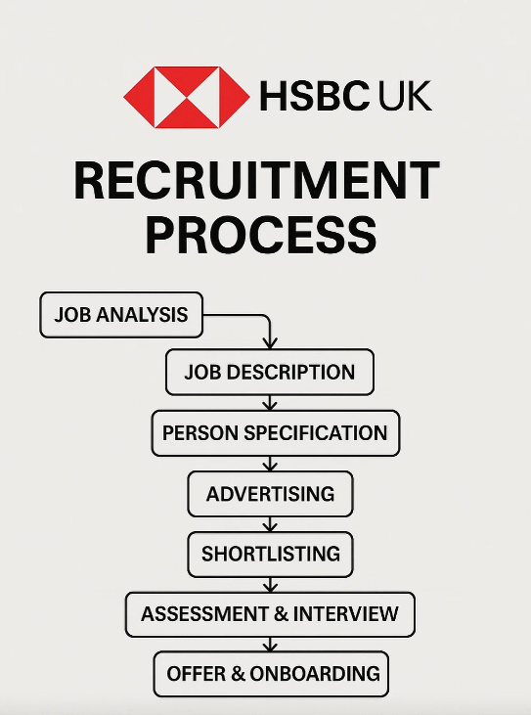
Recruitment Process Overview
The successful recruitment process will help HSBC UK to find and hire the best candidates to occupy specific positions such as Financial Analyst.
This is a seven-stage process which includes: Job Analysis - Job Description - Person Specification - Advertising - Shortlisting - Assessment and Interview - Offer and Onboarding.
This systematic method brings equity, uniformity, and conformity to organisational goals (Rees and French, 2022).
Notes:
The process of recruitment is not an administrative process but a strategic process that has a direct effect on organisational performance. In the case of HSBC UK, it starts with job analysis to get to know the main competencies of any financial job, a concise job description and person specification with the reflection of both technical and behavioural expectations.
Armstrong and Taylor (2023) state that a systematic recruitment framework helps to increase transparency, minimise bias, and make sure that candidates are objectively assessed. To recruit and hire qualified personnel keeping within the framework of the Equality Act 2010, HSBC applies such sophisticated recruitment technologies like LinkedIn Talent Insights, and its own mobility system.
All actions in the process such as advertising via reputable mediums, systematized shortlisting via scoring matrices and competency based interviews make sure that the bank hires analytically competent, ethically-based, and flexible professionals. The approach will enhance the capacity of the workforce and assist the HSBC in converting the strategy to digital finance and sustainable banking.

Slide 5
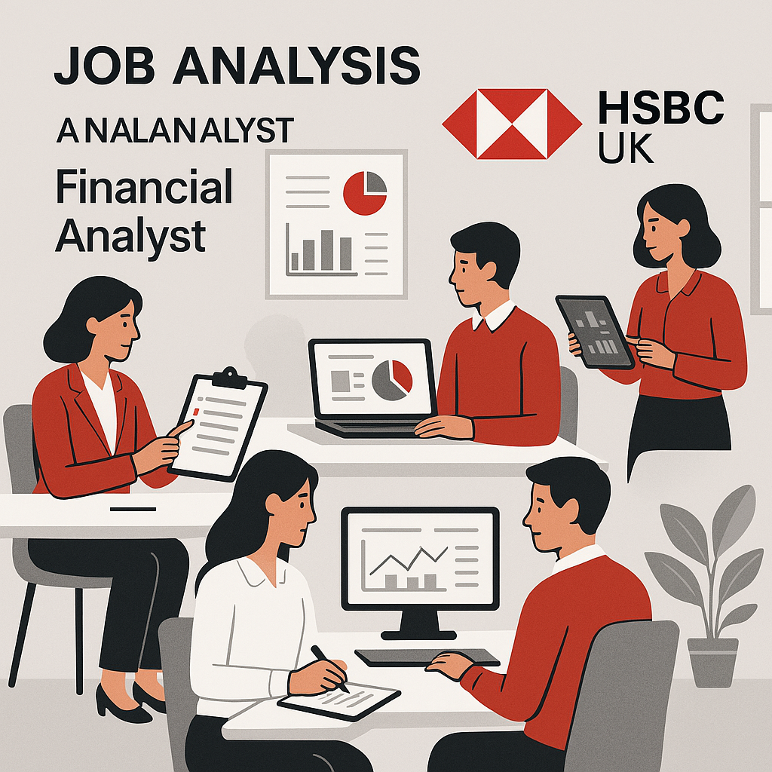
Job Analysis for Financial Analyst
Job analysis in HSBC UK is used to determine crucial tasks, responsibilities and skills needed to be used in Financial Analyst position. It entails the collection of data by way of interviews with managers, the use of questionnaires and observation of tasks in order to establish performance standards. The output informs recruitment documents and provides balance between the role expectations and strategic objectives (Bratton and Gold, 2022).
Notes:
Job analysis is the basis of effective recruiting that helps to understand what the job is and what kind of competencies are required to work in the job successfully. This is done at HSBC UK so that the position of Financial Analyst shows to reflect both technical and behavioural competence, including analytical reasoning, regulatory awareness and communication skills.
Torrington et al. (2023) note that a thorough job analysis is more effective to promote equality because it standardizes examples of evaluation and makes decisions based on evidence instead of emotions. This analysis is carried out by HSBC based on the feedbacks provided by the line managers, performance data, and industry benchmarking.
The result, which is a compilation of key result areas and competencies required, forms the basis of a specific job description and person specifications. This strategy will keep the recruitment process transparent, following the legislation on equality, and will be sensitive to the organisational objectives, especially in the fields of sustainable finance and digital transformation.

Slide 6

Job Description and Person Specification
The Job Description states important duties, responsibilities and reporting relationships whereas the Person Specification states the qualifications, skills and behavioural attributes required. As a Financial Analyst at HSBC UK, one of the competencies is data modelling, regulatory knowledge, and, ethical decision-making. A properly implemented specification is inclusive and objective in terms of its selection (CIPD, 2023).
Notes:
Job description and person specification are important tools that connect job analysis with the outcomes of the recruitment and selection. These documents at HSBC UK are developed jointly by the business human resource (HR) professionals and line managers so that they are in line with the culture and strategic objectives of the organisation.
Rees and French (2022) state that effective job documentation improves the efficiency of the recruitment process and minimises turnover by ensuring the expectations of performance. In the case of a Financial Analyst, analytical roles are outlined in the job description, which includes tasks such as the interpretation of financial information, forecasting and adherence to regulatory framework, such as Basel III.
In the meantime, the person specification will be about qualifications (e.g., degree in finance or economics), technical knowledge (e.g., Excel, Power BI), and behavioural skills like integrity and cooperation. The HSBC has incorporated such criteria into their Future Skills Framework, in which all candidates will be judged based on the same, bias-free objectives. This openness enhances fairness and integrity of the employer.

Slide 7

Interview Type 1: Structured Interview
Structured interviews use standardised questions and scoring systems to ensure consistency and reduce interviewer bias. They enhance the reliability and validity of selection decisions, particularly in analytical roles such as Financial Analyst. HSBC UK applies competency-based structured interviews to assess candidates against behavioural and technical benchmarks (Huffcutt, Culbertson and Goebl, 2021).
Notes:
One of the most effective methods of determining whether an applicant fits well is through structured interviews since they provide a standardized method of evaluating an applicant. At HSBC UK, every candidate who was applying to the Financial Analyst position is given similar competency questions, and the responses are graded according to pre-determined criteria.
According to Armstrong and Taylor (2023), such an organized approach helps to minimize the level of personal bias and ensure that all individuals are given equal opportunity. It allows the interviewers to emphasize on the things which can be quantified such as analytical skills, communication skills, and moral decision making, rather than personal impressions.
Indicatively, you might use the following question; ask the client to give an example of when he used data analysis to make a business decision. Such types of behavioural questions demonstrate how the candidates apply what they have learnt in the real life. Technology-assisted scoring is also employed by HSBC when making decisions more responsible and accountable. This ensures that each phase in the hiring process is equal and it adheres to the Equality Act 2010.

Slide 8

Interview Type 2: Panel Interview
A panel interview involves multiple assessors—typically HR, line managers, and senior executives—evaluating candidates collaboratively. This format promotes balanced decision-making and mitigates individual bias. HSBC UK uses panel interviews for Financial Analyst recruitment to ensure objectivity and diverse professional insights in selection decisions (Carnevale and Hatak, 2020).
Notes:
The inclusion and dependability in the evaluation of the candidates interviews are offered by the panel interview because it is necessary to be strategic as is the case with Financial Analyst where multidisciplinary views are paramount. Panels in HSBC UK include representatives of Finance, Compliance and Human Resources generally.
Rees and French (2022) state that the involvement of several assessors increases the sense of fairness and gives an opportunity to incorporate multiple organisational perspectives. Candidates are evaluated by each interviewer through a common competency matrix whereby the scores are summative in order to facilitate transparency and accountability.
To illustrate, whereas the finance specialist is concerned with the quantitative reasoning, the HR partner measures the communication and teamwork skills. This approach is not only a way to minimize the chances of bias but also demonstrates the collaborative nature of the HSBC culture and leadership grounded in the values. The result is the ability to understand the potential of every candidate more holistically so that hired analysts can become productive contributors to the data-driven decision-making process of the organisation.

Slide 9

Interview Type 3: Assessment Centre
Assessment centres evaluate candidates through multiple exercises, such as case studies, group tasks, and presentations. They provide a holistic view of competencies like teamwork, problem-solving, and analytical ability. HSBC UK uses digital assessment centres for Financial Analyst roles to ensure fairness, validity, and strong predictive reliability in recruitment outcomes (Robertson and Smith, 2021).
Notes:
Assessment centres are commonly considered to be among the best and most valid ways of assessing the candidates. They recreate actual work situations, which enables the recruiters to evaluate not only technical skills but also interpersonal skills at work.
Armstrong and Taylor (2023) also state that a combination of exercises is viewed as more predictive and less biased than interviews carried out with single methods. The HSBC UK uses virtual assessment centres where potential employees undergo the following: financial analysis case studies, data interpretation activities, and simulations on teamwork.
All the activities are rated by several trained assessors into standardised behavioural indicators. This multi-method will allow identifying high-potential candidates that have the analytical rigour and team spirit to succeed in a financial position. It also shows how HSBC is devoted to fairness, diversity and technological innovation in the hiring process, which is also in line with the sustainability and inclusion agenda of the organisation in general.

Slide 10

Questioning Techniques
Effective questioning techniques help interviewers assess candidates’ analytical, behavioural, and ethical competencies. HSBC UK applies probing, situational, and behavioural questions to reveal problem-solving capacity, while avoiding leading questions to minimise bias. This structured approach improves validity and fairness during Financial Analyst interviews (Torrington et al., 2023).
Notes:
The techniques of questioning play an important role in acquiring such information on the candidates as is pertinent and correct. The HSBC UK uses a combination of behavioural and situational questions to assess the approach of applicants to data-driven complex issues and ethical choices.
CIPD (2022) states that the probing questions prompt the candidate to explain their logic, whereas the Socratic method provokes increased thoughtfulness and intellectual consideration. An example is given of an interviewer posing a question like, how did your financial modelling contribute to a major decision in the business? Situational questions e.g. What would you do in the event of a data discrepancy in the report of a client? predictive behaviour under pressure and probe questions elucidate details of past performance.
To minimize the effect of unconscious bias, HSBC guarantees uniformity in interviews by training interviewers and setting competency systems. This methodical process will improve the quality of decisions made, and the performance of the recruitment process will be tied to the performance norms and the ethics of the organisation.

Slide 11

Face-to-Face vs Online Interview
Both face-to-face and online interviews are integral to HSBC UK’s hybrid recruitment model. While in-person interviews enable richer communication and assessment of non-verbal cues, virtual formats increase flexibility, reach, and sustainability. Selecting the appropriate method depends on job level, resources, and accessibility (Parry and Wilson, 2021).
Notes:
Over the last few years, HSBC UK has implemented a hybrid approach to recruitment, which involves both a face-to-face and virtual interviewing process aimed at improving the efficiency and inclusiveness of the recruitment process. The strategy is in line with the current workforce demands and the sustainability philosophy of the organisation.
CIPD (2023) states that online interviews increase talent pools by eliminating geographical constraints, endorsing diversity and decree carbon emissions in relation to travelling. Nevertheless, they are able to reduce interpersonal connection and complicate the non-verbal communication. On the other hand, face-to-face interview will enable establishing rapport and observing professional behavior directly, but it is resource-consuming.
HSBC attempts to reduce the difference by training interviewers to suit questioning and feedback techniques to either format. The hybrid structure of the bank guarantees equal treatment, access, and stability in operations- particularly around financial capitals across the globe where remote working has been the new order after the COVID-19.

Slide 12

Challenges and Ethical Considerations
Ethical recruitment ensures fairness, transparency, and equal opportunity. HSBC UK faces challenges such as mitigating unconscious bias, maintaining data privacy, and ensuring compliance with the Equality Act 2010 and GDPR. Implementing structured processes and diversity training promotes integrity and trust in recruitment practices (CIPD, 2022).
Notes:
Sustainable people management is based on recruitment ethics. In the case of HSBC UK, ethical issues go beyond the scope of legal requirements, but also transparency, inclusivity and privacy of the candidates.
Rees and French (2022) suggest that upholding fairness during selection safeguard the reputation of the organisation and the trust of employees. HSBC tries to reduce the possibility of bias by using anonymous applications, a variety of interviewers, and using gender-neutral language in job ads.
In addition, there is storage and processing all candidate information in accordance with GDPR standards, so the information is confidential and secure. The bank also undertakes frequent training of the HR personnel on ethical decision making and equality laws.
By integrating such practices, HSBC does not only comply with the law but also enhances its employer brand through its good, responsible and inclusive organisation. This proactive position can be attributed to long-term talent retention and it will be in line with the principle of sustainability and social responsibility under the financial sector of the company.

Slide 13

Conclusion
A strategic and ethical recruitment process enables HSBC UK to attract skilled Financial Analysts aligned with its organisational culture and compliance needs. Combining structured, panel, and assessment interviews ensures fairness, consistency, and performance accuracy. Continuous improvement through digital innovation supports sustainability and long-term talent development (Armstrong and Taylor, 2023).
Notes:
To sum up, the success of the HSBC UK recruitment and selection strategy is based on its well-organized, inclusive, and data-driven process. The level of each stage, such as job analysis and assessment, is a strong devotion to fairness, transparency, and skill selection.
As Bratton and Gold (2022) note, in modern recruitment, ethical responsibility should be incorporated and technology innovated alongside innovation to improve the ability of an organisation and employee engagement. HSBC has done this by using competency based based assessment, hybrid interviews as well as ethical governance models which encourage equal opportunity and integrity of data.
The evidence-based decision-making, diversity awareness, and digitalisation guarantee that the bank can hire analysts who can offer analytical excellence without compromising corporate values. As shown in this presentation, human resource practices will be aligned with ethical and strategic objectives in order to enhance sustainable organisational practices and facilitate the future of responsible leadership in global banking.

Slide 14
References
Bratton, J. and Gold, J. (2022) Human Resource Management: Theory and Practice. 7th edn. London: Palgrave Macmillan (Springer Nature).
Carnevale, J.B. and Hatak, I. (2020) ‘Employee adjustment and well-being in the era of COVID-19: Implications for human resource management’, Academy of Management Perspectives, 34(4), pp. 583–597. Accessible via Oxford University Press – Academy of Management: https://journals.aom.org/journal/amp
CIPD (2022) Effective Interviewing and Questioning Techniques. London: Chartered Institute of Personnel and Development. Available at: https://www.cipd.org/uk/knowledge/factsheets/interviewing-factsheet
CIPD (2022) Ethical Practices in Recruitment. London: Chartered Institute of Personnel and Development. Available at: https://www.cipd.org/uk/knowledge/reports/ethical-practices-in-recruitment
CIPD (2023) Job Design and Person Specification. London: Chartered Institute of Personnel and Development. Available at: https://www.cipd.org/uk/knowledge/factsheets/job-design-factsheet
CIPD (2023) Job Design and Person Specification. London: Chartered Institute of Personnel and Development.
CIPD (2023) Recruitment and Selection: Hybrid Interviewing Practices. London: Chartered Institute of Personnel and Development. Available at: https://www.cipd.org/uk/knowledge/factsheets/recruitment-factsheet
HSBC (2023) HSBC Holdings plc – Sustainability Report 2023. London: HSBC Group Publications; Official corporate source: https://www.hsbc.com/sustainability
Huffcutt, A.I., Culbertson, S.S. and Goebl, A.P. (2021) ‘Evaluating interview structure and validity’, Journal of Applied Psychology, 106(1), pp. 20–33. Available through American Psychological Association: https://www.apa.org/pubs/journals/ap
Parry, E. and Wilson, H. (2021) ‘Virtual recruitment and hybrid working practices: Emerging challenges post-pandemic’, Human Resource Management Journal, 31(5), pp. 1050–1064.
Published by Wiley for the Chartered Institute of Personnel and Development. Available at: https://onlinelibrary.wiley.com/journal/17488583
Notes:
Published by Wiley-Blackwell (Oxford). Accessible via: https://onlinelibrary.wiley.com/journal/17488583
Rees, G. and French, R. (2022) Leading, Managing and Developing People. 6th edn. London: Kogan Page. Available at: https://www.koganpage.com/
Robertson, I.T. and Smith, M. (2021) ‘Validity of assessment centres in modern recruitment: A systematic review’, Human Resource Management Journal, 31(4), pp. 1045–1060.
Torrington, D., Hall, L., Taylor, S. and Atkinson, C. (2023) Human Resource Management. 12th edn. Harlow: Pearson Education. Available through Pearson UK Academic Catalogue: https://www.pearson.com/en-gb.html
World Health Organization (2023) Ethical Principles in Human Resource Development and Workforce Planning. Geneva: WHO Technical Guidance Series. Available at: https://www.who.int/publications

Slide 15

This Photo by Unknown Author is licensed under CC BY-SA

