Slide 1
Recruitment and Selection During Organisational Transformation
Transformation: Digital retail, AI, online grocery and process improvement
Module: LCLM5002 Developing and Managing Individuals and Teams
Assessment: Component 1 – Individual Presentation
Submitted By: Estera Diana Vasile
Student ID: 233186

Slide 2
Presentation Agenda
Tesco PLC: company context
Nature of organisational transformation
Key transformation roles required
Recruitment process overview
Job analysis, job description and person specification
Advertisement and attraction strategy
Three suitable interview types
Questioning techniques for transformation roles
Face-to-face vs virtual interviews
Final recommendations
Notes:
This presentation begins with an overview of Tesco and its transformation. It then describes the selection process, job analysis, job description and advertising process. The three types of interviews are identified and discussed, followed by appropriate questioning strategies. Last, a comparison of face-to-face and virtual interviews is done, and finally, recommendations and conclusions are presented.

Slide 3
Tesco PLC — Company Context
Tesco is the UK’s largest food retailer with strong grocery market leadership
Tesco provides the UK’s largest food retail with a commanding position in the grocery sector.
Reported £66.59bn sales excluding VAT and fuel in 2025/26 (Market Screener, 2025).
There was 4.2% growth across like-for-like stores in the UK (Retail Insight Network, 2023)
Gain value, loyalty and excellent digital experience.
Uses Clubcard, online grocery, Whoosh delivery and retail media to compete (Tesco, 2025)
Tesco has been chosen for its role as a transformation case relevant to the UK.
Notes:
Tesco remains the top food retailer in the UK and continually develops its market-leading status with innovation and digital services. The company leverages data from the Clubcard, grocery delivery apps and fast food chains to provide customers with a better experience across the board. Such developments call for trained workers to assist with transformation over the long term.

Slide 4
Nature of Tesco’s Transformation
Transformation type: digitalisation + customer-led process improvement
An AI-powered personalised marketing initiative between Tesco and Adobe (Reuters, 2026)
Staff use the information from Clubcard to enrich offers and interactions with customers.
Clubcard has grown to 70% of households in the UK (Reuters, 2026b).
Around 28% of the total grocery market share in the UK belongs to Tesco (Reuters, 2025).
Transformation priorities:
  Faster digital customer service
  Better online grocery experience
  Cost efficiency and operational improvement
  Data-led decision-making
  Workforce capability development
Notes:
The focus of the transformation at Tesco is on digitalisation and process improvement geared towards customers. The company is making more and more investments in artificial intelligence and data analytics to offer individualised services. Focus areas include service improvement, operational efficiency and employee training and development for continued competitive advantage.

Slide 5
Key Roles Needed for Transformation
Role | Why Tesco Needs It | Core Skills
Change Manager | Reduce resistance and support adoption | Communication, resilience
Digital Specialist | Support AI, data and online systems | Digital literacy, analytics
Project Manager | Deliver transformation projects | Planning, risk control
Financial Analyst | Track cost savings and ROI | Budgeting, data analysis
Operations Manager | Improve store and supply processes | Problem-solving, leadership
Key point: Recruitment must assess both technical ability and behavioural competencies.
Notes:
Successful transformation requires different specialist roles. Change managers get employees to adapt to change, digital specialists get into technology, and project managers get into transformation activities. Financial analysts compare costs, and operations managers work on improving efficiency. Assess technical and behavioural skills when recruiting staff.

Slide 6
Recruitment Process Overview”?
Goal: right candidate, right role, right time
Determine gaps in the workforce as a result of transformation (Ogunbukola, 2025).
Outline role purpose and business need.
Collaborate with HR and line managers for job analysis
Prepare job description and person specification
Identify appropriate internal and external advertising options
Shortlist using essential criteria
Assess candidates through structured selection methods
Make offer and complete transformation-focused onboarding
Notes:
The process of recruitment starts with establishing the shortage of staff needed as a result of organisational changes. Tesco should outline job requirements and should involve HR professionals and line managers in the job analysis. The right media is utilised, candidates are shortlisted and evaluated, and successful candidates are onboarded to aid with transformation goals.

Slide 7
Job Analysis, Job Description and Person Specification
Job analysis
Identifies tasks, responsibilities and required skills
Links role requirements to Tesco’s transformation goals
Should involve HR, operations, digital and finance teams
Job description
Job title, department and reporting line
Main duties and performance expectations
Contribution to transformation outcomes
Person specification
Essential qualifications and experience
Technical skills and digital capability
Competencies: communication, leadership, customer focus and resilience
Notes:
Job analysis is used to determine tasks, responsibilities and knowledge needed. Data collected is leveraged to create job descriptions and person specifications. Expectations, qualifications and competencies are clearly articulated in these documents. These requirements are aligned with the transformation goals, which enable Tesco to attract staff who can participate and have an impact on the transformation.

Slide 8

Advertisement and Attraction Strategy
Internal channels
Tesco careers portal
Internal vacancy boards
Talent pools and succession planning
Employee referral scheme
External channels
LinkedIn for professional and digital roles
Indeed and UK job boards
Specialist digital / project management platforms
Recruitment agencies for urgent specialist roles
Attraction message
Career progression
Flexible working where possible
Learning and development
Purpose-driven retail transformation
Notes:
Tesco offers opportunities for recruitment, both within and outside the organisation. There are different methods, internal ones being the career portals and employee referrals, and external ones being LinkedIn and recruitment agencies. Attractive opportunities such as career development, flexible working and learning opportunities help Tesco compete for talented candidates.

Slide 9

Interview Type 1 — Structured Interview
Best for: fairness, consistency and comparison
Same core questions asked to all candidates
Answers scored against pre-agreed criteria
Reduces personal bias and improves transparency
Useful when hiring across multiple departments
Supports equality and evidence-based selection
Tesco example question
“Describe a time you managed resistance to organisational change.”
Assessment criteria
Communication
Stakeholder management
Problem-solving
Measurable outcome
Notes:
Structured interviews are standardised to guarantee fair comparisons and consistency since all interviewers pose the same questions to all interviewees. Responses are judged in accordance with a fixed scoring system, minimising interviewers' biases. This helps to provide transparency and aids in evidence-based decision-making. Useful for hiring staff from various departments and across different functions.

Slide 10
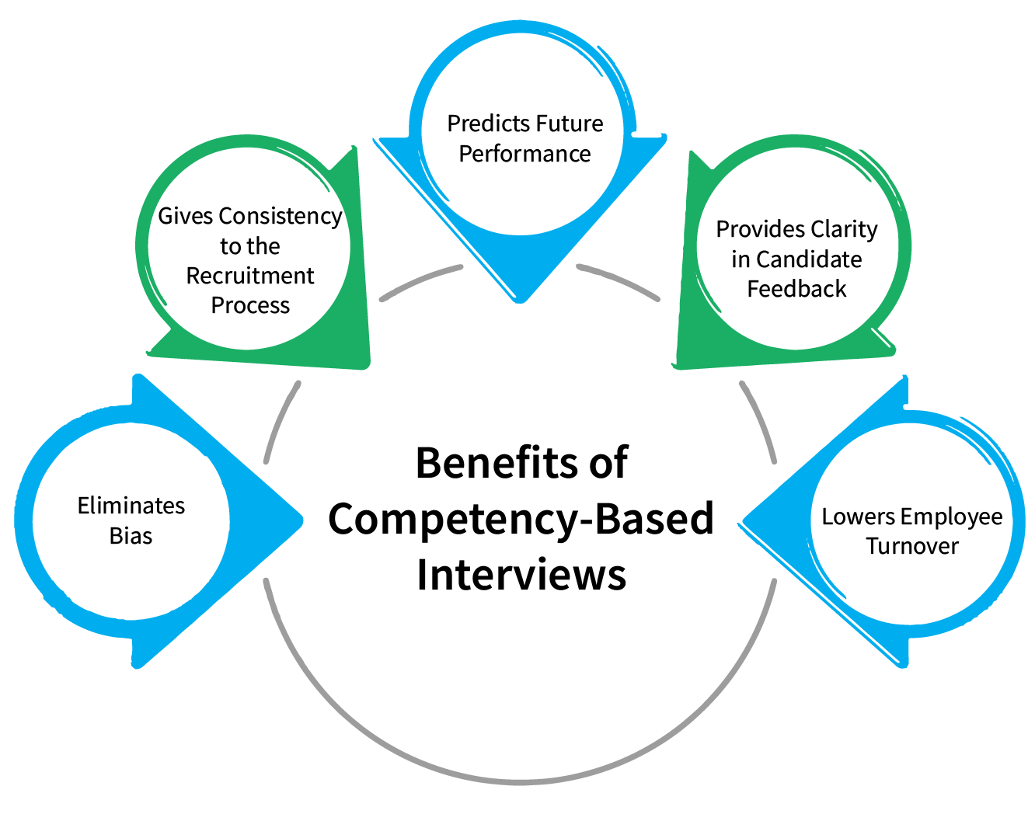
Interview Type 2 — Competency-Based Interview
Best for: testing skills and behaviours
Evaluates previous movements based on future movements.
Judges own previous movements according to future movements.
Ideal for Change Manager, Project Manager and Operations Manager positions
Uses real examples instead of general claims
Applies the STAR method (Situation, Task, Action, Result) (Armstrong & Taylor, 2023)
An overview of key competencies for Tesco
Leadership
Analytical thinking
Teamwork
Customer focus
Resilience
Digital awareness
Example question
“Share with us an experience of using data to enhance a business process.”
Notes:
Competency-based interviews focus on behaviours and skills in previous situations. STAR is a way to communicate a situation, task, action and result. This interview format assesses leadership, teamwork, analysis and customer focus. Therefore, it is highly suitable for change managers and project managers.

Slide 11

Interview Type 3 — Panel Interview
Best for: senior and cross-functional transformation roles
Panel may include HR, line manager, digital lead and operations manager
Gives a balanced view of technical and cultural fit
Reduces dependence on one interviewer’s opinion
Useful for roles affecting several departments
Requires clear scoring criteria to remain fair
Limitations
Can increase candidate pressure
Panel disagreement may delay decisions
Poorly trained panels may still create bias
Recommendation: Use for final-stage Change Manager and Project Manager roles.
Notes:
In a panel interview, multiple interviewers from various departments participate. This offers a fair horse race between technical skills and cultural match. Panel interviews can actually create more pressure for candidates, but they help to enhance the quality of hires and eliminate personal bias. They're best suited to senior roles that call for transformation.

Slide 12
Questioning Techniques
Technique | Purpose | Tesco Example
Behavioural | Tests experience | “Tell us about a time you led change.”
Situational | Tests judgement | “What would you do if staff resisted a new system?”
Competency-based | Tests role behaviours | “Give an example of stakeholder management.”
Probing | Checks depth | “What was your exact role?”
Socratic | Tests reasoning | “Why did you choose that approach?”
Best approach: combine behavioural + situational + probing questions.
Notes:
Various questioning methods can facilitate organisations in getting detailed information from candidates. Behavioural questions are about past events, situational questions assess your judgment, and competency-based questions focus on particular skills. Probing and Socratic questioning help to elicit deeper responses. These strategies can be used all together for more accurate and thorough evaluation.

Slide 13
Face-to-Face vs Virtual Interviews
Factor | Face-to-Face | Virtual
Best stage | Final selection | First screening
Strength | Relationship-building | Speed and flexibility
Candidate reach | Limited by location | Wider UK access
Assessment | Body language easier | Digital communication visible
Risk | Travel/time cost | Technical issues
Tesco use | Operations / Change roles | Digital / Finance roles
Recommendation: Tesco should use a blended interview model.
Notes:
Interviews done face-to-face facilitate establishing relationships and become more alert to body language. The flexibility and increased pool of talent are some of the advantages of virtual interviews. Tesco should adopt both strategies, virtual interviews for first-round screening, followed by face-to-face interviews for making final hiring decisions.

Slide 14
Key Recommendations
Be proactive when hiring by planning the workforce instead of posting jobs.
Link every role to Tesco’s transformation objectives
Clear job descriptions and person specifications are used.
Integrate internal promotions and outsourcing to leverage the services of experts. Perform internal promotions while also hiring external experts.
Use structured interviews for equitable and standardised questioning
The use of competency-based questions for evidence of ability:
If panel interviews work for senior transformation positions, do so. If panel interviews are applicable to high-level (transformation) positions, then do so.
Produce interviewers' scoring, equality and unconscious bias notes within a training document.
Utilise virtual interviews to screen candidates and in-person interviews to make hiring decisions (Peasgood et al., 2023).
Notes:
Tesco's strategy in recruiting employees should be proactive and in accordance with the objectives of transformation. Job descriptions and person specifications are crucial. Avoid unstructured and non-competency-based interviews as they tend to be less fair and less valid. Interviewers will be trained, and interviews will be done virtually and in person to improve recruitment results.

Slide 15
Conclusion
People with leadership capability, all with all the digital and analytical skills, are needed for Tesco's transformation.
Recruitment must be strategic, fair and need-based.
Structured selection brings more clarity and eliminates some of the bias.
Competency-Based Interviewing enables the evaluation of actual behaviour in the job.
The blended interview approach ensures flexibility and enhances final decision-making.
Fundamental recruitment practices will help guide Tesco to a long-term transformation and performance that remains sustainable.
Notes:
To sum up, only employees who possess leadership, digital and analytical skills can lead any organisation towards transformation. Strategic recruitment practices help ensure the right people are selected. Structured interviews, competency-based assessment and blended interview methods ensure that it is as fair and effective as possible, helping Tesco ensure that it has sustainable organisational performance and is successful in the long-term.

Slide 16
References
Armstrong, M. & Taylor, S., 2023. Armstrong's handbook of human resource management practice: A guide to the theory and practice of people management. s.l.:Kogan Page Publishers.
Market Screener, 2025. Tesco : Preliminary Results 2025/26. [Online]
Available at: https://www.marketscreener.com/news/tesco-preliminary-results-2025-26-ce7e50dddb81f320
[Accessed 6 June 2026].
Ogunbukola, M., 2025. Digital Transformation and Workforce Adaptability: Navigating the Global Skills Gap in the Age of Automation, s.l.: University of Maryland Global Campus.
Peasgood, T. et al., 2023. Randomised comparison of online interviews versus face-to-face interviews to value health states. Social Science & Medicine, Volume 323, p. 115818.
Retail Insight Network, 2023. BRC reports 4.2% increase in UK retail sales during January. [Online]
Available at: https://www.retail-insight-network.com/news/brc-january-2023-sales/
[Accessed 6 June 2026].
Reuters, 2025. Tesco's UK sales growth accelerates in 'intensely competitive' market. [Online]
Available at: https://www.reuters.com/world/uk/tescos-uk-sales-growth-accelerates-first-quarter-2025-06-12/
[Accessed 12 June 2026].
Reuters, 2026b. Britain's Tesco turns rapid-delivery threat into competitive edge. [Online]
Available at: https://www.reuters.com/world/europe/britains-tesco-turns-rapid-delivery-threat-into-competitive-edge-2026-02-10/
[Accessed 11 June 2026].
Reuters, 2026. Tesco partners with Adobe to ramp up AI‑driven personalised marketing. [Online]
Available at: https://www.reuters.com/business/media-telecom/tesco-partners-with-adobe-ramp-up-aidriven-personalised-marketing-2026-04-13/
[Accessed 6 June 2026].
Tesco, 2025. Interim Results Trading Statement 2025/26. [Online]
Available at: https://www.tescoplc.com/interim-results-trading-statement-202526/
[Accessed 5 June 2026].

