Slide 1
“Getting the most from your Online Library:
Creating a tailor made experience for staff and students.”
Samantha Scoulding
Academic Liaison Librarian
Library & Learning Resources

Slide 2

Programme for today:
UWTSD Online Library – benefits & features
Building your own e-shelf
Customising your favourite databases
Receiving current awareness updates
Value-added features – metrics & more!
Accessing & sharing information on the move
Feedback & conclusion

Slide 3




The benefits of your UWTSD Online Library…

Slide 4

The Online Library includes…
Library catalogue
Specialist databases
E-Books
Full-text Journals
Full-text newspapers
Conference proceedings
Technical standards
Legal information
Statistical data
Company & Industry reports
And much more…!

Slide 5

But did you know you can also…
Build a personalised e-shelf
Receive publication alerts
Save favourite resources
Access your search history
View citation help
Export references
Create permalinks
View metrics & recommendations
Access resources from your mobile device

Slide 6

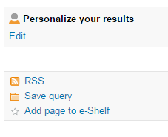
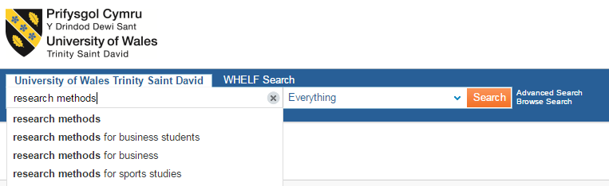
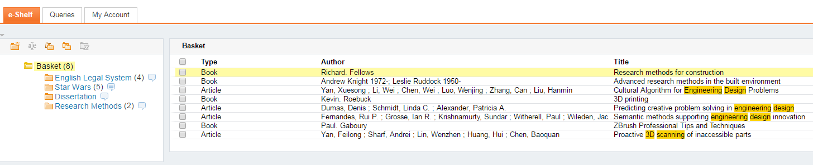
Library Catalogue e-shelf
Sign in
Save your search
Set alerts
Save to e-shelf
Create folders
Add notes
My Account
Organise reading lists
http://librarycatalogue.uwtsd.ac.uk

Slide 7

Customising databases
Saves you time
Provides extra functionality
Remembers your preferences
Creates a tailor made search experience

Slide 8

Save your search results
Track your search history
Save favourite resources
Organise your search results
Manage large quantities of data

Slide 9

Information straight to your inbox!
Search alerts
Publication alerts
Current awareness

Slide 10


Current awareness updates
Newsbank:
Receive news alerts by email
Select topic, publication or region
Choose alert frequency
Register for ‘My Collection’
Westlaw:
Receive legal updates by email
Create your own alerts using keywords, legislation or case names
Register for ‘My Westlaw UK’

Slide 11

Metrics & more…
Cited by
Usage statistics
Most popular downloads
Social media ‘shares’
Trending topics
Recommendations

Slide 12

Referencing Help
Citation formatting
Exporting references
Referencing software

Slide 13

Information on the move
Our library catalogue and other databases are mobile friendly
E-Books can be downloaded onto mobile devices
Some useful apps are also available
Access library resources when and where it’s most convenient for you!

Slide 14



Get social…
Follow us to find out what’s new…
Share what you’re reading! Remember to use permalinks
@UWTSDLib

Slide 15


Slide 16
For More information
Please contact your Academic Liaison Librarian:
Faculty of Art and Design
Emily Hywel
emily.hywel@uwtsd.ac.uk
Faculty of Architecture, Computing and Engineering
Samantha Scoulding
samantha.scoulding@uwtsd.ac.uk
Faculty of Business and Management
Vacant
Faculty of Education and Communities
Alison Evans
alison.evans@uwtsd.ac.uk
Faculty of Humanities and Performing Arts
Vacant

Slide 17
Image Credits
Stopwatch - https://unsplash.com/search/stopwatch?photo=p3Pj7jOYvnM
Book stack - https://unsplash.com/search/books?photo=o4-YyGi5JBc
Crowd - https://unsplash.com/search/crowd?photo=gcDwzUGuUoI
Open sign - https://unsplash.com/search/open?photo=R-HXWCbCBGU
Reading bench - https://unsplash.com/search/reading?photo=1MHU3zpTvro
Laptop - https://unsplash.com/search/reading?photo=1MHU3zpTvro
Question mark - https://unsplash.com/search/questionmark?photo=8xAA0f9yQnE
DNA - https://pixabay.com/en/dna-string-biology-3d-1811955/
Binoculars - https://unsplash.com/search/binoculars?photo=TFATaOllUC8
Mailbox - https://cdn.pixabay.com/photo/2015/11/17/23/33/mail-1048452__340.jpg
Newspaper - https://cdn.pixabay.com/photo/2014/09/13/21/40/newspapers-444449__340.jpg
Justice - https://cdn.pixabay.com/photo/2017/02/12/14/00/justice-2060093__340.jpg
Tape measure - https://cdn.pixabay.com/photo/2016/02/08/13/02/tape-measure-1186496__340.jpg
Dictionary - https://cdn.pixabay.com/photo/2016/08/25/15/30/dictionary-1619740__340.jpg
Smartphone - https://unsplash.com/search/mobile-phone?photo=pb_lF8VWaPU
Social media - https://unsplash.com/search/social-media?photo=DfMMzzi3rmg
Any Questions - https://cdn.pixabay.com/photo/2016/03/17/06/21/question-1262378__340.jpg

