Slide 1
BA Leadership and Management Skills for the Workplace
Developing Emotional Intelligence Skills for the Workplace
(BMSW6106)
Session 5
Mid-term Review

Slide 2
In this session we will…..
Review the main learning points from the Week 1-4
Provide guidance on assignment tasks
Respond to any questions related to the assignment tasks

Slide 3
Defining Emotional Intelligence
The ability to monitor one's own and others' feelings and emotions, to discriminate among them and to use this information to guide one's thinking and actions” (Salovey and Mayer, 1990)

Slide 4
Emotional Intelligence-key message
Everyone must learn how to understand and manage emotions in themselves and others.
Being able to effectively manage ourselves and our relationships with others.

Slide 5
Components of Emotional Intelligence

Slide 6
Models of Emotional Intelligence
Ability Model
  The Mayer-Salovey Model
Mixed Models
  The Goleman Model
  The Bar-On Model
Trait Model
  The Trait EI Model

Slide 7
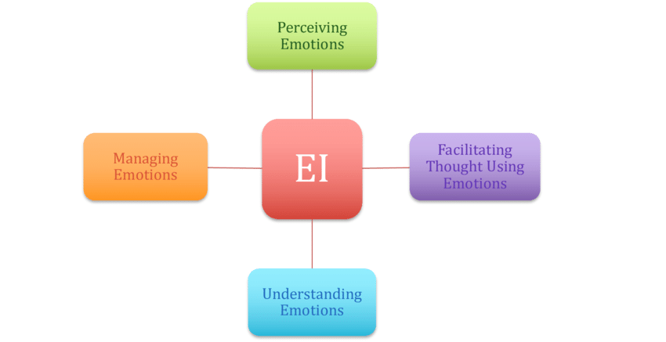
  The Mayer-Salovey (Ability) Model

Slide 8
The Mayer-Salovey (Ability) Model
Perception – identifying your own emotions and those of others in your social environment
Facilitation – using your emotion to interpret the world and changes in different ways
Understanding- being able to correctly express your emotions and learn how to communicate your needs
Management/Regulation – the ability to steer your emotions and those of peers

Slide 9
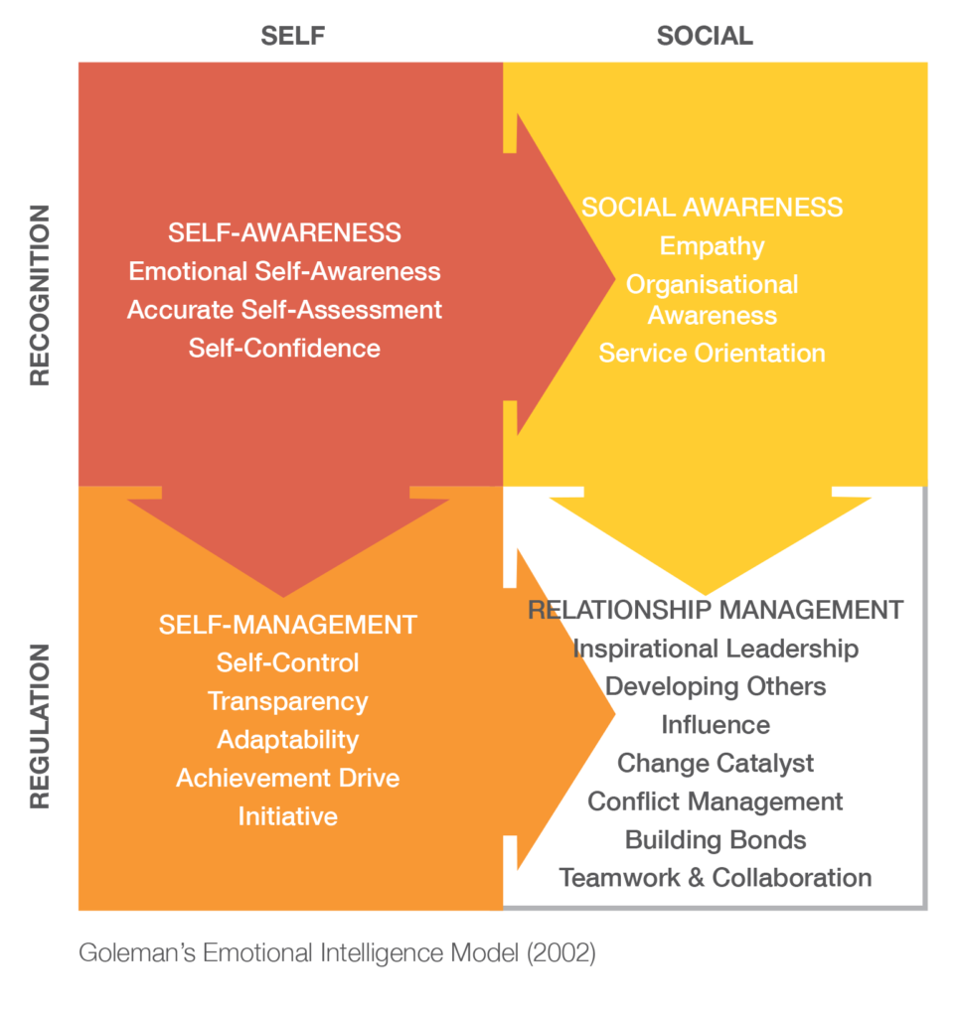
The Goleman Model

Slide 10
The Goleman Model
Individuals are born with a general emotional intelligence
Determines their potential for learning emotional competencies
Combination of various competencies and skills that contribute to successful managerial performance

Slide 11
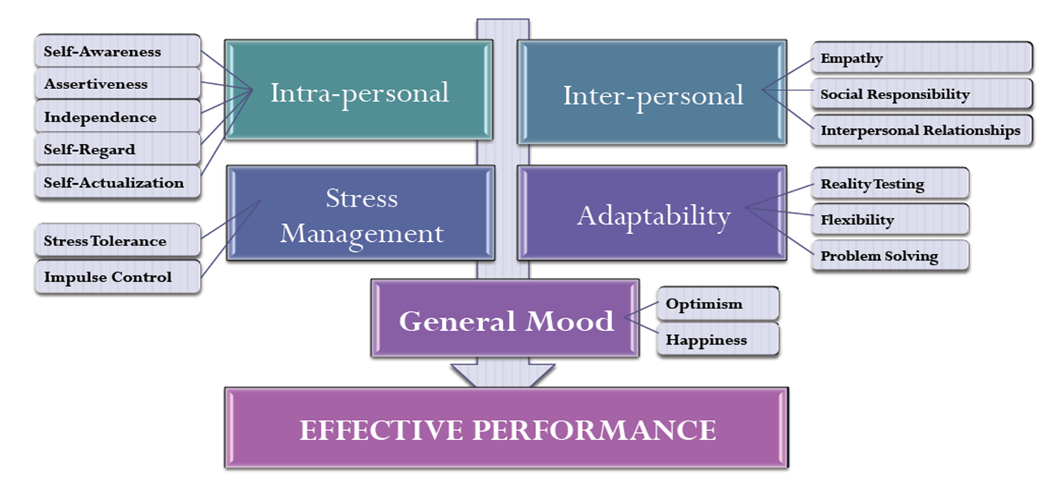
The Bar-On Model

Slide 12
The Bar-On Model
A combination of interrelated emotional and social competencies and skills of the individual.
These skills and social competencies determine how effectively individuals understand and express themselves.
Understand others and relate with them, and cope with daily demands, challenges and pressures.
Predicts performance and psychological wellbeing.

Slide 13
The Trait EI Model
Developed by Konstantin Vasily Petrides
Considers an individual's self-perceptions of their emotional abilities
Model covers the behavioural moods and self-perceived abilities, achieved by self-reporting

Slide 14
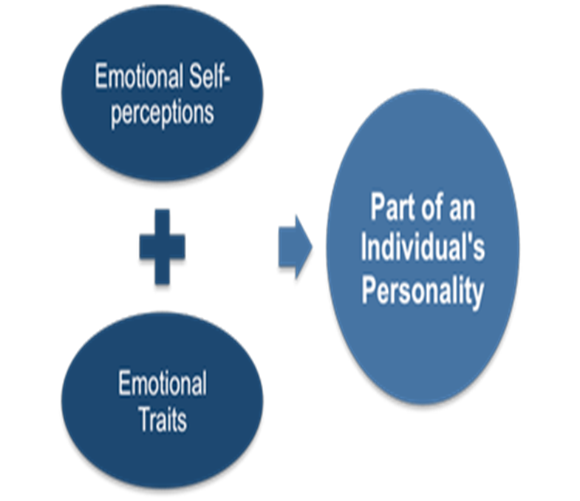
The Trait EI Model

Slide 15
Performance at work
The accomplishment of work tasks measured against defined standards of accuracy, completeness, cost, quality and speed (time).
The main aim of performance at work is to achieve the organisations objectives-strategic, tactical or operational

Slide 16
Using Emotional Intelligence to improve Work Performance
Dealing with situations where a conflict is likely to occur leading to non-productive behaviour
Limit offending others; customers, colleagues or management
Improved impulse control and avoid distractions

Slide 17

The Assignment Brief is on Moodle

Slide 18
Task 1
A 10-minute audio-visual recording critically discussing a an EI model of your choice

Slide 19
Task 1- Main Considerations
Show your understanding of EI (provide a definition of EI)
Briefly explain the purpose of models
Application of models in EI
Provide a description of your preferred model
Use your time properly
Avoid excessive dependence on prompts

Slide 20
Submission Details
Submission via Moodle
Task 1: 10 minute individual presentation
Submission: 26/02/21

Slide 21
Tutor Surgery Session
I am available to answer any questions
Note the deadline to submit!
All the best with your work

Slide 22


