Slide 1
BMSW 4004
Problem Solving Techniques:
Using situational assessment tools to identify and understand problems
Week 4: Session 1:
SWOT Analysis

Slide 2
Pick a Situation!
Think of a situation your organisation is facing or has experienced (e.g. loss of customers to competitors, untrained staff, poor ‘brand’ image etc.)
5 minute exercise!
Explain the impact this situation might have on your daily work.

Slide 3
What is SWOT Analysis?
Strengths
Weaknesses
Opportunities
Threats
SWOT analysis (strengths, weaknesses, opportunities and threats analysis) is a framework for identifying and analyzing the internal and external factors that can have an impact on the viability of a project, product, place or person.
Notes:
SWOT analysis (strengths, weaknesses, opportunities and threats analysis)
SWOT analysis (strengths, weaknesses, opportunities and threats analysis) is a framework for identifying and analyzing the internal and external factors that can have an impact on the viability of a project, product, place or person.
SWOT analysis is most commonly used by business entities, but it is also used by nonprofit organizations and, to a lesser degree, individuals for personal assessment. Additionally, it can be used to assess initiatives, products or projects.
The framework is credited to Albert Humphrey, who tested the approach in the 1960s and 1970s at the Stanford Research Institute. Developed for business and based on data from Fortune 500 companies, the SWOT analysis has been adopted by organizations of all types as an aid to making decisions.
When and why you should do a SWOT analysis
A SWOT analysis is often used at the start of or as part of a strategic planning exercise. The framework is considered a powerful support for decision-making because it enables an entity to uncover opportunities for success that were previously unarticulated or to highlight threats before they become overly burdensome. For example, this exercise can identify a market niche in which a business has a competitive advantage or help individuals plot career success by pinpointing a path that maximizes their strengths while alerting them to threats that can thwart achievement.
Elements of a SWOT analysis
As its name states, a SWOT analysis examines four elements:
Strengths: Internal attributes and resources that support a successful outcome.
Weaknesses: Internal attributes and resources that work against a successful outcome.
Opportunities: External factors that the entity can capitalize on or use to its advantage.
Threats: External factors that could jeopardize the entity's success.
A SWOT matrix is often used to organize items identified under each of these four elements. A SWOT matrix is usually a square divided into four quadrants, with each quadrant representing one of the specific elements. Decision-makers identify and list specific strengths in the first quadrant, weaknesses in the next, then opportunities and, lastly, threats.
Entities undertaking a SWOT analysis can opt to use any one of the various SWOT analysis templates in existence; these templates are generally variations of the standard four-quadrant SWOT matrix.
How to do a SWOT analysis
A SWOT analysis generally requires decision-makers to first specify the objective they hope to achieve for the business, organization, initiative or individual.
From there, the decision-makers list the strengths and weaknesses as well as opportunities and threats.
Cate Costa provides an example
of a simple SWOT analysis.
Various tools exist to guide decision-makers through the process, often using a series of questions under each of the four elements. For example, decision-makers may be guided through questions such as "What do you do better than anyone else?" and "What advantages do you have?" to identify strengths; they may be asked "Where do you need improvement?” to identify weaknesses. Similarly, they'd run through questions such as "What market trends could increase sales?" and "Where do your competitors have market advantages?" to identify opportunities and threats.
Using a SWOT analysis
A SWOT analysis should be used to help an entity -- whether it is an organization or an individual -- to gain insight into its current and future position in the marketplace or against a stated goal.
The idea is that because entities can see competitive advantages and positive prospects, as well as existing and potential problems, they can develop plans to capitalize on positives, address deficits or do both.
In other words, once the SWOT factors are identified, decision-makers should be better able to ascertain if an initiative, project or product is worth pursuing and what is required to make it successful. As such, the analysis aims to help an organization match its resources to the competitive environment in which it operates.
SWOT analysis pros and cons
SWOT analysis can help the decision-making process by creating a visual representation of the various factors that are most likely to impact whether the business, project, initiative or individual can successfully achieve an objective.
Although that snapshot is important for understanding the multiple dynamics that impact success, a SWOT analysis does have its limits. The analysis may not include all relevant factors for all four elements, thereby giving a skewed perspective. Moreover, because it only captures factors at a particular point in time and doesn't allow for how those factors could change over time, the insight it offers could have a limited shelf life.

Slide 4
SWOT Analysis
These are internal
These are negative
Strengths
Weaknesses
These are positive
These are external
Opportunities
Threats
Notes:
After this slide do activity one of “SWOT class activities”

Slide 5
Why do we want to use SWOT Analysis?
Identify and categorise
Build a comprehensive picture of a situation
Create links between positive and negative sides of a situation
  Can the organisation use one of it’s strengths to reverse/limit one of it’s weaknesses?
  Can the organisation avoid a threat through taking advantage of an opportunity?
Create links between internal and external sides of a situation
  Can the organisation use a strength to take advantage of one of the market opportunities?
  Might one of the organisations weaknesses hold it back from opportunities?

Slide 6
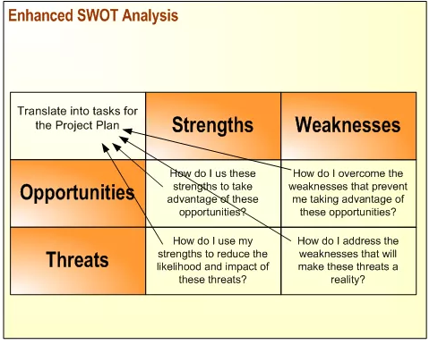
SWOT - Problem Solving Tool
Notes:
To evaluate a public relations project or campaign, you can use the SWOT analysis, a strategic planning method that allows you to get a better understanding of the situation so you can make justified and positive adjustments.
This tool, credited to Albert Humphrey, is one that, if done at the beginning of a project or start of a decision-making process, can certainly be returned to at any point of the projects implementation. This SWOT analysis is the core of your project, its foundation, that if you are ever lost while on the path to making a decision, you can simply refer back to your SWOT analysis to redirect yourself on a profitable course.
Strengths: Attributes of the organization that are helpful to achieving the objective.
Weaknesses: Attributes of the organization that are harmful to achieving the objective.
Opportunities: External conditions that are helpful to achieving the objective.
Threats: External conditions that are harmful to achieving the objective.
What you may have noticed is that this analysis focuses both on internal affairs as well as external. Strengths and Weaknesses are regarded distinctly as internal factors, whereas Opportunities and Threats are regarded distinctly as external factors.
It is extremely important to label the conditions and attributes correctly in relation to whether they are internal or eternal as it is this sort of labeling that assists you in prioritizing, classifying your actions in order of importance.

Slide 7
An example of SWOT Analysis in action
The organisation ‘training audit’ has identified an increase in customer care qualifications amongst staff
Strengths
Weaknesses
Opportunities
Threats

Slide 8
Revisit your Situation!
Return to the situation you identified earlier….
15 minute exercise!
Create a SWOT Analysis of the situation, identifying strengths, weaknesses, opportunities, and threats. As before, explain the potential impact of the situation.

Slide 9
Understanding situations to understand problems!
How might SWOT Analysis help you to identify and understand problems in your workplace?
How might SWOT Analysis help you to solve problems in your workplace?
What are the limitations of using SWOT
Notes:
Benefits and limitations of SWOT analysis
A SWOT (strengths, weaknesses, opportunities and threats) analysis can help you identify and understand key issues affecting your business, but it does not necessarily offer solutions. You should be aware of the limitations as well as the benefits of a SWOT analysis before you decide to conduct one. Knowing what you can reasonably expect to achieve will make the SWOT analysis more useful for your business, and will save you time. Ultimately, you must be prepared to spend the time to review your SWOT analysis and use it to determine the best way forward in your business.
Benefits of SWOT analysis
The main advantages of conducting a SWOT analysis is that it has little or no cost - anyone who understands your business can perform a SWOT analysis. You can also use a SWOT analysis when you don't have much time to address a complex situation. This means that you can take steps towards improving your business without the expense of an external consultant or business adviser.
Another advantage of a SWOT analysis is that it concentrates on the most important factors affecting your business. Using a SWOT, you can:
understand your business better
address weaknesses
deter threats
capitalise on opportunities
take advantage of your strengths
develop business goals and strategies for achieving them.
Limitations of SWOT analysis
When you are conducting a SWOT analysis, you should keep in mind that it is only one stage of the business planning process. For complex issues, you will usually need to conduct more in-depth research and analysis to make decisions.
Keep in mind that a SWOT analysis only covers issues that can definitely be considered a strength, weakness, opportunity or threat. Because of this, it's difficult to address uncertain or two-sided factors, such as factors that could either be a strength or a weakness or both, with a SWOT analysis (e.g. you might have a prominent location, but the lease may be expensive).
A SWOT analysis may be limited because it:
doesn't prioritise issues
doesn't provide solutions or offer alternative decisions
can generate too many ideas but not help you choose which one is best
can produce a lot of information, but not all of it is useful.

Slide 10
Understanding context to understand problems?
Why is it so important to understand context?
Why do we have to think about problems within context in order to solve them?
Notes:
context
ˈthe circumstances that form the setting for an event, statement, or idea, and in terms of which it can be fully understood.
Context definition
noun. the parts of a written or spoken statement that precede or follow a specific word or passage, usually influencing its meaning or effect: You have misinterpreted my remark because you took it out of context. the set of circumstances or facts that surround a particular event, situation, etc.
What is Problem Context
1. A set of considerations constituting a problem situation including goal, constraints, as well as environmental conditions

Slide 11
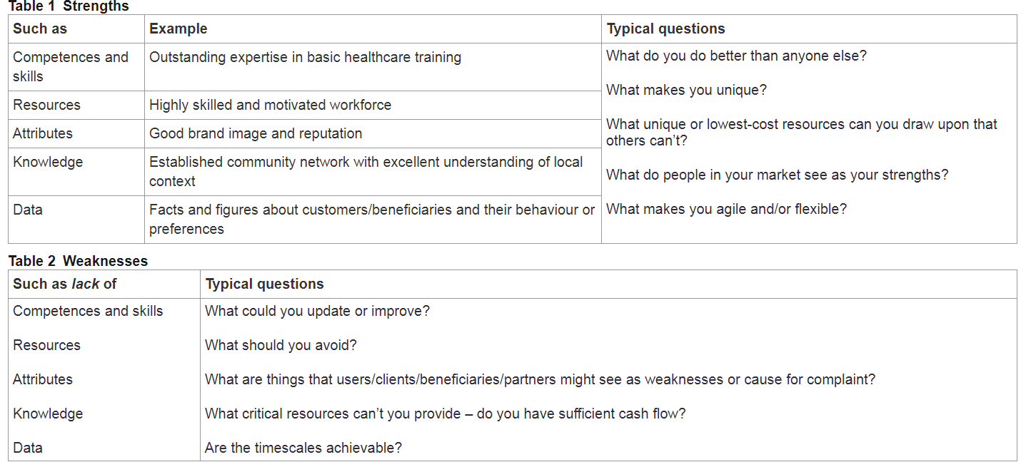
The four components of SWOT analysis
Notes:
So far, we’ve established that SWOT stands for:
Strengths
Weaknesses
Opportunities
Threats
These components could be described as providing different perspectives through which to explore an issue. We’ll now look at each of these in more detail.
3.1 Strengths and weaknesses
Strengths and weaknesses refer to factors in the internal environment of the project.

Slide 12
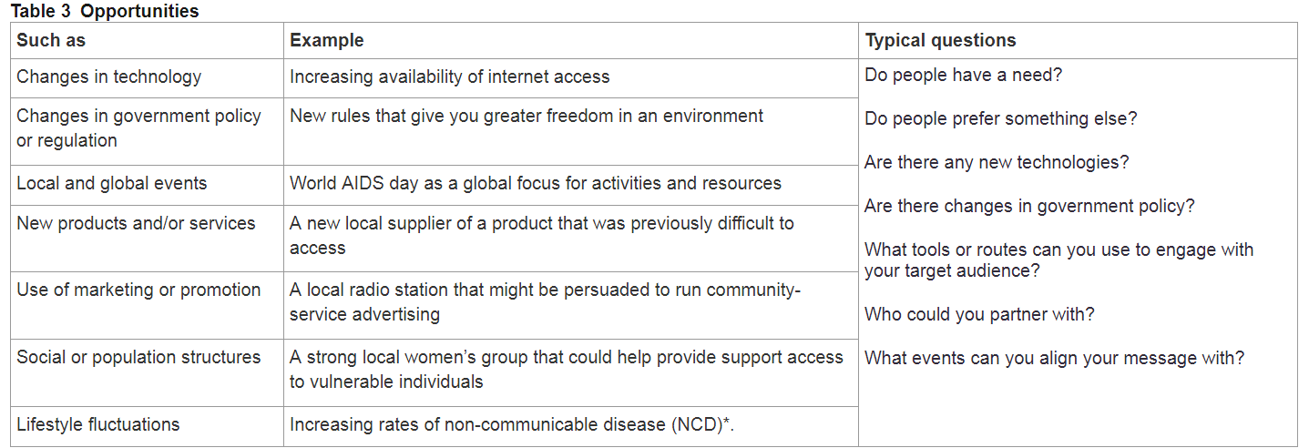
The four components of SWOT analysis
Notes:
Opportunities and threats
Opportunities and threats refer to factors in the external environment around the project.

Slide 13
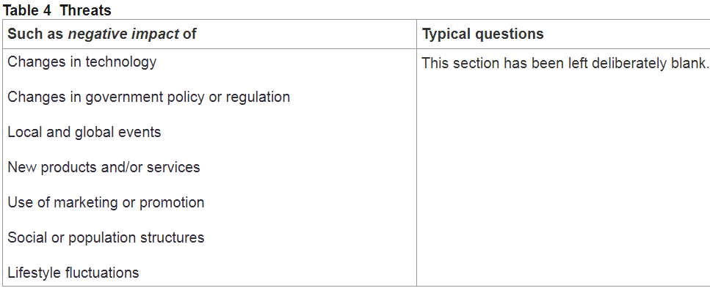
The four components of SWOT analysis
Notes:
Key point
It is important that the four components of the SWOT analysis are considered together and not in isolation. This is because a factor can be both a threat oran opportunity, depending on the context and how you are able to respond to it

Slide 14
Closing thoughts
Your module objectives:
  Identify work based problems through the application of problem solving tools;
  Apply problem solving tools to identify obstacles and resolutions;
  Organise knowledge and learning through use of a range of information resources, and present work at the appropriate level.
How can you use tools like SWOT Analysis and PESTLE Analysis to achieve these…?
Notes:
After this slide do activities in “SWOT class activities” and maybe Philtest file if you can find the case.

