Slide 1

Group presentation, Yamaha group analyses
Students: Silvana Montalvo Riofrio 2130452
Ionica Mihaita Boghiceanu 2224220
Ion Cuciorva 2326046
Lecturer: Laila Maazouz
Module: Introduction to Business
Module code: LCBB4007_LON

Slide 2

Overview of Yamaha Corporation

Slide 3

Yamaha Corporation: A Global Leader
Established in 1887 as a piano manufacturer (Hwang, 2022).
Evolved into a multinational conglomerate with diverse offerings.
Headquarters in Shizuoka, Japan.
Mission: "Create 'Kando' Together" - forging emotional connections with customers (Integrated Report, 2022).

Slide 4

Yamaha's Wide Range of Products
Musical Instruments: Pianos, guitars, drums, wind instruments, synthesizers.
Audio Equipment: Home theater systems, hi-fi components, headphones.
Recreational Vehicles: Motorcycles, personal watercraft, all-terrain vehicles.
Golf Products: Clubs, accessories, apparel.
Other Sectors: Semiconductors, industrial machinery, robotics.

Slide 5

Yamaha's Worldwide Operations
Workforce of approximately 28,000 employees.
Presence in Japan, the United States, Europe, Asia.
Holding company structure with a Board of Directors.
Diverse subsidiaries and affiliated companies across various segments (About Us - Yamaha Corporation, n.d.).

Slide 6
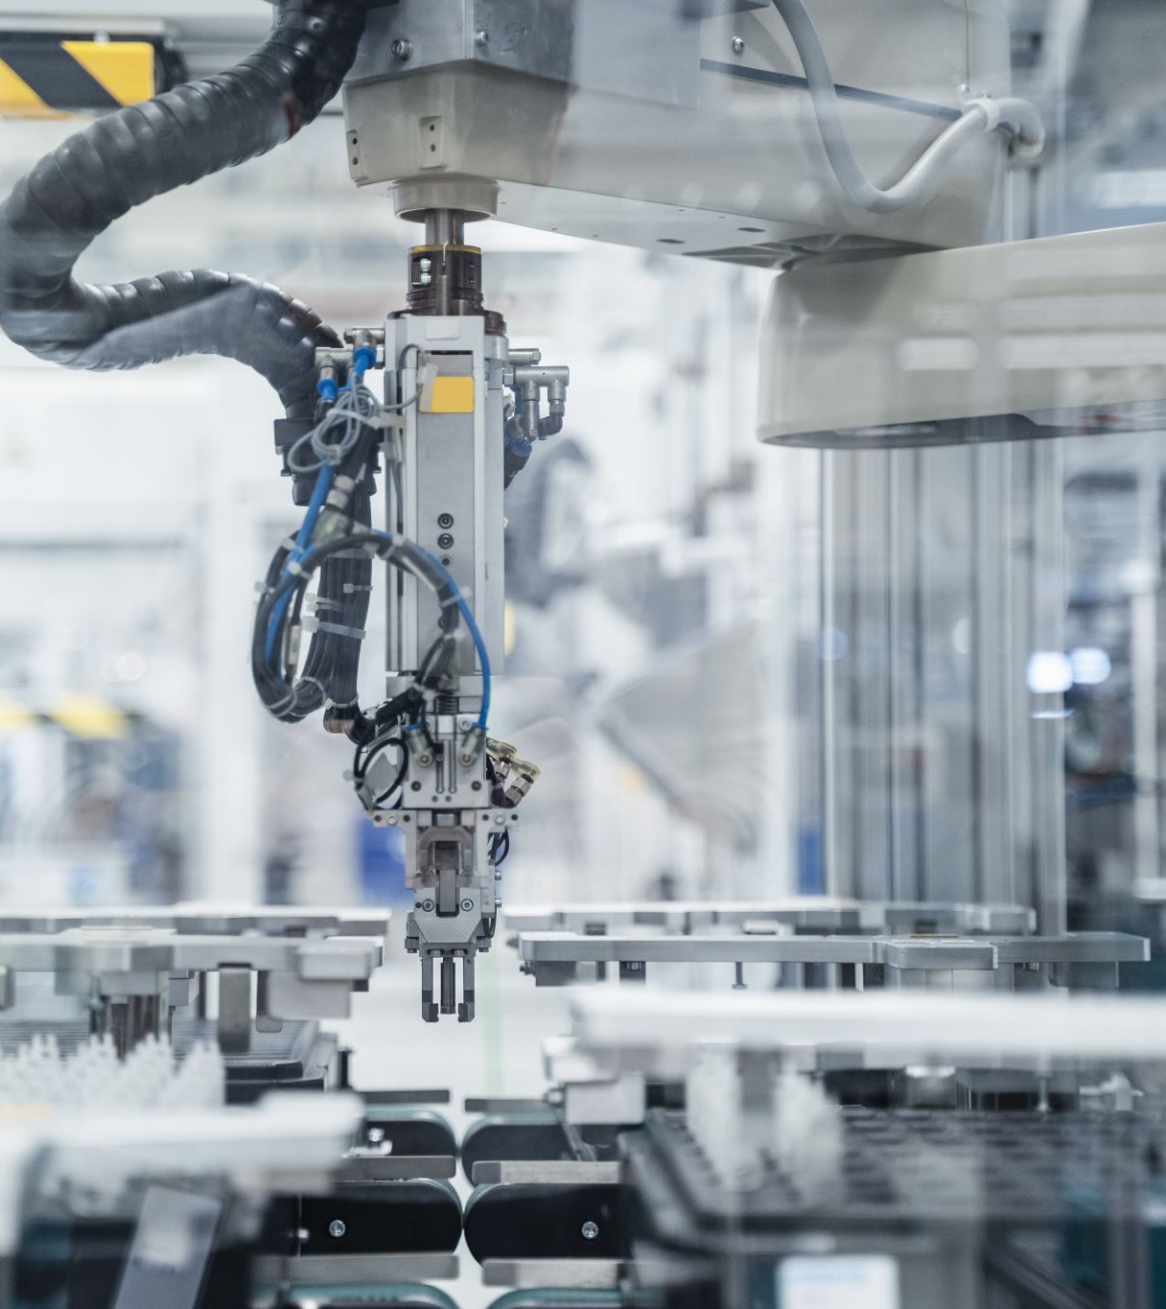
Yamaha's Strategic Business Units
Musical Instruments: Core division with a range of instruments and professional audio equipment (Reiffenstein, 2006).
Audio Equipment: Catering to audiophiles with high-quality audio systems.
Semiconductors: Developing components for electronic devices.
Industrial Machinery: Producing robots and machinery for various industries.
Recreational Vehicles & Golf Products: Offering products for outdoor activities and sports.

Slide 7
Yamaha's Legacy and Future Prospects
A history of innovation and quality across multiple industries.
Continuously adapting to market changes and exploring new opportunities.
Committed to maintaining global leadership and enhancing customer experiences.

Slide 8
References
About Us - Yamaha Corporation. (n.d.). Www.yamaha.com. https://www.yamaha.com/en/about/
HWANG, P. (2022). Trends and Characteristics of Musical Instrument Industry in Hamamatsu, Japan. 浜松学院大学研究論集, (18), 53-64.
Integrated Report . (2022). https://global.yamaha-motor.com/ir/integrated-report/integrated2022/pdf/YMC_IR2022_E_01.pdf?20220804
Reiffenstein, T. (2006). Codification, patents and the geography of knowledge transfer in the electronic musical instrument industry. The Canadian Geographer/Le Géographe canadien, 50(3), 298-318.

Slide 9
Introduction
A Swot analysis will be made, to show the strength, weakness, opportunity, and threats of Yamaha group company, followed by PESTEL analysis which will determinate the place of the company on the market, with its political, economic, social, technological, environmental, and legal factors.

Slide 10
Strength
Large range of products
Long period on the market
Financial strength
Good brand image
Weaknesses
By being under the Japanese management can be a weakness
The price range may be considered to be high
Being a premium product can be considered as a target therefore people avoid buying them.
Opportunities
Globally dynamic market
Regulate developments to respect the environmental regulations
Threats
Export and international law restrictions
Struggling to change consumers behavior to boost the sales

Slide 11
PESTEL Analysis of Yamaha group
Political | Economical | Social | Technological | Environmental | Legal
Straighter control from governments Local partnership to expand the business Focusing on stabile political environments | Economic changes Jobs and spendings New opportunities Watching the economy movement World exchange | Social factors can affect the company and its products Shifting in trends can affect the buyers The company appeals to different tastes than older generations Cultural differentiation on selling the products | High interest in new technology Using social media to reach bigger range of customers Automatization and using it in its favour Investing in technology is the key of doing well | Caring about environment is the key point of the company Complying with government rules regarding the environment Using eco-friendly in producing the products Investing in reducing pollution | Working with governments to follow the rules Avoiding fines and caring not to look bad to customers Using systems to report illegal issues and acting ethical on it Adjusting policies according to the market

Slide 12
Reference list
Pratap, A. (2018) YAMAHA MOTORS PESTEL ANALYSIS, Notesmatic. Available at: https://notesmatic.com/yamaha-motors-pestel-analysis/ (Accessed: 31 March 2024).
SWOT Analysis example - Yamaha (2021) www.oboolo.com. Available at: https://www.oboolo.com/blog/our-tips/swot-analysis-example-yamaha-13-10-2021.html (Accessed: 31 March 2024).
Yamaha Motor Co., Ltd. (2019) Yamaha Motor Global Site. Available at: https://global.yamaha-motor.com/ (Accessed: 31 March 2024).

Slide 13
Introduction:
A stakeholder is a individual or organization with a same interest in a company and can be affected by them actions or decisions and they are divided into two categories.
Stakeholder primary:
Suppliers
Employees
Managers
Stakeholder secondary:
Government
Customers
Investors

Slide 14
Stakeholder Intern:
The suppliers of Yamaha corporation are based all around the world: Japan, China, Taiwan, Indonesia, Thailand, Vietnam, India, Brazil, America.
Because Yamaha is worldwide it has employees on all sides of the world like Europe, Asia, America and Middle East & Africa.
Yamaha Corporation was form by: Two Directors, Six Outside Directors, President and Representative Executive Officer, two Managing Executive Officers, two Executive Officer, until 2020 when was change in:
  Executive Officer, Chief General Manager of Design Center
  Executive Officer, Senior General Manager of 3S Advanced Countries Section, Motorcycle Business Operations
  General Manager of Frontier Design Division, Design Center
  General Manager of Production Division, Robotics Business Unit, Solution Business Operations
  General Manager of Product Engineering Division, Surface Mount Technology Section, Robotics Business Unit, Solution Business Operations Manager of Risk Management & Compliance Group, Sustainability Division, Human Resources & General Affairs Center
  General Manager of Corporate Design Division, Design Center
  Senior General Manager of Research & Development Section, Advanced Technology Center
  Manager of System Planning Group, SCM Division, CS Center
  Manager of Mechanical Engineering Group, Product Engineering Division, Surface Mount Technology Section, Robotics Business Unit, Solution Business Operations
  Manager of Robot Production Group, Production Division, Robotics Business Unit, Solution Business Operations
  General Manager of Procurement Division, Robotics Business Unit, Solution Business Operations

Slide 15
Stakeholder Extern:
Government: Fair and honest operation, is important for companies, "Prevention of Corruption" refers to the measures taken to stop bribery, fraud, and other forms of unethical behaviour in business and government. with a focus on promoting the common good and serving the interests of the public, Fair trade practices for everyone.
Customers: Yamaha Motor Group's corporate mission is to be a "Kando creating company" and offer people new-generation technology. Yamaha Company aims to innovate and provide value to customers.
"* Kando is a Japanese word for the simultaneous feelings of deep satisfaction and intense excitement that we experience when we encourage something of exceptional value."
Investors: Individual investors and others, National and local governments, Financial institutions, Other domestic companies, Foreigners, and Securities companies.

Slide 16
Conclusion
Yamaha Corporation Group is based on a strong management strategy and marketing on the entire world.
The Company Yamaha values the experience of customers and customer service.​
The manufacture of production is a placet where the risk of inflation is low, and goods in have a low price.
Yamaha Corporation is keeping tight communication with suppliers, investors and employees.
Reference:
Trading Economics (2024) TRADING ECONOMICS | 20 Million INDICATORS FROM 196 COUNTRIES, Tradingeconomics.com. Available at: https://tradingeconomics.com/ (Accessed: 31 March 2024).
global.yamaha-motor.com. (n.d.). New Organizational Reforms and Personnel Changes at Yamaha Motor - News Releases | Yamaha Motor Co., Ltd. [online] Available at: https://global.yamaha-motor.com/news/2020/0414/personnel.html [Accessed 31 Mar. 2024].
Yamaha Motor Co., Ltd. (n.d.). Global Links - Company information. [online] Available at: https://global.yamaha-motor.com/link/ [Accessed 31 Mar. 2024].
YAMAHA MOTOR CO., LTD. (n.d.). Global Manufacturing Network. [online] Available at: https://global.yamaha-motor.com/business/cf/business/global/#:~:text=Providing%20%E2%80%9CMade%20in%20Japan%E2%80%9D%20Quality [Accessed 31 Mar. 2024].

