Slide 1
Understanding Film Technique
Cinematography and Editing #3

Slide 2
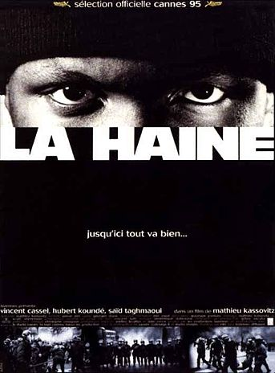
La Haine
Kassovitz, 1995
Cinematography
  Telephoto
  Deep Focus
  Dolly zoom
  Establishing shot
  Reaction shot
  Offscreen space
  ‘Reveal’
Contexts
  Realism
  Continuity editing

Slide 3
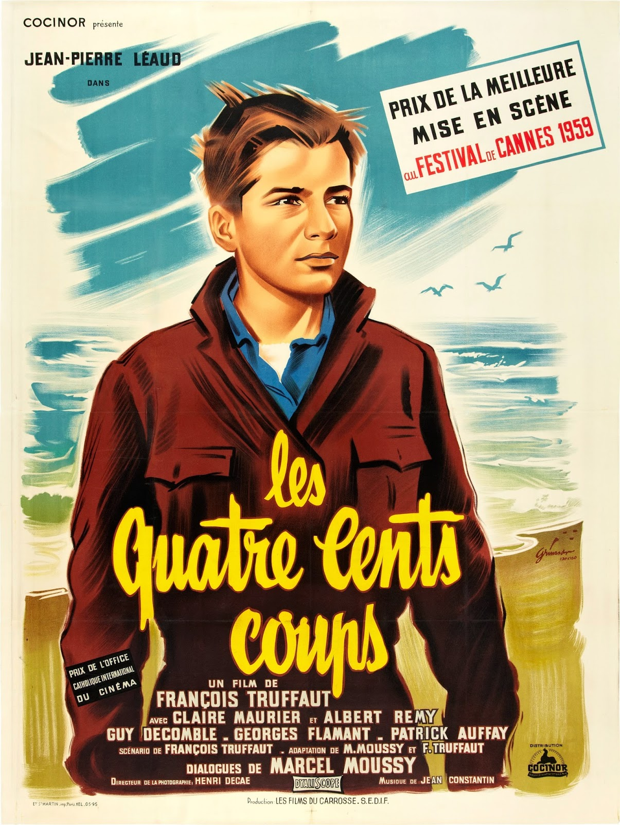
The 400 Blows
Truffaut, 1959
Location shooting
Long shots/long takes
Editing:
  Lap dissolve
  Jump cut
Contemporary subject
‘Coming of Age’
Auteur theory
Crime
Hollywood and crime?

Slide 4
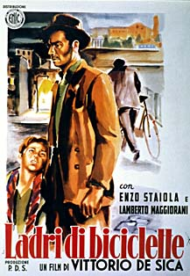
Bicycle Thieves
De Sica, 1948
Location shooting
Long shots/long takes
Natural lighting
Naturalistic editing
Contemporary subject
Everyday working class life
Wealth/poverty
Social status (and lack of)
Crime in social context
Hollywood and crime?

