Slide 1

Professional development for sports industry placement
Michael Ridgway
1701446

Slide 2
Potential future career
Working with a professional sports team - business / marketing
01
Sports agent – player representation
02
Sports coach – football, rugby, multi skills
03

Slide 3

Benefits of a placement
Build up confidence
Awareness of any developments within the industry
Increases employability
Develop interpersonal skills

Slide 4
Placements considered
Swansea City football club
Bristol city football club
Cardiff city football club
Principality stadium
Celtic Manor
The Vale resort

Slide 5

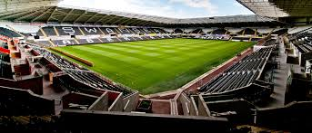
Swansea City football Club
positives:
approximately 1 hour 15 minutes travel by car from home
Football player and supporter
Good knowledge of the club
Professional sports team
Various career pathways
Negatives
Difficult industry to get into
Limited placement opportunities if any
Apply through HR

Slide 6

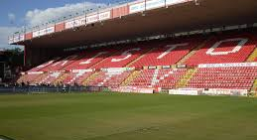
Bristol City football club
Positives
Offer a placement scheme with application form
40 minutes travel time
Professional sports team
Negatives
High number of applicants – limited spaces
Difficult industry to pursue a career in

Slide 7

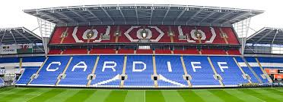
Cardiff city football club
Positives:
Professional sports club
Various career opportunities
30 minutes travel time
Negatives
Apply through HR
High number of applicants
Difficult industry to get into

Slide 8
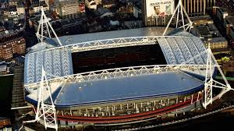
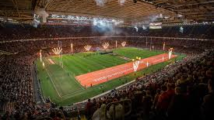
Principality Stadium
positives
Apply through application on website
National stadium of Wales
30 minutes travel time
Various career opportunities
Negatives
High number of applicants
Holds other events other than sports
limited sports career opportunities

Slide 9
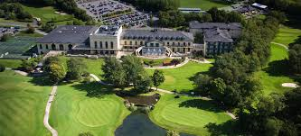
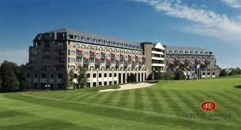
Celtic Manor hotel And Vale resort
Positives
Both within 40 minutes travel time
Various career opportunities in different sectors
Understanding of facility management
Negatives
Limited sports career opportunities
Apply through HR

Slide 10



Other options considered
Challenger sports
Rockley
Camp America

Slide 11
Summary
Preferred option – Swansea City Football Club
2nd choice – Principality stadium
3rd choice – Cardiff city Football Club

Slide 12




Any questions?

