Slide 1
Festivals and Events Management
BMTP6017

Slide 2
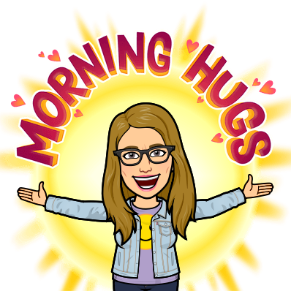
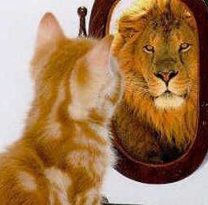
Have you awakened your inner lion today?!

Slide 3
This week
• Policy and strategy
• Economic considerations / Impacts
• Key performance indicators

Slide 4
Policy & Strategy
Event strategy is the overall plan of the event. It will include all tasks, from concept to wrap up and everything in-between. It should have a template or defined process for each step
Strategic and business planning is good business. It is important for all event entities regardless of size. The processes should be seen as tools for internal and (when appropriate) external use.

Slide 5
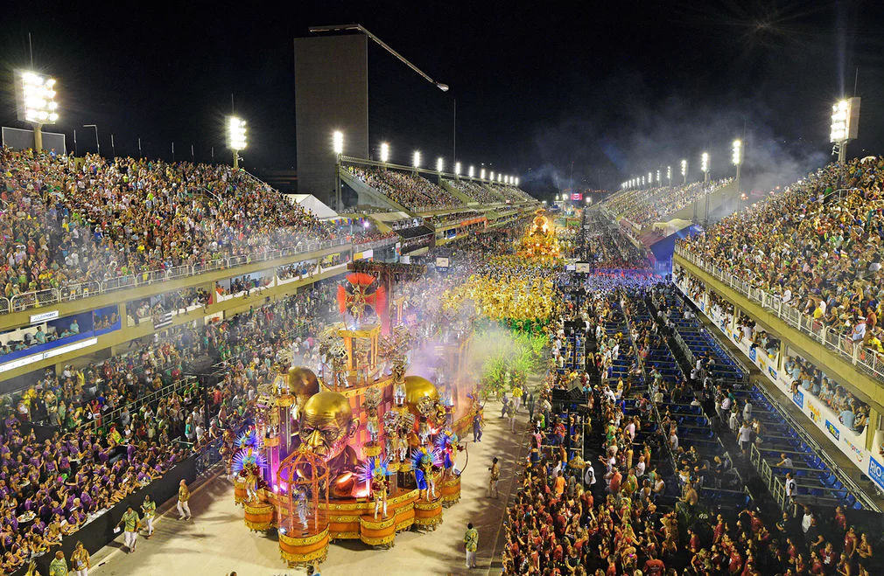
Economic Impact of Events

Slide 6
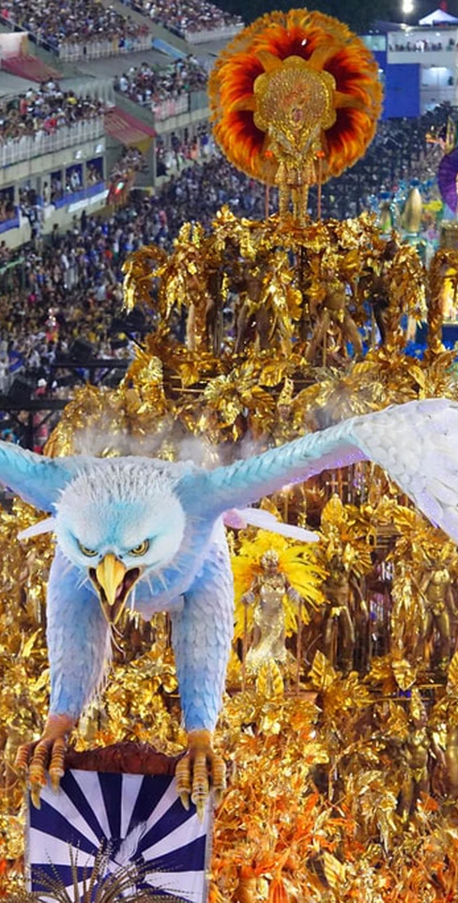
What determines the scale of economic impacts? Rio Carnivale
Brazil’s festivities are associated with Catholicism and carnaval—a word derived from the Latin carne vale, meaning ‘goodbye flesh’—was originally a food festival where Catholic worshipers feasted in preparation for the following 40 days of Lent that started on Ash Wednesday
Portuguese settlers brought this festival with them from Europe when they colonized Brazil in the early 1600s, though back then, it was celebrated as formal balls in the grandeur of the Portuguese elite’s homes
Afro-Brazilians to start their own Carnival with African-inspired dances, music and the introduction of the fancy dress element by dressing up in a way that mocked the white Brazilian elite
20th century parties take to the streets and it became a festival that everyone enjoyed together. In Rio de Janeiro, samba—which was formerly considered the music genre of the poor and slaves—came to represent Carnival and in the early 1920s, the first samba schools were formed. This led to the samba schools starting to compete in the early 1930s through performances in the now world-famous parades in a bid to be crowned the winner of Carnival.
Events are held all over Brazil however Rio is the focal point.
Brazilians and foreigners alike take to Brazil’s streets to let go for one week and enjoy this traditional aspect of Brazilian culture.
500,000 visitors to the event (excludes locals)
What do you know about Rio? What needs to be in place to maximise the level of economic impact?
What does this tell us about the political, economic and environmental world around us?

Slide 7
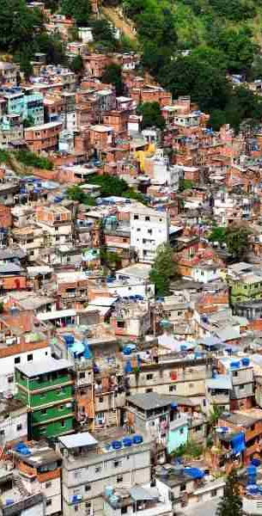
political, economic and environmental impacts
Carnival contributed with around 7.91 billion Brazilian reals to the Brazilian economy in 2019, and this value was expected to reach 7.99 billion reals in 2020. The largest share of this revenue would be generated in the state of Rio de Janeiro.
During past Carnival seasons, the tourism sector generated annually more than seven billion Brazilian reals in revenue and approximately 25 thousand temporary jobs.
Pandemic hit - Cancelled carnival has heavy effect on Brazilian economy
Roughly $1.5 billion may not circulate, in addition to nearly 25,000 jobs not created, according to estimate - Gabriel Toueg |12.02.2021
https://earth5r.org/top-4-environmental-issues-in-rio-de-janeiro-how-to-solve-them-with-circular-economy/

Slide 8
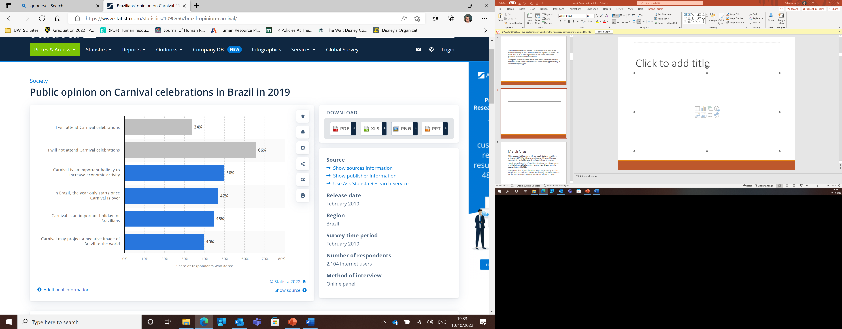
Brazil: opinion on Carnival 2019
Published by Teresa Romero, Jul 5, 2021
In a survey conducted in February of 2019, most Brazilians surveyed said they would not join public celebrations during Carnival season. While 34% of respondents answered they would attend Carnival festivities, 66% would spend the holidays in another way. Up to 4% of the people interviewed confirmed that, in Brazil, the year only starts once Carnival is over.

Slide 9
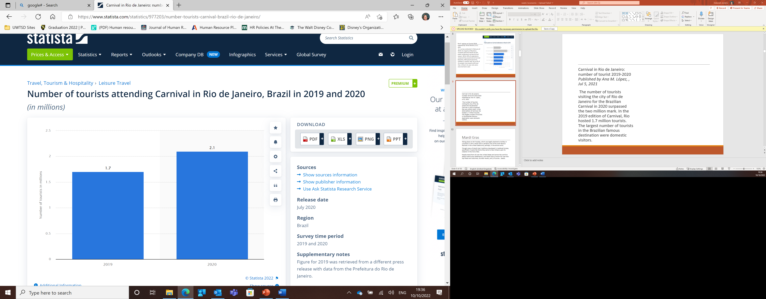
Carnival in Rio de Janeiro: number of tourist 2019-2020 Published by Ana M. López, , Jul 5, 2021
The number of tourists visiting the city of Rio de Janeiro for the Brazilian Carnival in 2020 surpassed the two million mark. In the 2019 edition of Carnival, Rio hosted 1.7 million tourists. The largest number of tourists in the Brazilian famous destination were domestic visitors.

Slide 10
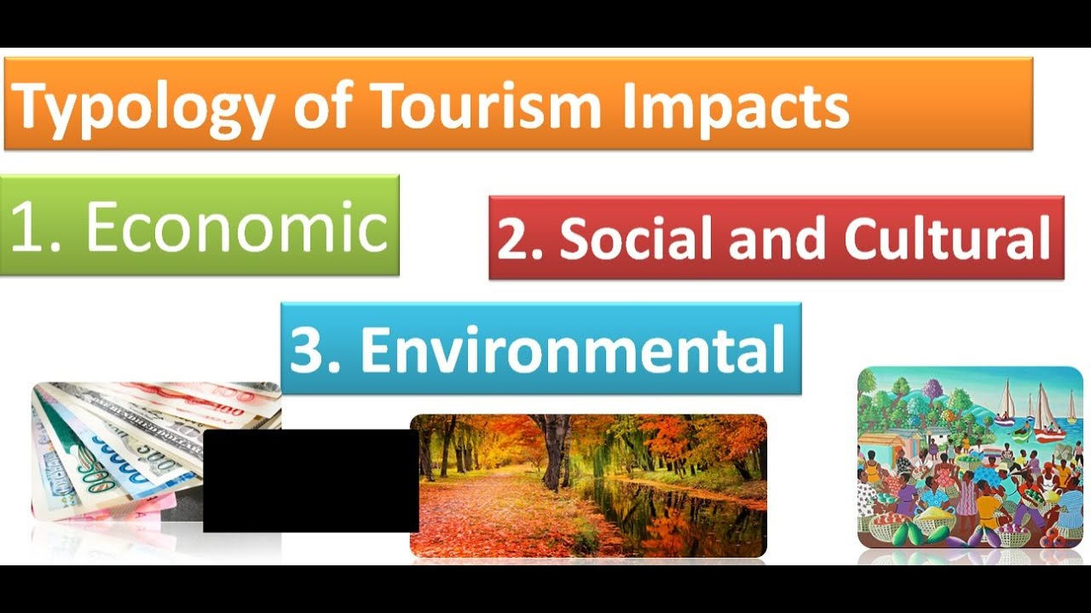
Macro environmental analysis
PEST (Allen et al, 2008) or
S P E C T E:
Social
Political
Economic
Cultural
Tourism
Environmental
Notes:
Social, political, economic, cultural, tourism, environmental

Slide 11
Examples of external factors
Upheaval in the Insurance industry
Environmental sustainability
Global Financial Crisis
Name some more?

Slide 12
Tourism Impacts
Images – social media
Branding and Rebranding
Destinations /Resorts
Hotels - accommodation
Attractions – cultural links
Long term/short term- return Legacies – long lasting
Visitor Profile = market segments
Visitor numbers = changing
Demand = supply
Short stay – high spend
Conference Market = business

Slide 13
Social Impacts
Regeneration – community spirit
Visitor Profile v host profile- culture
Immigration/population movement
Displacement of locals
Working hours, lifestyles and employment = spend
Increased expectations = experiences
Commercialism and money power = mass tourism
Seasonality – weather
Crime rates – safety issues
Developments – urbanisation and facilities = infrastructure
Services – hospital, transport
Unused facilities -
Royal wedding effect – sense of spirit
Legacies – long lasting effects

Slide 14
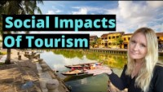
The Social Impacts Of Tourism That We All NEED To Know About!

Slide 15
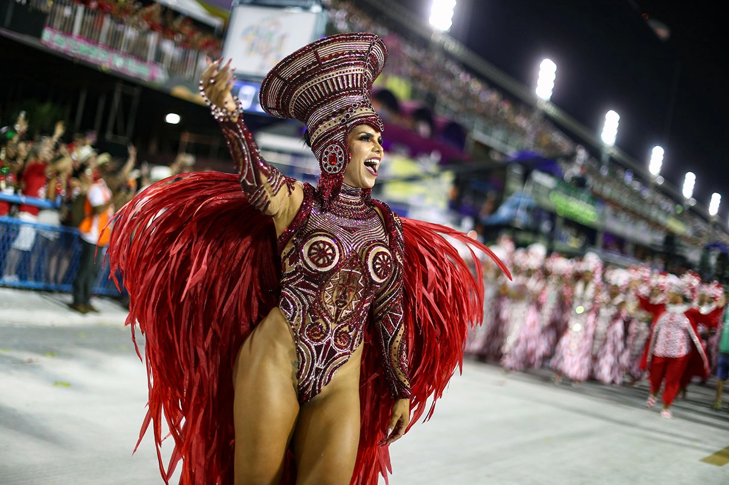
Cultural Impacts
National Cultures and Identities
Cultural Democracy
Diversity – link to markets
Mass Culture
Elite/high Culture = price
False Culture = authenticity
Breakdown of culture
Decline in traditional values and beliefs
Westernisation and globalisation
Commercialisation = mass tourism
Them and us cultures = behaviours
Seasonality – weather / experiences

Slide 16
What is staged authenticity?
According to the dictionary, authenticity is; “Not false of copied: Genuine and original, as opposed to being a fake or reproduction”
Theorists such as MacCannel (1973) and Cohen (1972) state that tourism is a modern quest for authenticity.
Staged authenticity is essentially a cultural practice, event or activity that is ‘staged’ for the purpose of the tourists. It could be that this is an outdated practice or that it has been modified for the purpose of tourism
Think Scotsman wearing a kilt, Chicken Tikka Masala at an Indian restaurant, Maasai Mara tribe carrying swords. These are all examples of staged authenticity.
Dungeon tours - It’s not bad. Its just not authentic. At all.
Whilst this is a great day out, especially for kids, it is a prime example of Disneyfication. In other words, the authenticity of the dungeons has been exchanged for role-play, thrill rides and fun activities.

Slide 17
Economic Impacts
Financial impact measures - improved tax revenue and personal income, increased standards of living, and more employment opportunities
Net economic change (local)
Additional expenditure
Additional local income
Additional local employment (LT/ST)
Locals v Visitor - Tourism boosts the revenue of the economy, creates thousands of jobs, develops the infrastructures of a country, and plants a sense of cultural exchange between foreigners and citizens.

Slide 18
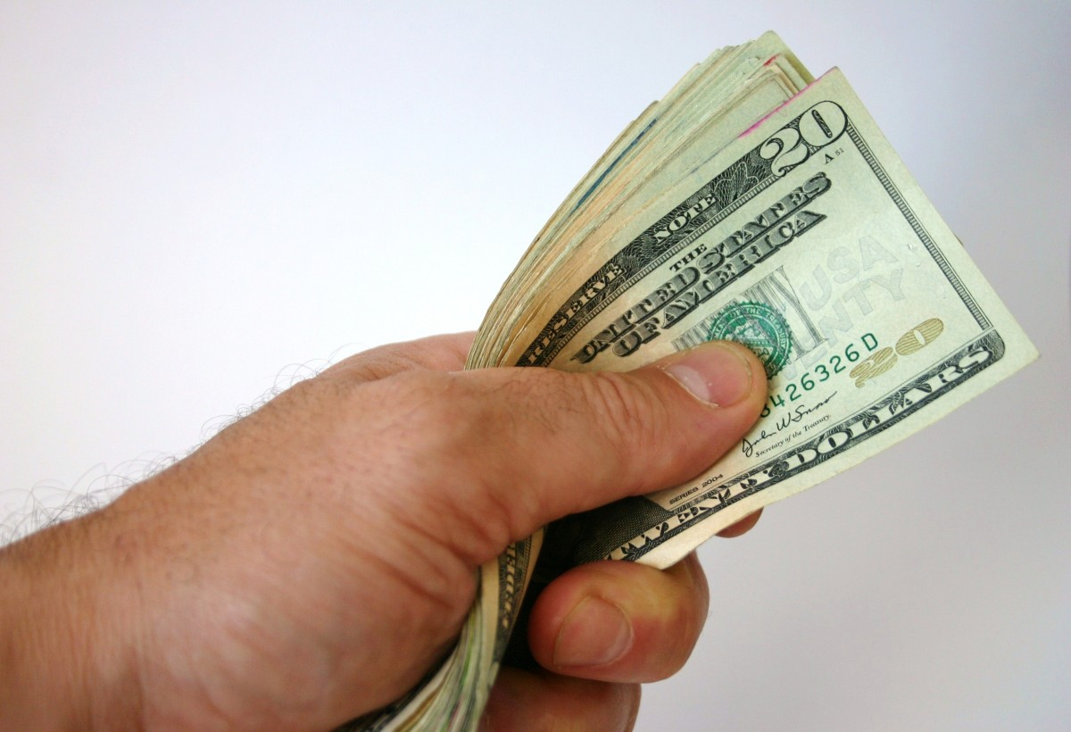
Economic Expenditure
INDUCED
Local direct/indirect re-spending
MULTIPLIER
Direct + Indirect + Induced
DEADWEIGHT EXPENDITURE
Expenditure by visitors NOT attributed directly to the event
Local resident spend
DIRECT
Total local visitor expenditure
Primary Spend
Secondary Spend
Initial visitor expenditure
Employment impact = additional income / job years
INDIRECT
Benefits to others in the community
EG indirect recipients / suppliers

Slide 19
Political Impacts
+/-
National pride and identity
Political tensions
Government Policies
Globalisation
Legal systems
Terrorism risks and threats

Slide 20
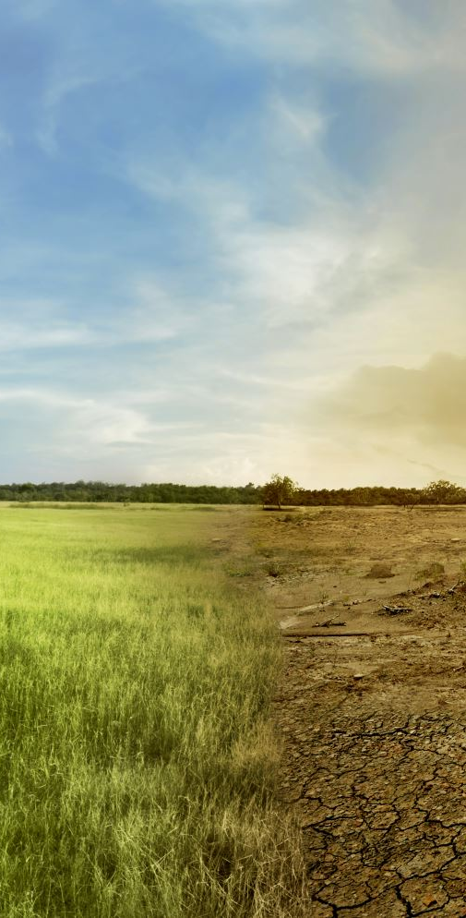
Environmental Impacts & green issues
+/-
Developments
Impacts on the environment
Transport
Noise
Wildlife
Erosion
Seasonality
Environmental strategies
Unused facilities

Slide 21
Balancing the
impact of events
Social and cultural impacts
POSITIVE
Shared experience
Revitalising traditions
NEGATIVE
Community alienation
Manipulation of community
Building pride
Validation of community groups
Increased participation
Introducing new ideas
Expanding perspectives
Negative image
Bad behaviour
Substance abuse
Social dislocation
Loss of amenity

Slide 22
Balancing the
impact of events
Environmental impacts
POSITIVE
Showcasing of the environment
NEGATIVE
Environmental damage
Providing best practice models
Increasing awareness
Infrastructure legacy
Improved transport and communication
Urban renewal
Pollution
Destruction of heritage
Noise disturbance
Traffic congestion

Slide 23
Balancing the
impact of events
Tourism and economical impacts
POSITIVE
Destination promotion and increased tourist visits
NEGATIVE
Community resistance to tourism
Extended length of stay
Higher yield
Increased tax revenue
Business opportunities
Commercial activity
Job creation
Loss of authenticity
Damage to reputation
Exploitation
Inflated prices
Opportunity costs
Financial mismanagement and loss

Slide 24
What do we spend to generate economic activity?
Pre-event
Constructing facilities
Employment of people (architects, designers, construction workers etc.)
Jobs created to serve these workers (e.g transport, food, recreation, accommodation)
Constructing supporting services/infrastructures
Selling naming rights/sponsorship

Slide 25
What do we spend to generate economic activity?
During event
Food
Accommodation
Merchandise (can leak)
Media rights
transport
How can an event project manager/researcher measure the spend?

Slide 26
Economic Impacts of Mega Events (some general points)
  Multiplier effect of events, such as the Olympic Games is often over-estimated.
  In terms of operational costs, only since 1972 have the Olympic Games made surpluses.
  It is in the capital infrastructure investments where losses are made. Vital to put it in perspective AND NOT simply place these costs against the 2 weeks of events (What is legacy? Life span of facilities 20 -50 years?)
  Cities can often lose money, but many others can gain
  https://olympics.com/ioc/news/london-2012-s-sustainability-legacy-lives-on
  https://www.dw.com/en/rio-hits-the-brakes-on-controversial-favela-cable-car/a-37368291

Slide 27
Why are impact assessments necessary?
predicts the consequences of disruption of a business function and process and gathers information needed to develop recovery strategies.
Estimate the legacy (Long-term impacts)
Maximise good impacts/minimise bad impacts
Different stages require different studies.

Slide 28
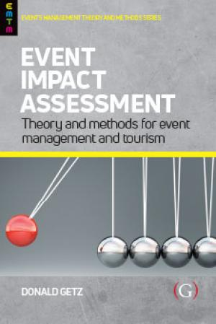
The time scales
  Pre- event feasibility analysis (can also be long-term)
  Short-term impact – during the event
  Medium term impact – post event after original event closed
  Long term impact (legacy) – post event when original organisers transfer control of the facilities, land and programmes.
  Recommend goals, methods and measures for planning, evaluation and impact assessment pertaining to events and tourism ( Getz.D,2019)

Slide 29
What determines the scale of economic impact?
Level of economic development/opportunities to spend money/Location of the event
Nature of the event/facilities and their attractiveness/pulling power
Degree of foreign/outside ownership (leakages)
Number of local people employed
Provision of supporting infra-structure
Type of supporter/spectator/participant and location.
Type of spectator and participant
Timing of the event
Opportunities for secondary spend
Scale of leakages

Slide 30
Task - Identifying Economic Impacts
Consider an event you have attended
Identify some of the areas within an event where economic activity takes place (money spent/exchanged)
Categorise this as pre-event and during event expenditure

Slide 31
Concept of the multiplier
It is a coefficient (measurement) which expresses the amount of income generated by visitors, tourists, spectators.
It relates to the idea that there is a chain of economic activity
Money is spent and re-circulated in the economy creating ripple effects.

Slide 32
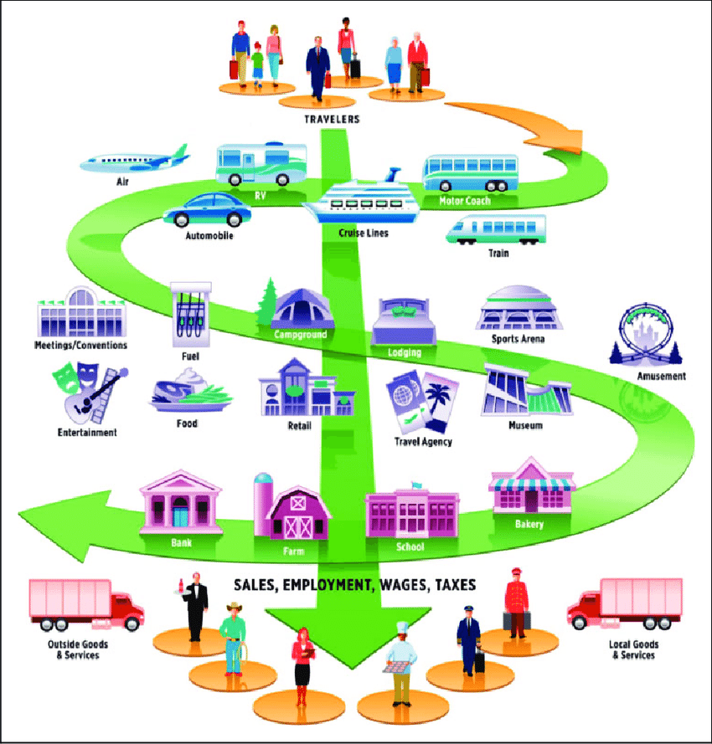
The Multiplier
Net increase in spending as a result of the event
Further rounds of spending in the local economy
Multiplier = Direct expenditure + Indirect+ Induced
This measures the total affect of spending
Apply this to the Edinburgh Festivals example
https://www.bing.com/videos/search?q=youtube+the+multiplyer+effect&view=detail&mid=EE3AE08F3E3B7F45E7F5EE3AE08F3E3B7F45E7F5&FORM=VIRE

Slide 33
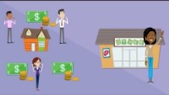
The Multiplier Effect

Slide 34
3 ways to measure impacts
Effects of the multiplier
Direct/Core
(First round of expenditure)
e.g. Fan at an away game spends £200 (ticket, transport, accommodation, food)
Indirect
(second round that initial money is spent)
e.g. £110 is re-spent by businesses to purchase goods/supplies
Induced (subsequent rounds of expenditure)
e.g. £ 50 is re-spent by retail staff in local economy
Notes:
K = Multiplier
Y change in income generated by E
E chang

Slide 35
Edinburgh Festivals Impact Report p59 to p73
“In the main, the Edinburgh Festivals have not had the contribution that they make to the economy as a core aim. However, as the Festivals have grown in size and stature, they have become a key contributor to the economy of both Edinburgh and Scotland. The economic importance of the Festivals lies primarily in the expenditure made by audiences on trips to the Festivals.
Most of this expenditure is generated outside of the cultural and events sector, and is made instead on items such as accommodation, food and drink, shopping and transport.
In this way, the Festivals economic impact is larger for the wider economy of Edinburgh and Scotland than it is for the cultural economy.”
https://www.edinburghfestivalcity.com

Slide 36
Edinburgh Festivals Impact Report p59 to p73
“The increase in economic activity as a result of the Festivals will have two types of wider “multiplier” effects:
supplier effect - an increase in sales in a business will require that business to purchase more supplies. A proportion of this ‘knock on’ effect will benefit suppliers in the local economy.
income effect - an increase in sales in a business will usually lead either to an increase in employment or an increase in incomes for those already employed. A proportion of these increased incomes will be re-spent in the local economy.”

Slide 37
Concept of leakages
It is rare that all the money from the Direct Spend is re-spent. the money is not being utilised elsewhere in the economy
This is because of leakages.
Key leakages:
  Savings
  Taxation
  Imports
  Interest rates

Slide 38
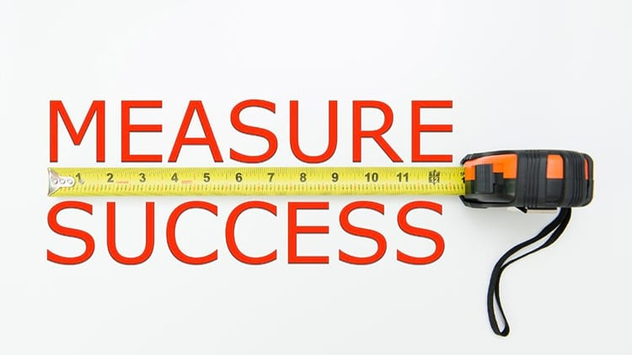
Key performance Indicators
a KPI is a measurable factor that helps the decision maker, identify how well the business is doing.
Can be affected by the economic impacts
Measured and monitored across various areas of the business.
An attraction might measure : frequency of visits ; Ave spend per visitor; profit.
Main KPI’s for events : people who registered for the event; interest in the speakers, mentions on social media; sponsor satisfaction; number of attendees; new clients; profit.

Slide 39
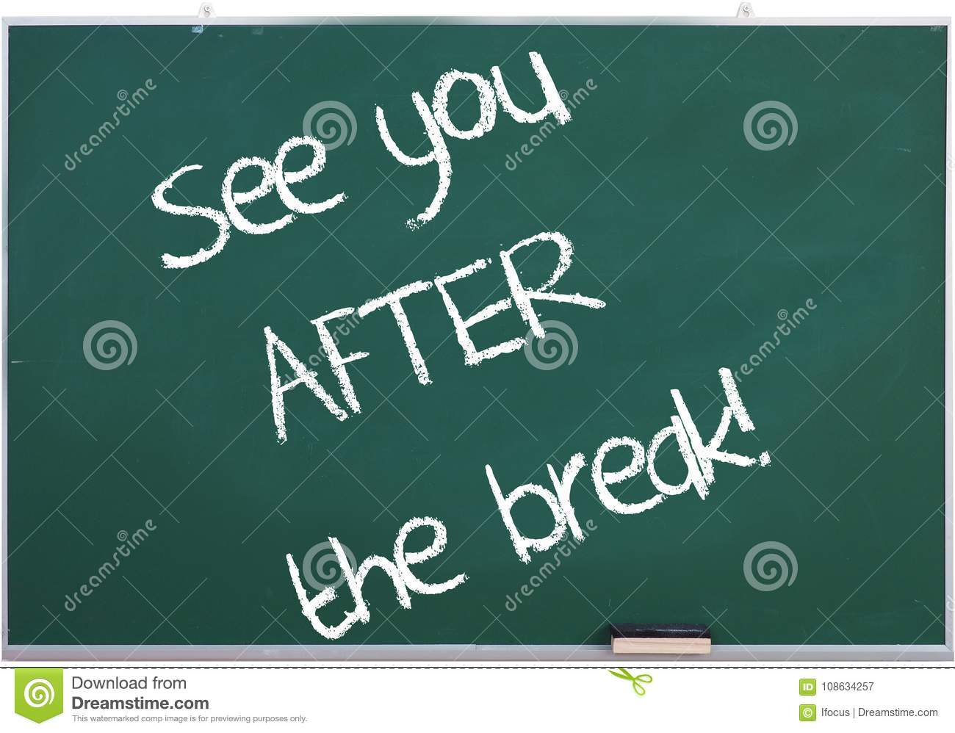
Part 2:

Slide 40
Economic and Political debates
Watch the video from the BBC
http://www.bbc.co.uk/sport/0/football/31595500
How could this form part of a wider debate for the impact of events?
What’s happened since?
http://www.bbc.co.uk/news/world-middle-east-41752490
Read one of the journal articles and…
  Choose 2-3 passages which could be incorporated into discussion to highlight/support an area of impact
  Summarise the key themes
  Write out the reference and share.

Slide 41
Pyongchang 2018
https://thinkprogress.org/pyeongchang-2018-let-the-games-destruction-and-debt-begin-bc0e545e5747/
http://www.gamesmonitor.org.uk/taxonomy/term/261

Slide 42
Must read… Masterman (2009)
Must Read: chapter 4 ‘Impacts and Legacies’
Identify the various ways sport events can impact on communities over the short, medium and long term. Try and present them in a simple table.
How do the impacts vary according to different types of events?
Overall, to what extent do you think sport events deliver mostly negative or positive impacts?

Slide 43
Also read… Rugby World Cup (Deloitte 2008)
RWC 3rd largest sporting event
Identify benefits to the sport and to the nation
Benefits of the events goes beyond just ticket holders creating commercial opportunities (e.g. fanzones, festivals etc.) See concept of leakages.
Higher income groups with a greater propensity to spend
Cumulative TV audience estimated over 4 billion
High attendance so good multiplier effects on transport, food etc..
Limited infra-structure development so greater certainty over cost.
Direct impact = £200 to £800 million depending on facilities
Indirect impact (ripple) = £620 to over 2 billion £
Host nation boost to the economy
Importance of high number of travelling supporters
International attendees assumed to spend between £4 to £6 per match on food and beverage (p.16). 14 -25 % of international attendees hospitality package and average spend per head is £125 -£175)
Good example for seminar presentations!!

Slide 44
A new debate on Economic impacts?
The circular economy…..
What are the implications for events management?
https://www.ellenmacarthurfoundation.org/circular-economy/concept

Slide 45
Finally…
WHY hold or organise a festival or event?
What are the key aims, objectives and outcomes?

Slide 46
Conclusion
Key area of analysis
Need to identify how much people spend/likely to spend
The concept of the multiplier effect and leakages important to understand.
Assignment – use the concepts to frame your discussion.

Slide 47
References
DCMS Select Committee (2006) , London 2012 Olympic games and Paralympics: Funding and Legacy , House of Commons, available at: http://www.publications.parliament.uk/pa/cm200607/cmselect/cmcumeds/69/69i.pdf
Deloitte (2008) Potential Economic Impact of the Rugby World Cup on a Host Nation, London, Delioitte and Touche. Available from: http://www.deloitte.com/view/en_GB/uk/industries/sportsbusinessgroup/7d73942e84ffd110VgnVCM100000ba42f00aRCRD.htm (Accessed 4/10/11).
Chengli, T, Huai-Chun, L, & Hsiou-Wei, L 2011, 'The Economic Benefits of Mega Events: A Myth or a Reality? A Longitudinal Study on the Olympic Games', Journal of Sport Management, 25, 1, pp. 11-23, SPORTDiscus with Full Text, EBSCOhost, viewed 3 October 2011.--Additional Information:
Persistent link to this record (Permalink): http://search.ebscohost.com/login.aspx?direct=true&AuthType=athens&db=s3h&AN=59667718&site=ehost-live
Barget, E, & Gouguet, J (2010), 'Hosting Mega-Sporting Events: Which Decision-Making Rule?', International Journal of Sport Finance, 5, 2, pp. 141-162, SPORTDiscus with Full Text, EBSCOhost, viewed 3 October 2011.--Additional Information:Persistent link to this record (Permalink): http://search.ebscohost.com/login.aspx?direct=true&AuthType=athens&db=s3h&AN=54570955&site=ehost-live
Blake, A. ( 2005) The Economic Impact of the London, 2012 Olympics, Discussion Paper. Available at: http://utsescholarship.lib.uts.edu.au/dspace/bitstream/handle/2100/994/Impact%202005_5.pdf?sequence=1
https://www.theguardian.com/world/gallery/2018/feb/12/spirit-of-samba-the-best-of-rio-carnival-in-pictures
https://www.theguardian.com/world/video/2015/feb/14/rio-carnival-gets-underway-samba-school-processions-video

Slide 48
Some Links to Explore
Sport England: http://www.sportengland.org/research/benefits-of-sport/economic-value-of-sport/ (very useful for some basic concepts)
http://www.eventimpacts.com/economic/
(This gives a useful overview of economic impact analysis and key info, such as: Number of spectators, Number of attendee; % of spect/attend from outside the area; Duration of the event; Direct economic impact (spend surveys); Economic calculator;Total economic calculator)
This link gives a more critical perspective of the negative impacts. For example:
http://www.gamesmonitor.org.uk/

Slide 49
WEEK 2 WORKSHOP
Listen to the podcast on the link below. This podcast provides an interesting insight into the Events industry. This contemporary forward thinking company is "putting a new era in experiential"!
The development of technology discussed within this podcast highlights how technology can support the industry through developing tech for brand development and for rethinking/adapting the experiential space.
Spawned from the UK’s first guerrilla marketing agency Buddha’s experience with/onus on projections, disruption and PR stunts and his military background, Mark Evans launched Kommando Experiential Marketing in 2000.
http://www.kommando.co.uk/

Slide 50
TASK
Moving forward to the reopening of the events industry, make detailed notes to highlight how this may help in the future.
Consider some of the issues discussed and how the industry may become safer for its attendees and more efficient for all.
There may even be some information for assignment 1 regarding the move from a physical to a virtual event experience.
I have included the weblink to Kommando to support the podcast which will provide additional information around some of the topics discussed.
Present back as you wish, a presentation, a short Vlog/video or detailed notes - we will discuss your findings in next lecture.

Slide 51
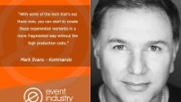
Podcast: Putting a new era in experiential

Slide 52
What do you think are the major challenges currently facing event managers in the UK?
What are the key political, cultural and social trends that determine the current climate of events in Britain?
Identify an event that you know of that has the capacity to be developed into something bigger than its current size. Give your reasons for suggesting this.

Slide 53
So, you have an idea for a new event …
Or you want to develop an existing theme?
What are the macro-environmental issues?

Slide 54
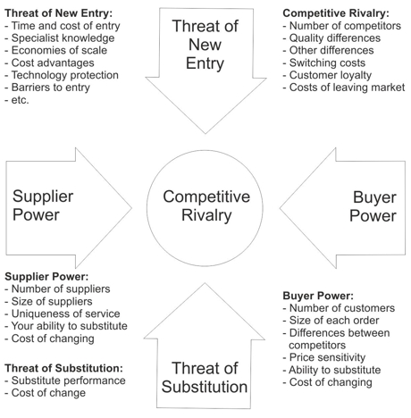
Using Porter’s 5 forces model:

