Slide 1
Technology In Practice
Digital Technologies:ACCA4030
Ashton Daley 1809661

Slide 2
My I.T Experience.
I am now 37 years old and have been I would say fortunate to have gained a lot of what I called basic I.T skills such as using a pc/laptop to be able to type up letters, assignments by using the word processing software like Microsoft word or even using Microsoft excel to make graphs and organise work a lot easier. I can say over the years having these skills has become more necessary as it has become part of everyday life for accessing information and maybe directions by using a lot of different search engines to-do so I have gain experience through school, college and university.

Slide 3
Digital resources and software used by professionals in construction.
3D digital printing equipment.(used to print labels, badges etc)
Digital software for Project analytics and insights.
Digital mobile navigation systems.(to help find locations a lot quicker and more precise)
Artificial intelligence and machine technology (BIM).
Use of Drones (help view who working are taking images).
Internet of things.
Cloud based computing.(helps store work and access information easier).

Slide 4
Digital resources and software used by professionals in construction.
After looking into this module and researching the importance of the digital software we have about today I would say it plays a very crucial part in making the work a lot more efficient and in some cases can help reduce a lot of outgoing costs. I believe that all construction companies should invest into this as it also can help store important information about staff, deliveries or contracts between companies with cloud base software on computers. Using digital technology like drone's help take more precise and harder to get to images and reduces risks of falls from heights in some places so all these are benefits for the industry going forward.
“the industry can benefit from using drones, from Thermography to highly accurate measurements, electrical equipment testing to digital mapping, UAV’s are becoming increasingly crucial in Construction” (Bose, 2015)

Slide 5
Google Applied Digital Skills (5)
In the next few slides I will be talking about what was good about the 5 online digital skills google classes. I will be explain what information I have gathered and also what was learnt from these classes. I will also explain how I can you apply what I have learnt to the relevant job rolls in construction and how they might be helpful in future.

Slide 6
Brainstorming Outline.
After watching this google class and doing some research, I have found that Brainstorming before a job or any paperwork u have can be very useful and can become very effective going forward.
By brainstorming an idea before doing it help the work can become a lot easier and give you and maybe your staff a better idea of where they need to be and what work they have to do.
It also helps prevent any accidents or time loss in places of work as speaking in a groups before work can help motivate team or point out any potential hazards.
I think this will be very good in the construction industry as they have a lot of workers and machinery around sites and a team talk with brainstorming will definitely help motivate teams and prevent accidents onsite.
“The activity allows exploring and expanding a student’s ability to think critically and laterally.” (KP Cross Academy, 2022)

Slide 7
Create And Safeguarding Passwords.
This class I found was very important and very useful as creating and safeguarding password is used all around the world in business and everyday life. I found the class very interesting and learnt a lot about safeguarding passwords I didn’t realise about for example doing a dictionary attack on your password before setting it up will show you how likely it is for your password to be guessed by someone else, It is also wise to use more than 8 characters and use upper and lower case to prevent memorable words.
This will be very important in the construction industry as they will have need to file a lot of paperwork and send via emails and post all these need to be safe in order to protect company legislations and client information so may need protected passwords to access.
“Passwords are considered the keys to the kingdom, so it is essential that users keep their passwords safe and secure.” (Robb, 2022)

Slide 8
Avoid Online Scams
Now learning about this google class was very important as I know personally that scams can affect peoples lives in a bad way, so learning about how to avoid them will be useful. Watching the clips gave me a good idea of ways to avoid these scams by simple little things like never share bank account details with random people and always ask for invoices and receipts, double check emails from the buyer, check payments, all these methods help avoid getting scammed. These skills will be useful in the construction industry because they will need to confirm payments for equipment, staff by using online payments platforms so leaning to check things like the metadata is crucial as it provides detailed information about an emails origin and sender.
“’Phishing’ and ‘vishing’ are the two main types of scams criminals will use to try to gain access to your personal details. They can then use these details to sign in to your online account, steal information and potentially take your money.” (Company, 2021)

Slide 9
To Structure An Argument In a Presentation.
By learning more on how to structure an argument in a presentation has been good as it has giving me many tips on how to improve my presentation skills for example always question yourself first, think about the audience your audience for the presentation, things like what's important to them? and why would they listen too your idea?, and in learning this it helps me be more direct and focus on the job in hand. Learning and teaching your staff how to do this might help a lot as in construction workers normally have to attend a meeting or do one themselves to be able to get staff in right place or orders going to the right place as construction companies often get a lot of complaints from surrounding areas.
“There are various types of argument structures. Most arguments fall into one of two primary categories—inductive and deductive—based on the type of reasoning they present. Inductive reasoning refers to the act of drawing broad conclusions from evidence gathered through specific scenarios. Comparatively, deductive reasoning refers to the act of supporting a larger conclusion with evidence from specific scenarios” (Company, 2021)
“Understanding how to present an argument is a versatile skill that can enable professionals to accomplish high-level objectives and make tactful decisions” (Company, 2021)

Slide 10
Communicating Using Email / Send Emails in the workplace.
While learning this goggle skills lesson I have learnt how to improve the way how I go about sending emails at work. In the first few slides it help me understand more about the importance of adding a subject title to recipients as it highlights the main reasons for the email they have received, also by making the email clear, simple and brief helps recipient understand a lot better. I believe this skill will be very useful in the construction industry as companies need to send policies and statements via emails, the need to address customers and workers via these platforms also so gaining knowledge of how to do this better will only improve your company or business as it will help will privacy and storage of policy’s that were sent out to work groups for later evidence if necessary.
“Avoid miscommunication by keeping content clear, organized and contextual. Begin your email with a formal salutation, state the purpose of writing and provide a context to why you are writing” (Bose, 2015)

Slide 11
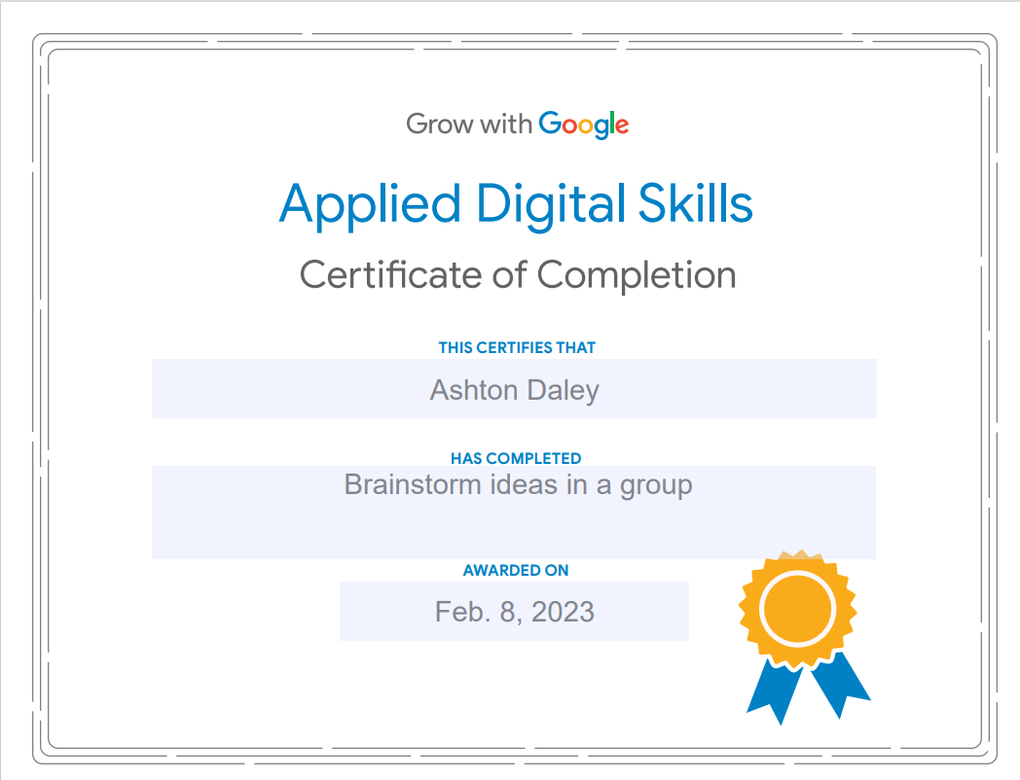
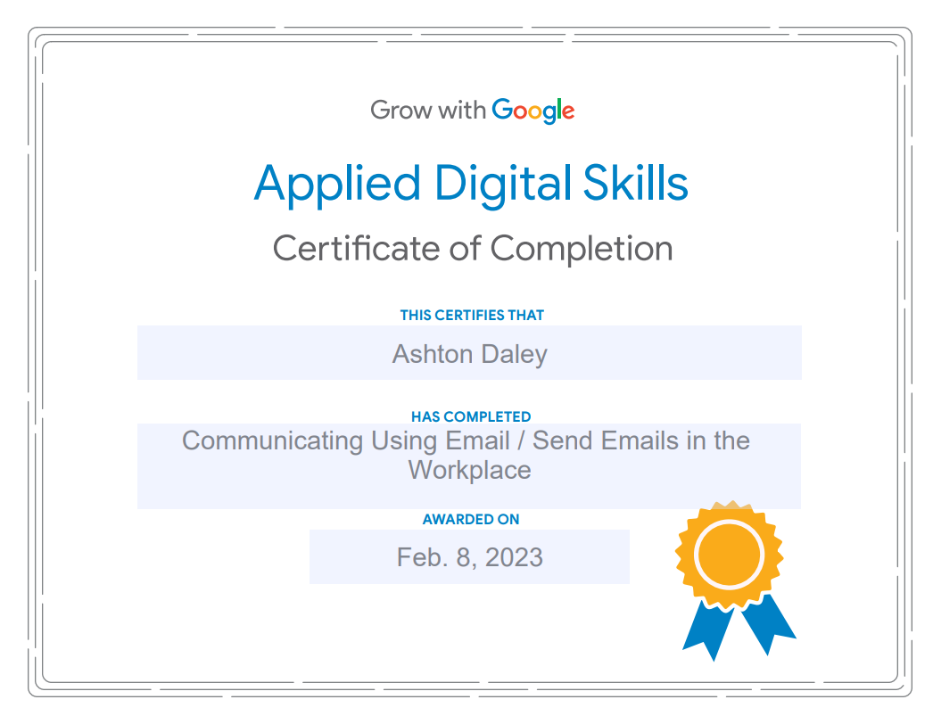
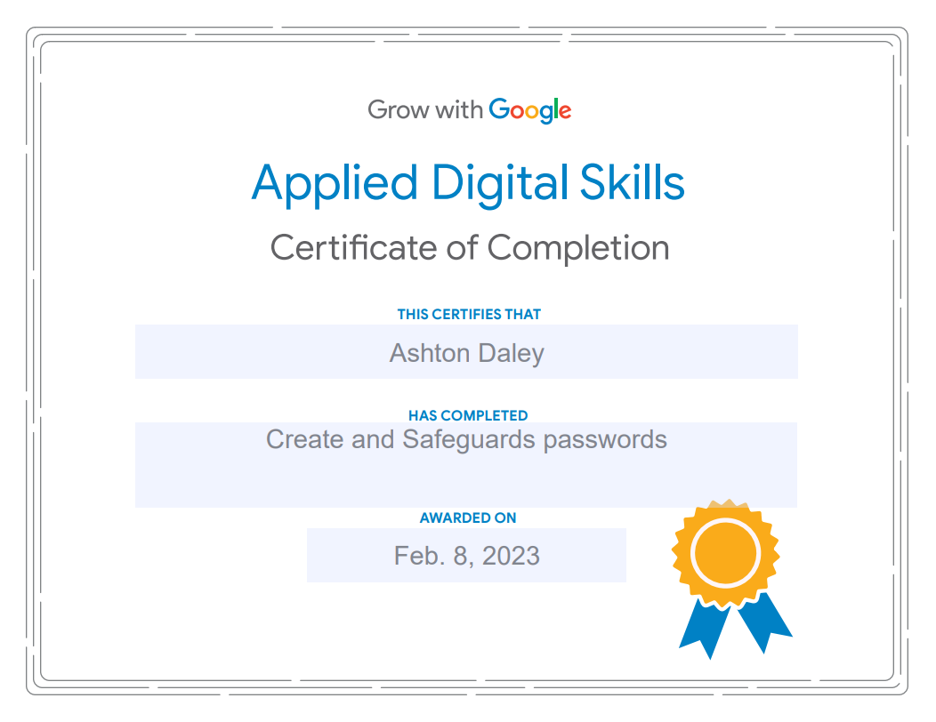
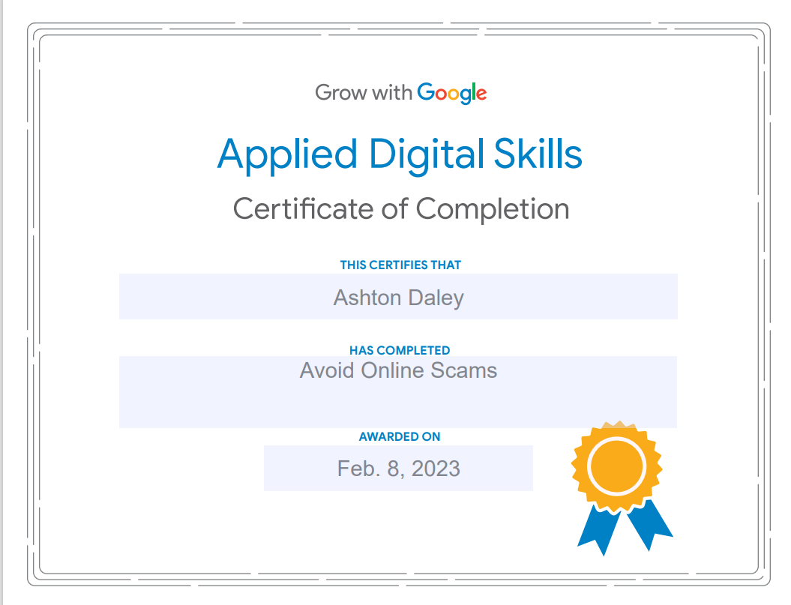
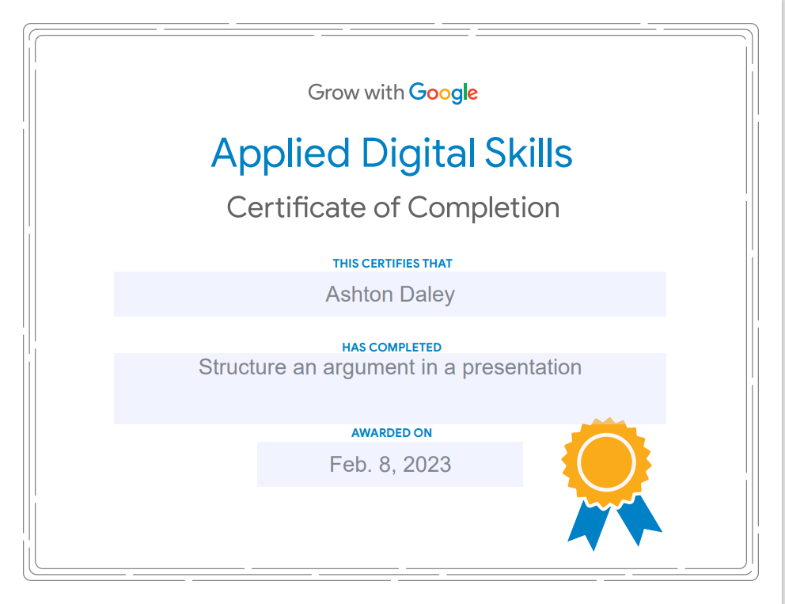

Slide 12
References.
KP Cross Academy (2022) The benefits and challenges of brainstorming, The K. Patricia Cross Academy. Available at: https://kpcrossacademy.org/the-benefits-and-challenges-of-brainstorming/ (Accessed: March 1, 2023).
Robb, J. (2022) Cyber security: The importance of strong passwords, Newsroom. Available at: https://www.unmc.edu/newsroom/2022/10/19/cyber-security-the-importance-of-strong-passwords/ (Accessed: March 1, 2023).
Company, S.L. (2021) Scams: How you can avoid them, GOV.UK. GOV.UK. Available at: https://www.gov.uk/guidance/phishing-scams-how-you-can-avoid-them (Accessed: March 1, 2023).
Company, S.L. (2021) Scams: How you can avoid them, GOV.UK. GOV.UK. Available at: https://www.gov.uk/guidance/phishing-scams-how-you-can-avoid-them (Accessed: March 1, 2023).
Bose, M. (2015) How to communicate effectively over emails at Workplace, Entrepreneur. Entrepreneur India. Available at: https://www.entrepreneur.com/en-in/business-news/how-to-communicate-effectively-over-emails-at-workplace/250279 (Accessed: March 1, 2023).

