Slide 1

Enterprise and Innovation Group Project
ACDA5003
Assignment on:
Group Presentation PowerPoint
Assignment 1
Submitted to:
James Williams
Submitted by:
Anthony Smith
1704559
Year 2 semester 1

Slide 2
Contents
Presentation section title Slide 3
Effects of Drink driving Slide 4 – 6
Cark-E Logo Slide 7
Unique Selling points Slide 8
Design Prototype Slide 9
MOSCOW Chart Slide 10
Capabilities of fingerprint Scanners Slide 11 - 12
Conclusion Slide 13
Business Logo Slide 14
References Slide 15

Slide 3
Anthony Smith 1704559
Database Designer / Printing Engineer
Background Overview
and
initial Idea

Slide 4
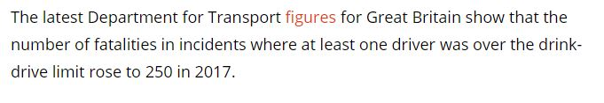
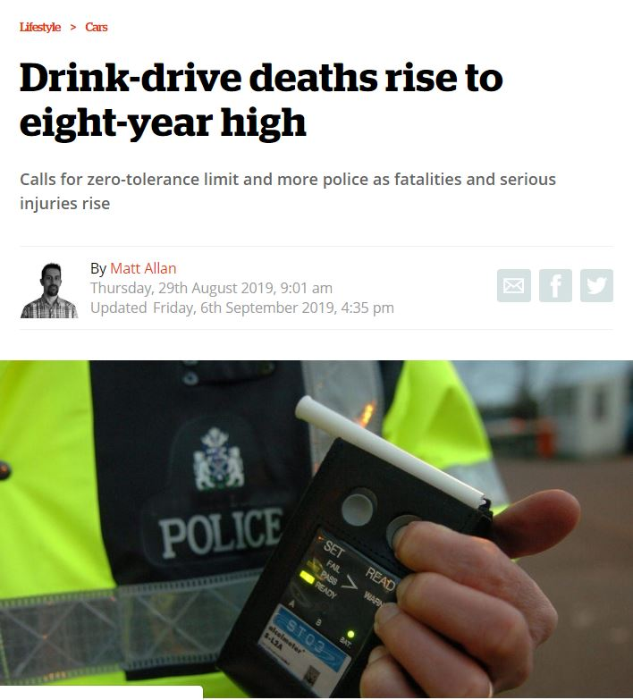
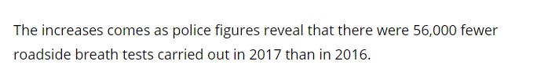

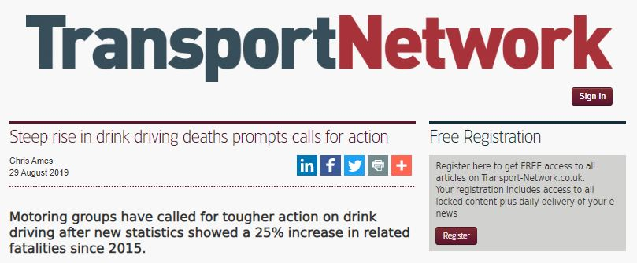
Circumstances behind the Project
[1]
[2]
Anthony Smith 1704559
Notes:
References
[1]https://inews.co.uk/inews-lifestyle/cars/drink-drive-deaths-rise-to-eight-year-high-494908
[2]https://www.transport-network.co.uk/Steep-rise-in-drink-driving-deaths-prompts-calls-for-action/16116

Slide 5
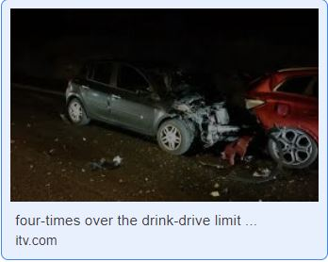
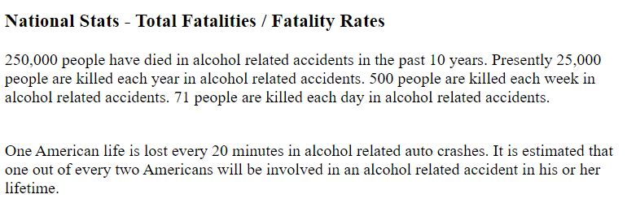
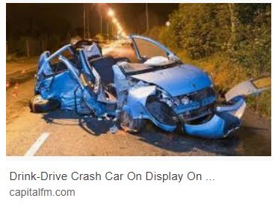
Taken from FADD Fathers Against Drunk Drivers
In the United States
[4]
[3]
It’s global issue, that seems uncontrollable
People will always push the boundaries of what is acceptable
All human sin seems so much worse in its consequences than in its intentions. — Reinhold Niebuhr [6]
[5]
Anthony Smith 1704559
Notes:
References
[3]http://www.faddintl.org/nationalstats.html
[4]https://www.itv.com/news/wales/2017-02-13/woman-destroys-two-cars-four-times-over-the-drink-drive-limit/
[5]https://www.capitalfm.com/southcoast/radio/news/local/drink-drive-crash-car-display-isle-wight/
[6]https://www.psychologytoday.com/gb/blog/here-there-and-everywhere/201204/50-quotes-consequences

Slide 6

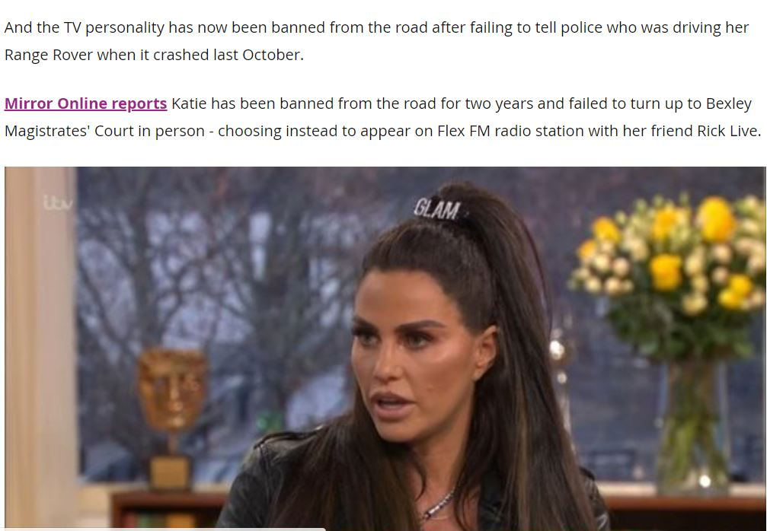
Why Didn’t
The Police
Know!!
[7]
Anthony Smith 1704559
Notes:
References
[7]https://www.birminghammail.co.uk/news/showbiz-tv/katie-price-hit-fourth-driving-17064023

Slide 7

CARK-E
KEY TO THE FUTURE
Anthony Smith 1704559

Slide 8
A biometric car key that will insure the safety for drivers and non-drivers.
The concept behind the key, is to reduce accidents on the road and give countability to those who cause them.
USP – Unique Selling Point
A sensor that can read the alcohol content in the user’s sweat to determine if they are over the drink drive limit and refuse them the opportunity to drive.
Contain the user’s medical history in case of emergency’s.
Store the name of the user/ Time / date of the journey in case evidence needs to be produced to the authorities.
Gain access to DVLA database to store driver information such as points, which can result in the user not being able to drive if maximum points have been reached.
Anthony Smith 1704559

Slide 9
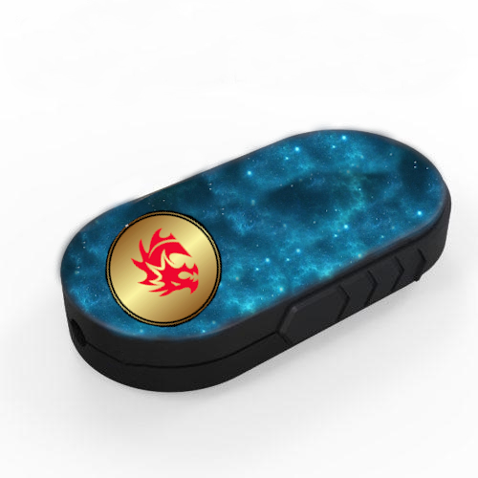
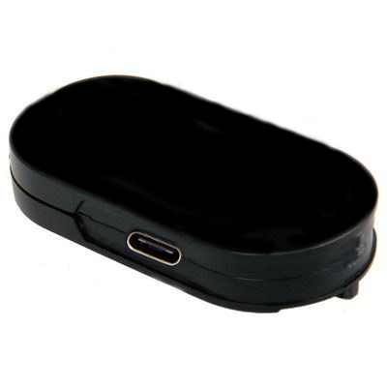
Design Prototype
Fingerprint Sensor Under Screen
OLED Touch Screen
Screen in Standby
Business Logo Background
Charger Pad Underneath (optional)
USB-c Charger Port
[8]
Key barrel dependant on Car Make
Anthony Smith 1704559
Notes:
References
[8] https://ukspygear.com/collections/car-key-fob-spy-cameras/products/premium-full-hd-1080p-ir-car-key-fob-dvr-recorder-with-motion-detection-0290

Slide 10
Initial Requirements
As a group, we compiled a MOSCOW chart to cover the functionality of the key:
Must Have
Biometrics
Blutooth
Prototype
Website / App
Database
Should Have
OLED
GPS / Tracker
Indicator to show Operation
Charging Capabilities
Alcohol Reader
Could Have
Medical Records
Security Features
SOS Feature
Public Transport Feature
Voice Recognition
DVLA Connection
Police Accessibility
Insurance Purposes / Blackbox
Won’t Have
ECU Connection
None Universal
No Input Data Features
Anthony Smith 1704559

Slide 11
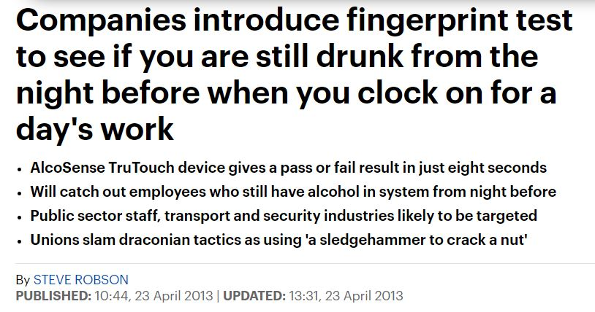
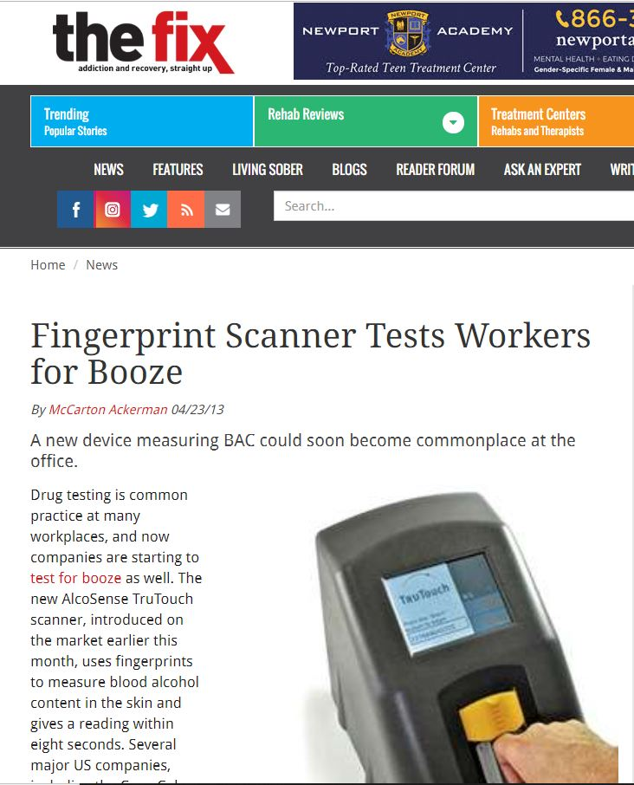
[9]
The True Touch Alcohol fingerprint scanner Can read the sample from your finger in 8 seconds. [11]
This can suggest that taking a sample will not become a hassle for the user.
[10]
Anthony Smith 1704559
Notes:
References
[9] https://www.dailymail.co.uk/news/article-2313355/Companies-introduce-fingerprint-test-drunk-starting-days-work.html
[10] https://www.thefix.com/content/workplaces-start-testing-employees-booze91579
[11] https://www.youtube.com/watch?v=35oC6W4jVu4

Slide 12
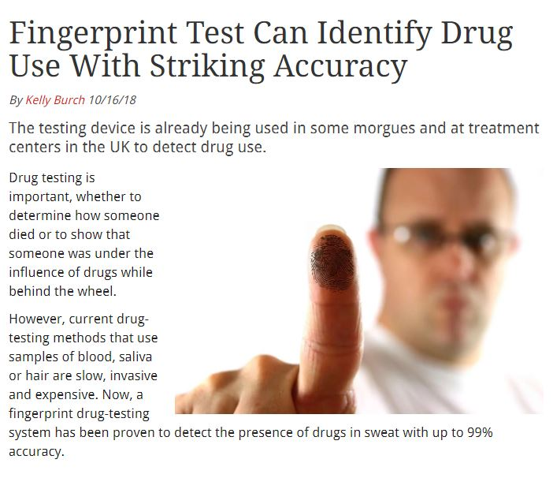
Upgrading Possibilities Are endless…
Drugs in the system
To many points on your License
Banned drivers
Uninsured drivers
Drivers without permission
We can make the roads safer for the people who use them.
[12]
Anthony Smith 1704559
Notes:
References
[12] https://www.thefix.com/fingerprint-test-can-identify-drug-use-striking-accuracy

Slide 13
Conclusion
The idea behind the Cark-e is to provide safety, not only to drivers but also to pedestrians. Using technology that is available such as fingerprint scanners and software, makes this concept attainable and unique.
Working as a group and highlighting what the requirements are to make the key a success, it installed confidence in each member of the group and increased the faith in the product. Using the MOSCOW chart, it refined what was important to have on the key and what should be left out at the present time.
The design of the key is very much in keeping with the designs of fobs you can acquire from any vehicle, which can have that familiar feel to it. But the major difference is, is that the OLED will be fully functioning and display information on the screen.
The Key can have endless possibilities and upgraded to do more than just drink driving. Drug use, banned drivers or people who do not have authorisation to drive the car, can be stopped. Banned drivers or drivers that have reached their maximum points can be prevented from driving by accessing the DVLA database and access that kind of information, but this concept would have to be discussed with the DVLA.
Overall, the group are trying to achieve a goal that secures the safety to all and accessibility of the key to be put into global legislation. The aim is to make sure the key is put into every vehicle by law, just like the seatbelt and not a luxury addon like some of the key fobs you can get with certain vehicles.
Anthony Smith 1704559

Slide 14

Thanks For Listening

Slide 15
Anthony Smith 1704559
References
[1]
[2]
[3]
[4]
[5]
[6]
[7]
[8]
[9]
[10]
[11]
[12]
https://inews.co.uk/inews-lifestyle/cars/drink-drive-deaths-rise-to-eight-year-high-494908
https://www.transport-network.co.uk/Steep-rise-in-drink-driving-deaths-prompts-calls-for-action/16116
http://www.faddintl.org/nationalstats.html
https://www.itv.com/news/wales/2017-02-13/woman-destroys-two-cars-four-times-over-the-drink-drive-limit/
https://www.capitalfm.com/southcoast/radio/news/local/drink-drive-crash-car-display-isle-wight/
https://www.psychologytoday.com/gb/blog/here-there-and-everywhere/201204/50-quotes-consequences
https://www.birminghammail.co.uk/news/showbiz-tv/katie-price-hit-fourth-driving-17064023
https://ukspygear.com/collections/car-key-fob-spy-cameras/products/premium-full-hd-1080p-ir-car-key-fob-dvr-recorder-with-motion-detection-0290
https://www.dailymail.co.uk/news/article-2313355/Companies-introduce-fingerprint-test-drunk-starting-days-work.html
https://www.thefix.com/content/workplaces-start-testing-employees-booze91579
https://www.youtube.com/watch?v=35oC6W4jVu4
https://www.thefix.com/fingerprint-test-can-identify-drug-use-striking-accuracy

