Slide 1
Scriptwriting
M4X01654

Slide 2
Dialogue Strategies
Good dialogue is not the transcription of everyday speech
Dialogue is not simply exposition
Dialogue exposition can be useful but needs careful handling
Notes:
It's often easier to say what good dialogue isn't rather than define what it actually is. In much the same way that good dramatic writing is not simply the verbatim recording of something that has happened, so good dialogue is not simply a transcription of something someone has said. Your dialogue, just like every other element of your screenplay, is serving a function. That's not to say it's lifeless, on the contrary, dialogue that is merely exposition has no place either. What do I mean by exposition? The bare, uninflected statement of facts. This has its place and, indeed, it can be a the correct kind of dialogue for the right character in the right circumstances but it has to be dramatised and not just a convenient info dump.

Slide 3
Dialogue Strategies
Good dialogue is tied to characterization
Best dialogue is an expression of character
Notes:
You will remember McKee's distinction between characterization and character, between the surface details of any movie character and their true self revealed by their actions. The family life, the eduction, the job, the personal life, in short, the characterization, will all inform what vocabulary a character would use, how talkative they might, how open or closed they might be, and that's just for a start. The best dialogue is an expression of what McKee termed character, the true self revealed through action, that action, in this case, being what statements they make.

Slide 4
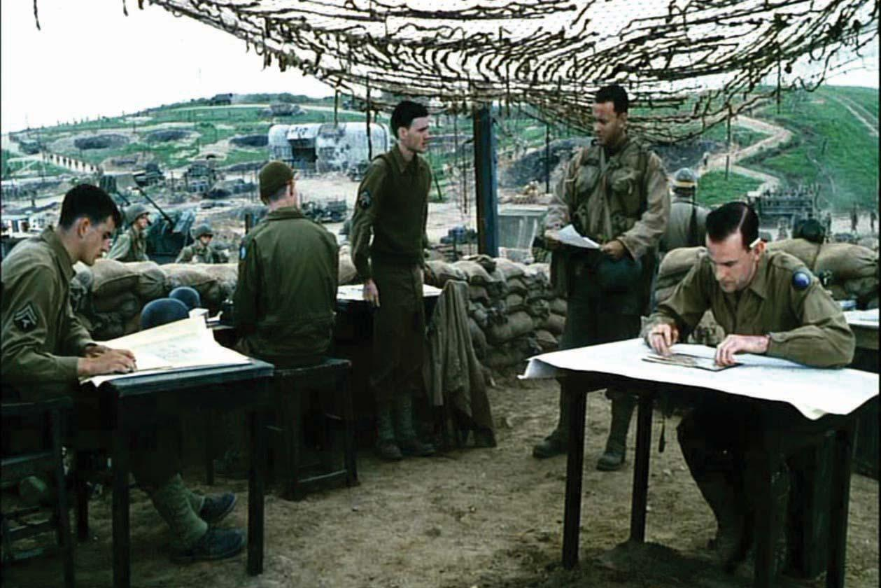
Saving Private Ryan (1998)
Notes:
//CLIP Saving Private Ryan (CH 6, 34-35 to 39-36) (5 mins)

Slide 5
Saving Private Ryan (1998)
How is dialogue tied to characterization?
How is it an expression of character?
How is exposition handled?

Slide 6
Brevity is the soul of wit
Good dialogue is economical
Get in late, get out early
Avoid repetition
Notes:
Real world dialogue can be waffly. We go through the motions of hello, hi, how are you, I'm fine, how are you, and so on. All of which may have its place in the right scene at the right moment but more often than not, dialogue in a scene should come in as close to the main action and turning point as possible and should finish very soon after the turning point of the scene. Very often, in real world dialogue, people repeat the same point or slightly vary it; not in movie dialogue. Lastly, think long and hard about any chunk of speech that runs longer than three lines.

Slide 7
Your subtext is showing
Characters rarely say exactly what they think or feel
Remember conscious and unconscious goals
Show don't tell
Avoid overt reporting and telegraphing
Notes:
If a dialogue scene consists of two characters explaining exactly how they feel or think then chances are this has no place in a screenplay. If you recall the concept we discussed of divergent wants and needs, of conscious and unconscious goals in a well-designed character, then it should be clear that the character doesn't even know what they want and only discover it through the challenges they overcome in the extraordinary world. Therefore, may say what they think they feel but they will not actually be articulating what they really feel. Similarly, when we looked at Visual Writing, we examined how the action writing should show something rather than tell. Avoid writing dialogue that explains what has happened to the character or what will happen – reporting and telegraphing – if at all possible. However, this can work in a comedy, where what is being reported or telegraphed is a joke. But it has to be funny.

Slide 8
Dialogue as conflict
Dialogue as duel for dominance
Expression of differing points of view
Exchange/use of information for power
Notes:
If you have designed your characters and your scenes well, then your dialogue will often function as part of the conflict. The challenge that the character is facing will often be to gain knowledge or information in a scene, with dialogue the way that this information is at first withheld then ultimately delivered. Dialogue, therefore, can become an expression of different points of view on, the use of and exchange of information in a scene, is a power struggle between the metaphorical ideas that the story explores.

Slide 9
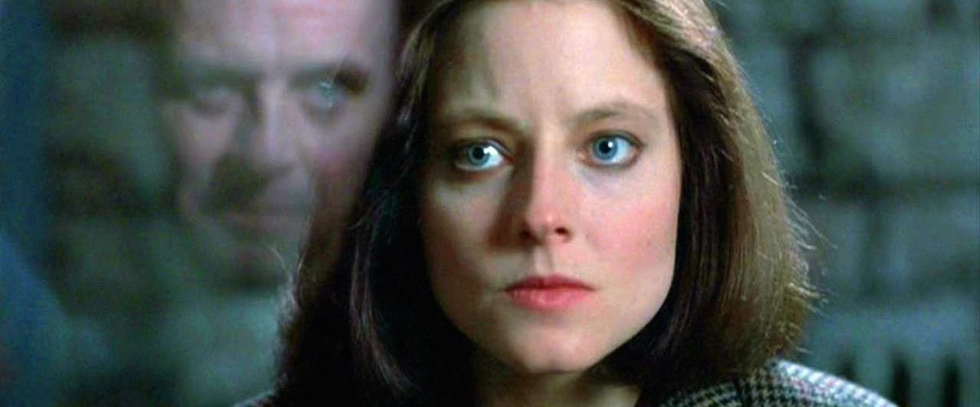
The Silence Of The Lambs (1991)
Notes:
//CLIP The Silence Of The Lambs (CH4, 11-21 to 18-45) (7-24 mins)

Slide 10
The Silence Of The Lambs (1991)
When, if at all, do the character(s) say what they really think?
How does Clarice reveal her unconscious goal in this scene?
How does it use reporting/telegraphing?

Slide 11
Heightened dialogue
Genres have their own dialogue conventions
Notes:
Certain genres will have highly stylised dialogue. Film noir has the rhythms of the hard-boiled detective and femme fatale trading knowing phrases. Comedy has the set up/pay off of jokes, as well as sarcasm, litotes, eupemism and much more.

Slide 12
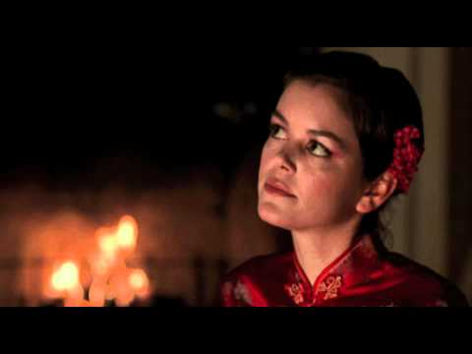
Brick (2006)
Notes:
//CLIP Brick, dir. Rian Johnson (2006) (CH3, 13-33 to 15-54) (2-30 mins)

Slide 13
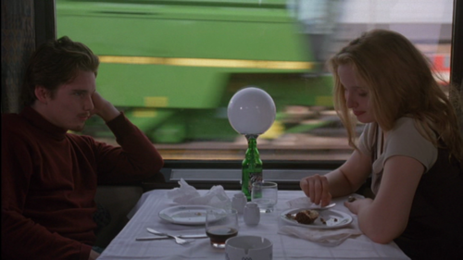
Before Sunrise (1995)
Notes:
https://www.youtube.com/watch?v=psSQsNqgUzg

Slide 14
Dialogue strategies
How does your dialogue reflect character & characterization?
How does your dialogue reflect conflict?
How does your dialogue employ subtext?
How does your dialogue respond to genre?

