Slide 1
Athens and Rome: Life and Culture in Classical Antiquity
Lecture 3 – The “Ordinary Man”
CLCS4007

Slide 2
Top of the Pyramid
The elite in Athens:
  pentakosiomedimnoi (500 bushel men)
  Hippeis (cavalrymen)
The elite in Rome:
  senators (1,000,000 HS property qualification)
  equestrians (400,000 HS property qualification)

Slide 3
Privileged and Unprivileged
The “ordinary” man – born free, poor or middling (not member of the elite).
Status as a person:
  Social status: how you are regarded among your peers and other members of society,
  Legal status: your rights, duties and subjection to the law,
  Power and influence: ability to control, influence or be taken into account (informal as well as formal).
Occupation (often affects your status):
  Job you perform and the income it provides you,
  Vast majority of the population engaged in agriculture.
Urban vs. rural: depends upon the region, but Mediterranean wide most would live in semi-/rural conditions.

Slide 4
Ordinary Man and Politics
Athens
Rome
Registered in deme.
over 20 (ephebic training)
not disqualified (disqualified are:
  any atimos (dishonourable person); judicial status given as direct or indirect punishment (internal exile); Public debtors.
Part of a “tribe” – 31 Rural tribes, and 4 urban.
Become an adult when putting on the toga virilis (14-18)
Disqualification through infamia:
  actors, gladiators etc.
  Romans (over periods of time) more willing to extend their franchise
  Pericles’ citizenship law (451/50 BC)
  Social War (91-88 BC) and Lex Iulia – granting of Roman citizenship to most Italian socii.
  Constitutio Antoniniana – all freeborn males become Roman citizens (AD 212).

Slide 5
“Classes”
Athens
Rome
Pentakosiomedimnoi
  those that owned land able to yield more than 500 medimnoi a year.
Hippeis
  those that could afford a horse.
Zeugitai
  those that could afford two oxen?
Thetes
  the lowest social class, those whose property in land yielded less than 150 medimnoi.
Medimnos = c.52 dry litres (equivalent to about 48 days of rations by Athenian standards).
Patricians:
  claim lineage back to foundation of Rome.
  some religious offices and magistracies restricted to Patricians.
Plebeians:
  Free Roman citizens.
  Lex Licinia Sextia (367 BC) – required one of consuls to be Plebeian.
Wealthy have disproportionate influence in Comitia Centuriata.

Slide 6
Rights and Duties
Athens
Rome
Rights:
  To be protected from physical attack
  To attend, propose, discuss, and vote on proposals in the assembly
  To take turn in various offices
  To use the courts
  To own land
  To participate in festivals and sacrifices
  To exercise in gymnasia
Duties:
  To obey the laws
  To defend the state
  To serve in office when chosen
  To learn how to perform those offices (ignorance is not an excuse for incompetence)
Rights:
  to vote in assemblies (Ius suffragiorum).
  to stand for public office (Ius honorum).
  Marriage and parental rights (Ius connubii).
  to make contracts, hold property and initiate/conduct legal cases (Ius commercii).
  cannot be legally tortured.
Duties:
  Subject to laws
  Military service (may depend on class and period)

Slide 7
Occupations
Reputable
Disreputable
Military service.
Landownership and farming.
Politics and holding magistracies.
Legal Practice.
Large scale trading? (preferably discretely and though slaves/freedmen).
Prostitution.
Acting.
Working with ones hands – e.g. potters, fullers, sculptures(?)
Vending/market stall trader.
Petty trading.
Doctors, architects, teachers?
See Cicero De Officiis 1.150-151.

Slide 8
Prejudices
Freedmen: limits on legal freedom, odium of former servile status – distaste for the “upstart”.
Slaves: without legal rights, open to abuse, essentially property – could be treated as sub-human.
The Poor: looked down-up, especially by the elite – cf. Tacitus (Hist 1.4) “sordid plebs”.
Merchants: view of the elite that merchants were lying thieves – view not necessarily shared by others.
Work: elite prided themselves on their ability not to work – professions normally mentioned with pride on epitaphs (craftsmen, artisans, traders etc.).

Slide 9
An “ordinary” day in Rome

Slide 10
Keeping Punctual?
By the later Republic and Imperial period the sundial (horologium = hour counter) and water clock (horologium ex aqua) became more common.
Civil day (24 hours) from mid-night to mid-night – and natural day, two blocks of twelve hours.
Accuracy dependent upon factoring in latitude correctly.
Problem of seasons affecting hours of daylight.
  First hour of the (natural) day – winter solstice 7.33 to 8.17 am – summer solstice 4.27 to 5.42 am.
  Twelfth hour of the (natural) day - winter solstice 3.42 to 4.27 pm – summer solstice 6.17 to 7.33 pm.
“…the exact hour I cannot tell you, it’s easier to get philosophers to agree than clocks…” – Seneca Apocolocyntosis 2.

Slide 11
Up at the Crack of Dawn
“One cannot live for schoolmasters in the morning… I am awakened by the laughter of the passing crowd; and all Rome is at my bed-side.” – Martial Epigrams 12.57.
Sleeping during the day often met with censure – excesses from the night before.
Light breakfast, little in the way of washing.
Bed-room usually sparsely adorned.
  Couch (cubile)
  Chest (arca)
  Chamber pot (lasanum)

Slide 12
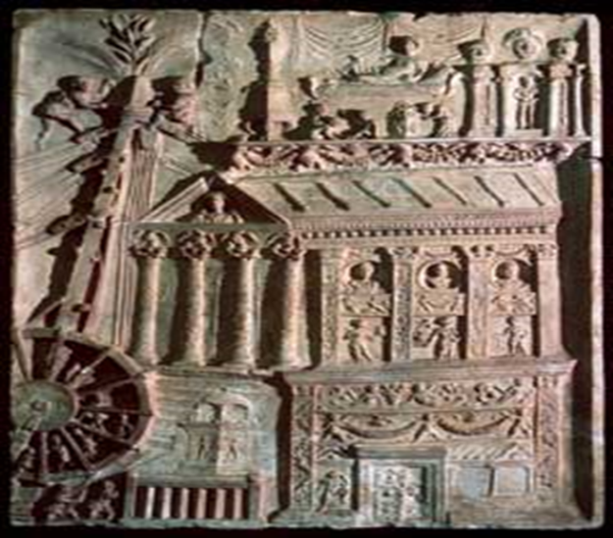
Morning Business
Atrium of the domus opened up for salutatio – clients meeting patrons.
Occupations (day labouring):
  Builders
  Transporters
  Unloaders of cargo
  Warehouse workers (horraerii)
Craftsmanship, baking, vending, etc.
Civil cases before tribunals normally took place from dawn until the fourth hour (c.9-10 am) – Mart. Ep. 8.67.3 – but could go on till noon – Twelve Tables 1.6.
Tomb of the Haterii – Vatican Museum.
“…if someone has contracted to build an insula, he should certainly not rush the work by gathering fabri from all over the place and bringing in large numbers of day labourers…” – Digest 45.1.137.3.

Slide 13
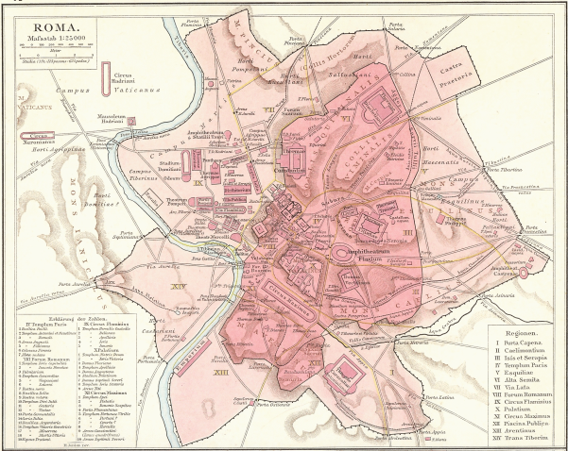
Negotiating the City
[Syrus]: You know that colonnade near the meat market, down that way?
[Demea] of course I do.
[S]: Go strait up the street past it. Then there’s a turning point going downhill; go strait down and you’ll see a temple on this side and next to it an ally –
[D] Which one?
[S] Where there is a big fig-tree.
[D] I know]
[S] Go on through it.
[D] That ally hasn’t got a way through.
[S] So it hasn’t. What a fool I am…
- Terence Adelphoe 573 ff.
“When the Vespasiani were Emperors and Censors in the year of the building of the city, 826 [AD 73], the circumference of the walls which surrounded it was thirteen miles and two-fifths. Surrounding as it does the Seven Hills, the city is divided into fourteen districts, with 265 crossroads under the guardianship of the Lares [i.e., a little shrine to the Lares would stand at each crossing].” Pliny NH 3.5.66.

Slide 14
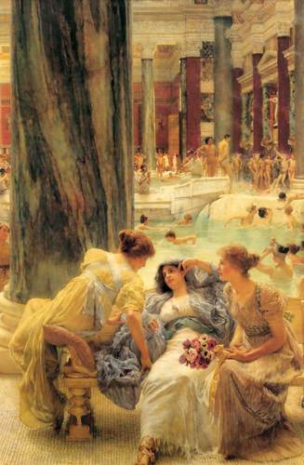
Afternoon and Early Evening
Finishing working around noon or just after – eat light lunch.
Bathing and “sporting activities” normally began at the 8th hour (c. 1.30-2.30 pm).
Evening cena beginning around the 10th hour (c. 3-5 pm).
Wealthy could afford to burn oil for light after dark.
Lawrence Alma-Tadema, The Baths of Caracalla

Slide 15
Passing Time in Athens

Slide 16
Leisure Time?
Stereotypical way of spending leisure time in Athens:
  Gymnasium
  Philosophical discussion (Plato – the Academy)
  Gambling and cock-fighting
    “The gambling place… where the gaming-table is set, and cock-fighting and dice-throwing are the regular occupations.”- Aeschines Against Timarchus 53.
  Animal shows:
    “But most absurd of all, they behold in the shows which are held year after year lions which are more gentle toward their trainers than some people are toward their benefactors, and bears which dance about and wrestle and imitate our skill…” – Isocrates Antidosis 15.213.
  Symposia – drinking parties – also taverns (kapeleia).

Slide 17
Communal Life
Political life:
  Attendance at assemblies (c.15-18% of adult male citizen population (=3-5% of the total population?)) – 5000 attendees an upper limit (Thucydides 8.72).
  Jurors
  Selection by lot to certain magistracies.
Theatre:
  City Dionysia - 9th to 13th days of Elaphebolion (24th to 28th March).
  Lenaia (during month of Gamelion – circa January).
Other religious festivals.
  Monthly festivals – honouring “birthdays” of the gods.
  Agricultural festivals.
  Festivals for the dead.

Slide 18
Bibliography
Carcopino, J. (1941) Daily Life in Ancient Rome: The People of the City at the Height of the Empire. London: Penguin.
Garland, R. (2009) Daily Life of the Ancient Greeks: Second Edition. London: Greenwood Press.
Hope, V. (2000) ‘Essay Five: Status and Identity in the Roman World’, in Experiencing Rome: Culture, Identity and Power in the Roman Empire (ed., Huskinson, J.), London: 125-152.
Knapp, R. (2013) Invisible Romans. London: Profile Books. – chapter 1.

