Slide 1
Cognitive Theory

Slide 2
Cognitive Approach
  Is all about thinking…..
  Perception
  Attention
  Memory
  Problem Solving
Face Recognition
Forgetting
Language
Curiosity

Slide 3
Cognitive Psychology
Cognition means ‘knowing’.
Cognitive processes refer to the way that knowledge is gained, used and retained.
Cognitive psychologists therefore study; attention, perception, memory, problem solving, thinking, curiosity, concentration, understanding, imagination and language.

Slide 4


Cognitive Psychology
Senses = input = keyboard
Brain = processing = Hard drive
Actions = output/responses = Seen on monitor

Slide 5
A persons behaviour can be determined by
The information available in their environment
They ways they have learned to manipulate (or process) information
The capacities for information processing inherent in the types of brain people have

Slide 6
Cognitive explanation of human behaviour
Order & Meaning
Explanations - Organising & Processing
Abnormal Behaviour –
  Faulty thought processing
  Irrational thinking

Slide 7
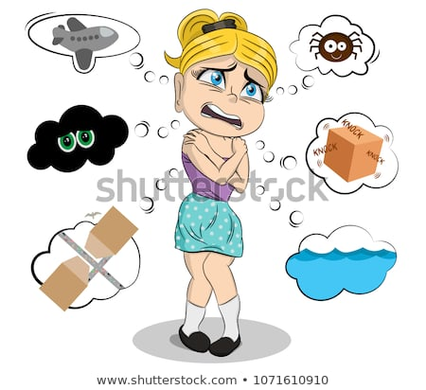
PHOBIAS…

Slide 8
Phobia…
  the FEELINGS and BEHAVIOUR reflect faulty processing of information about threats

Slide 9
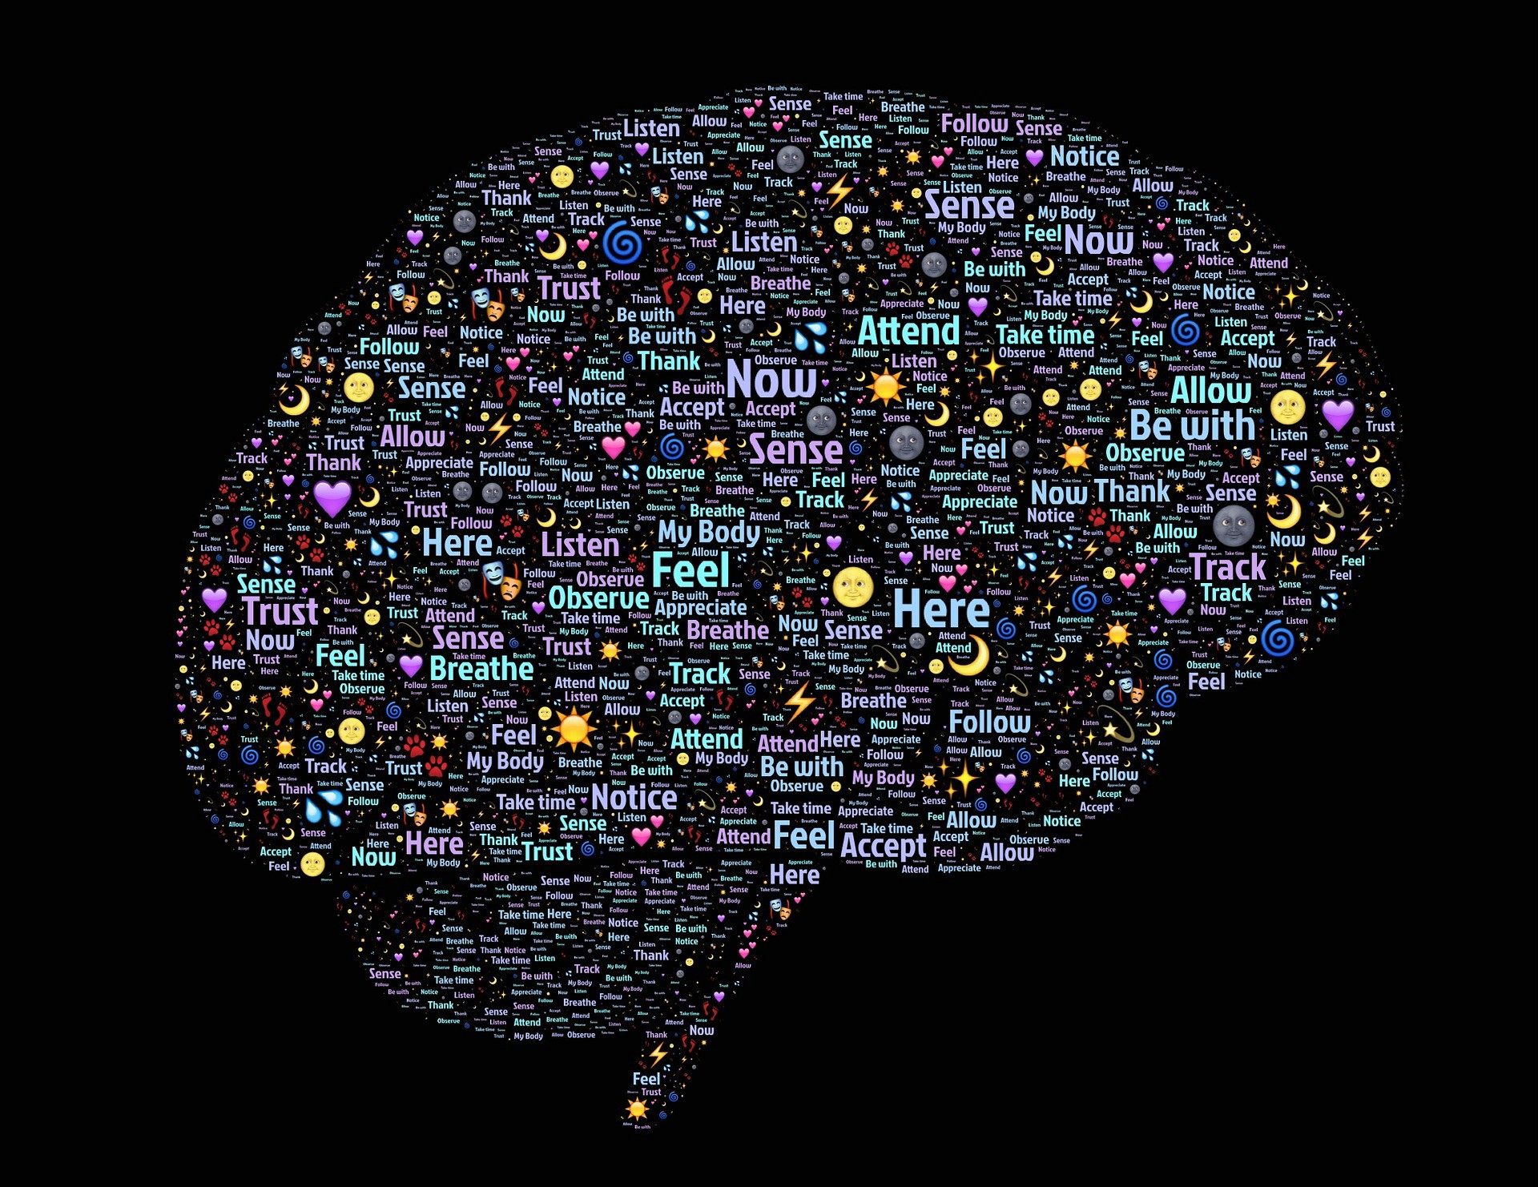
…Cognitive psychology
Cognitive approach guides psychologists to study the rapid series of mental events
Example
An incident in which one person shoves another in front of a theatre

Slide 10
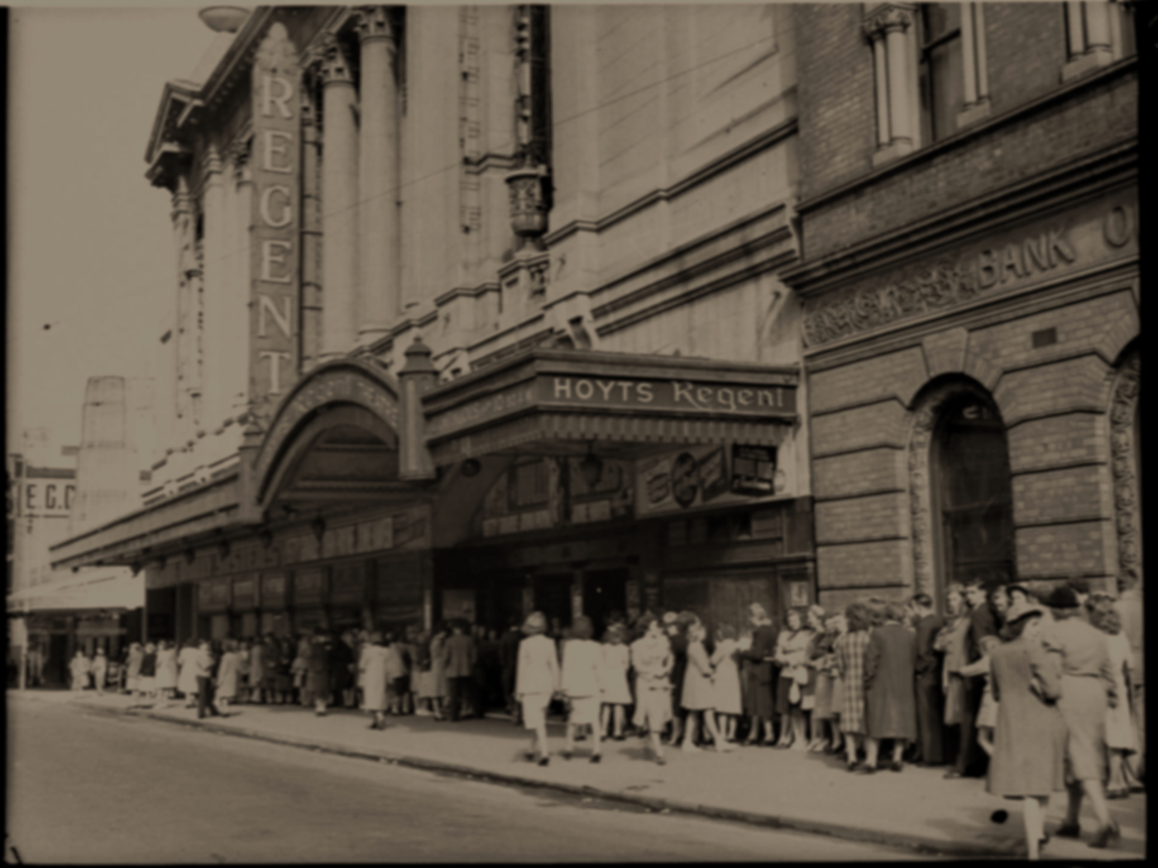
The aggressor…
Perceives that someone has cut into the theatre queue
Uses stored memories and concepts to decide that this behaviour is inappropriate
Attributes the act to the culprits obnoxiousness
Considers possible responses and their likely consequences
Decides that shoving the person is the best response
Executes that response
These are ‘mediational processes’ (black box)
This Photo by Unknown Author is licensed under CC BY

Slide 11
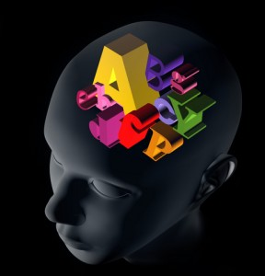
Schemas

Slide 12
What is a schema?
A framework to organise & interpret information
First used by Frederick Bartlett
Term ‘Schema’ was introduced by Jean Piaget
Constant adaptation to the environment
New Experiences = New Schemas

Slide 13
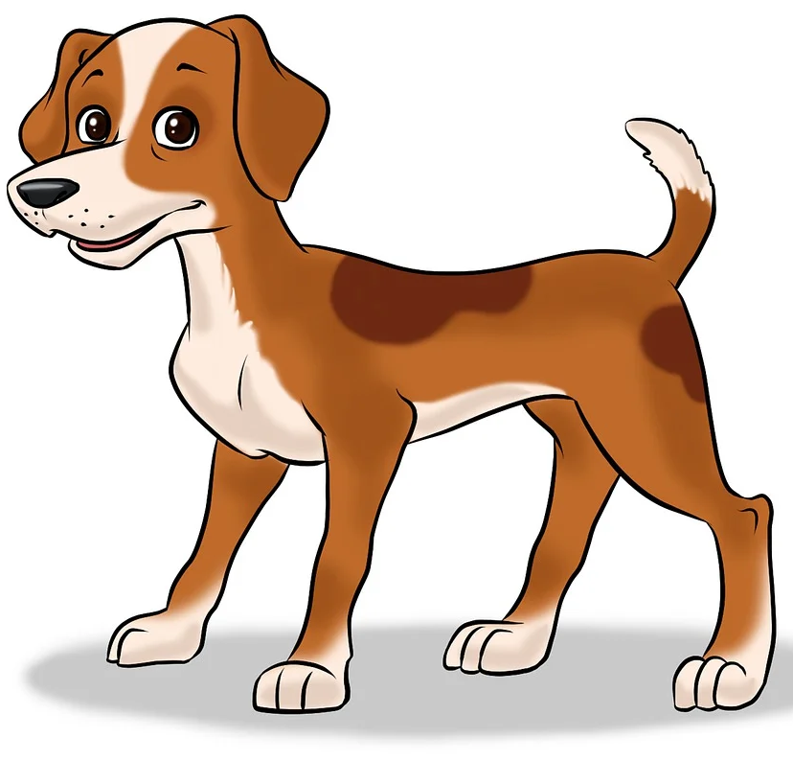
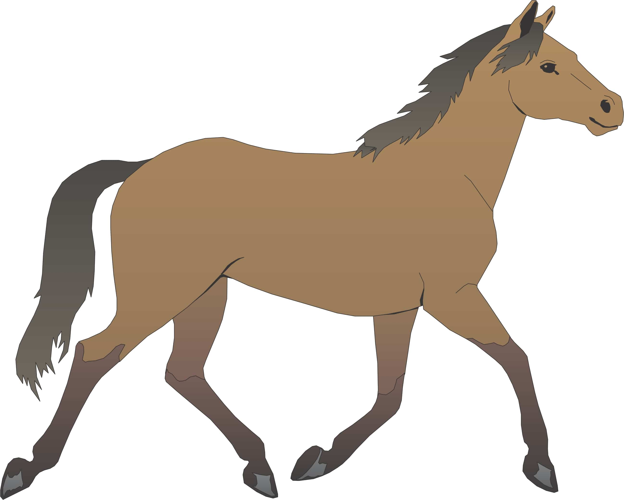


Example Schema…
Accommodation
Assimilation

Slide 14
Schema’s
Assimilation - new information is incorporated into pre-existing schemas.
Accommodation - new schemas might be formed as a person learns new information and has new experiences.
Schemas tend to be easier to change during childhood but can become increasingly rigid and difficult to modify as people grow older. Schemas will often persist even when people are presented with evidence that contradicts their beliefs.

Slide 15
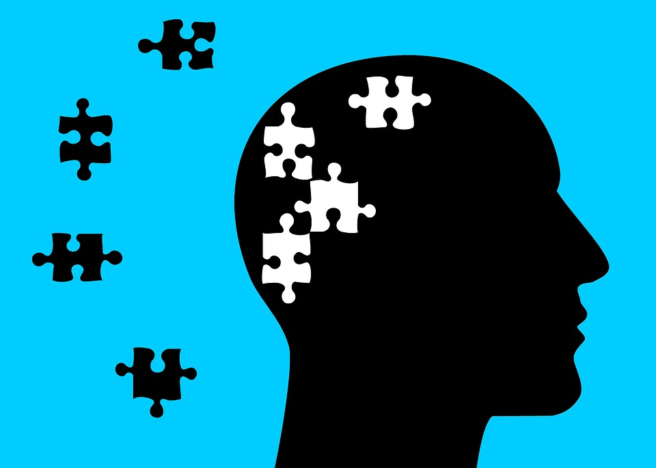
The Cognitive Model
Normal Behaviours
Rational thought patterns that allow people to accurately view the world and control their behaviours.
Abnormal Behaviours
Irrational and distorted thoughts about themselves, others and their environment resulting in difficulty to control their actions.

Slide 16
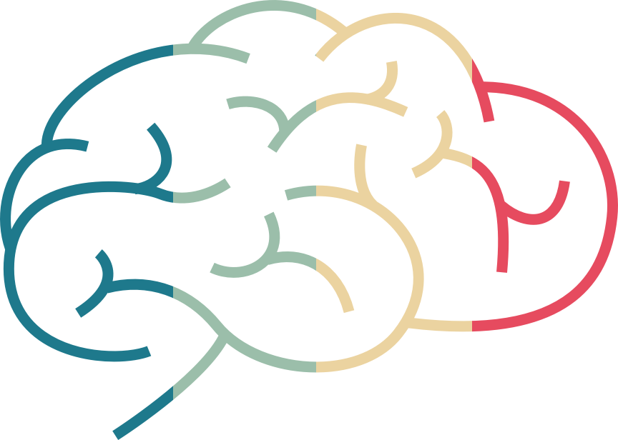

Cognitive Approach - Assumptions
Behaviour is the result of information processing
Cognitive change will lead to behavioural change.
Comparison between the mind and computers

Slide 17
The Cognitive Model: Main Assumptions
Assumption 1: The Cognitive Model of Abnormality assumes that how we think influences how we feel and how we behave. The ways in which we process information (cognition) directly affect the ways we behave. The Cognitive Model suggests that disordered thinking can cause disordered or abnormal behaviour. Disordered thinking includes irrational assumptions and negative views about the self, the world and the future.
Assumption 2: The Cognitive Model assumes that cognitive disorders are the result of negative or disorganised thinking and, therefore, they can be made positive or organised. Thoughts can be monitored, evaluated and altered. Individuals can modify their thinking, challenge their irrational cognitions and self-defeating thoughts.

Slide 18
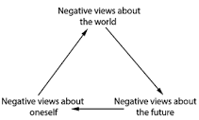



Beck’s (1976) cognitive triad
negative (irrational) thoughts that depressed individuals have about...
  “I am helpless and inadequate”
  “The world is full of insuperable obstacles”
  “I am worthless, so there’s no chance that the future will be any better than the present”

Slide 19
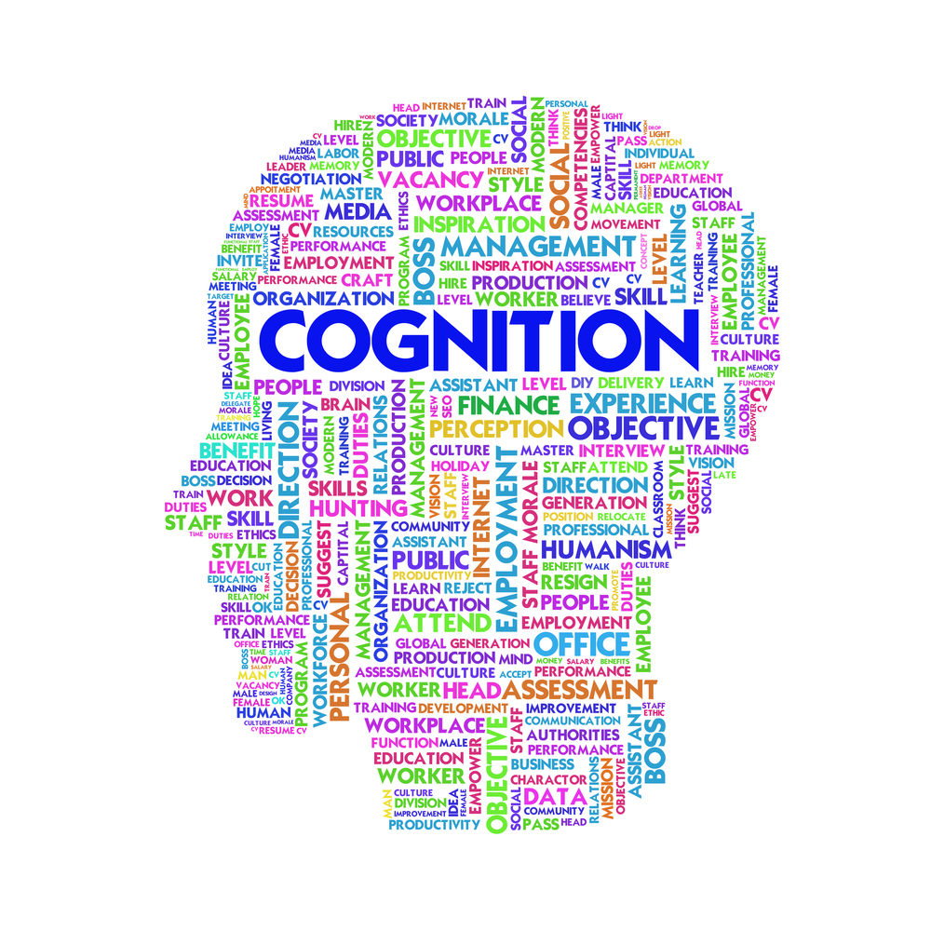
Cognitive Tests….

Slide 20
The Cognitive Approach
The Stroop Test
On the next slide, call out the colours that you see NOT the words you see.

Slide 21
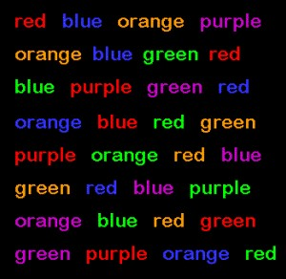

Slide 22
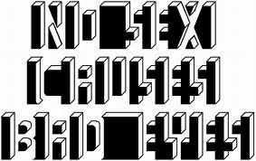
What about this last picture?

Slide 23
Cognition Number assessment test….

Slide 24
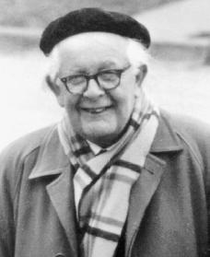
Jean Piaget (1896 – 1990)
Piaget's (1936) theory of cognitive development explains how a child constructs a mental model of the world
Still used in education today.

Slide 25
Stages of Cognitive Development
Four stages:
  The Sensorimotor Stage
  The Pre-operational Stage
  Concrete Operational Stage
  Formal Operational Stage

Slide 26
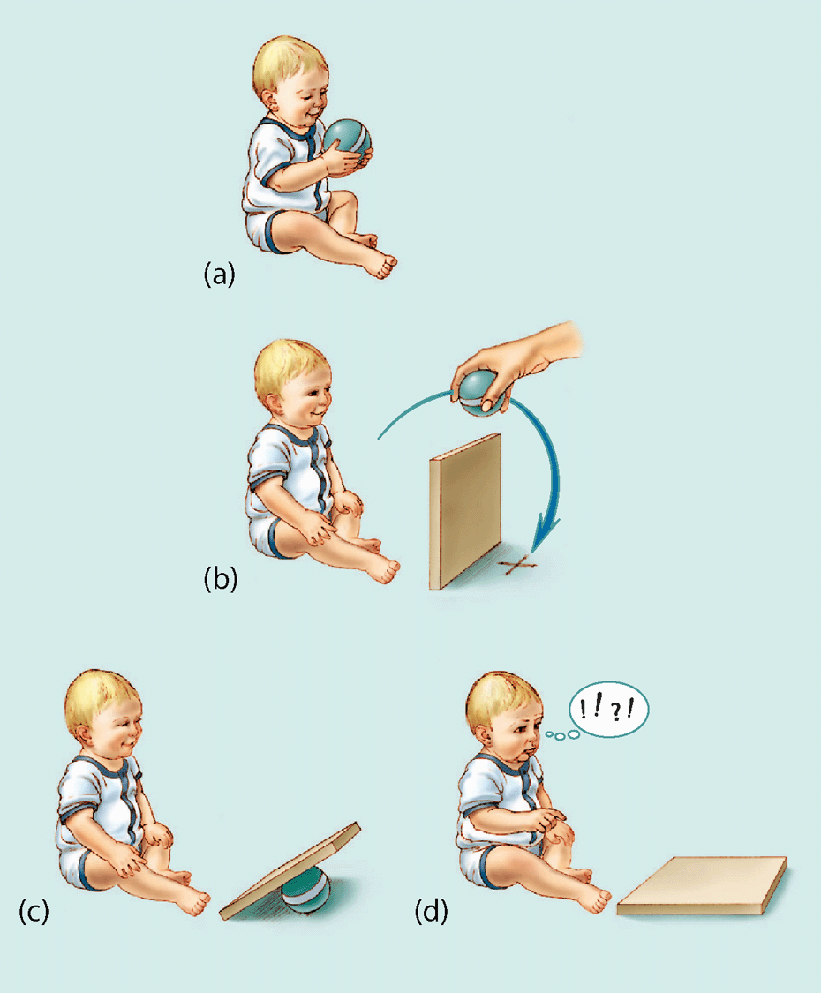
Sensorimotor Stage
0-2 Years
Only knows the world via its immediate senses.
Egocentrism – cannot distinguish between itself and environment.
Object permanence – when child cannot see object it no longer exists for them.

Slide 27

Sensorimotor Stage
Example of Object permanence
If a child between 0-5 months is shown an object they want, which is then hidden, the child will not look for it.

Slide 28
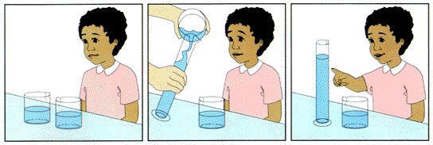
Pre-operational Stage
2 – 7 years
Internal process continue to grow.
Dominated by the external world and the appearance of objects in it.
Shows centration – focuses on only one aspect of an object or situation at a time.
Lacks mental ability to carry out logical operation on the world.

Slide 29
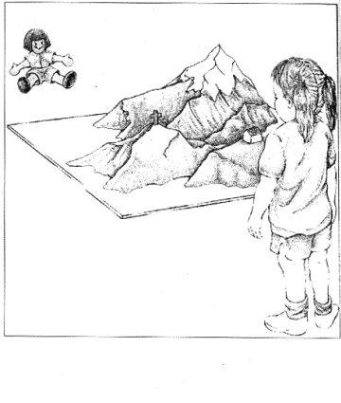
Pre-operational Stage
Egocentrism (mountain task)
Children in this stage cannot describe the world from any point of view but their own.

Slide 30
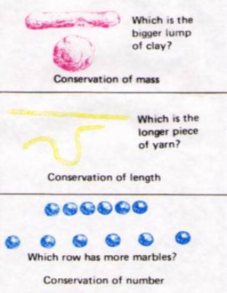
Concrete Operational Stage
7 – 11 years
Carry out logical manipulations between objects and situations.
De-centrate - more than one aspect of an object or situation can now be taken into account at the same time.

Slide 31
Concrete Operational Stage
Deal with ‘what is’ rather then ‘what if’.
Understand things that are tangible and present.
Not ‘what if’ questions or abstract situations.

Slide 32

Formal Operational Stage
11 onwards
Can think about hypothetical problems.
Ideas can be manipulated in their head and reasoning/deductions can be carried out on verbal statements, without any concrete examples.

Slide 33



Formal Operational Stage
Can solve problems such as,
‘Edith is fairer than Susan. Edith is darker than Lily. Who is the darkest?’
Without the need of images or dolls.

Slide 34
COGNITIVE THERAPIES
Cognitive Behavioural Therapy
Cognitive Restructuring Therapy
Rational Emotive Therapy
Stress Inoculation & Hardiness Training.

Slide 35
Cognitive-behavioural therapies (CBT)
“A talking therapy designed to help you cope with symptoms and approach problems positively.”
Thoughts (cognitions) interact with and have an enormous influence on emotions and behaviour.
The aim of therapy is to identify irrational thoughts and replace with more positive rational ways of thinking
Notes:
Good for stress and depression

Slide 36
Cognitive Behavioural Therapy
Cognitive behavioural therapy (CBT) is used to help solve problems in people's lives, such as anxiety, depression, post-traumatic stress disorder (PTSD) or drug misuse. CBT was developed from two earlier types of psychotherapy:
Cognitive therapy, designed to change people's thoughts, beliefs, attitudes and expectations. (i.e. Changing negative thoughts to positive) Includes Stress Innoculation and Hardiness training (both cognitive methods)
Behavioural therapy (designed to change how people acted/behaved).
American psychotherapist Aaron Beck developed CBT believing that the way we think about a situation affects how we act but also that our actions/behaviours can affect how we think and feel.
It is therefore necessary to change both the act of thinking and behaviour at the same time. This is known as cognitive behavioural therapy. CBT says that your problems are often created by you. It is not the situation itself that is making you unhappy, but how you think about it and how you react to it.

Slide 37
Effectiveness of CBT
CBT is often favoured over other therapies because it aims to get rid of the problem not just the symptoms.
Evans (1992) CBT is at least as good as drug therapy in preventing a relapse
Keller (2001) combination of CBT and drug therapy more effective than either therapy alone
Butler (2006) effectiveness depends on the disorder. When the problem is severe, a combination of drugs and CBT is best. E.g. Drugs may reduce disturbed thoughts of Schizophrenics allowing CBT to be used effectively.

Slide 38
Rational Emotive Therapy
Albert Ellis (1962) argued that anxiety and depression occur as the end points in a 3 point sequence
According to this A-B-C model, anxiety and depression are caused by the irrational thoughts that follow from the occurrence of unpleasant events
The interpretations that are produced at point B depend on the individuals belief system
Occurrence of unpleasant event
(rejection by a partner)
Cognitive reaction to the unpleasant event:
“I am a valueless person to be rejected like this”
State of anxiety or depression
A
B
C

Slide 39
Rational Emotive Therapy - cont
In 1962 Ellis developed rational-emotive therapy as a way of removing irrational and self-defeating thoughts and replacing them with more rational and positive ones
Encouraged to create a point D – a system that allows them to interpret life’s events in ways that do not cause them emotional distress.

Slide 40
Rationale emotive therapy starts with the therapist making patients aware of the self-defeating nature of many of their beliefs.
Patients are then encouraged to ask themselves questions to discover if beliefs are rational or logical…
Patients taught to replace their faulty & irrational beliefs with more realistic ones…
Why do I have to be liked by everybody?
Why is it so terrible if I cant have my own way all the time?
Does it really matter if I am not competent in every way?
It is impossible to be liked by everybody, but most people like me
My life can be happy even if I sometimes can’t do what I want
I will strive to be fairly competent, and accept that that perfection cannot be achieved.

Slide 41

Evaluation….

Slide 42
Evaluation – Strengths
Concentrates in current thought processes. It does not depend on the past history of the client, for example, recovering repressed memories from the unconscious. This is an advantage because details about a person’s past are often unclear, irrelevant, misleading and misremembered.
Cognitive Therapies, especially when used together with Behavioural Therapy, have a good success rate in helping clients.
It is a popular and much-used approach. Very effective in anxiety and depression.
It also empowers the individual to take responsibility for his own thinking processes by monitoring, evaluating and altering self-defeating thought processes. Can use techniques for future problems.
Client can ‘cure’ themselves

Slide 43
Evaluation - Weaknesses
Like all other approaches, psychological and medical, the Cognitive Model rarely supplies the complete solution to abnormal behaviour by itself. There may be medical and environmental influences affecting a person’s behaviour. Focussing only on a person’s cognition may be too narrow an approach.
The Cognitive Model sometimes places the blame for any disorder unfairly on the individual – “It’s your disordered thinking, so you are at fault”. For example, a person suffering from depression may be living in awful circumstances where depression is a perfectly valid and rationale response to the situation. It will hardly be surprising if he perceives the world and his future as a negative and grim.

Slide 44
Criticisms of the cognitive approach?
Assumes human behaviour is a result of external stimuli only
Human thinking is an invisible process, therefore cognitive processes are hypothetical only
Biology, genetics, culture, past experience have not been sufficiently tested as factors in mental processing

Slide 45
Criticisms of the cognitive approach?
Likening the human information processing to a computer vastly over simplifies the human mind
The outcome of cognitive tests like the ones we’ve undertaken today can be affected by many different factors

Slide 46
Cognitive approach
Structured approach of understanding and changing behaviour
Theory is easy to understand and process of theory is understood – it makes sense to the client.
Pays attention to what the client says – what the person thinks and feels
Therapist then looks for faulty or dysfunctional beliefs which affects how the client behaves.
There is no therapist interpretation or finding “hidden meanings”
Direct approach
Easy to learn and apply – clients can learn the techniques and use themselves in other areas of their lives
Aims for independence of the client – empowerment is key and so follows the care value base
Widely used in health care and can be applied to a wide range of issues e.g. stress, anxiety, anger management
Cost effective and can be relatively quick
Not suitable for all as it relies on good language skills – the client needs to be able to express their thoughts and understand what the counsellor wants them to do
Hard to use with those that can’t follow a rational train of thought
Doesn’t deal with the underlying causes of problems
One problem worked on at a time
Debate on it’s effectiveness – some studies show it works, some show it doesn’t

