Slide 1

Getting Ready for your Dissertation
Sofie Arif
Academic Liaison Librarian.

Slide 2
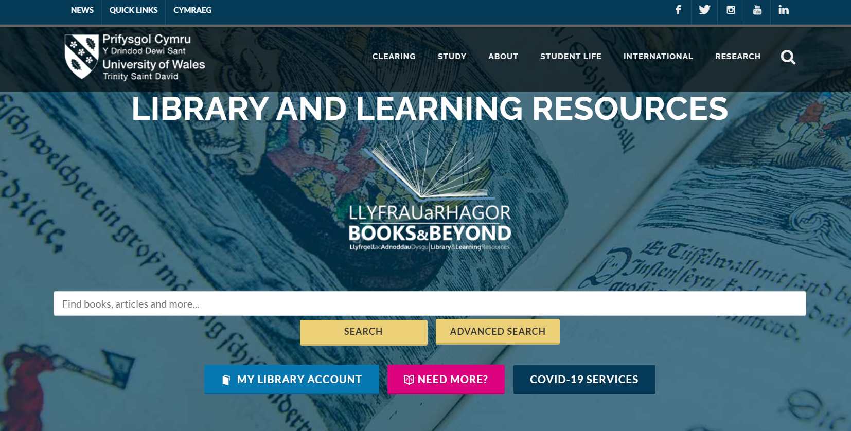
How to access the library catalogue
Direct link:
Library and Learning Resources | UWTSD Intranet

Slide 3
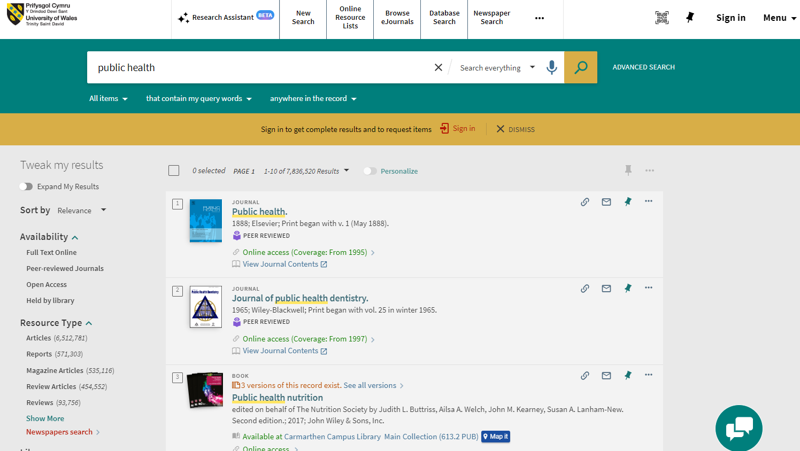
The UWTSD Library
Access specific Journal/Database menus.
ALWAYS sign in to access all features.
NEW
FEATURE!
Use the pin to save to favourites.
Think about the QUALITY of the information.

Slide 4
Direct Links
Library New Search - https://librarysearch.uwtsd.ac.uk/discovery/search?vid=44WHELF_UWTSD:44WHELF_UWTSD_VU1&lang=en
eJournals (Browzine) - https://browzine.com/libraries/1422/subjects
Database Search - https://librarysearch.uwtsd.ac.uk/discovery/dbsearch?query=contains,dbcategory,&tab=jsearch_slot&sortby=title&vid=44WHELF_UWTSD:44WHELF_UWTSD_VU1&lang=en&offset=0&databases=category,Institute%20of%20Management%20and%20Health

Slide 5

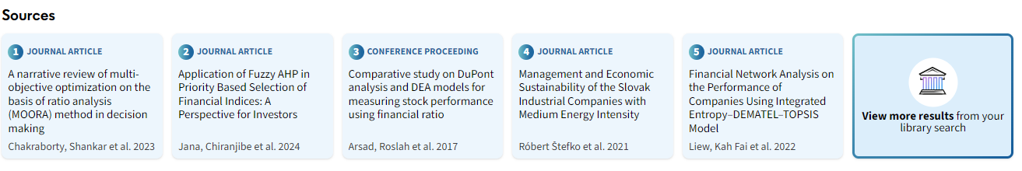
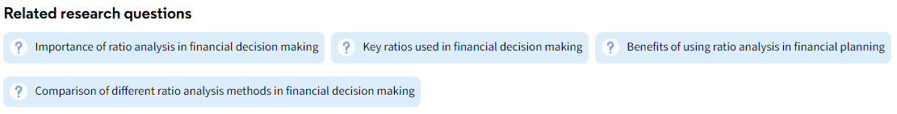
Search question
Results from UWTSD library
Results.
Note: not all may be available via our library.
Further related question prompts.
Library Results
Library Intranet

Slide 6





How it works
The AI generated overview and sources are returned in the response​.
The top 5 results are sent to the LLM to create an overview with in-text references based on the abstracts​.
Your question is sent to the Large Language Model (LLM).
The question is converted into a Boolean query.
The Boolean query is sent to the central Primo library catalogue to retrieve results.

Slide 7
Search results
Important: It does not search everything. You will still need to perform your own search!
It does not currently search the following:
Any collections from the following content providers - APA, DataCite, Elsevier, JSTOR, Kogan Page and Conde Nas.
News content (newspaper articles, newsletters, text resources).
Collections that are not marked as 'free for search' in the CDI collection list.
Furthermore, certain requests or queries are unavailable:
Requests for materials of a particular type, e.g. "give me peer reviewed articles on x.y.z"
Requests for materials from a certain time period, e.g. "give the most recent information on climate change"
Follow up questions are not supported. Each question stands alone, and all relevant information needs to be asked in each.

Slide 8
Library result search string
This is a copy of the search string created by the AI tool to search for results in the library catalogue.
(ratio analysis in financial decision making) OR
(importance of ratio analysis in finance) OR
(application of ratio analysis in financial management) OR
(role of ratio analysis in financial planning) OR
(significance of ratio analysis in decision making) OR
(Importance of ratio analysis in financial decision making) OR (Application of ratio analysis in making financial decisions) OR (Significance of ratio analysis in financial decision-making process) OR
(Role of ratio analysis in financial decision making) OR
(Utilization of ratio analysis for financial decision making) OR
(How is ratio analysis used in financial decision making?)
Tip:
Note the keywords and terms it applies and use these with Boolean Operators to perform your own search in the library catalogue.
Library Results

Slide 9
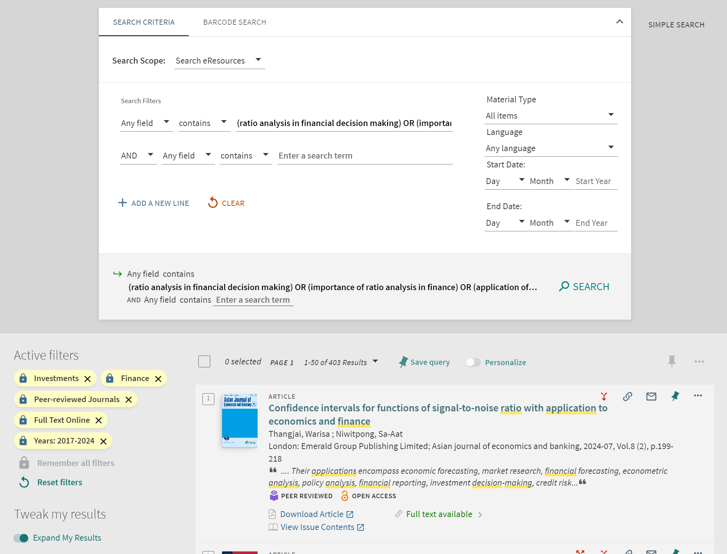
Library results (with filters)
Tip:
Open up in the Advanced Search view and explore some of the suggested keywords.
Try subject searching or title searching, along with date and further subject filters.
Explore further and narrow down results.
Further results

Slide 10
Advanced Search Process
Formulate
Formulate a search with key concepts
Choose
Choose the databases
Find
Find synonyms, alternative keywords
Combine
Combine your keywords and run search
Review, adjust and add
Review, adjust and add limits (if necessary)
Save
Save your results and search history

Slide 11

Advanced Search Tips
Finding a relevant article / book can lead to many more resources.
Note key words / concepts / terminology used
Check cited in and cited by
Locate key journals and authors
Explore subject headings (SH) : Check out SH below the bibliographic details in the catalogue record.
Use filters: date, location, type of resource

Slide 12

AND
OR
NOT
Boolean Operators allow you to combine your keywords to narrow or broaden your search.​
AND: narrows your search by only giving results where ALL your search terms are present.​
OR: broadens your search where ANY of your search terms are present.​
NOT: Excludes specific terms​

Slide 13
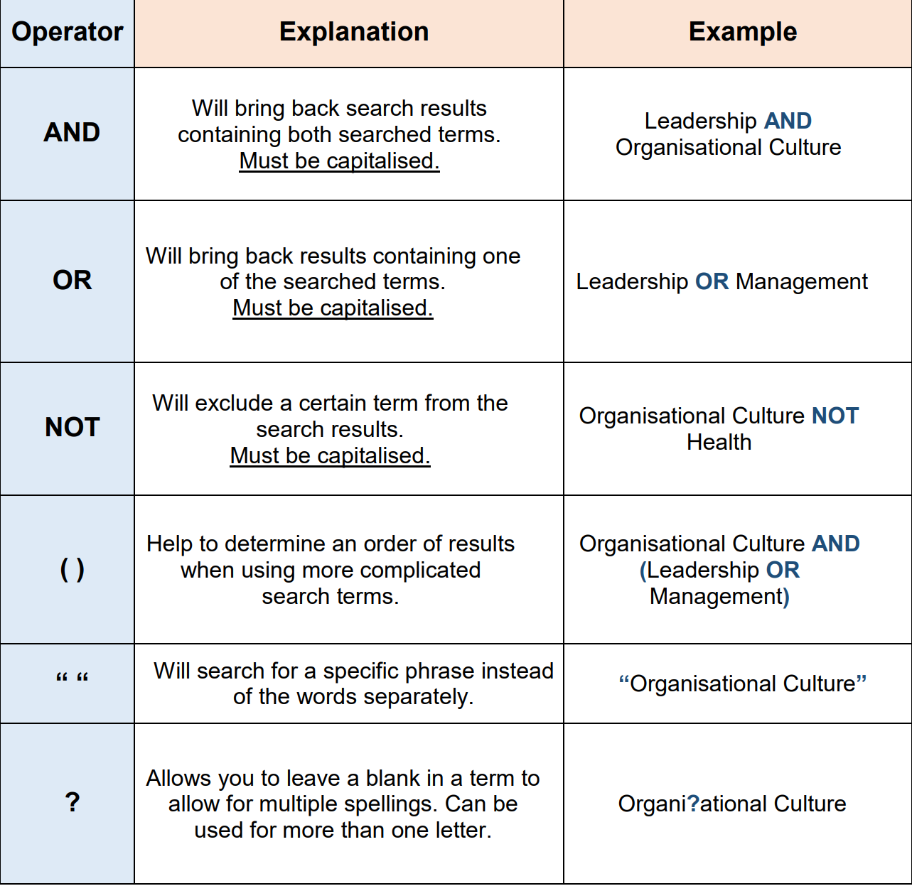
Search Operators
https://libguides.mdx.ac.uk/ld.php?content_id=32846025

Slide 14
BSc H&SC – Recommended Databases.
Cite Them Right (essential for referencing)
ProQuest Central
PubMed
Science Direct
Database Search (uwtsd.ac.uk)
Notes:
Epidemiology

Slide 15

Cite Them Right
Available via Library catalogue (Search Cite Them Right and then choose the database version)
ESSENTIAL for Referencing!
Gives examples, templates for you to use and is updated regularly.
Cite Them Right - Home

Slide 16
Database Tutorial Videos
BASIC SEARCH (ProQuest)
Advanced Search (ProQuest)
Search Results (ProQuest)
EBSCOhost Basic Search – Tutorial
EBSCOhost Advanced Searching – Tutorial
The ScienceDirect Database
What is in PubMed?

Slide 17
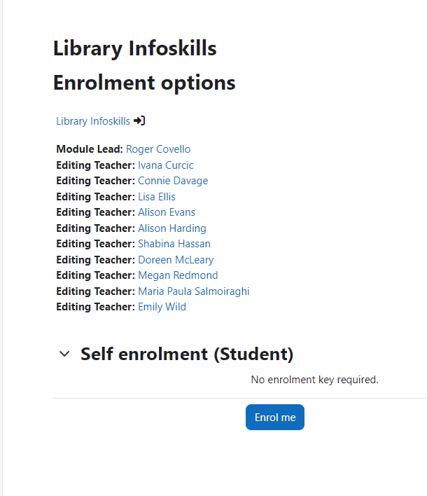
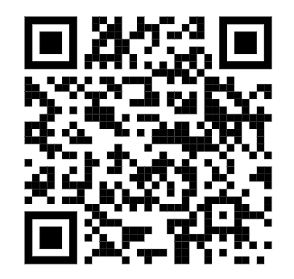
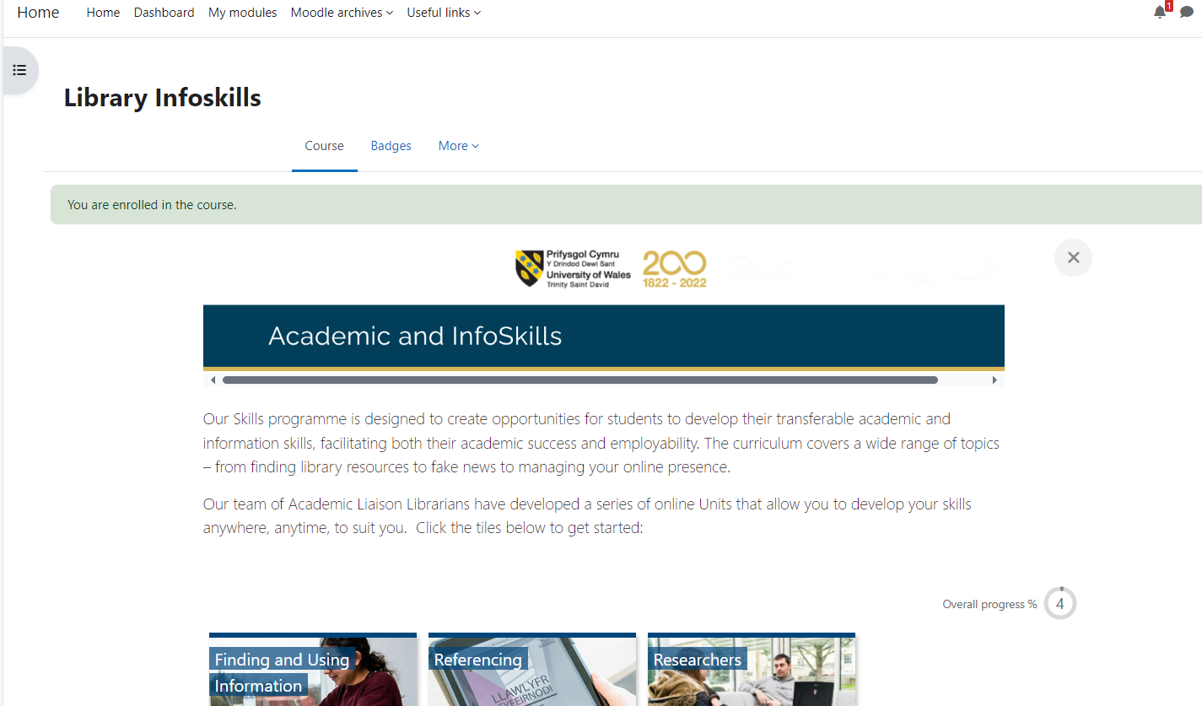
UWTSD Moodle – Online Infoskills Programme

Slide 18
Online Infoskills – Recommendations.
Infoskills Moodle site : Referencing - The Mechanics | Home
Infoskills Moodle site : Advanced Searching | Home (Includes Using Google Scholar and External databases, Literature Review and Introduction to AI)
Infoskills Moodle site : Searching for information | Home (includes searching journals and databases)
Infoskills Moodle site : Evaluating information | Home

Slide 19

RefWorks
RefWorks is an online research management, writing and collaboration tool, designed to help you easily gather, manage, store and share all types of information, as well as generate citations and bibliographies.
Available FREE to all UWTSD students (logging in with your University e-mail address.)

Slide 20
RefWorks – Tutorials.
Log into RefWorks here: RefWorks | UWTSD Intranet (Click on CREATE NEW ACCOUNT)
Tutorial – How to create a RefWorks account - Accessing RefWorks
Link to RefWorks YouTube page: RefWorks – YouTube (Includes additional tutorials)

Slide 21

Support available for MSc Public Health students.
Sofie Arif
Doreen McLeary
Olivia Edmonds
Email:
infoskills@uwtsd.ac.uk
Notes:
What we do
Ensure your needs are the focus of the services and that we use our resources effectively for the benefit of our customers.
Support and help you become empowered, critical and independent in your use of information and to get the most out of the wide range of resources available.
Communicate with you in a clear, timely and accurate manner through a variety of channels and publicise our range of services, terms and conditions, opening hours, and keep you informed of any changes.
Work collaboratively across the whole university, actively engage with the wider academic and professional communities to share and disseminate best practice.

Slide 22
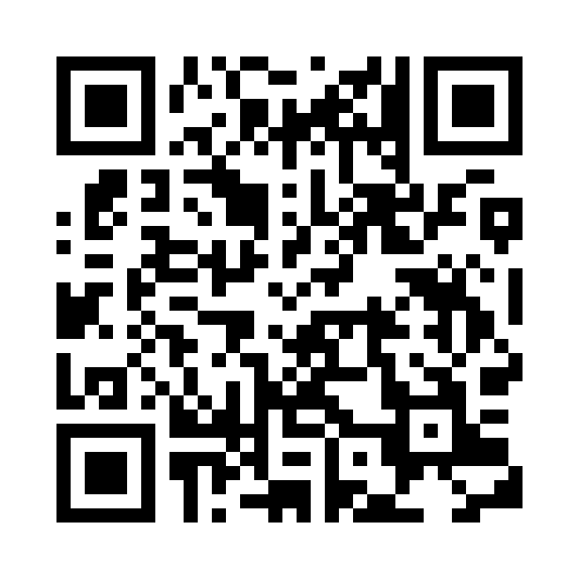
STUDENTS
Let us know how we did.
Please scan the QR code and fill out our feedback form – your comments are greatly appreciated.

