Slide 1

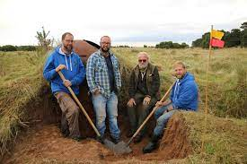
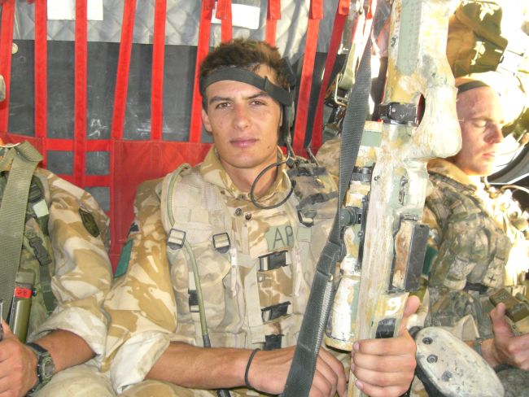






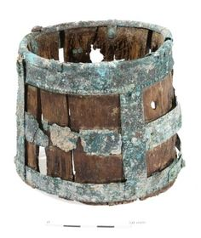
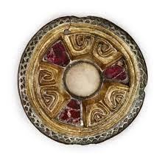
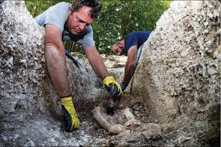
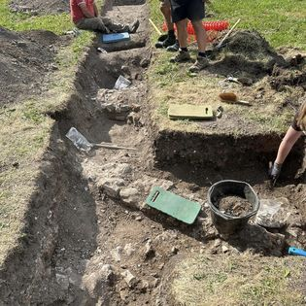
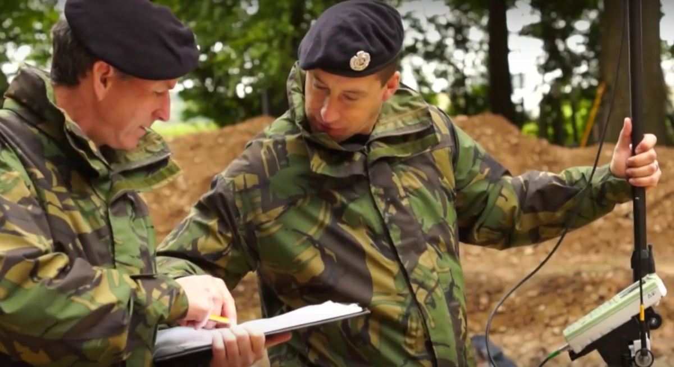
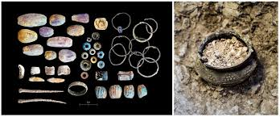
Wellbeing
Employment
Education
Volunteer
Recover
Repurpose
PTSD
MOD
Est. 2011
Armed Service Personnel
Stakeholders
Barrow Clump
Heritage
International
Fieldwork
Historic Stewardship
Finds

Slide 2
References
Breaking Ground Heritage, (2024) Breaking Ground Heritage Logo Available at: https://breakinggroundheritage.org.uk/ (Accessed: 6th February 2024)
Brigade UK, (2018) HM Armed Forces British Army Veterans Sticker Available at: https://www.amazon.co.uk/Armed-Forces-British-Veteran-Sticker/dp/B07CMGSJTX (Accessed: 6th February 2024)
Crown Copyright/MOD, (2017) Veterans Excavating First World War Training Trenches. Available at: https://insidedio.blog.gov.uk/tag/breaking-ground-heritage/ (Accessed: 6th February 2024)
Gov.uk, (2019) Operation Nightingale. Available at: https://www.gov.uk/guidance/operation-nightingale#:~:text=An%20initiative%20to%20assist%20the,them%20involved%20in%20archaeological%20investigations (Accessed: 4th February 2024)
Heritage Fund (2019) Our Acknowledgement Stamps and Logos Available at: https://www.heritagefund.org.uk/funding/run-your-project/logo/acknowledgement (Accessed: 6th February 2024)
Tishk International University, (2024) png-transparent-university-of-leicester-banner-logo-brand-line-text-logo-university. Available at: https://iro.tiu.edu.iq/png-transparent-university-of-leicester-banner-logo-brand-line-text-logo-university/ (Accessed: 6th February 2024)
Tyson, P. (2021) Afghanistan war: The British veterans who felt abandoned after risking their lives. Available at: https://www.itv.com/news/2021-07-26/the-afghanistan-veterans-who-felt-abandoned-after-risking-their-lives (Accessed: 6th February 2024)
Wikipedia, (2024) Defence Infrastructure Logo. Available at: https://en.wikipedia.org/wiki/Defence_Infrastructure_Organisation (Accessed: 6th February 2024)
Zen Graphics, (2024) Wessex Archaeology Logo. Available at: https://shop.zengraphics.co.uk/hm-armed-forces-veteran-british-army-stickers-decals- (Accessed: 6th February 2024)

