Slide 1
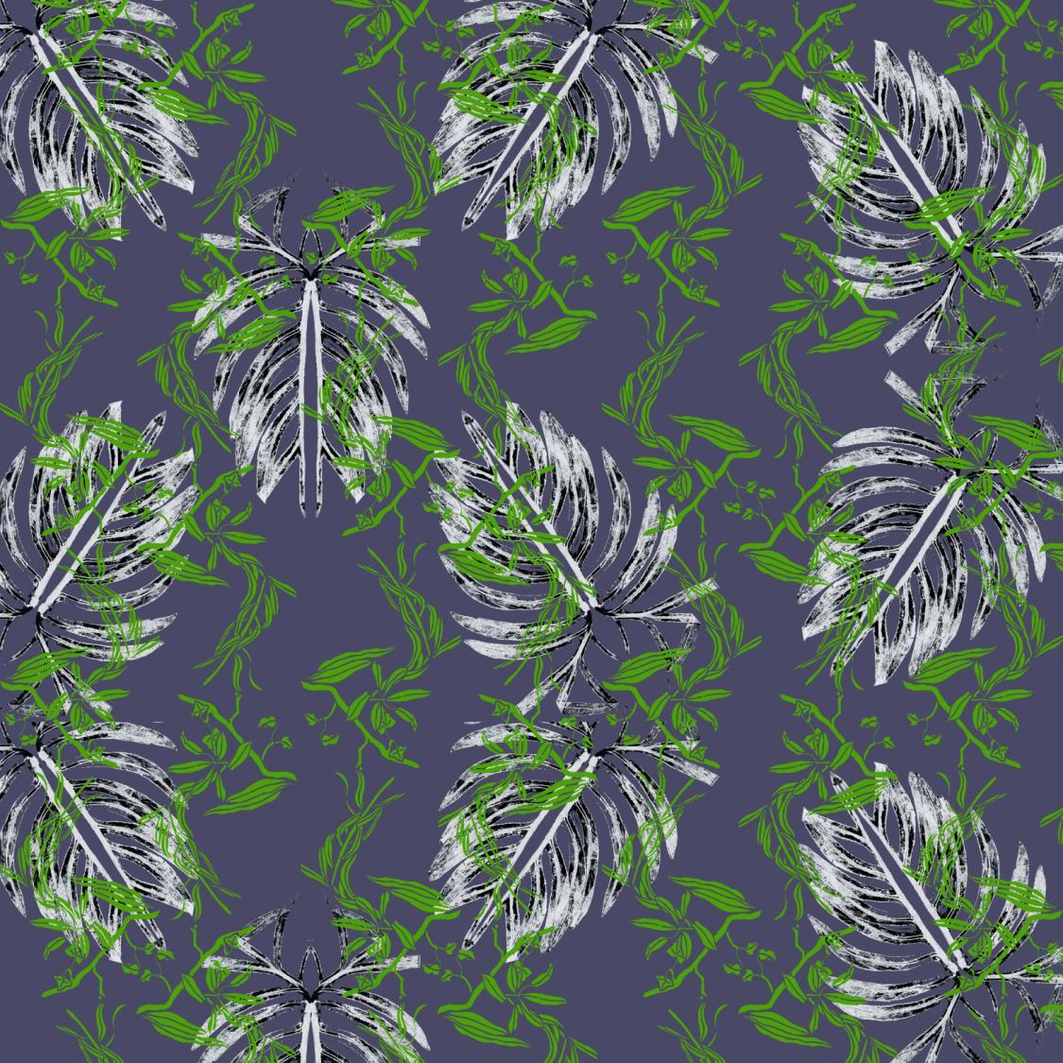
1st YEAR
Digital & Material
Process B2
Digital Portfolio
Submission
deadline date:
Monday 11th May
2020
9:30am
Notes:
Image: Scanned mono-print and gouache/indian ink resist images – digital drop repeat patterns created with both images

Slide 2
Carmen San-Miguel
P009583
B2 – Digital & Material Process
M4X02220
UWTSD
Notes:
Practical Skills (Marks Available: 70 out of 100)
At level 4, you should be able to apply the basic underlying concepts and principles to evaluate and interpret these within the context of your area of study. You should be able to demonstrate how the subject-related concepts and ideas relate to real world situations and/or a particular context. How do they work in practice? You will deploy models, methods, techniques, and/or theories, in that context, to assess current situations, perhaps to formulate plans or solutions to solve problems, or to create artefacts. This is likely to involve, for instance, the use of real-world artefacts, examples and cases, the application of a model within an organisation and/or benchmarking one theory or organisation against others based on stated criteria.
Guidance specific to this assessment:
Select and apply a wide-ranging and challenging body of practical explorations and outcomes.
Identify and select appropriate methods and techniques, to realise and clearly communicate your ideas.
Manage, organise and refer to your technical notes in a coherent way, to evidence your practical development.
Transferable Skills for Life and Professional Practice (Marks Available: 30 out of 100)
Your work must provide evidence of the qualities and transferable skills necessary for employment requiring the exercise of some personal responsibility. This includes demonstrating: that you can communicate the results of your study/work accurately and reliably, and with structured and coherent arguments; that you can initiate and complete tasks and procedures, whether individually and/or collaboratively; fluency of expression; clarity and effectiveness in presentation and organisation. Work should be coherent and well-structured in presentation and organisation.
Guidance specific to this assessment:
Present your work with care, applying attention to the finishing and detail required from professional practice necessary for future employment.
Apply your knowledge and skills in organisation and time-management. Work should be visually coherent and well-structured in presentation and organisation.
Take personal responsibility and pride in your presentation.

Slide 3
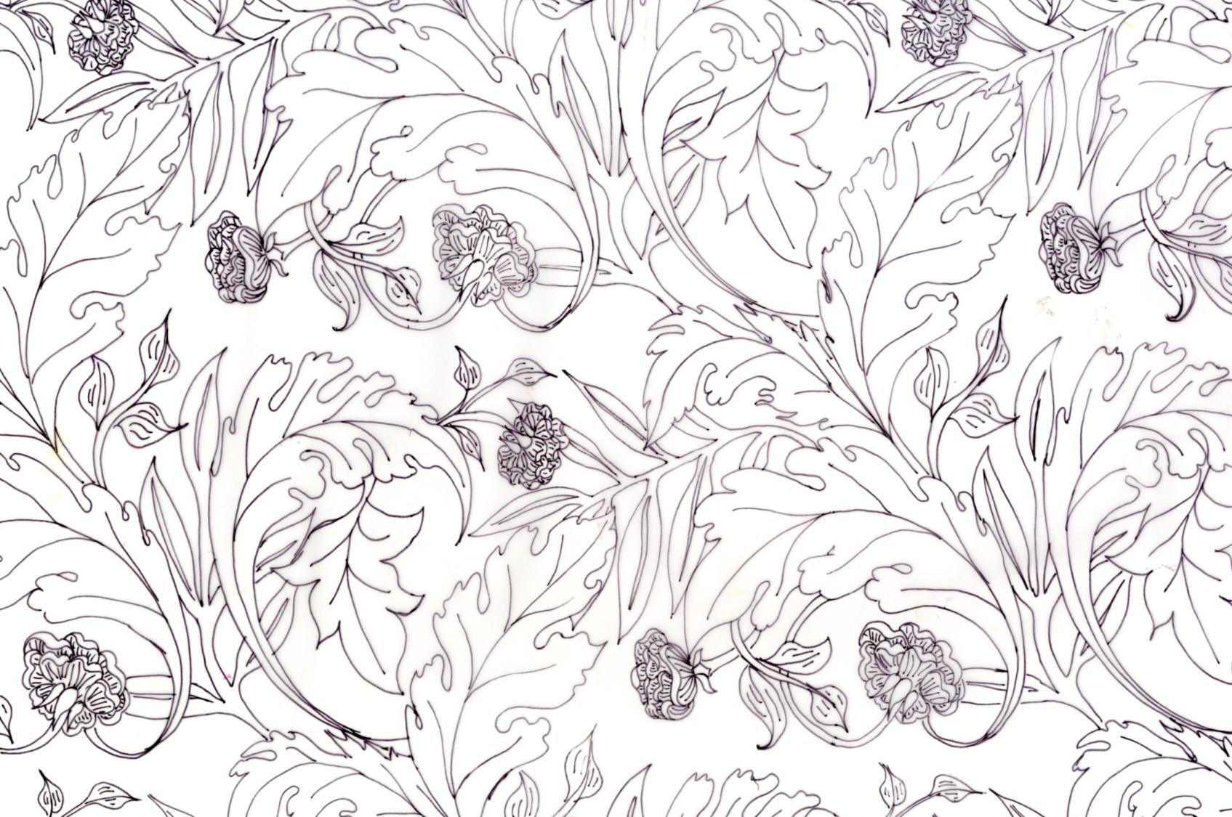
Throughout this digital portfolio, please find a minimum of 12 samples, evidencing a range of both digital and hand processes.
Notes:
Image: Hand rendered half-drop repeat pattern – fine-liner on paper

Slide 4
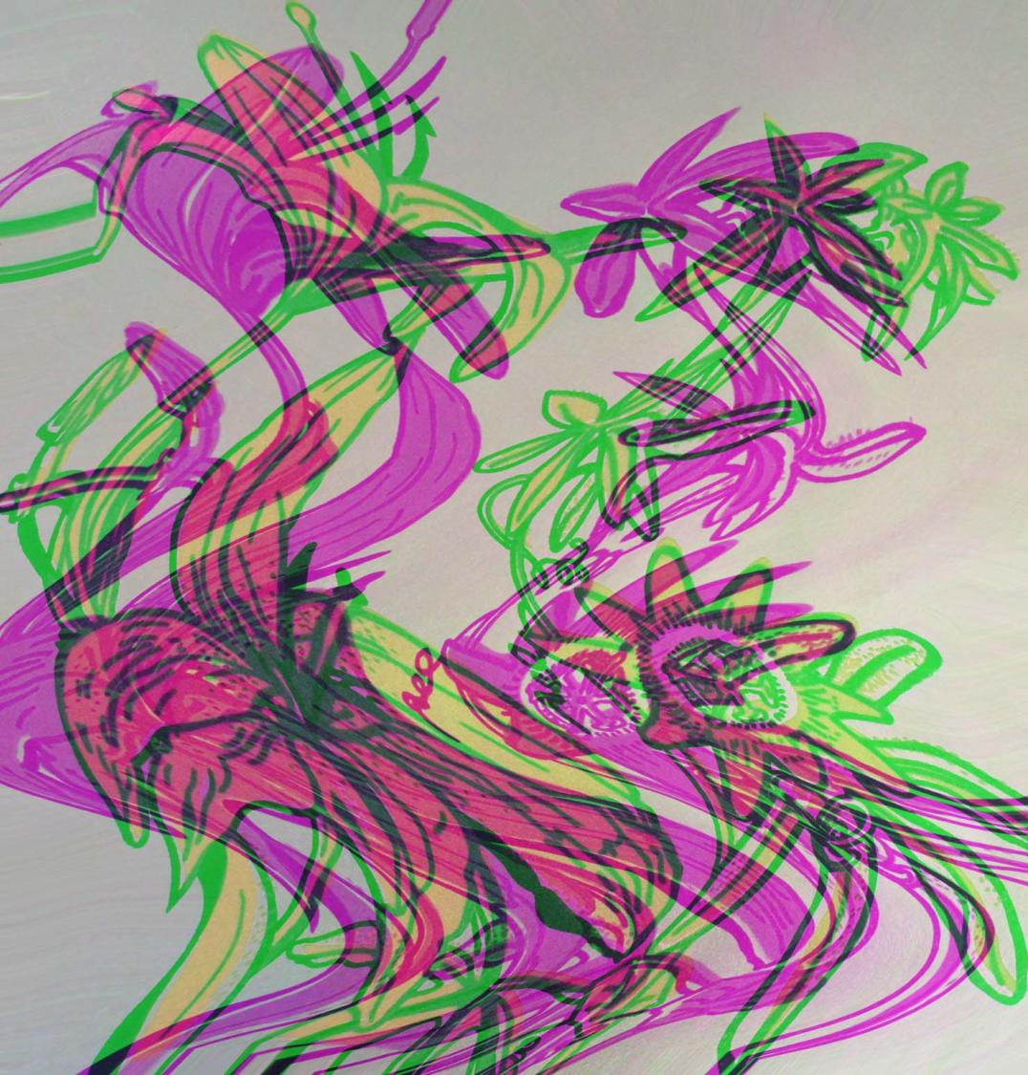

https://www.pinterest.co.uk/carmens1407/carmen-s-m-digital-material-processes-b2/
Notes:
Image: Scanned silk screen print - glitched using the wave and stained glass distort filters.

Slide 5
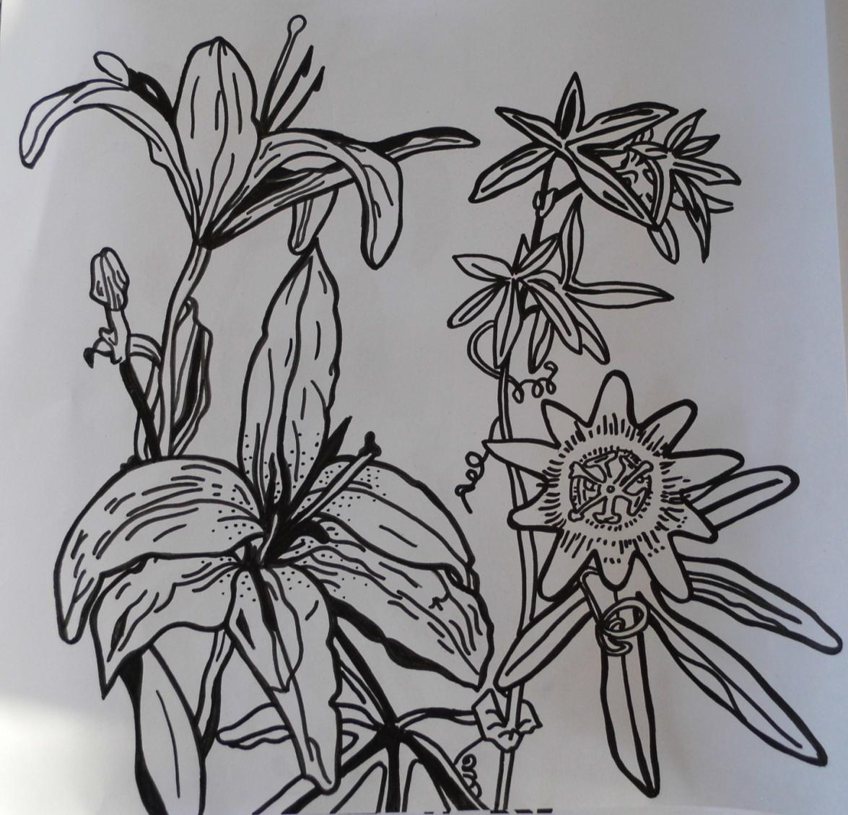
Colour separation artwork for screen
Upper/detailed layer/separation
Fine-liner and Indian ink on paper
Notes:
Colour separation artwork for screen

Slide 6
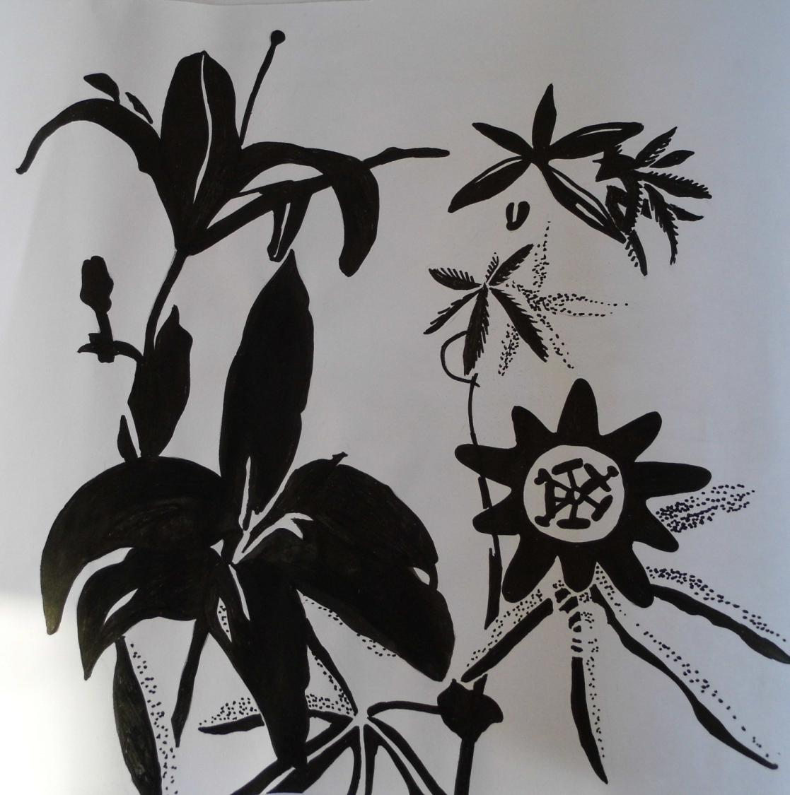
Colour separation artwork for screen
Base/block layer/separation
Fine-liner and Indian ink on paper
Notes:
Colour separation artwork for screen

Slide 7
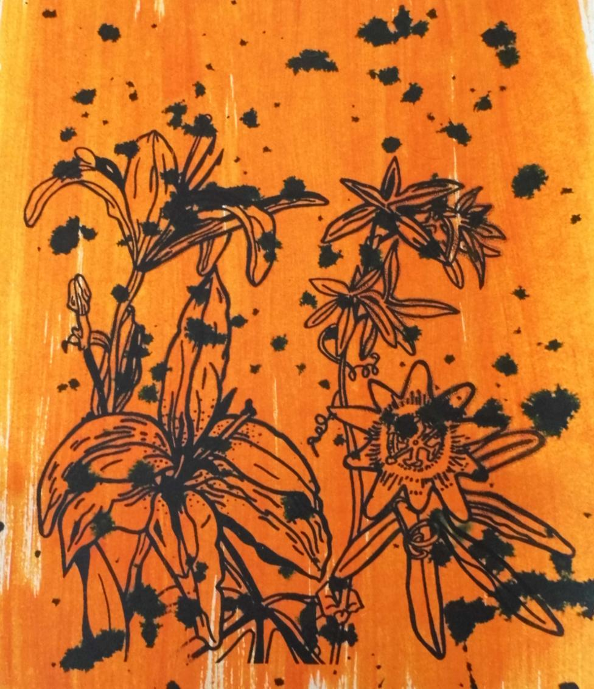
Screen printed samples
Substrate: Procion dyes on wallpaper
Black binder @ 5% strength (detailed layer)
I like the simplicity and colour contrast – not sure about the black splashes – could work better using different colour print medium.
Notes:
Photograph of screen printed samples

Slide 8
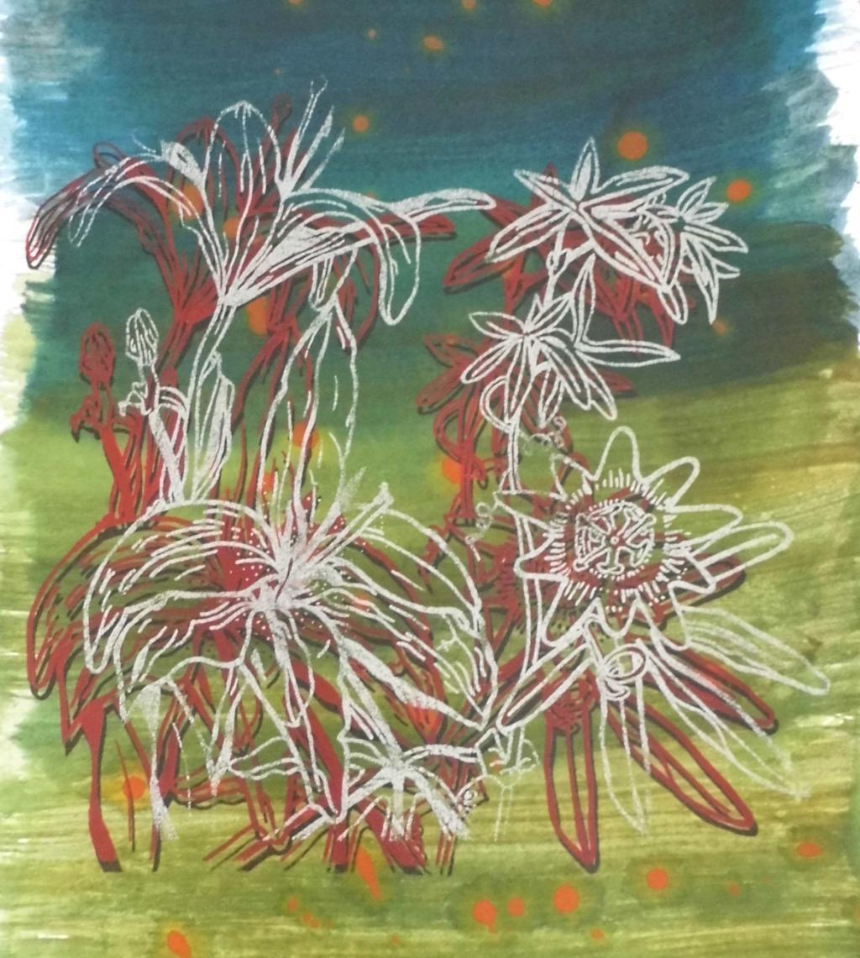
Screen printed samples
Substrate: Procion dyes on wallpaper
Black binder @ 5% strength (detailed layer)
Red puff binder @ 5% strength (detailed layer)
Metallic silver @ 5% strength (detailed layer)
Printed in that order
Good contrast using silver medium, too many layers – looks messy.
Notes:
Photograph of screen printed samples

Slide 9
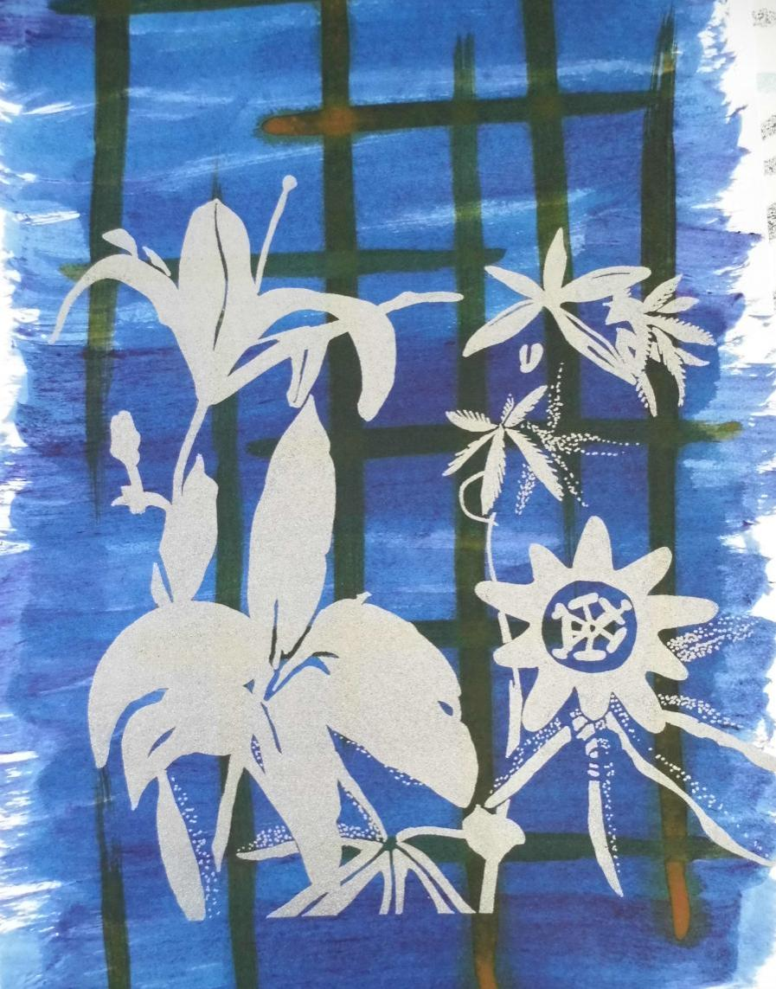
Screen printed samples
Substrate: Procion dyes on wallpaper
Metallic silver @ 5% strength (block layer)
Good contrast using silver medium.
Notes:
Photograph of screen printed samples

Slide 10
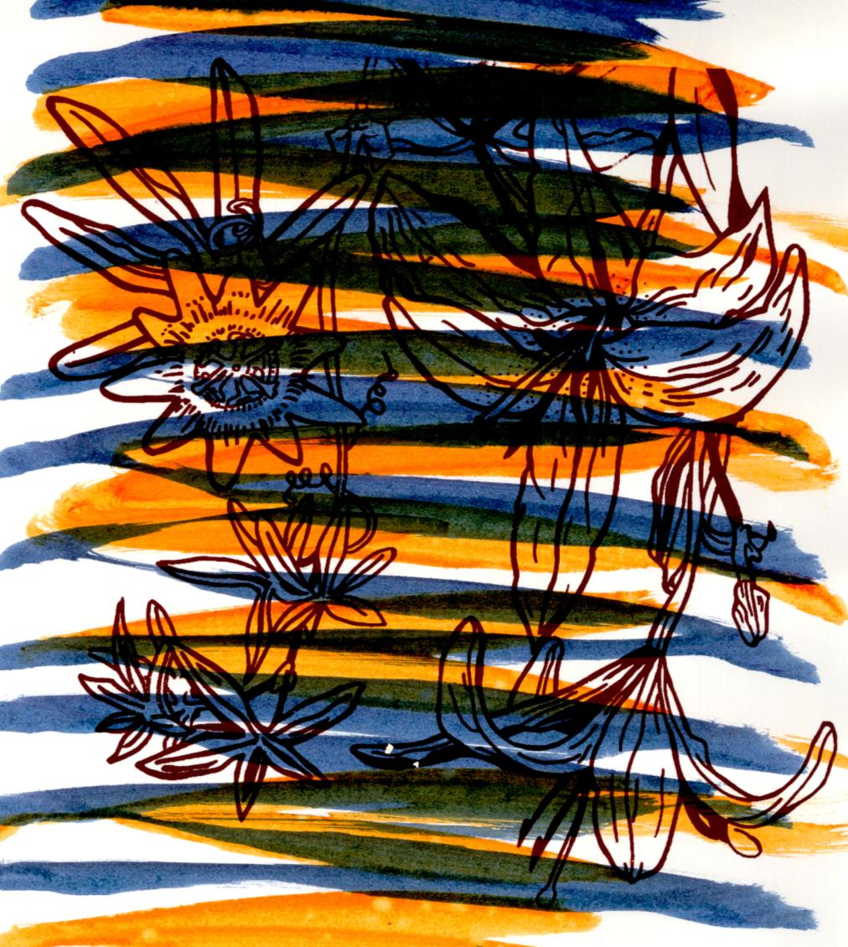
Screen printed samples
Substrate: Procion dyes on wallpaper
Black binder @ 5% strength (detailed layer)
Poor contrast with background – coloured stripes looks messy.
Notes:
Photograph of screen printed samples

Slide 11
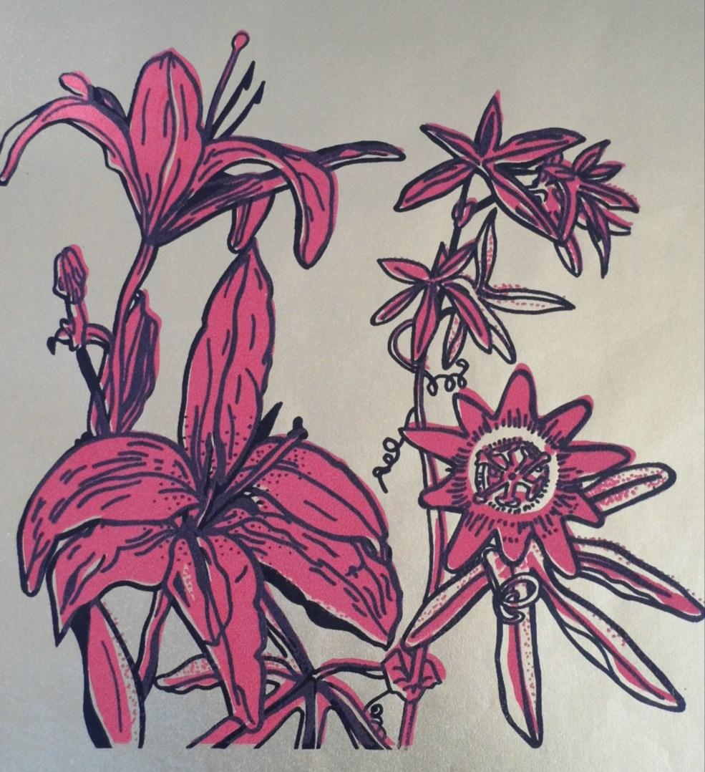
Screen printed samples
Substrate: Gold paper
Red puff binder @ 5% strength (block layer)
Black binder @ 5% strength (detailed layer)
Printed in that order
Black becomes faded when heat press applied to puff binder.
Notes:
Photograph of screen printed samples

Slide 12
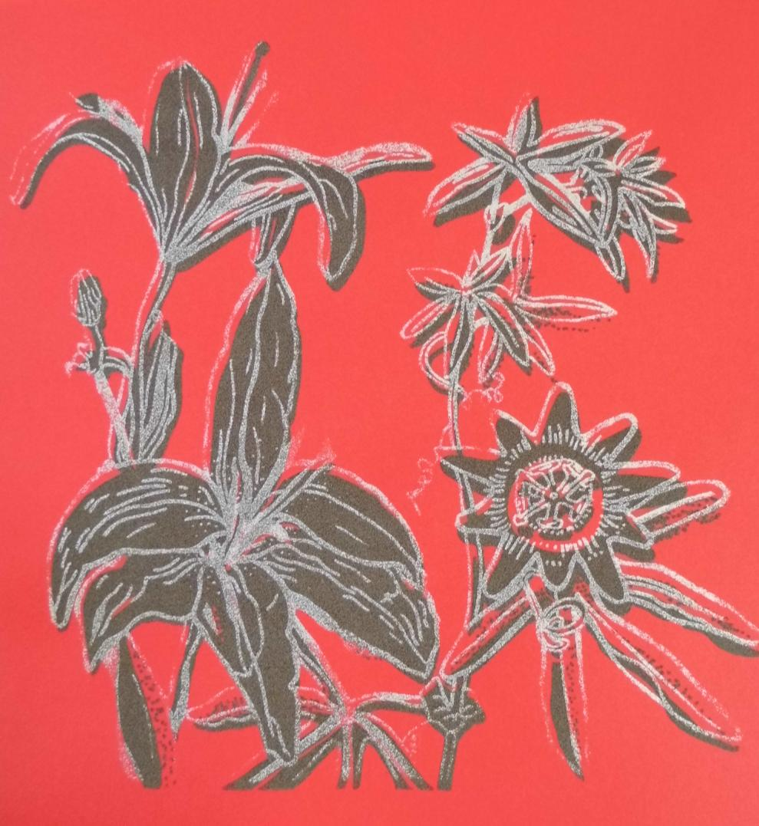
Screen printed samples
Substrate: Red card
Brown puff binder @ 5% strength (block layer)
Metallic silver binder @ 5% strength (detailed layer)
Printed in that order
Silver looses colour strength/becomes faded when heat press applied to puff binder.
Notes:
Photograph of screen printed samples

Slide 13
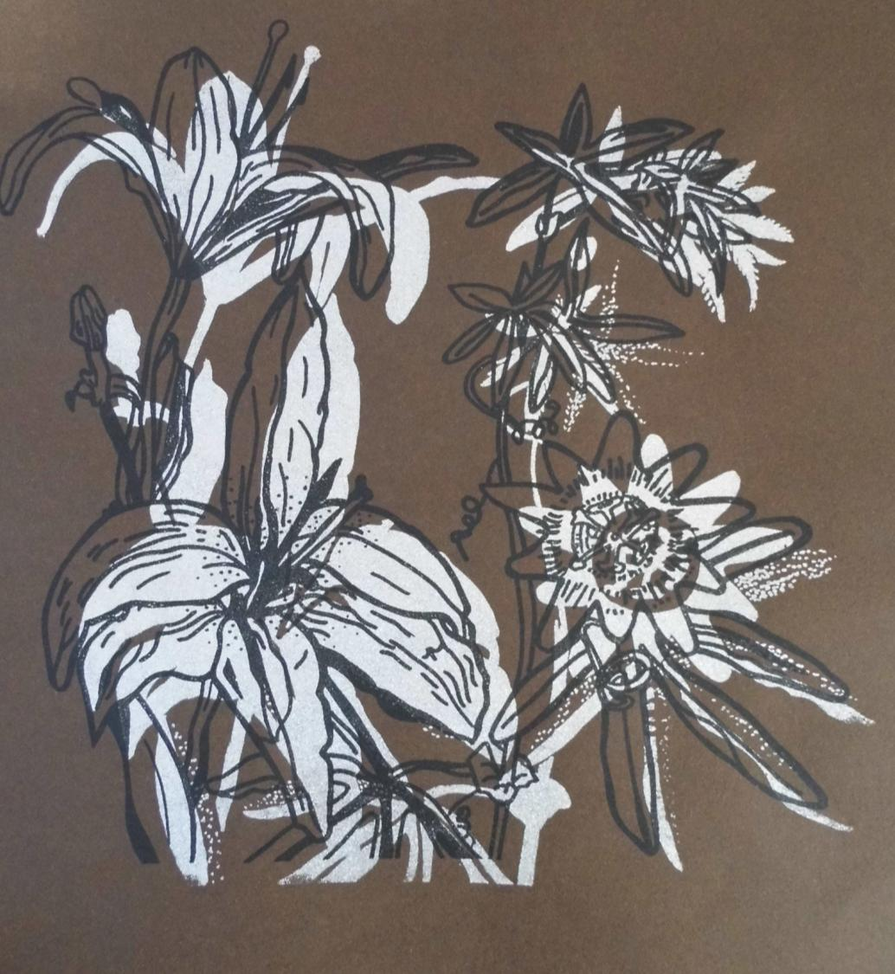
Screen printed samples
Substrate: Brown card
Metallic silver binder @ 5% strength (block layer)
Black binder @ 5% strength (detailed layer)
Printed in that order
Good contrast but poor registration of layers.
Notes:
Photograph of screen printed samples

Slide 14
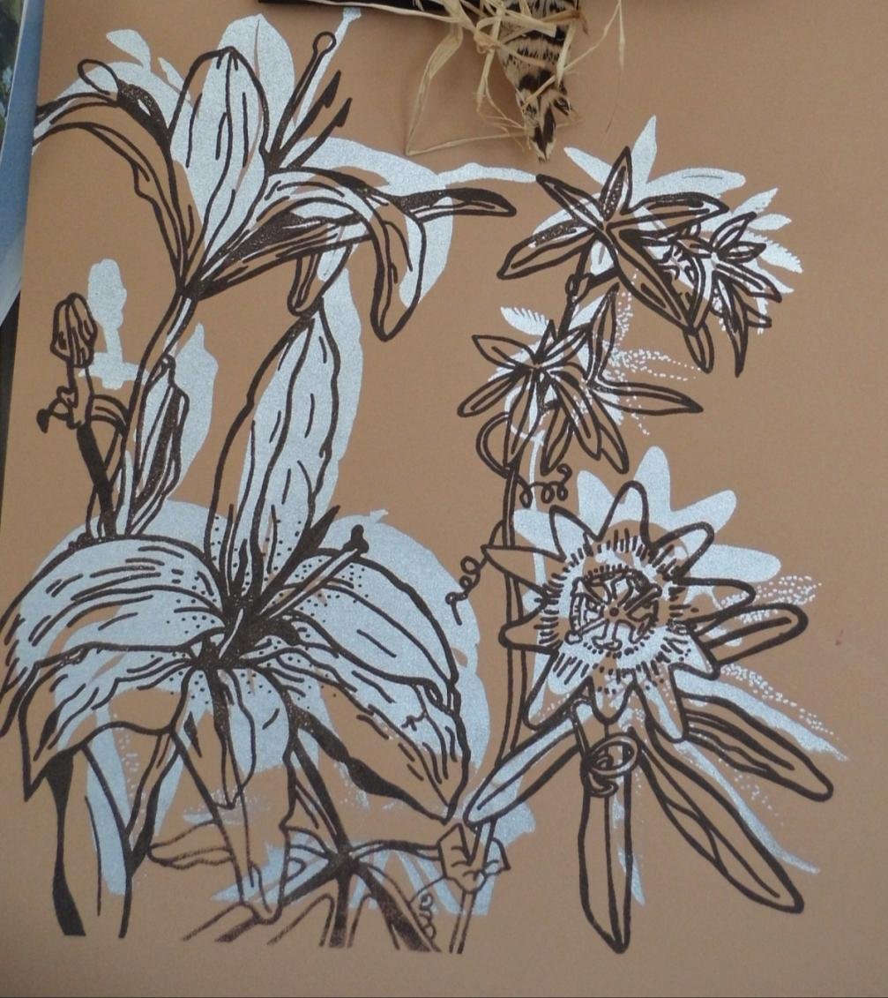
Screen printed samples
Substrate: Light brown card
Metallic silver binder @ 5% strength (block layer)
Black binder @ 5% strength (detailed layer)
Printed in that order
Good contrast but poor registration of layers.
Notes:
Photograph of screen printed samples

Slide 15
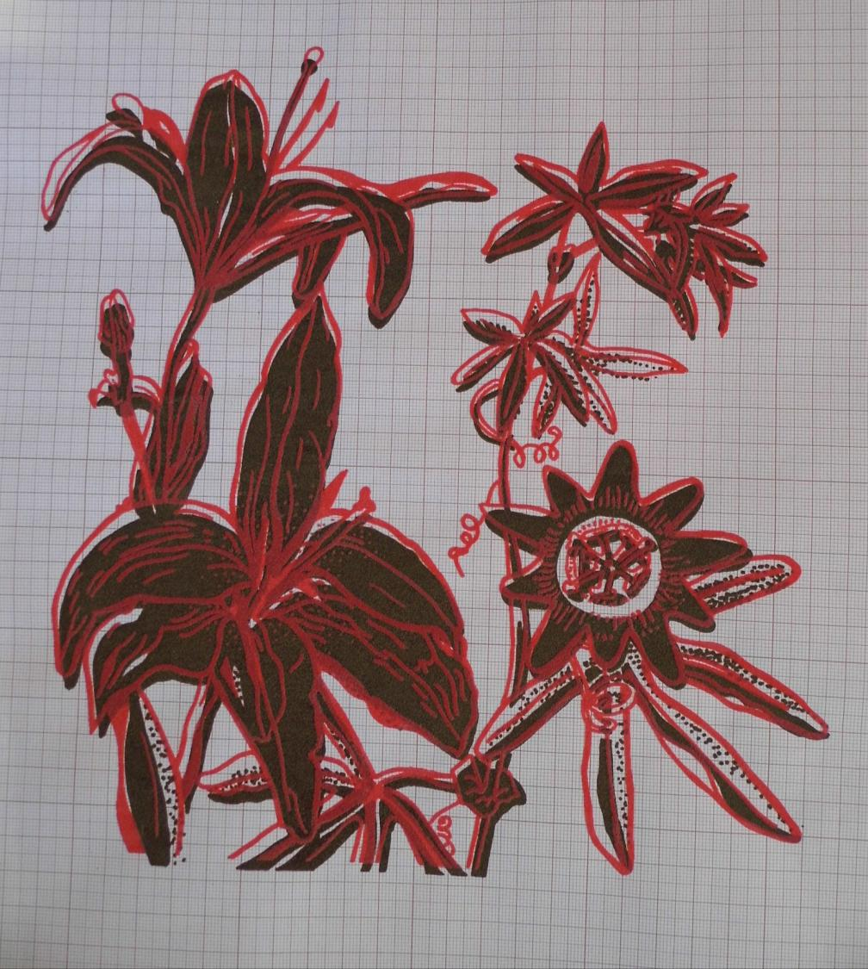
Screen printed samples
Substrate: Graph paper
Brown binder @ 5% strength (block layer)
Red puff binder @ 5% strength (detailed layer)
Printed in that order
Good contrast with ground, poor colour choices and poor registration of layers. I don’t like the effect heat has on the colour of the puff.
Notes:
Photograph of screen printed samples

Slide 16
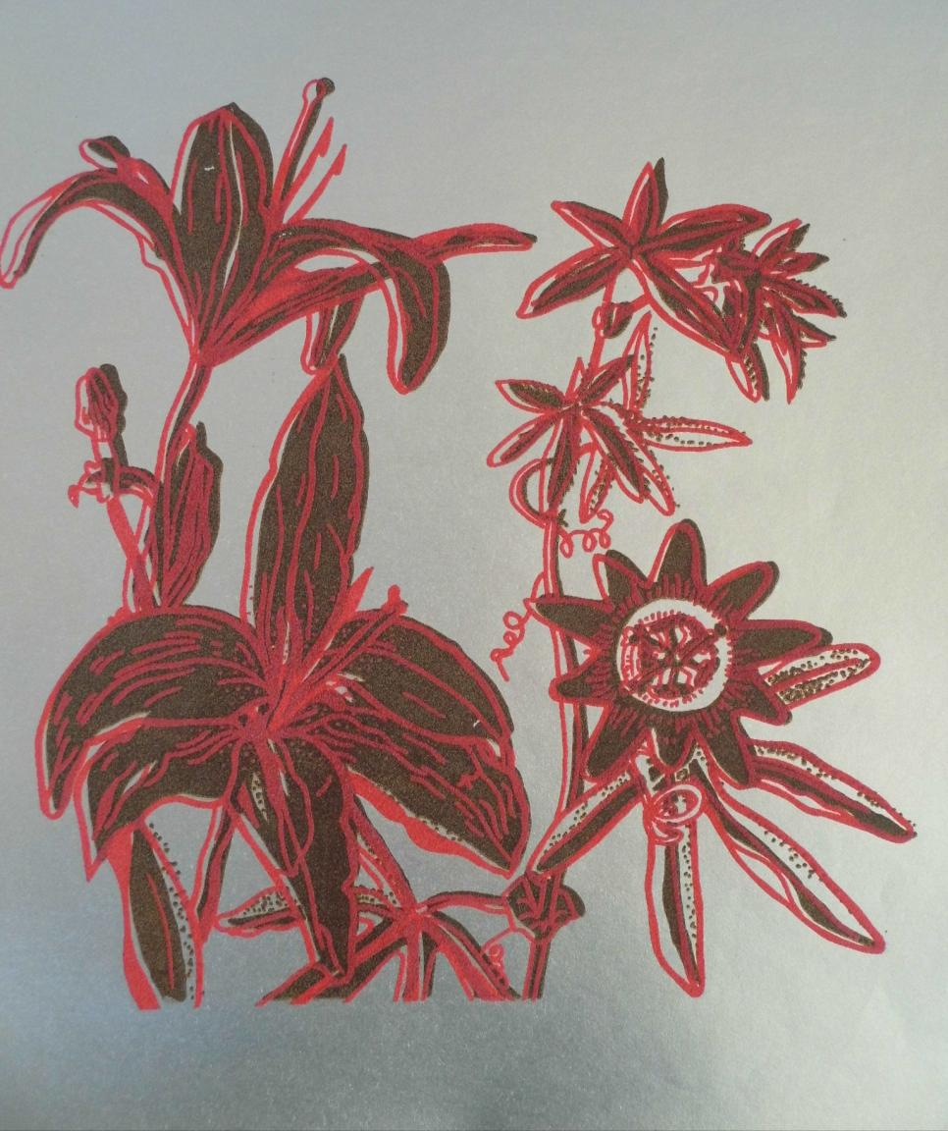
Screen printed samples
Substrate: Silver paper
Brown binder @ 5% strength (block layer)
Red puff binder @ 5% strength (detailed layer)
Printed in that order
Good contrast but poor registration of layers. I don’t like the effect heat has on the colour of the puff.
Notes:
Photograph of screen printed samples

Slide 17
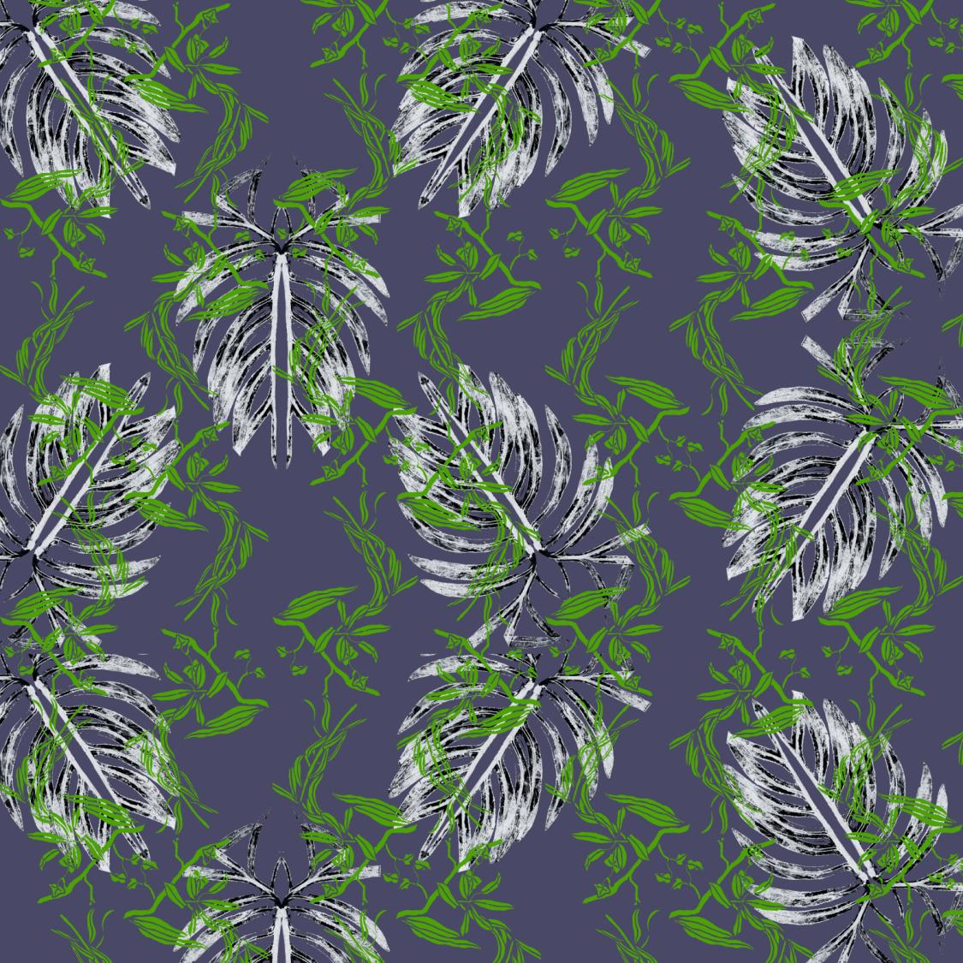
Digital sampling of repeat idea
Mono-print and gouache/indian ink resist images
digital drop repeat patterns created with both images
53x53cm
Notes:
Digital sampling of repeat ideas

Slide 18
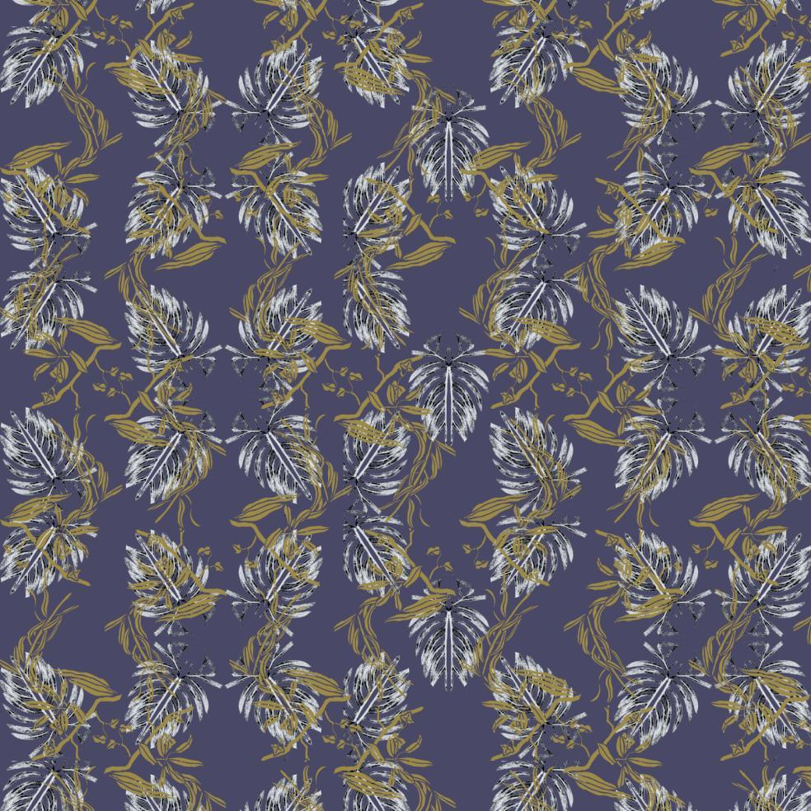

Notes:
Digital sampling of repeat idea – Different colour ways and repeat sizes – 53x53cm
Mono-print and gouache/Indian ink resist images
digital drop repeat patterns created with both images

Slide 19
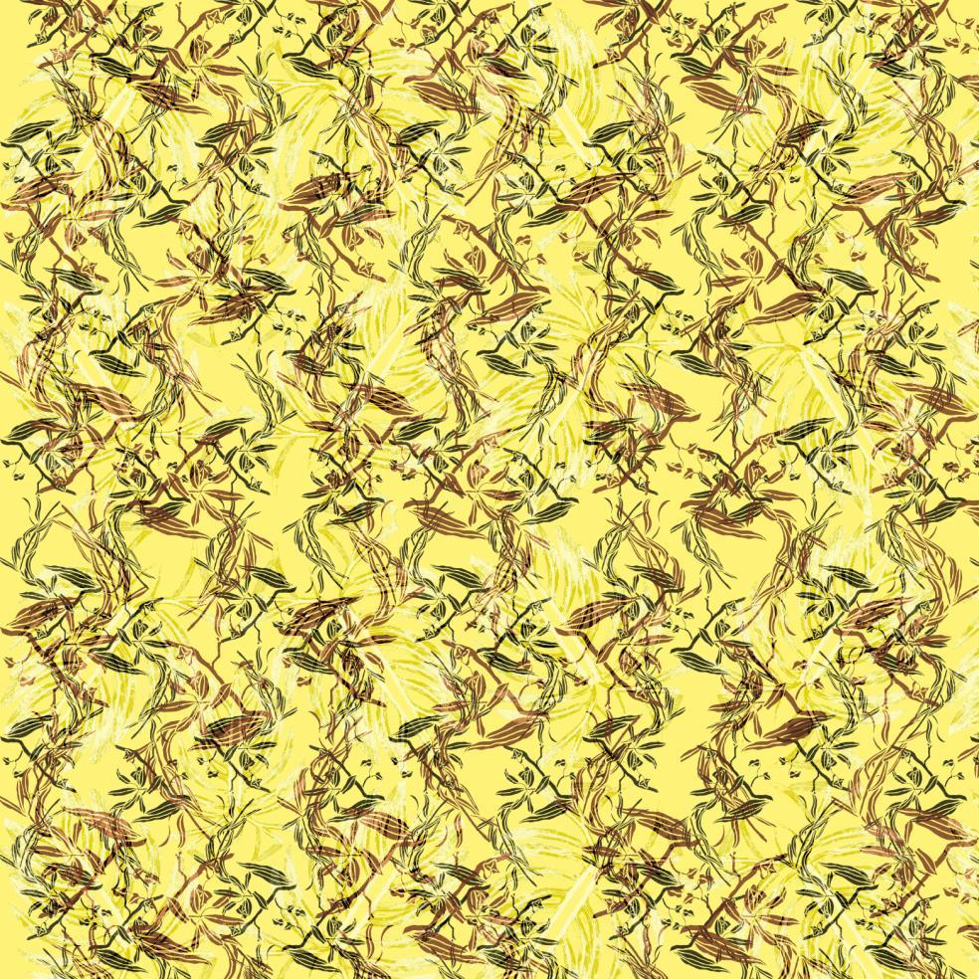
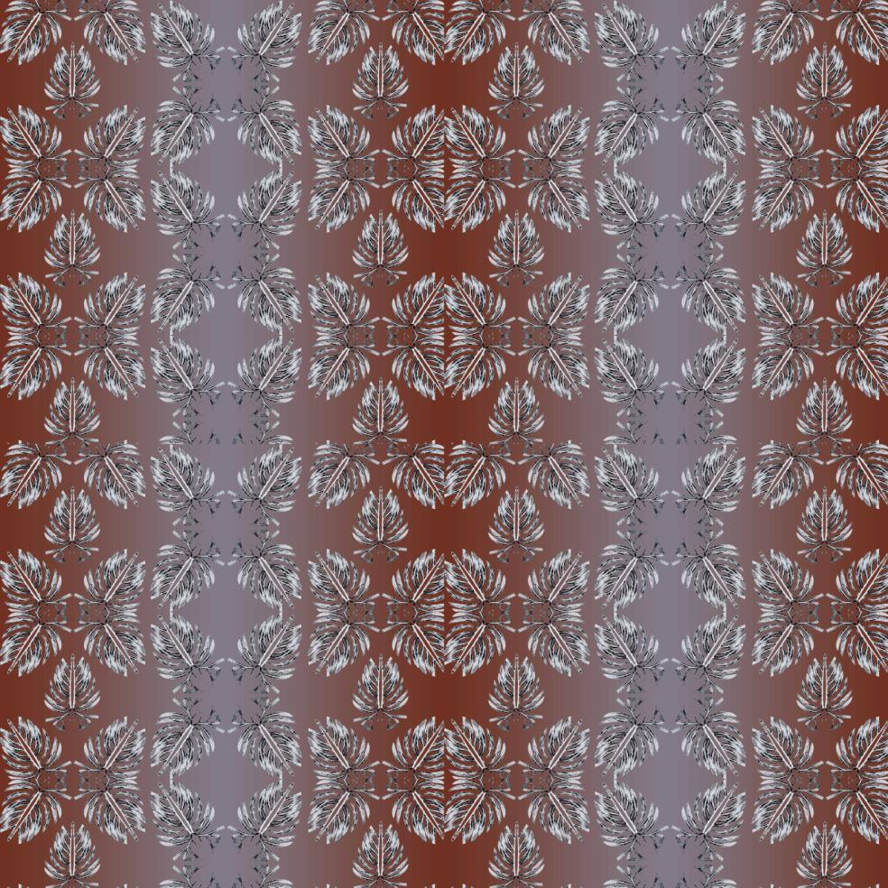
Notes:
Digital sampling of repeat idea – Different colour ways and repeat sizes – 53x53cm
Mono-print and gouache/Indian ink resist images – digital half-drop repeat pattern
Mono-print image – digital block repeat pattern with graduated tint background

Slide 20
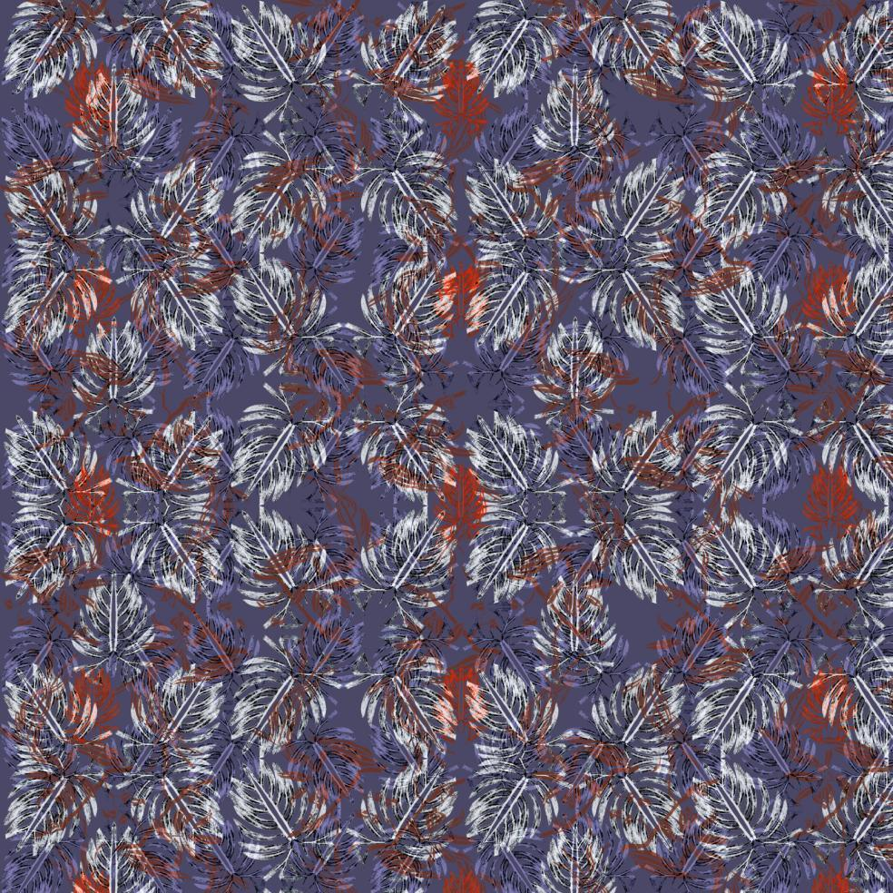
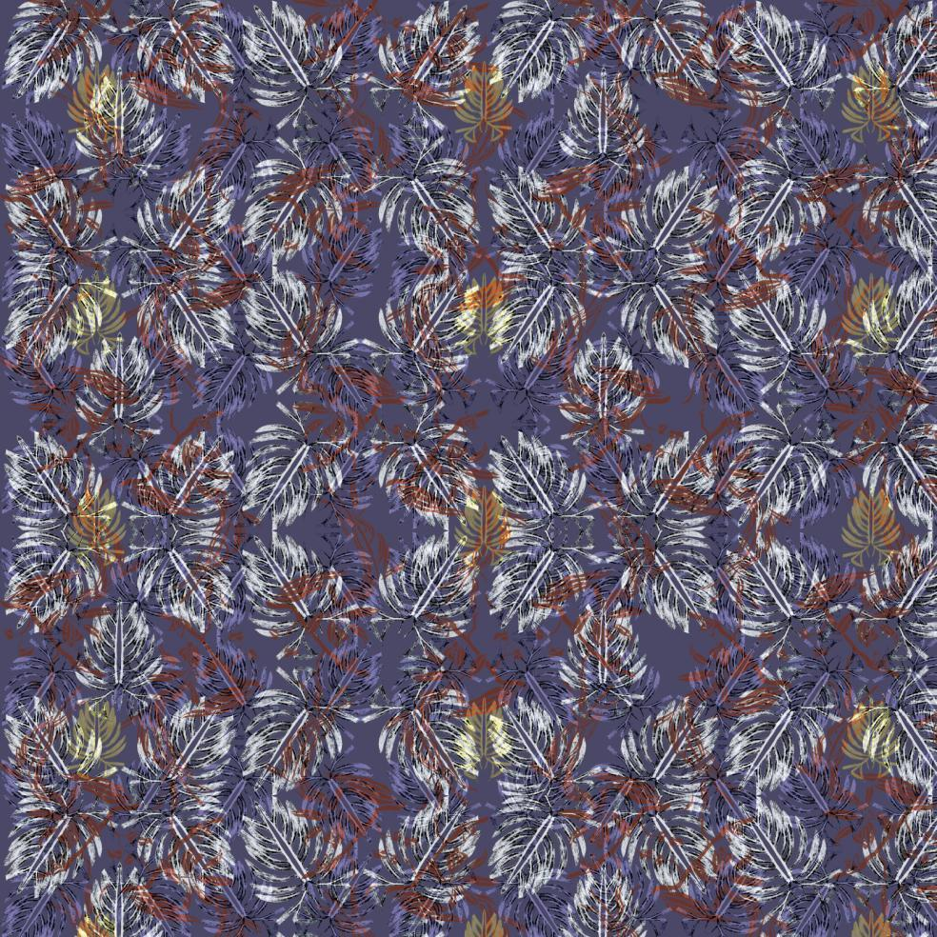
Notes:
Digital sampling of repeat idea – Different colour ways – 53x53cm
Mono-print and gouache/Indian ink resist images
digital half-drop repeat patterns

Slide 21
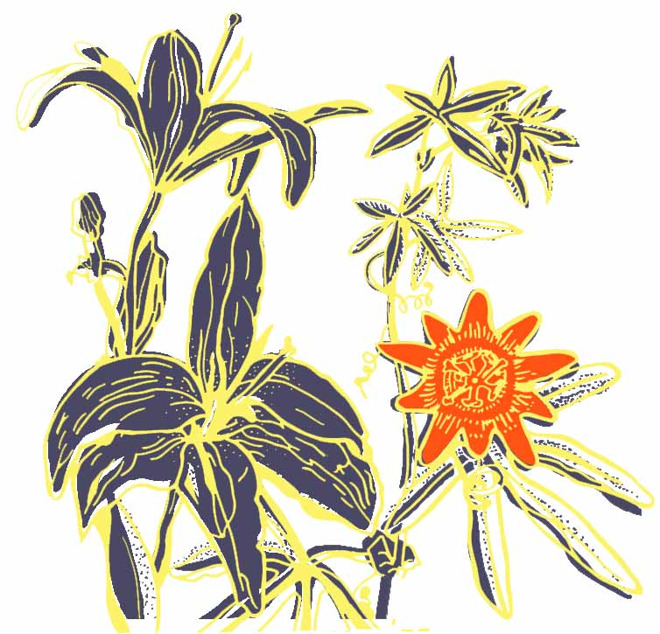
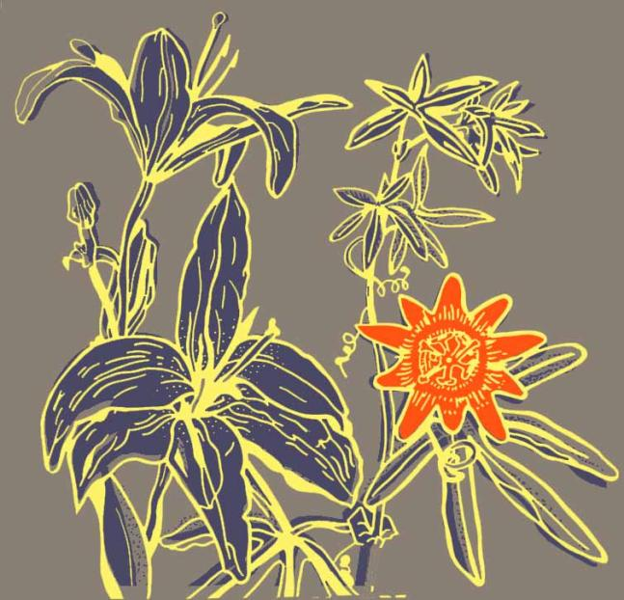
Digital re-colouring of colour separation artwork for screen
Notes:
Digital re-colouring of colour separation artwork for screen
Possible use as placement piece/motif

Slide 22
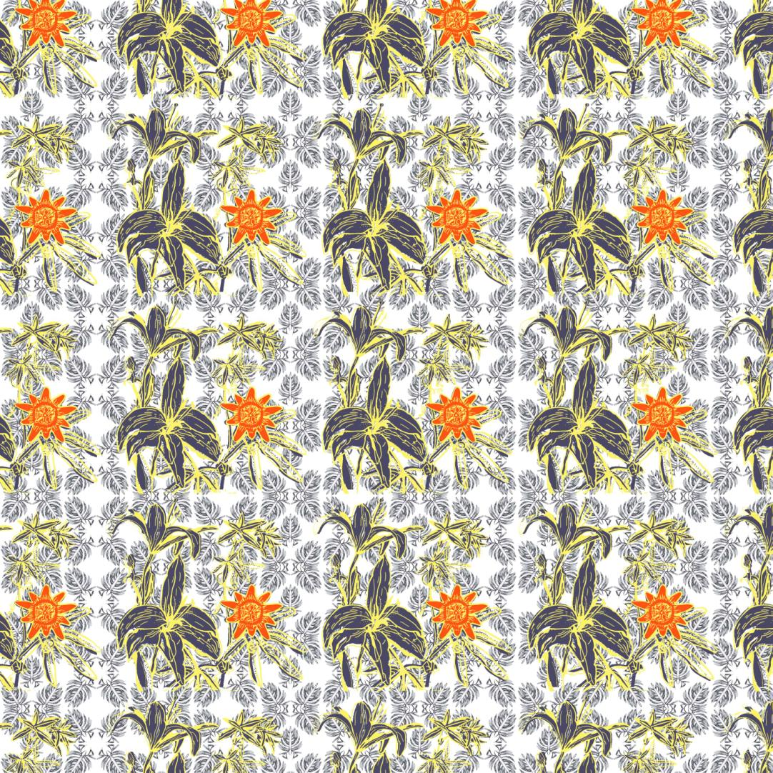
Digital re-colouring of colour separation artwork for screen
Re-coloured screen print and mono-print images
digital block repeat pattern
light ground
25x25cm
Notes:
Digital re-colouring of colour separation artwork for screen and sample of repeat idea

Slide 23
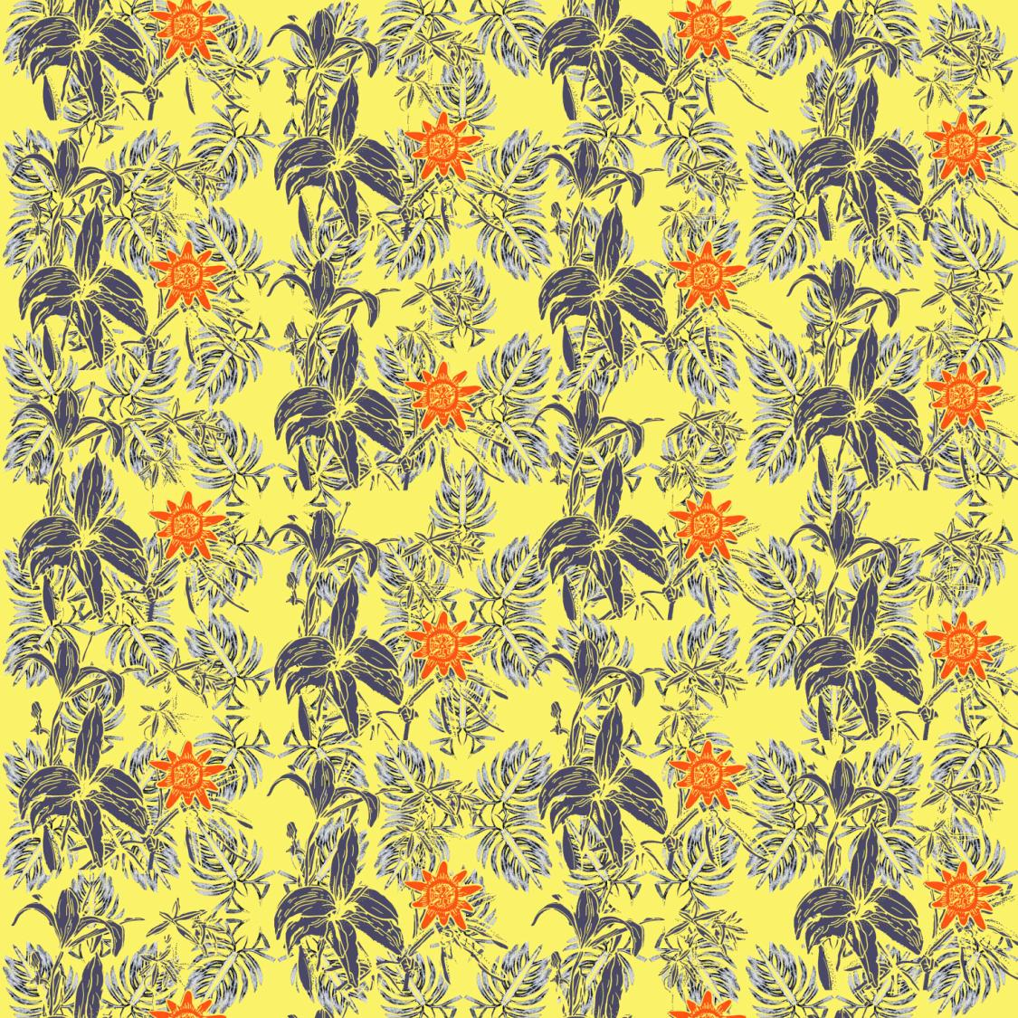
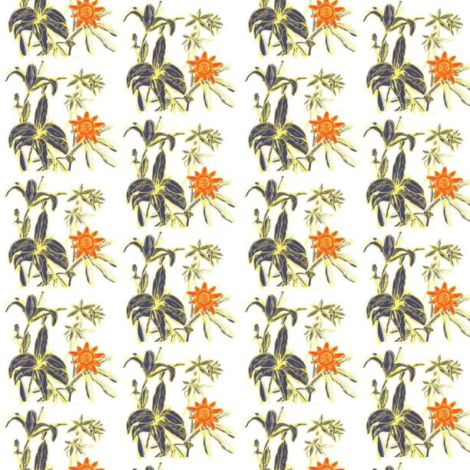
Digital re-colouring of colour separation artwork for screen
Re-coloured screen print and
mono-print images
digital drop repeat pattern
light ground
25x25cm
Notes:
Digital re-colouring of colour separation artwork for screen and sample of repeat idea

Slide 24
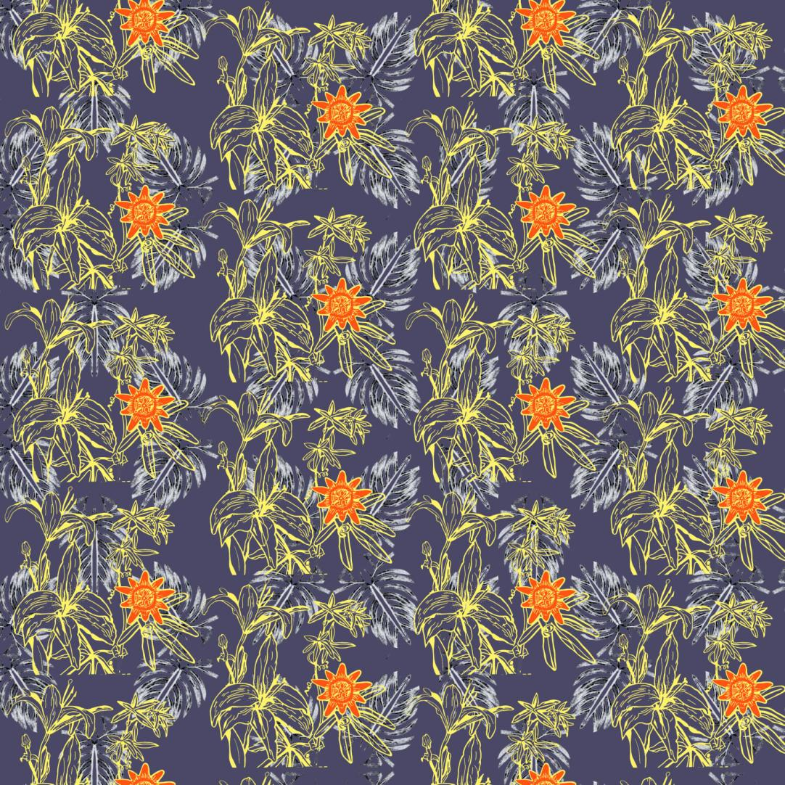
Digital re-colouring of colour separation artwork for screen
Re-coloured screen print and mono-print images
digital drop repeat pattern
dark blue ground
25x25cm
Notes:
Digital re-colouring of colour separation artwork for screen and sample of repeat idea

Slide 25
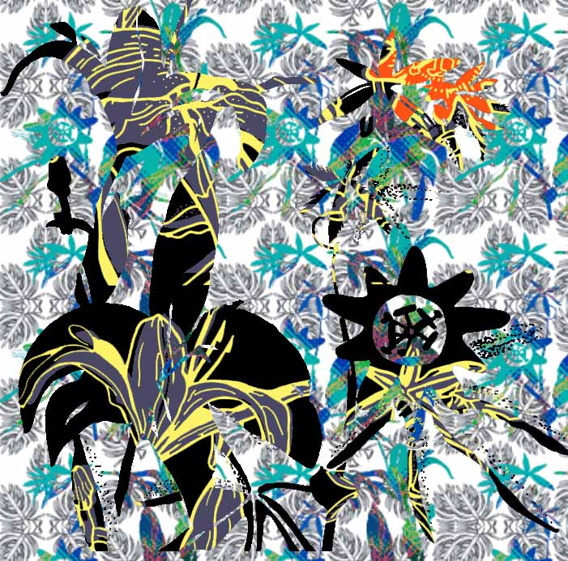
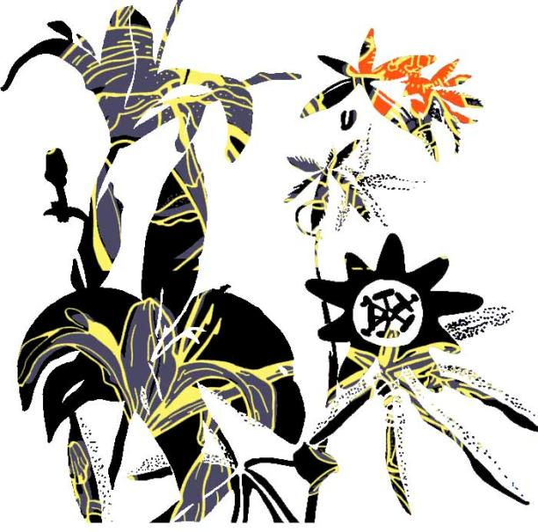
Pattern placement within digital colour separation artwork for screen
Inverted image filled with re-coloured screen artwork
Mid layer inverted image filled with glitched screen print image
Background layer of mono-print repeat
25x25cm
Notes:
Pattern placement within digital colour separation artwork for screen
Possible use as placement piece/motif

Slide 26
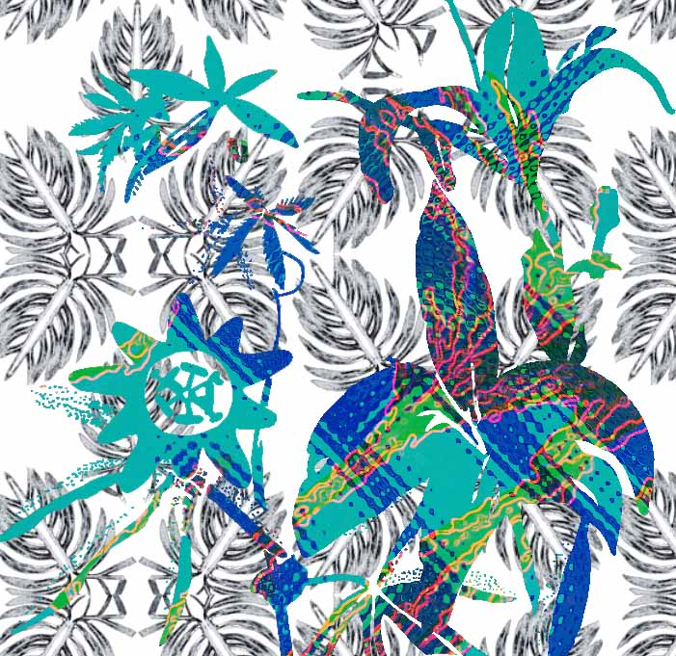
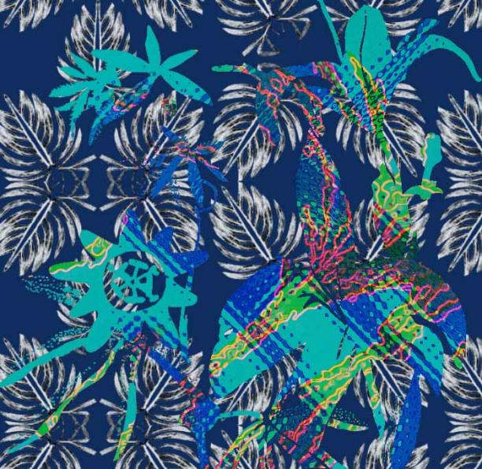
Pattern placement within digital colour separation artwork for screen
Inverted image filled with glitched,
re-coloured screen artwork
Background layer of mono-print repeat
Background colour variations of dark blue or white
25x25cm
Notes:
Pattern placement within digital colour separation artwork for screen

Slide 27
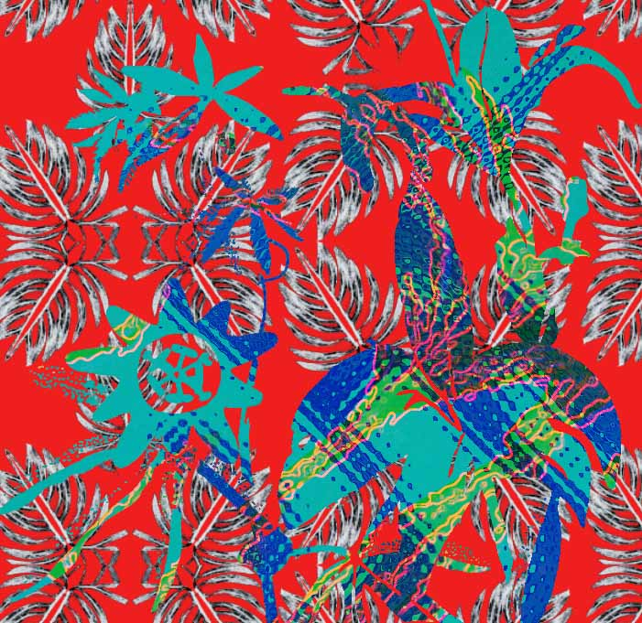
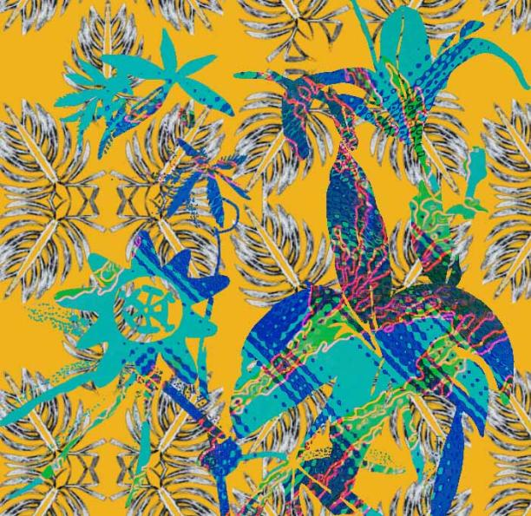
Pattern placement within digital colour separation artwork for screen
Inverted image filled with glitched,
re-coloured screen artwork
Background layer of mono-print drop repeat
Background colour variations of red or dark yellow
25x25cm
Notes:
Pattern placement within digital colour separation artwork for screen

Slide 28
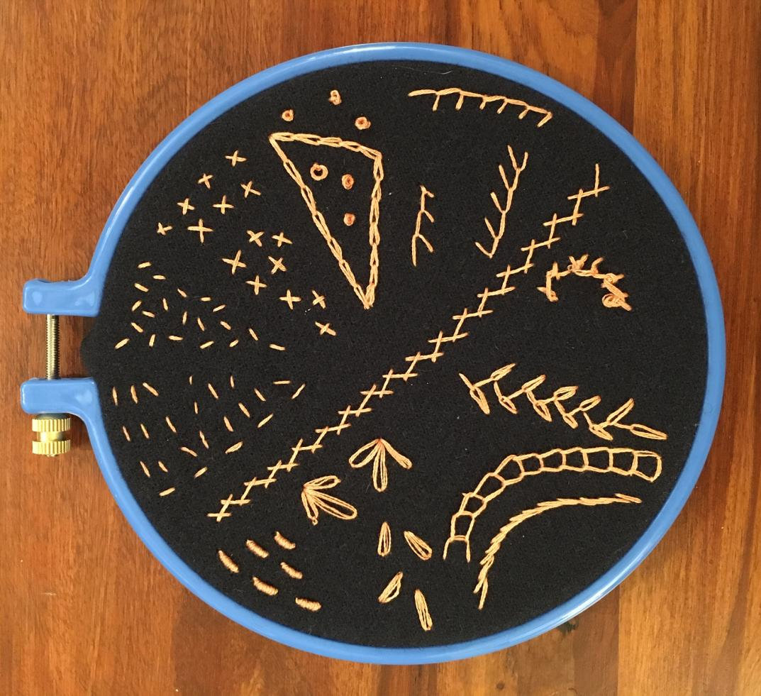
Hand stitched samples
Substrate: dark green wool fabric
silk embroidery thread (split into 3 strands)
From top – clockwise:
  Seed stitch
  Cross stitch
  Chain stitch
  French knots
  Blanket stitch
  Sloping blanket stitch
  Herringbone stitch
  Rosette chain stitch
  Feathered chain stitch
  Open chain stitch
  Stem stitch
  Bullion knot
  Lazy daisy stitch
Notes:
Hand stitched samples - silk thread on wool

Slide 29
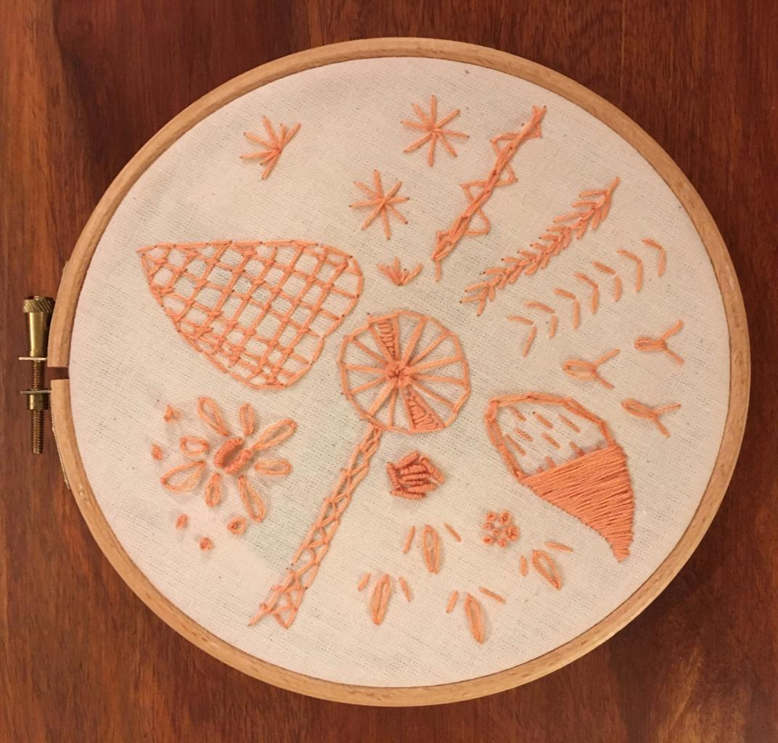
Hand stitched samples
Substrate: natural canvas fabric
silk embroidery thread (split into 3 strands)
From centre – clockwise:
  Eyelet wheel
  Trellis stitch
  Star stitch
  Fern stitch
  Chain stitch
  Feather stitch
  Arrowhead/fly stitch
  Wheatear stitch
  Padded satin stitch
  French knot
  Tete de boeuf stitch
  Bullion knot
  Closed feather stitch
  Lazy daisy stitch
  Bullion knot
Notes:
Hand stitched samples - silk thread on canvas

Slide 30
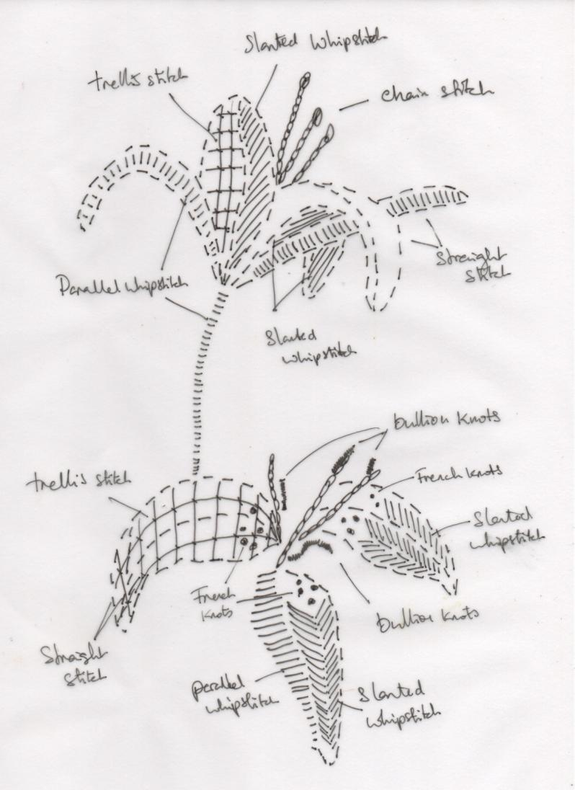
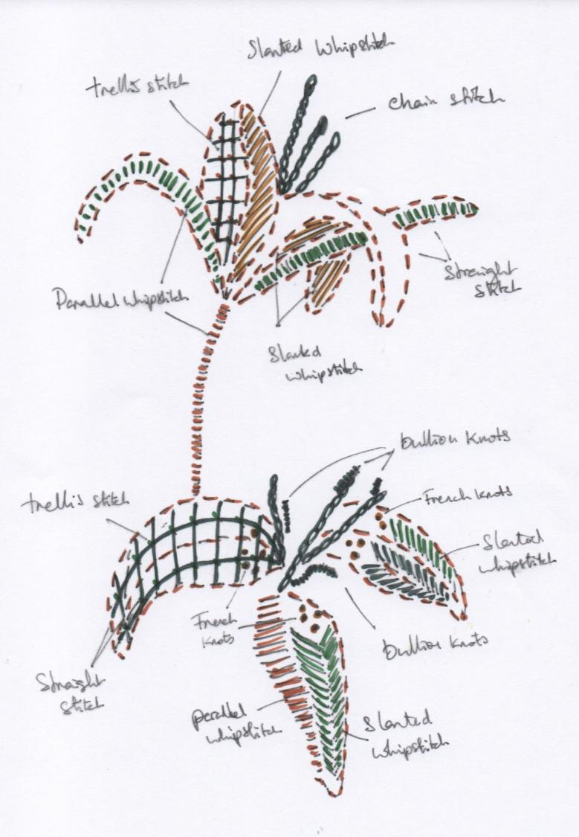
Hand stitched sample drafts to paper
Notes:
Hand stitched sample drafts

Slide 31
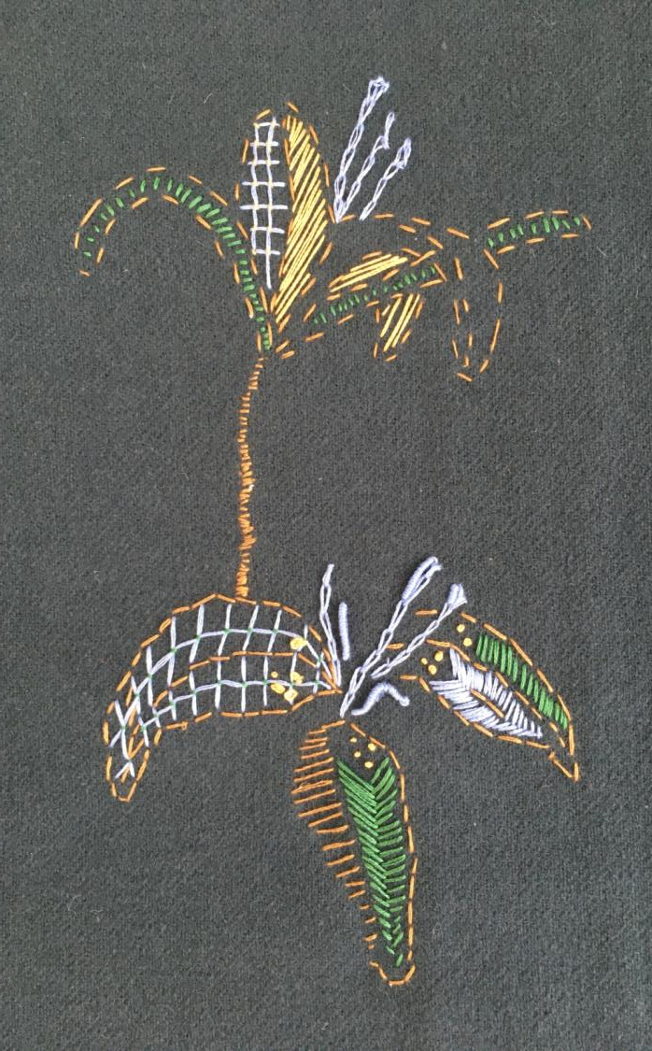
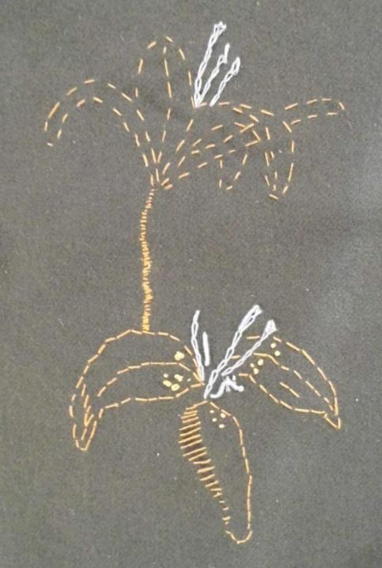
Hand stitched samples
Substrate: dark green wool fabric
silk embroidery threads in various colours (split into 3 strands)
Stitches used:
  Trellis stitch
  Chain stitch
  Parallel whipstitch
  slanted whipstitch
  Straight stitch
  French knot
  Bullion knot
Notes:
Hand stitched samples – silk thread on wool
Potential as single motif or to create digitised image and repeat pattern

Slide 32
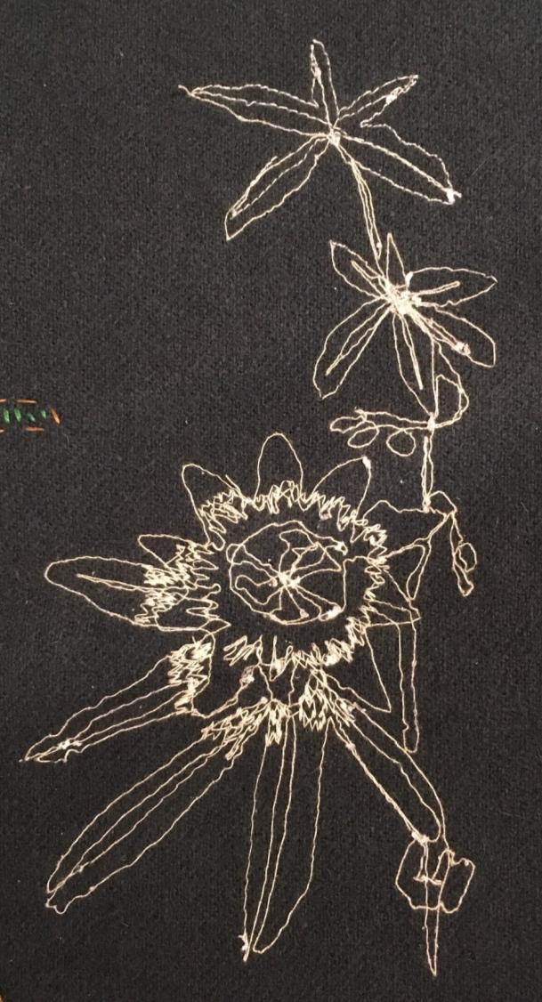
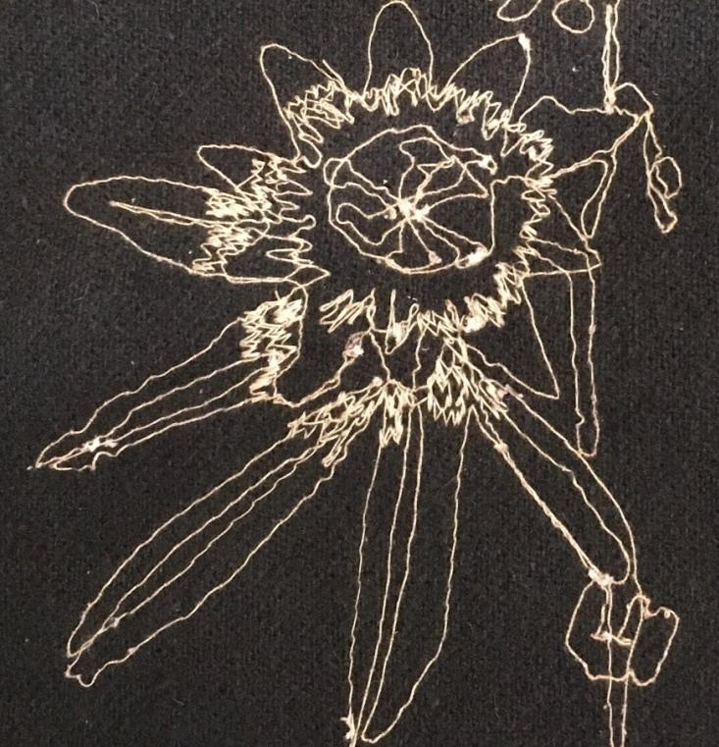
Machine stitched samples
Substrate: dark green wool fabric
cream cotton machine thread
Embroidery foot used
This monochrome image could be developed digitally
Notes:
Hand stitched samples – silk thread on wool

Slide 33
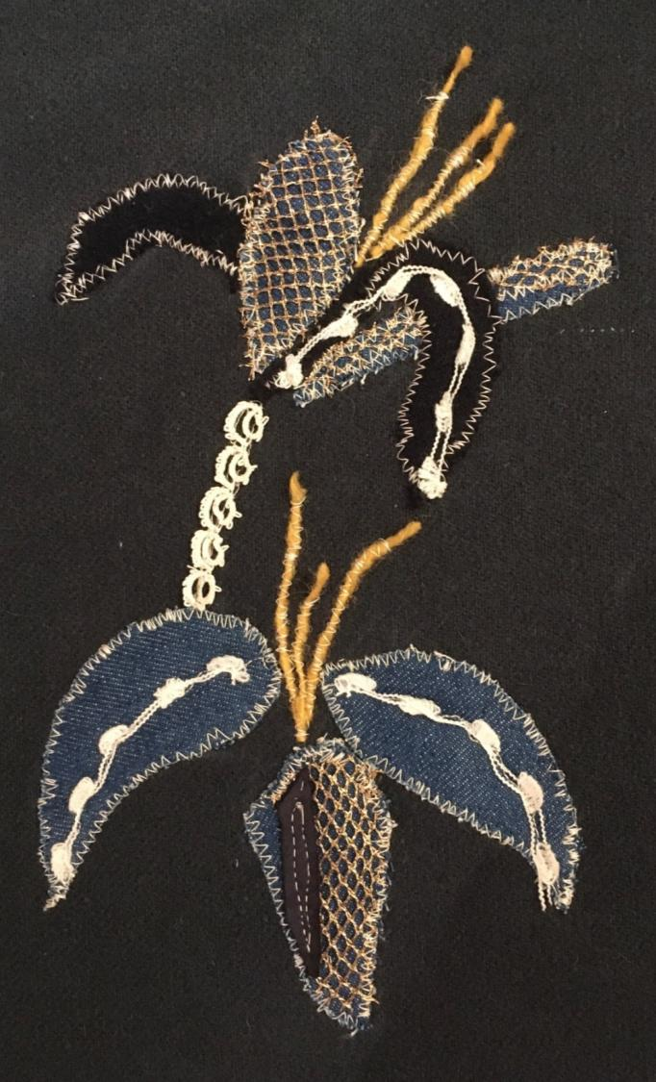
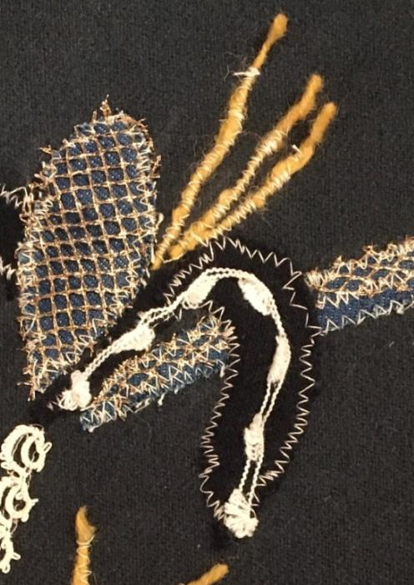
Machine stitched collage/appliqué
Substrate: dark green wool fabric
cream cotton machine thread
Embroidery foot used
Materials include:
  Found lace
  Denim
  Wool
  Mesh
  Leather/suede
Has potential to be developed digitally
Notes:
Hand stitched samples – silk thread on wool
Potential as single motif or to create digitised image and repeat pattern

Slide 34
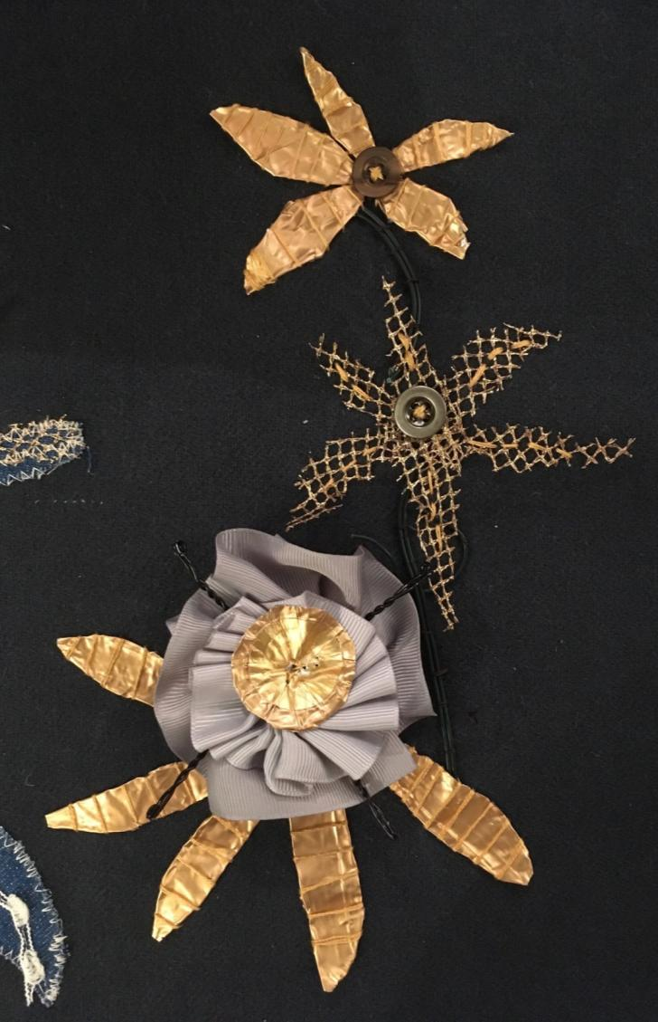
Hand stitched collage/appliqué /embelliment with found objects
Substrate: dark green wool fabric
silk embroidery threads in various colours (split into 3 strands)
Materials include:
  Metal foil
  Wire from champagne cork
  Electrical wire
  Mesh
  Grosgrain ribbon
  buttons
Has potential to be developed with embroidery and digitally
Notes:
Hand stitched samples – silk thread on wool
Potential as single motif or to create digitised image and repeat pattern

Slide 35
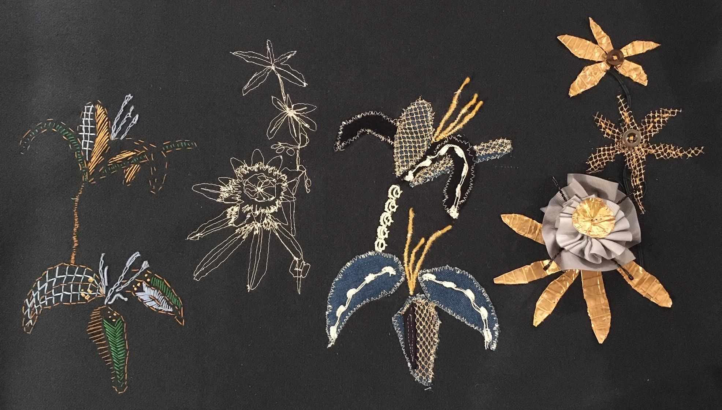
Notes:
Hand and machine stitched work on wool with embellished pieces from found objects

Slide 36
New digital work and ideas
Digital manipulation and added filter distortion of colour separation artwork for screen
Wave and stained glass filters applied
Notes:
New digital work and ideas
Digital manipulation and added filter distortion of colour separation artwork for screen

Slide 37
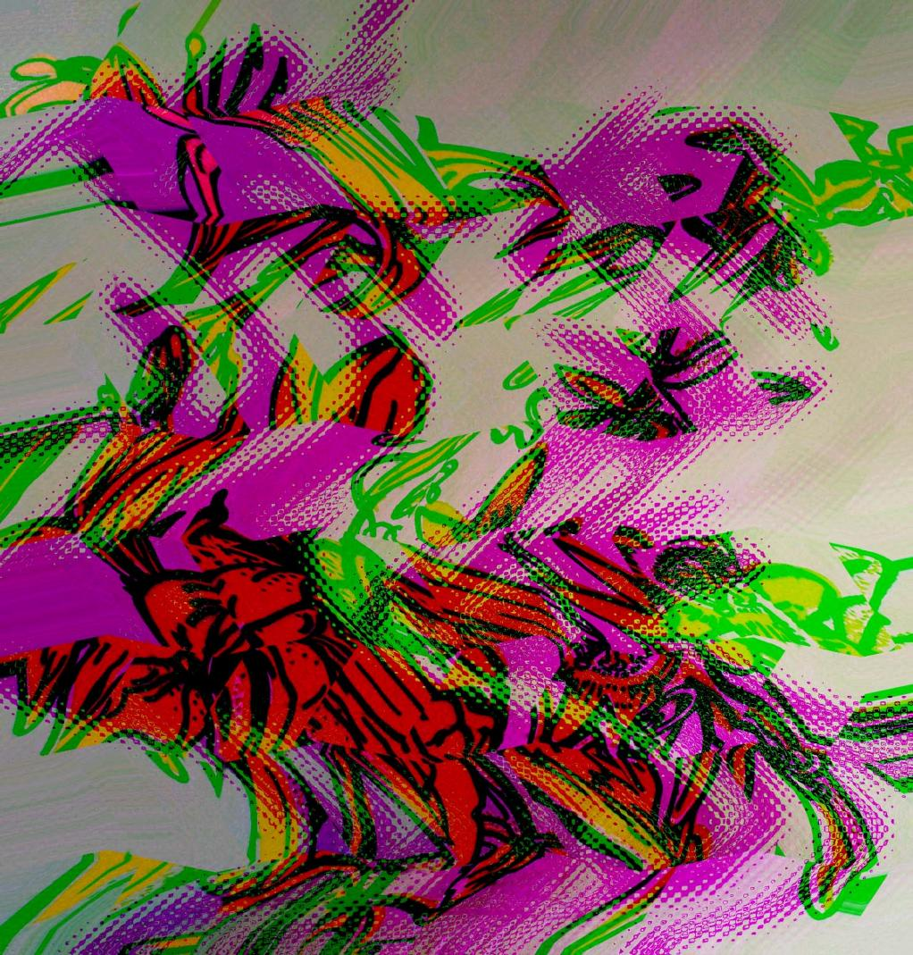
New digital work and ideas
Digital manipulation and added filter distortion of colour separation artwork for screen
Wave, stained glass and mosaic filters applied with colour burn
Notes:
New digital work and ideas
Digital manipulation and added filter distortion of colour separation artwork for screen

Slide 38
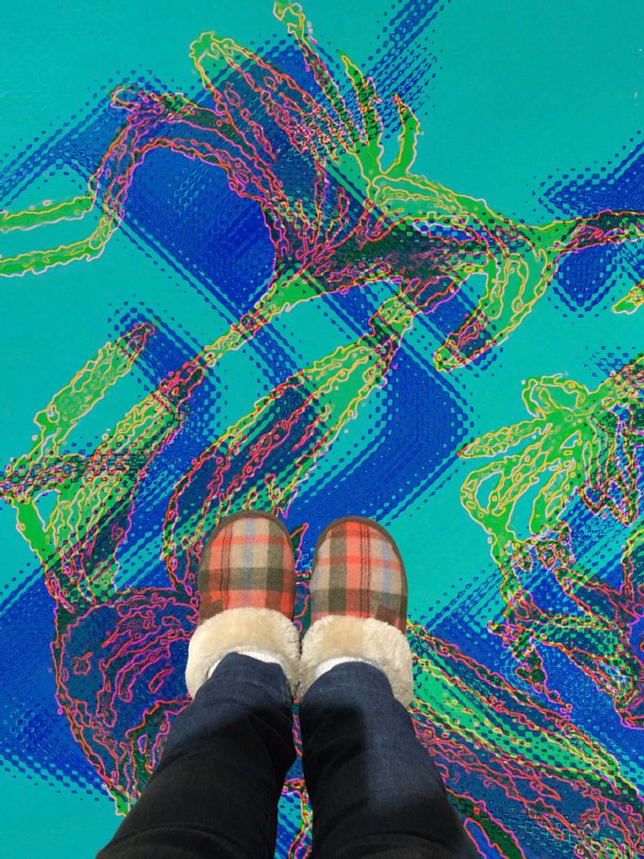
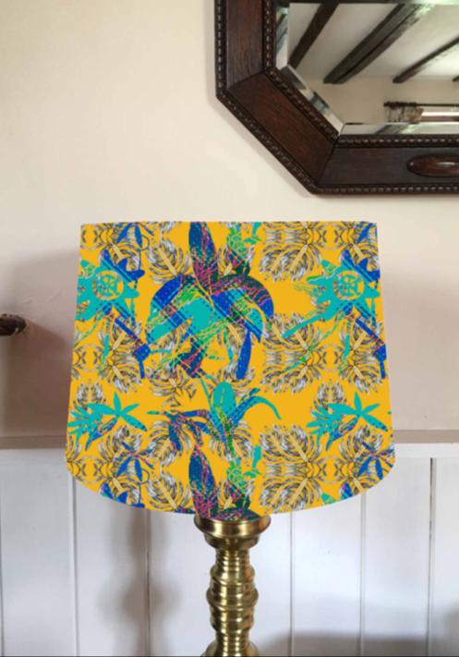
New digital work and ideas
Digital visualisations and placement – pattern options and applications for the design
Glitched/filtered digital screen print
Notes:
New digital work and ideas
Digital visualisations – different pattern options
Glitched/filtered digital screen print

Slide 39
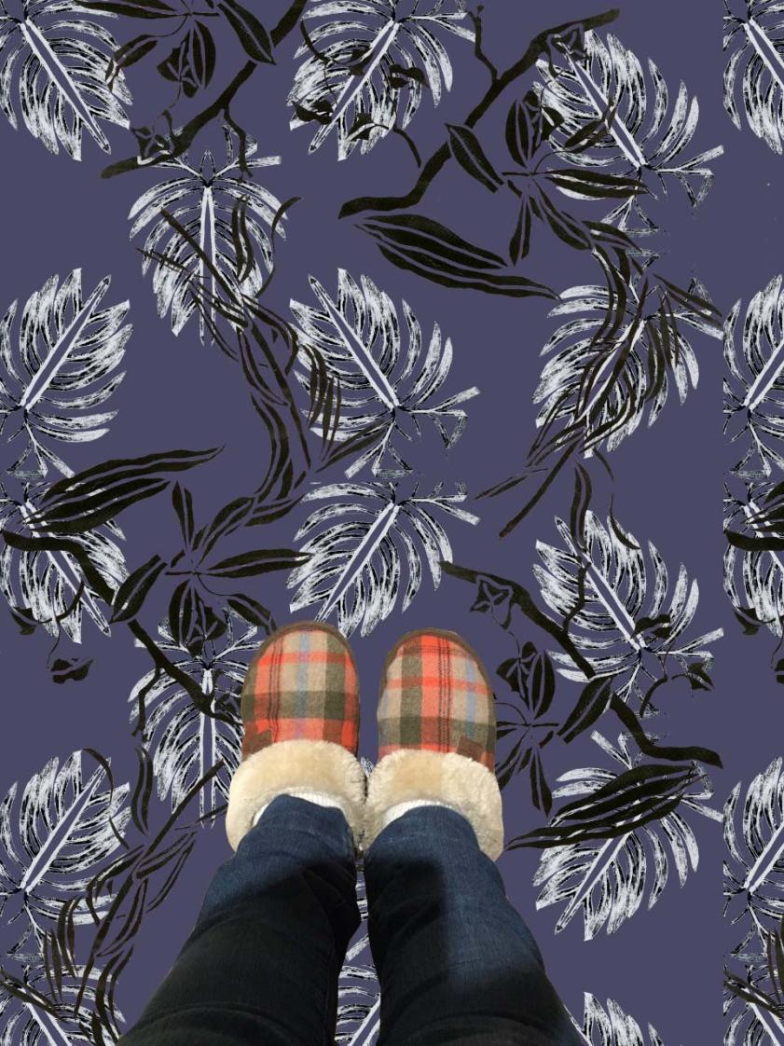
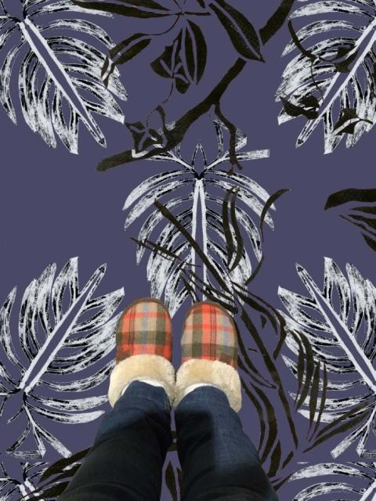

New digital work and ideas
Digital visualisations – different pattern size options
Digital drop repeat patterns created with mono-print and gouache/indian ink resist images

Slide 40



New digital work and ideas
Digital visualisations or placements showing different size options and applications for design
Notes:
New digital work and ideas
Digital visualisations showing different size options for design

Slide 41


New digital work and ideas
Digital visualisations and placement – pattern options and applications for the design
Notes:
New digital work and ideas
Digital visualisations showing different size options for design

Slide 42



New digital work and ideas
Digital visualisations / placement of pattern, showing colour ways and different variations and applications for the design
Notes:
New digital work and ideas
Digital visualisations showing different size options for design

Slide 43


New digital work and ideas
Digital visualisations and placement – pattern options and applications for the design
Notes:
New digital work and ideas
Digital visualisations showing different size options for design

