Slide 1

Programme: BA (Hons) Leadership and Management Skills for the Workplace​
Student: Tsvetana Galabova
Student ID: 2507216
Module Code: LCLM5002_BIRM
Lecturer: Dr Shujun Xiao

Slide 2

Organisation Overview​
HealthConnect UK Overview​
Digital healthcare provider offering virtual consultations and remote monitoring​
Rapid expansion across the UK​
Current Workforce Challenges​
Difficulty attracting healthcare & tech specialists​
High turnover and burnout​
Digital skills shortages​
Low engagement​
Leadership capability gaps​
Strategic Importance of HRM​
HRM supports organisational performance and employee effectiveness (Armstrong &Taylor, 2014)​
Ensures workforce capability and sustainable growth​

Slide 3
Workforce Planning
Importance of Workforce Planning
Aligns staffing with organisational strategy
Identifies future digital skills needs
Supports proactive recruitment and development
Key Activities
Demand forecasting
Workforce supply analysis
Succession planning
Relevant Theory
Human Capital Theory
Talent as a strategic asset (Leatherbarrow & Fletcher, 2019)
Workforce Planning
Forecast Future Demand
Analyse Current Workforce
Identify Skills Gaps
Develop Recruitment & L&D

Slide 4
Skills Gap Identification
Current Skills Gaps at HealthConnect UK
Digital health technologies
Data analytics & cybersecurity
Multidisciplinary teamwork
Leadership & people management
Methods of Skills Gap Analysis
Competency frameworks
HR analytics
Performance reviews
Critical Insight
Skills gaps reduce innovation and service quality (Mullins & McLean, 2019).
Skills Gap Analysis
Digital Health Tech (AI, remote systems)
Data Analytics & Cybersecurity
Leadership & Team Management

Slide 5
Recruitment Challeng
• Competition for talent
• High turnover
• Skills shortages
• Weak employer branding
Recruitment Challenges at HealthConnect UK​
​
Key Recruitment Issues​
Competitive labour market for digital health talent​
Limited internal pipeline​
High turnover → unstable workforce​
Employer brand not fully developed​
Critical Evaluation​
Recruitment systems influence job descriptions and person specifications (Leatherbarrow &Fletcher, 2019).​
External recruitment is essential but costly​
Internal recruitment supports retention but limited by skills shortages​

Slide 6

Theoretical Justification​
Person – Organisational Fit​
Employer Branding Theory​
Effective recruitment supports organisational performance (Armstrong & Taylor, 2014)​
Recruitment Recommendations​​
─────────────────────────────────────────────────────────
Recruitment Method Best Use in HealthConnect UK
─────────────────────────────────────────────────────────
Internal Recruitment • Succession planning
• Retaining organisational knowledge
─────────────────────────────────────────────────────────
External Recruitment • Hiring digital specialists
• Expanding innovation capability
─────────────────────────────────────────────────────────
Online Recruitment • Fast, wide reach
• Efficient creening of tech candidates
─────────────────────────────────────────────────────────
Social Media Recruitment • Employer branding
• Targeting passive, tech‑savvy talent
─────────────────────────────────────────────────────────

Slide 7
Recruitment & Reward Systems
Different Sectors Recruit Differently
Healthcare roles emphasise stability and wellbeing
Technology roles emphasise innovation and competitive rewards
Hybrid Reward Strategy
Supports multidisciplinary teams
Enhances engagement and retention (Wellington, 2011)
Critical Insight
Reward systems shape recruitment outcomes and candidate expectations.

Slide 8
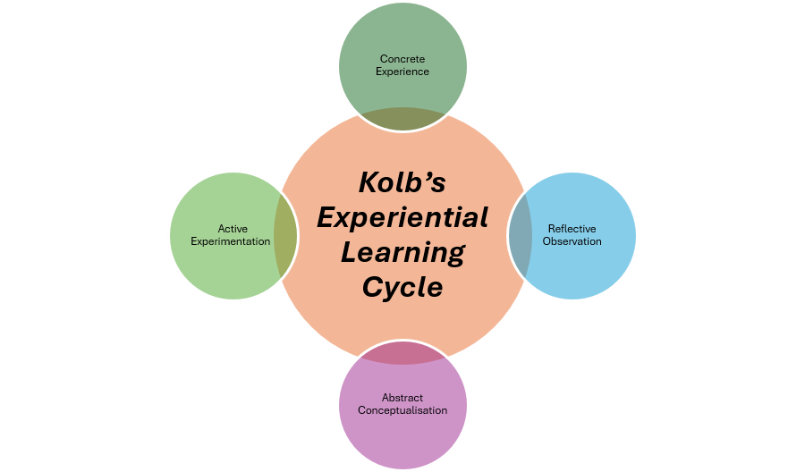
Learning & Development
L&D Recommendations
Digital skills training (AI, telehealth systems)
Leadership development programmes
Cross-functional team training
CPD pathways
Relevant Theory
Social Learning Theory
Application to Scenario
Digital training reduces skills gaps
Leadership development addresses team management challenges (Rees, 2015)
Experiential learning involves a cycle of experience, reflection, conceptualisation, and experimentation (Kolb, 1984, Lecture Slide)

Slide 9
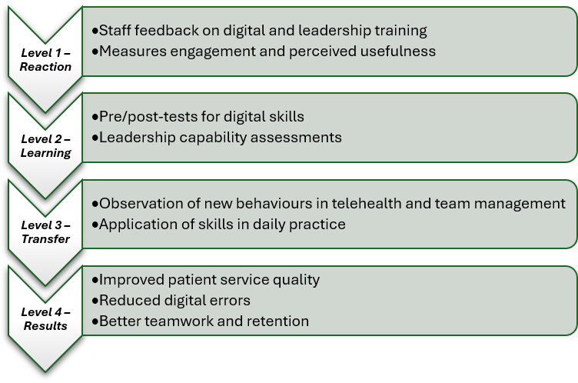
Training Evaluation – Kirkpatrick’s Model (1967)
(Kirkpatrick, 1967, Lecture Slide)
Application to HealthConnect UK: Training effectiveness is demonstrated through improved digitalcapability, stronger leadership behaviours, and measurable service improvements.​

Slide 10
Talent Management & Retention
Talent Management Strategies
  Clear career pathways
  Mentoring & coaching
  High‑potential employee programme
Retention Approaches
  Wellbeing initiatives
  Flexible working
  Recognition & reward systems
Relevant Theory
  Maslow’s Hierarchy of Needs
  Herzberg’s Two-Factor Theory
Evidence
Effective people management improves engagement and retention (Wellington, 2011).
Career Pathways
Mentoring & Coaching
High-Potential Staff
Leadership Training ​

Slide 11
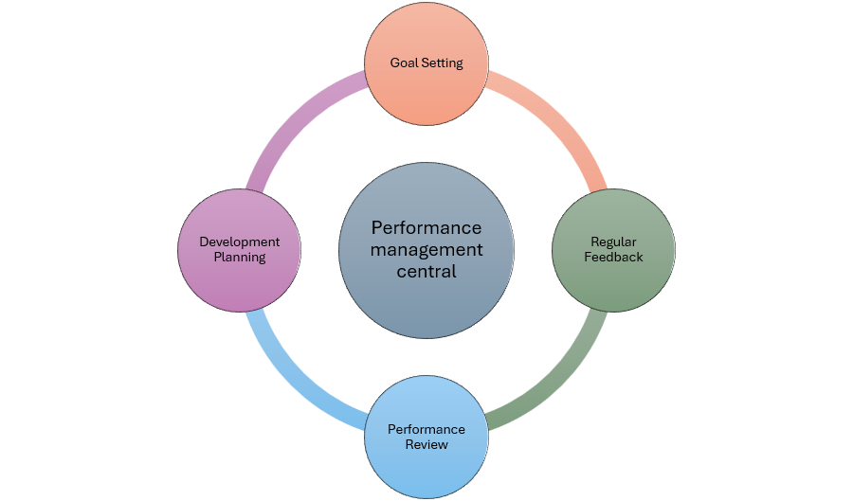
Performance Management
Effective Performance Management Practices
SMART objectives
Regular feedback & coaching
360-degree feedback
Data-driven performance metrics
Theory
Goal-Setting Theory
Expectancy Theory
Outcome
Higher motivation
Improved accountability
Better patient service quality
Evidence
Managing employee performance through clear objectives, feedback, review, and development is essential for organisational effectiveness (Mullins & McLean, 2019).

Slide 12
Conclusion
Key Findings
HRM is essential for addressing recruitment, skills shortages, engagement, and leadership gaps
Workforce planning and targeted recruitment improve talent acquisition
L&D and talent management strengthen capability and retention
Effective performance management enhances motivation and organisational performance
Expected Organisational Benefits
Reduced turnover
Improved employee wellbeing
Stronger digital capability
Enhanced patient service quality
Sustainable organisational growth

Slide 13
Harvard Reference List
Armstrong, M. and Taylor, S. (2014) Armstrong’s Handbook of Human Resource Management Practice. 13th ed. London: Kogan Page. Available at: VLeBooks
Leatherbarrow, C. and Fletcher, J. (2019) Introduction to Human Resource Management. 4th ed. London: Kogan Page. Available at: VLeBooks
Mullins, L.J. and McLean, J.E. (2019) Organisational Behaviour in the Workplace. 12th ed. Pearson. Available at: ProQuest
Rees, W.D. (2015) Skills of Management and Leadership. Palgrave Macmillan. Available at: ProQuest
UWTSD (2026) Kolb’s Experiential Learning Cycle. Lecture slide, University of Wales Trinity Saint David.
UWTSD (2026) Kirkpatrick’s Four Levels of Evaluation. Lecture slide, University of Wales Trinity Saint David.
Wellington, P. (2011) Effective People Management. Kogan Page. Available at: VLeBooks

Slide 14
Q & A

