Slide 1

Reflection on digital skills presentation
Presented by Toni waith
Student number 2535074
Assignment Three

Slide 2
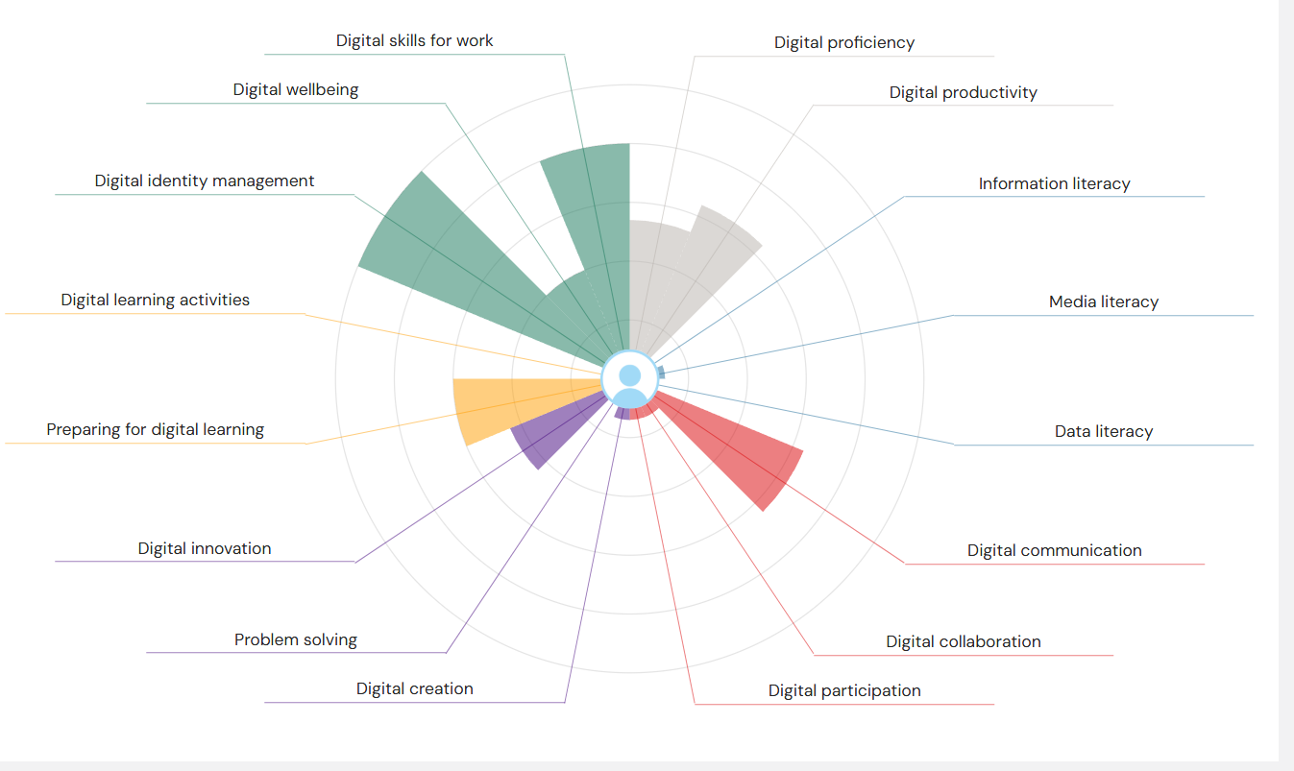
JISC

Slide 3
Week One
Stepping into higher education.

Slide 4
What I have learned in week one.
Learned what office 365 is and how it is used in higher education.
Learned how to log into my office 365 account and explore the different apps.
Practised saving and accessing files using one drive.
Office 365

Slide 5
Week Two
Outlook

Slide 6

What I have learned about outlook in week two.
Learned how to send, receive, and reply to emails.
Learned how to write a professional emails with clear subject lines.
Explored how to use outlook calendar to manage appointments and deadlines.
Gained confidence in using outlook to stay organised and communicate affectively.

Slide 7

Week Three- LinkedIn learning
What I have learned in week three this is where I found things were getting a little bit harder.

Slide 8
LinkedIn Learning.
Learned new techniques and strategies that can be applied in practical situations.
Recognised the value of continuous learning and professional development.
Improved my communication and organisational skills.
During week three I found some of the more advancved topics challenging, especially when learning new tools and techniques for the first time.

Slide 9
Week Four Microsoft word
How to format text using different fonts, sizes, colours, and styles.
How to use headings and apply built-in styles to organise a document.
How to insert tables, pictures, shapes, and icons into a document.
How to spell check and grammar check to improve accuracy.
During week 4, I found some of the Microsoft word formatting features a little difficult to use at first, particularly applying styles consistently and adjusting page layouts. After practising the different tools and revisiting the lessons, I became more confident and was able to use these features more effectively.

Slide 10
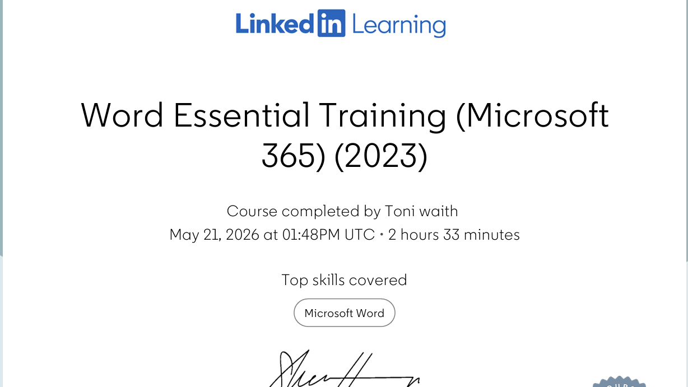

Slide 11
Week 5 – PowerPoint
Learned how to create a new PowerPoint presentation.
Learned how to insert text, pictures, icons and shapes.
Learned how to add, edit and organise slides.
I found animations and transitions a little difficult at first but after practising, I became more confident.

Slide 12
Week 6 Excel
Learned how to create and save excel spreadsheets.
Learned how to enter and edit data in cells.
Learned how to use basic formulas, such as SUM and AVERAGE
I found using formulas a little difficult at first, as I had to remember the correct functions.

Slide 13
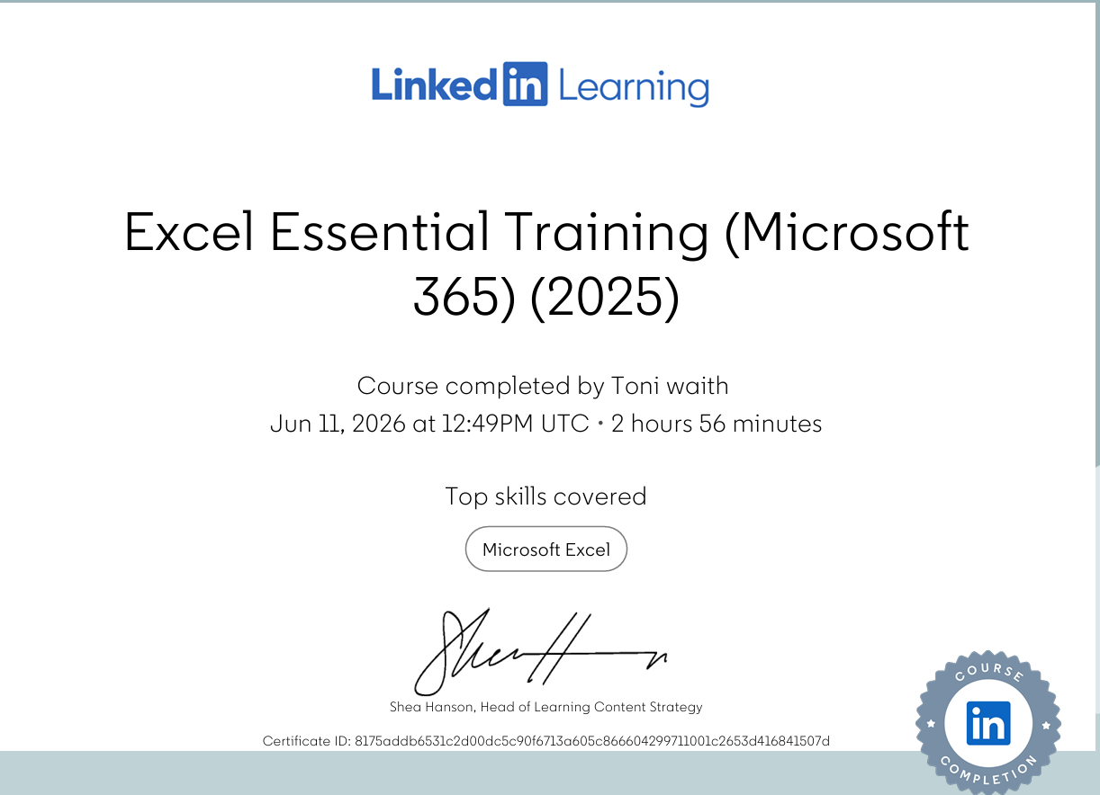

Slide 14
Week 7 Microsoft forms and AI
Learned how to create surveys, quizzes, and questionnaires using Microsoft forms
Learned the importance of checking AI- generated information for accuracy
Learned how to use AI tools responsibly and ethically
Learned how to share forms and collect responses
I found using AI difficult at first as there were many new concepts to understand but I finally got it In the end.

Slide 15
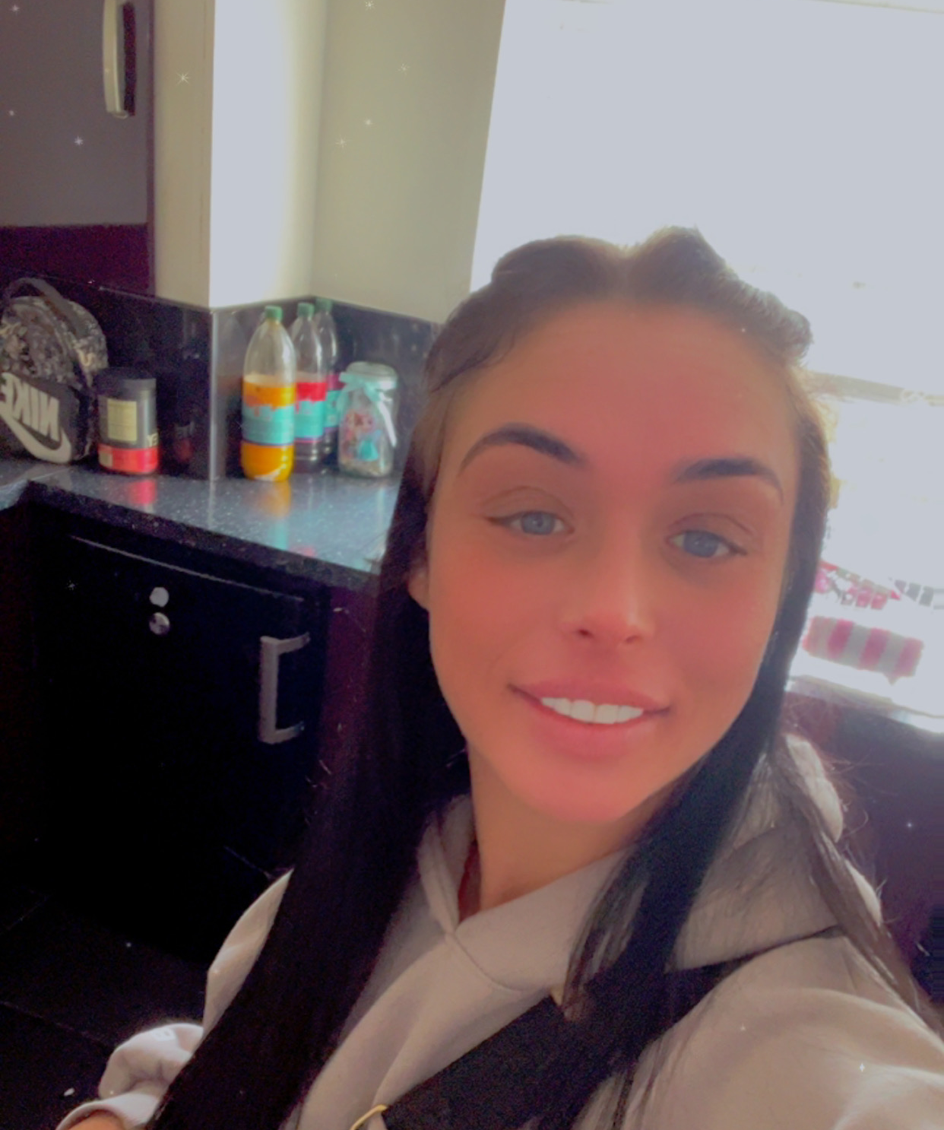
Thank you for watching
Hope you all enjoyed my presentation for this term hope to see you all next term!!

