Slide 1

Mastering Metrics
Revision
Chris Thomas

Slide 2
Module overview
Importance of managing marketing data in order to make effective marketing decisions
How to create marketing insights to support and inform strategic decision making

Slide 3
Measurement techniques aligned with business objectives, can help to identify the most appropriate marketing activities for any situation, and gauge their effectiveness.
Value of appropriate data sources to enable effective marketing analysis, and of employing the most relevant analytic tools and techniques.

Slide 4
Uncover insights and optimise marketing resources
Marketer can overcome one of the main challenges facing the discipline: accountability

Slide 5
Organisational context
Justification
Limited resources
Successful marketing = marketing that helps a business to achieve its strategic goals.

Slide 6
Exponential growth in data
  Big Data
  Internet of Things
Measure activities in order to answer:
  Are we achieving our goals?
  How far are we from achieving them?
  Are our activities working
  Where have we been and where are we going?
  How can we improve?

Slide 7
Sorger (2013) cited by CIM identifies 5 benefits of analysing marketing:
  Drive revenue
  Save money
  Persuade executives
  Encourage experimentation
  Reduce internal politics (conflict)

Slide 8
Assessment
CIM give an audio detailed assignment brief:
https://vimeo.com/213079231/684a71d387

Slide 9
Command Words
See handout

Slide 10
Data
The raw output from metrics
Data are raw facts and figures that on their own have no meaning
These can be any alphanumeric characters i.e. text, numbers, symbols

Slide 11
Data Examples
Yes, Yes, No, Yes, No, Yes, No, Yes
42, 63, 96, 74, 56, 86
111192, 111234
None of the above data sets have any meaning until they are given a CONTEXT and PROCESSED into a useable form

Slide 12
Data Into Information
To achieve its aims the organisation will need to process data into information.
Data needs to be turned into meaningful information and presented in its most useful format
Data must be processed in a context in order to give it meaning

Slide 13
Information
Data that has been processed within a context to give it meaning

Slide 14
Example
Raw Data
Yes, Yes, No, Yes, No, Yes, No, Yes, No, Yes, Yes
Context
Responses to the market research question – “Would you buy brand x at price y?”
Processing
Information
???

Slide 15
Intelligence/Knowledge & Insights
When information is manipulated and applied, it gives us intelligence/knowledge and this in turn provides insights into the ways consumers , markets and marketing works.

Slide 16
Knowledge Examples
Using the previous example:
  A Marketing Manager could use this information to decide whether or not to raise or lower price

Slide 17
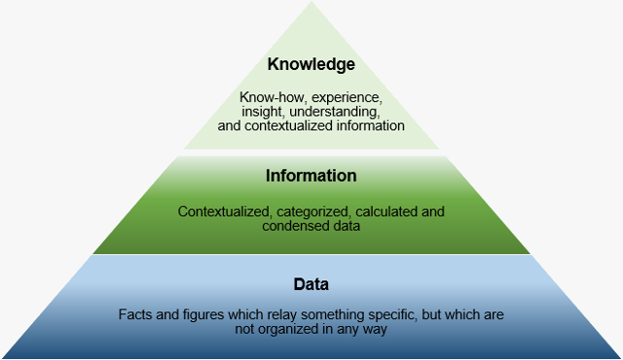

Slide 18
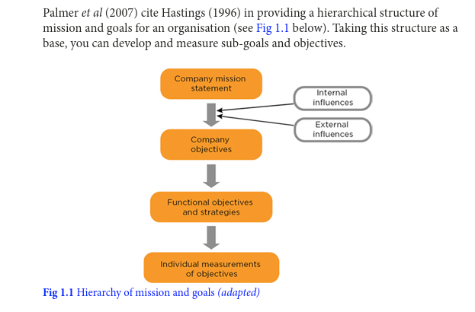
Mission and Goals

Slide 19
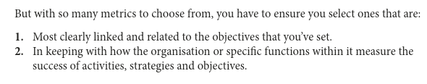

Slide 20
Working practices that facilitate the use of metrics
Effective team structures
  What is your organisational structure?
    Hierarchical?
    Matrix?
    http://www.learnmanagement2.com/hierarchical%20structure.htm

Slide 21
CIM likes matrix structures
As they breakdown the traditional ‘silo’ mentality
Support workflow management and lead to better decision-making.
Bring together different perspectives and metrics contain multiple inputs.

Slide 22
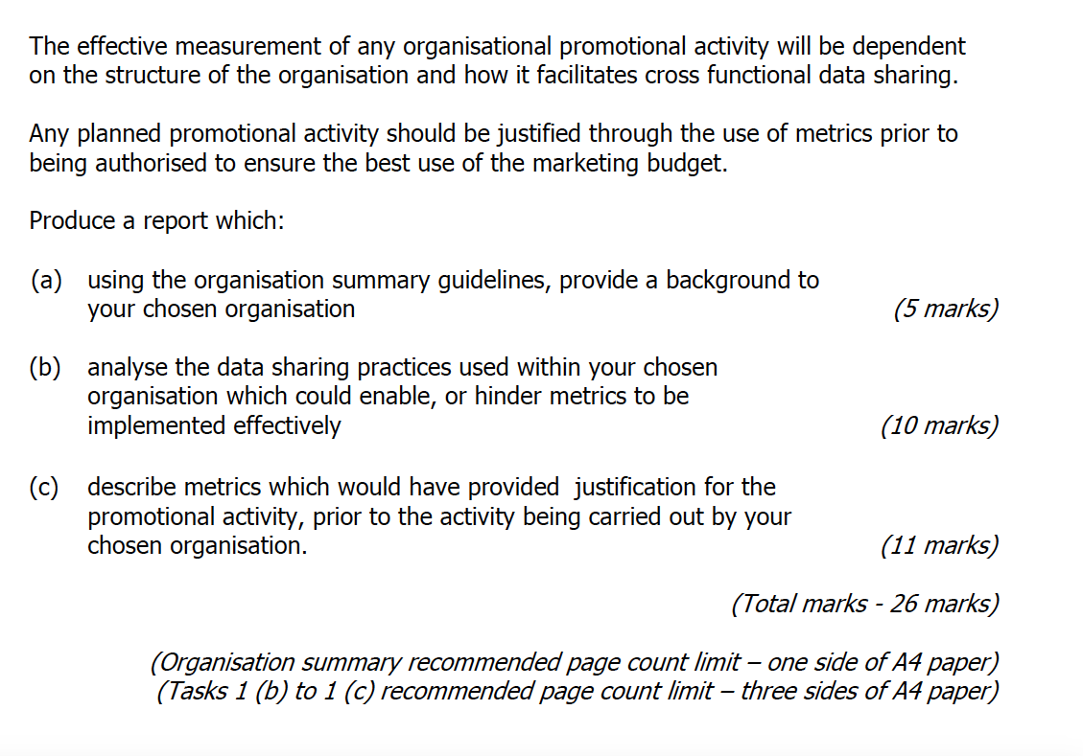
Task 1

Slide 23
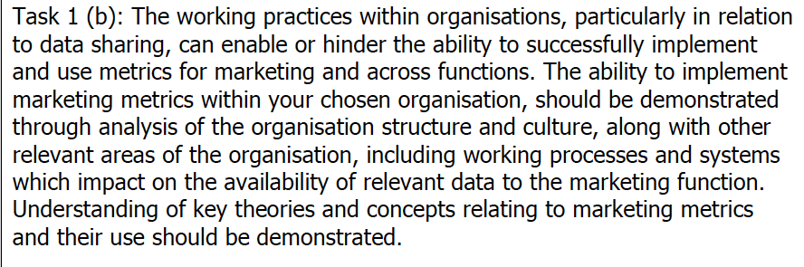

Slide 24
Organisational Culture
http://www.jcch.com.ar/books/Management%20and%20Organisational%20Behaviour.pdf
Mullins Management and Organisational Behaviour pages 740 -744

Slide 25
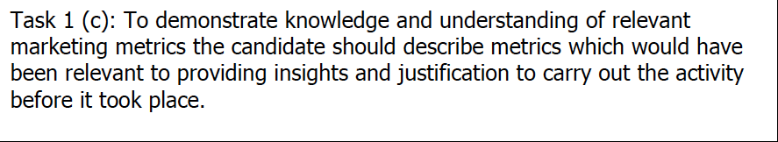
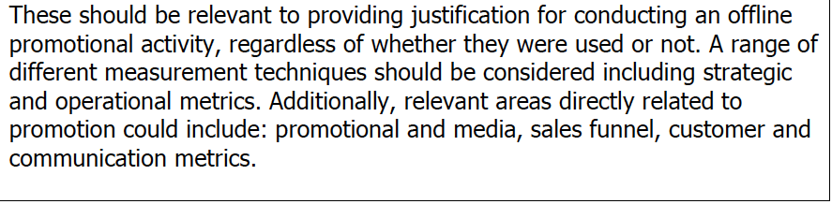

Slide 26
Task 1 c is looking at what metrics would have been used BEFORE embarking on your promotional activity.
This will include strategic reasons/metrics i.e. possibly looking to increase brand awareness or revenue
And operational measures i.e. why you chose one promotional activity over another.
Your metrics should also be justifying why you chose your promotional activity i.e. comparing ROI’s of different options.

Slide 27
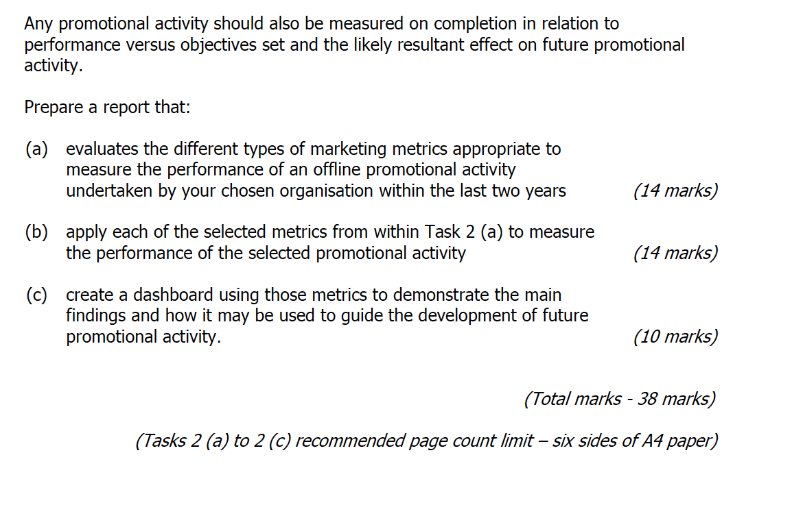
Task 2

Slide 28
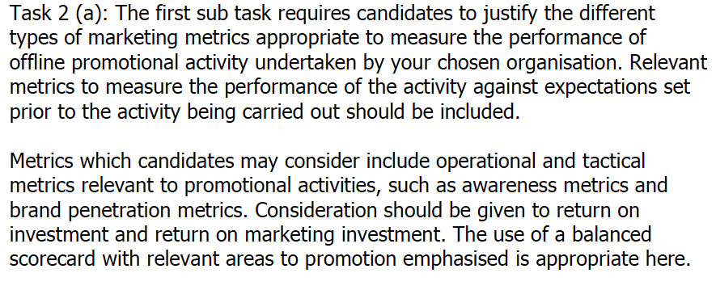

Slide 29
Four area of the BSC
Customer
  e.g. time, quality, service and cost
Internal Business Processes
  e.g. number of activities per function; cycle time, productivity
Financial Measures:
  e.g. Cash flow, ROI, ROCE, profitability
Learning and growth e.g. (innovation and staff development)
  e.g. % rev from new services; employee turnover, job satisfaction

Slide 30
Balanced Scorecard example
  https://www.slideshare.net/Jasminekaurnagpal12345/sample-balanced-scorecard
  http://cmgpartners.com/blog/implementing-a-marketing-balanced-scorecard/
  https://www.oxlearn.com/arg_-Balanced-Scorecards_11_36

Slide 31
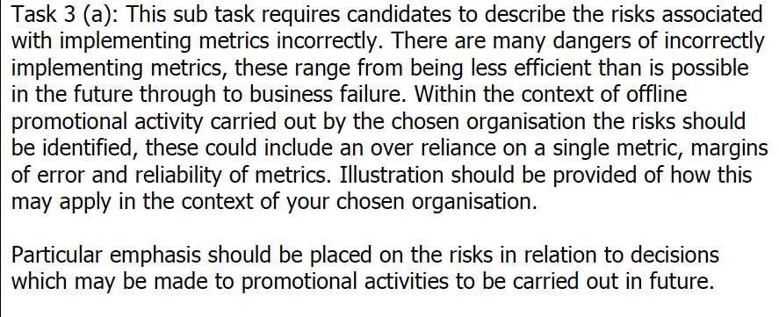
x

Slide 32
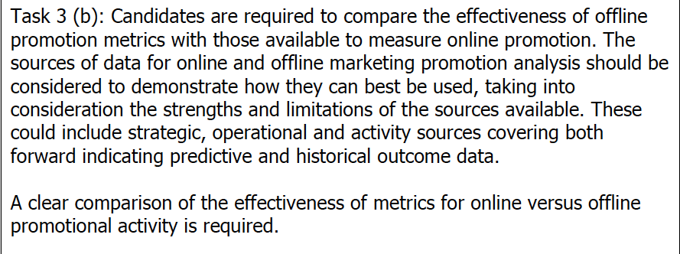

Slide 33
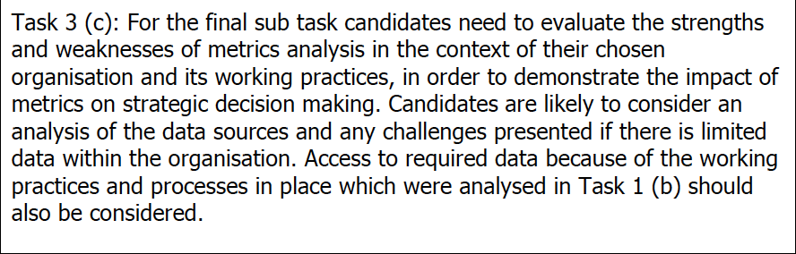

Slide 34
Offline marketing metrics
https://hypedmarketing.co.uk/metrics-for-measuring-offline-marketing-success/

Slide 35
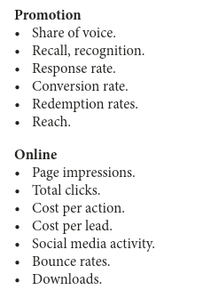
Operational metrics

Slide 36
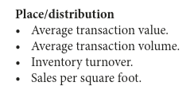
Operational metrics

Slide 37
Activity metrics
Aggregates and reporting
  Number of leads at a trade show
  Number of visitors to a website
RARELY DEMONSTRATE THE CONTRIBUTION MARKETING MAKES TO BUSINESS OUTCOMES
Think of some further examples

Slide 38
Outcome based metrics
**LINK MARKETING METRICS to ORG STRATEGY
  Market share
  Customer value
  New product adoption
(Depending on the organisations strategy)

Slide 39
Leading indicators
Measures of potential future activity
  If looking to increase your share of customer then Customer Lifetime Value (CLV) could serve as an indicator.

Slide 40
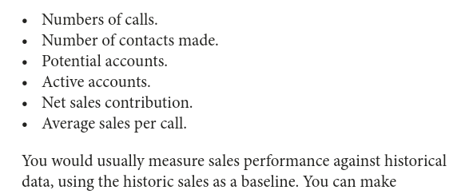
Sales force Metrics

Slide 41
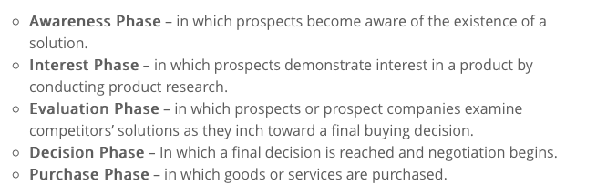
Sales Funnel
Sales process customer is taken through. Channel and company dependent
Salesforce example:

Slide 42
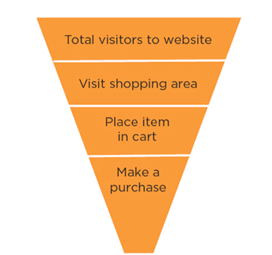
Sales Funnel
Website example:

Slide 43
Sales Funnel Metrics
Numbers and percentages can be shown for each stage
Sourcing and engagement: where customers come from and how people are engaged (usually web analytics software). Understanding this can help increase flow to top of funnel.
https://support.google.com/analytics/answer/6367342?hl=en

Slide 44
Sales Funnel metrics (Digital focus)
Conversion rate: ratio of deals that are closed that enter the funnel
Funnel value: This represents the potential value of prospective customers in the funnel. If the ‘normal’ funnel conversion rates are understood , you can use this to estimate future income.
Time spent at each stage: Important measure because it builds understanding of future potential, and allows you to speed up the process.
Average sales value: the average spend of customers in that channel, particularly if related to the costs involved in attracting and converting them. It can be a critical measure.

Slide 45
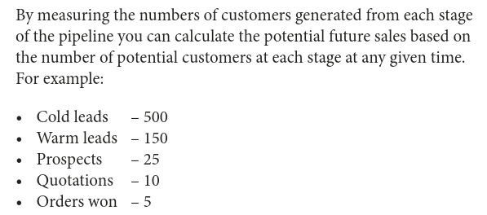
Sales Funnel Metrics
(offline emphasis)

Slide 46
CIM Sales Funnel Metrics
http://www.cimmarketingexpert.co.uk/page/9475/sales-funnel-metrics

Slide 47
Marketing ROI
Compare different types of expenditure actual or proposed by looking at the cash profit return after deducting the cost of the activity i.e. Return minus investment.
More generally ROI measures tends to be calculated as return divided by investment expressed as a percentage.
Problem is actually calculating the profit and the actual expenditure.

Slide 48
Return on Investment (ROI)
Marketing ROI measure is most useful for comparing different potential uses of the marketing budget – you can forecast the activity which is likely to yield the highest returns. Use it post implementation for future planning.
http://www.cimmarketingexpert.co.uk/page/2974/return-on-investment-roi-

Slide 49
Promotional Media Metrics
For potential impact and effectiveness of a promotional or media campaign.
Beneficial to set metrics before and after a campaign to identify and measure the impact.

Slide 50
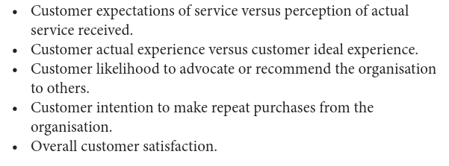
Service and satisfaction metrics
Traditionally not a strong area for marketers in demonstrating strategic impact.
Key metrics for real insight:

Slide 51
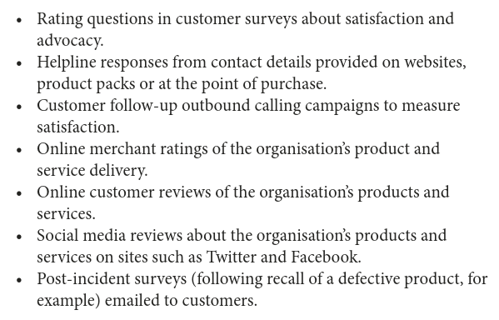
Measurement tools to assess impact of customer activity

Slide 52
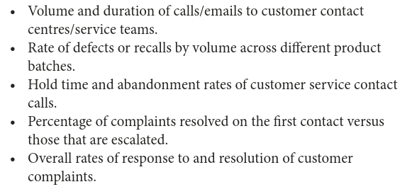
Measurement tools to test internal responsiveness to customer queries and complaints

Slide 53
Customer loyalty and Customer Lifetime Value (CLV) are more strategic measures than customer satisfaction alone.
Combining them can give both short-term satisfaction measures and longer-term relational building activities. E.g….

Slide 54
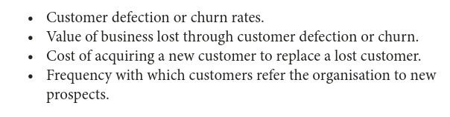

Slide 55
***Customer Lifetime Value (CLV)***
A forward-looking indicator that forecasts the value of the relationship between an organisation and a customer and ho much profit the organisation will make out of that customer.
How much that customer is worth to that organisation as a lump sump in current money terms.
It helps organisations decide which customers are worth the most not just based on past spend but potential future spend.

Slide 56
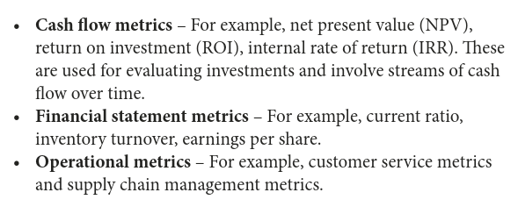
Financial and Operational Metrics

Slide 57
Marketers should integrate operational and financial metrics in order to gain a strategic view of the impact of metrics on the others.
E.g. operational metrics such as delivery quality, purchase cost and supply chain process efficiency should be measured in conjunction with product costs, customer satisfaction rates and rates of return. As it could show a deteriorating supply chain.

Slide 58
Choosing Appropriate measures
Use a wide variety of metrics initially, and study the results and decide which provide the most salient data to inform the setting and monitoring of KPIs

Slide 59
MKIS?
A Marketing Information System (MKIS) should integrate the data from all of the organisations customer data sources to allow informed business decisions.
Better customer insights, higher conversion rates, improved retention rates and better customer service.

Slide 60
MOST IMPORTANT
Metric must link with strategies
CIM will want you to JUSTIFY your choice of metrics
BIG DATA many sources of data available which can complement ‘traditional’ sources but beware of too much analysis and too little decision making.

Slide 61
Summary
Some metrics are better than others (to inform business decisions:
  Some are just ‘vanity metrics’/totals: they tell of quantity not quality
  Better metrics should give an idea of costs for comparison i.e. ROI
  Any task undertaken should be linked to the overall business strategy so some metrics should be strategic
  Some really useful metrics are predictive: trends, sales funnel, CLV
  Some metrics may be strategic and/or predictive but not relevant to the task you are considering. I you cant justify it as a measure of your promotional activity for your assignment – don’t use it.
  Balanced scorecard

