Slide 1


Birds Directive
By Paige Cole

Slide 2
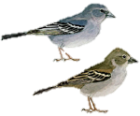
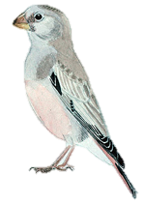
Wild Birds: Threatened Birds (European Commission, 2016)
The importance of protecting birds:
Many members of the public enjoy watching and listening to birds
Birds play key roles in food webs
They are important to the function of ecosystems
Birds indicate the state of biodiversity.
In November 2004, The European Commission expressed that Europe’s bird species are currently not in good conservation status; with 43% threatened or facing serious decline.
Wild Birds: Threatened Birds (European Commission, 2016)

Slide 3
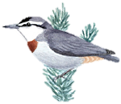
Birds Directive
What is it and what’s its purpose?
Birds Directive is a European Union directive, which is a form of legislation, that relates to wildlife and nature conservation.
It was the first major nature conservation law, being implemented in 1979.
The directive applies to Europe’s Member States and sets objectives for the conservation and management of, and human interactions with, wild birds.
It takes into account marine and terrestrial areas, and includes birds habitats, nests and eggs.
Wild Birds: Threatened Birds (European Commission, 2016)

Slide 4
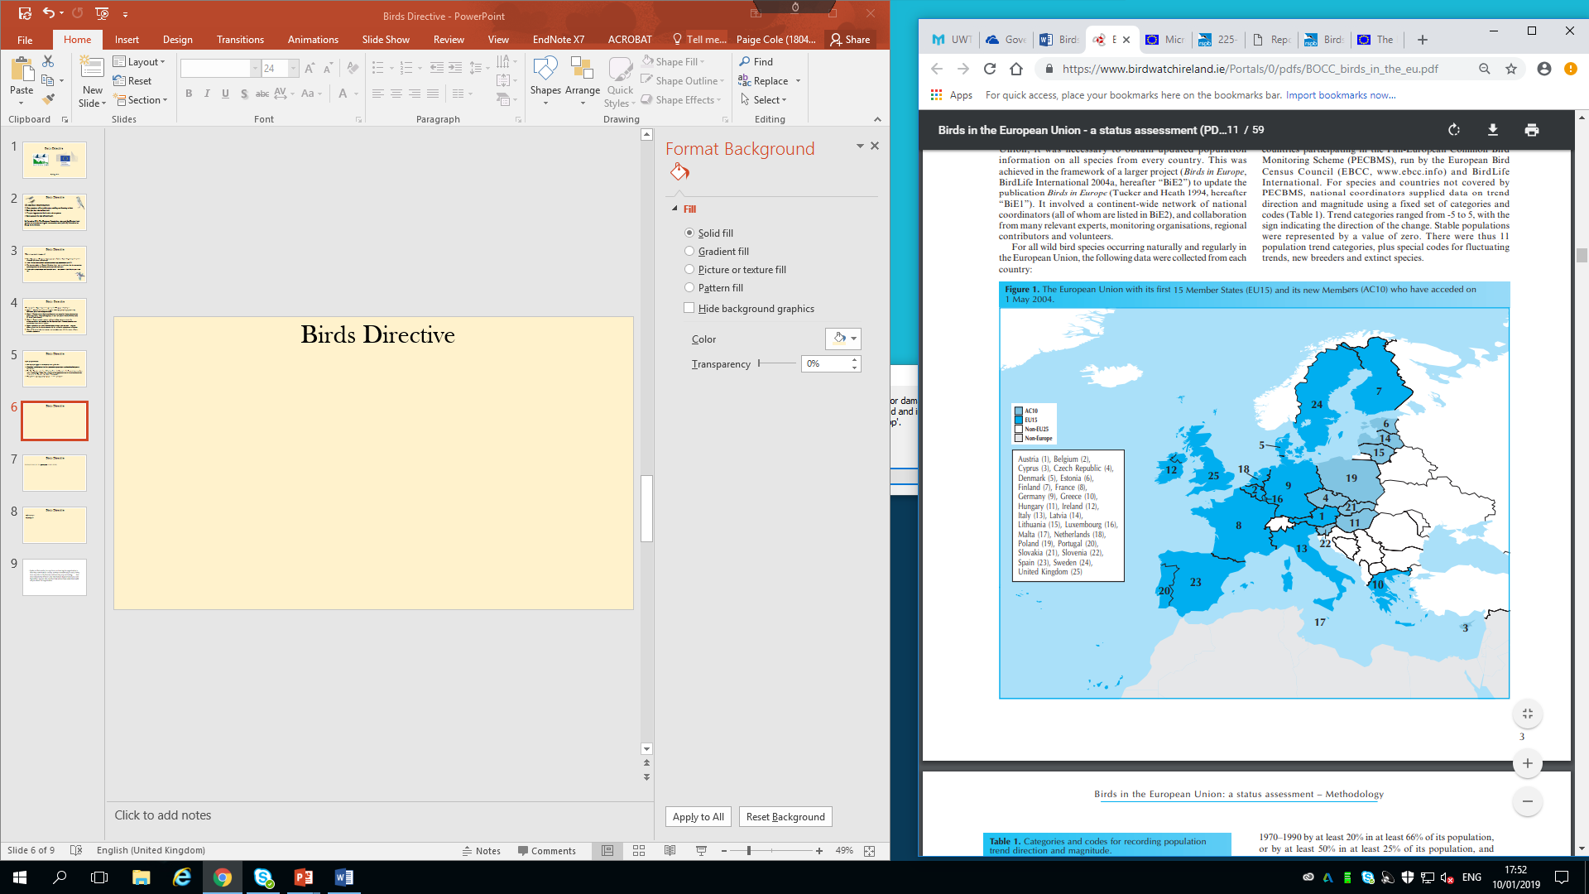
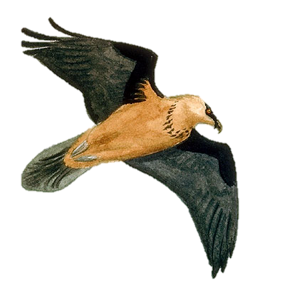
Birds Directive
(BirdLife International, 2004)
The Directive applies to all Member States in the EU.
Therefore, each Member State has individual responsibilities on how they shall protect bird species.
The Bird Directive states that ‘Member States shall forward to the Commission every three years, starting from 7 April 1981, a report on the implementation of the national provisions taken under this Directive’ in Article 12 paragraph 1.
This includes reporting on bird species’ status and trends.
This is then sent to the European Commission for them to consider further initiatives.
Wild Birds: Threatened Birds (European Commission, 2016)

Slide 5
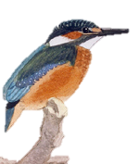
Wild Birds: Threatened Birds (European Commission, 2016)
Birds Directive
The Directive has 5 parts (annex’s) to protect the 500 species of wild birds.
Annex 1: Member States need to designate SPAs (Special Protection Areas) for threatened species and all migratory birds.
Annex 2: Hunting periods forbidden when birds are venerable (during reproduction and raising periods, along with migrating seasons) and limited overall, however, only 82 species can be hunted.
Annex 3: Banned activities include: deliberate killing, capture or trade, the destruction of nests and anything else that threatens birds. However, member states can allow for some of these activities.
Annex 4: Member states must outlaw all forms of large scale and non-selective killings of birds but the directive provide for the sustainable management of hunting.
Annex 5: In order to protect, manage, and underpin usage of all the species of birds, research is promoted.

Slide 6

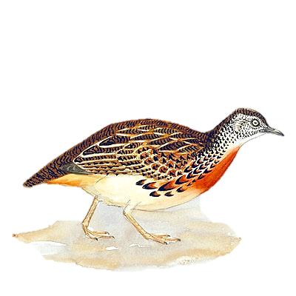
Birds Directive
It is mostly EU funded, but member state projects are often involved with charities, for example in the UK:
The Royal Society for the protection of Birds (RSPB)
RSPB campaigned for the directive during the late 1970s and helps the UK government ( along with country administrations and statutory conservation bodies) with the application of and guidelines for site selection of SPAs, along with other things.
Wild Birds: Threatened Birds (European Commission, 2016)

Slide 7
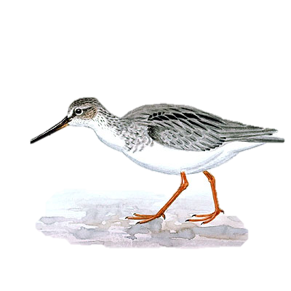
Birds Directive
Achievements:
A primary achievement of the Birds directive is the classification of many SPAs in Europe. These cover 7% of EU-15 coastal, inshore marine, and terrestrial areas.
Species Action Plans have been put in place, resulting in a halt in decline for some species.
An increasing awareness of the dangers of hunting in hunting communities.
  An agreement on sustainable hunting and the commitment to Birds Directive has been signed by FACE (Federation of Associations for Hunting and Conservation of the EU) and BirdLife International.
Not only has there been an increase of awareness among hunters, but also, bird conservationists, ornithologists and people who have an interest in birds- resulting in a chance in attitude towards wild birds and their habitats.
All data was provided by the European Commission in November 2004.
Wild Birds: Threatened Birds (European Commission, 2016)

Slide 8
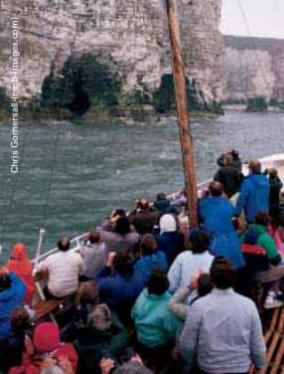
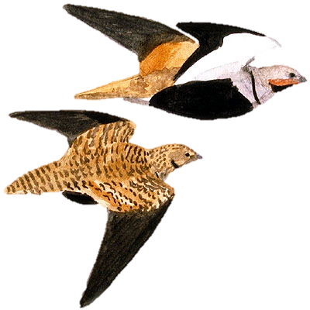
Birds Directive
Economic benefits:
There is growing evidence that conservation sites under proper management, including Natura 2000 sites, are active in supporting remote, rural, or deprived areas through supporting products, employment and contributing to local economies.
Nature conservation provides employment opportunities within the EU-15.
An important role in urban regeneration is a high quality environment.
Another positive is that it helps the growth of nature tourism.
This increases local spending through investment and employment.
The RSPB puffin cruise from Bridlington to view the sea birds of the Flamborough Head and Bempton Cliffs SPA.
Wild Birds: Threatened Birds (European Commission, 2016)

Slide 9
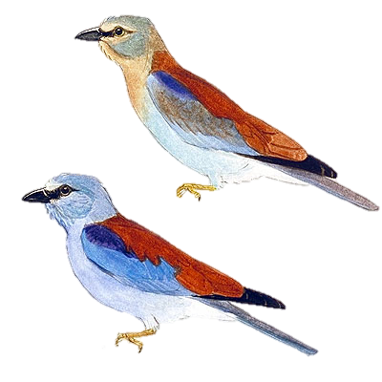
Birds Directive
Wild Birds: Threatened Birds (European Commission, 2016)
Future developments of the Directive:
The RSPB says that some SPAs in terrestrial areas are incomplete, especially in Scotland.
They also say 'some parts of the Directive are still poorly implemented in the UK'
Criticisms:
Some people suggest that the approach taken by the Directive is too static when considering the implications of changed caused by climate change and sea level rise.

Slide 10
Birds Directive
European Commission (2016) Wild Birds: Threatened Birds. Available at: http://ec.europa.eu/environment/nature/conservation/wildbirds/threatened/per_species_en.htm (Accessed: 7th January 2019)
Hunt, M. (2013) Why Do Birds Matter? Available at: https://www.audubon.org/news/why-do-birds-matter (Accessed: 7th January 2019)
The Royal Society for the Protection of Birds (RSPB) (2018) EU Birds Directive. Available at: https://www.rspb.org.uk/our-work/our-positions-and-casework/our-positions/safeguarding-wildlife-sites/eu-birds-directive/
Williams G, Pullan D, Dickie I, Huggett D, Mitchell H (2005) The European Birds Directive – safeguarding special places for people and wildlife. Available at: https://www.rspb.org.uk/globalassets/downloads/documents/positions/safeguarding-sites/the-european-birds-directive.pdf (Accessed 8th January 2019)
European Commission (2004) Why do we need to take care of our birds? Available at: http://ec.europa.eu/environment/nature/legislation/birdsdirective/docs/why_take_care_of_birds.pdf (Accessed 9th January 2019)
BirdLife International (2004) Birds in the European Union: a status assessment. Wageningen, The Netherlands: BirdLife International.

