Slide 1
Precautionary and proximity principles
M6X01894 – Environmental law & policy
BSc Renewable energy & the Built environment

Slide 2
outline
What are they
History of development
Application in relation to environmental law

Slide 3
Precautionary principle: definition
“When human activities may lead to morally unacceptable harm that is scientifically plausible but uncertain, actions shall be taken to avoid or diminish that harm. Morally unacceptable harm refers to harm to humans or the environment that is:
  threatening to human life or health, or
  serious and effectively irreversible, or
  inequitable to present or future generations, or
  imposed without adequate consideration of the human rights of those affected.”
Source: UNESCO COMEST, 2005

Slide 4
Lessons learnt from past mistakes
“To know and not to know; To act or not to act…?”
Early warnings / late & loud warnings
Aristotle – information is critical in how we see the world
  Where received from?
  True, fair & independent?
  Understandable to non-experts?
Source: European Environment Agency report, 2001

Slide 5
An early example…
Quote from Lucy Deane, UK Factory Inspector, 1898:
“The evil effects of asbestos dust have also instigated a microscopic examination of the mineral dust by HM Medical Inspector. Clearly revealed was the sharp glass-like jagged nature of the particles, and where they are allowed to rise and to remain suspended in the air of the room in any quantity, the effects have been found to be injurious as might have been expected.”
Source: European Environment Agency report, 2001

Slide 6
Use in environmental matters
“Man has lost the ability to foresee & forestall…he will end up destroying the Earth…” – Albert Schweitzer, 1875-1965
Precautionary prevention is not new, esp. medicines & public health
1970s – emergent for environmental matters
Within 1970s and 80s – risen up political agendas (esp. for marine environments)
1992 – Principle 15 in UN Rio Declaration:
  “In order to protect the environment, the precautionary approach shall be widely applied by States according to their capabilities. Where there are threats of serious or irreversible damage, lack of full scientific certainty shall not be used as a reason for postponing cost-effective measures to prevent environmental degradation”.

Slide 7
Precautionary principle in international agreements
Treaty / agreement | Wording
Montreal Protocol 1987 | Parties…determined to protect the ozone layer by taking precautionary measures to control total global emissions..
Third North Sea Conference 1990 | Participants…will continue to apply the precautionary principle, to take action to avoid potentially damaging impacts of substances…even where there is no scientific evidence
Rio Declaration 1992 | In order to protect the environment the Precautionary Approach will be widely applied by states according to their capabilities
Framework Convention on Climate Change 1992 | The Parties should take precautionary measures to anticipate, prevent or minimise the causes of climate change & mitigate its adverse effects
Maastricht Treaty 1992 | Community policy on the environment…shall be based on the precautionary principle
Stockholm Convention on POPs 2001 | Precaution, including transparency, is operationalised throughout the treaty, being mindful of the Precautionary Approach set out in Principle 15 of the Rio Declaration.

Slide 8
Towards a clarification of terms
Situation | States & dates of knowledge | Examples of action
Risk | ‘Known’ impacts; ‘Known’ probabilities e.g. asbestos causing respiratory disease, lung & mesothelioma cancer 1965-present | Prevention: action taken to reduce known risks e.g. eliminate exposure to asbestos dust
Uncertainty | ‘Known’ impacts; ‘Unknown’ probabilities e.g. antibiotics in animal feed & associated human resistance to those antibiotics 1969-present | Precautionary prevention: action taken to reduce potential hazards e.g. reduce / eliminate human exposure to antibiotics in animal feed
Ignorance | ‘Unknown’ impacts; ‘Unknown’ probabilities e.g. the ‘surprises’ of CFCs & ozone layer damage prior to 1974; asbestos mesothelioma cancer before 1959 | Precaution: action taken to anticipate, identify & reduce the impact of ‘surprises’ e.g. use of properties of chemicals e.g. persistence as ‘predictors’ of potential harm; use of broadest sources of information

Slide 9
Key elements of pp
Applies where scientific uncertainty exists
Some form of scientific analysis is mandatory
The unquantified possibility is sufficient to trigger PP
Application is limited to unacceptable hazards
Interventions are required before possible harm occurs
Interventions should be proportional
A repertoire of interventions exists
Ongoing need for better evidence & understanding

Slide 10
The precautionary principle is Not…
Based on ‘zero risks’
Based on anxiety or emotion
A decision-based algorithm

Slide 11
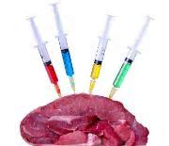

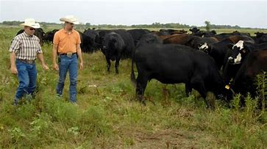
PP in practice?
EU ban of US hormone fed beef

Slide 12
Proximity principle: definition
“environmental damage should be rectified, compensated or treated at or as near to source as practicable and waste should be dealt with as close as possible to where it is produced” (IEMA, 2017)

Slide 13
Proximity principle in use
1999 – EC outlined for waste management
“waste should be disposed of as closely as possible to where it is produced”
Transportation is not sustainable
Should be minimised

Slide 14
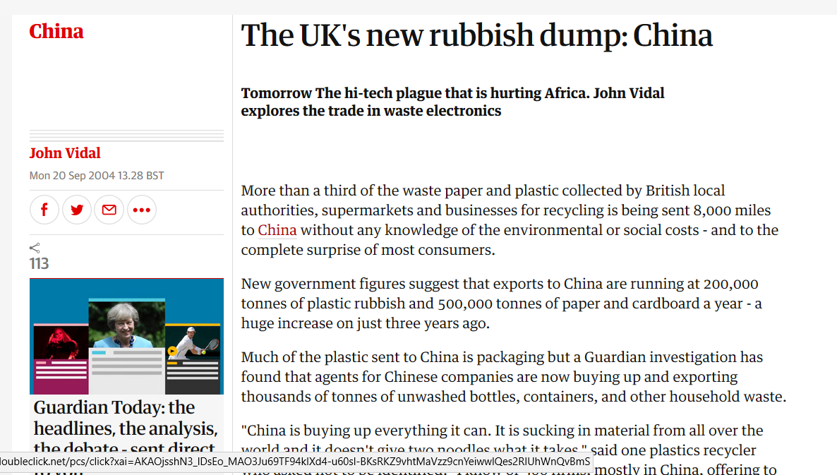
Proximity principle in action?
Source: The Guardian, Sept 2004

Slide 15
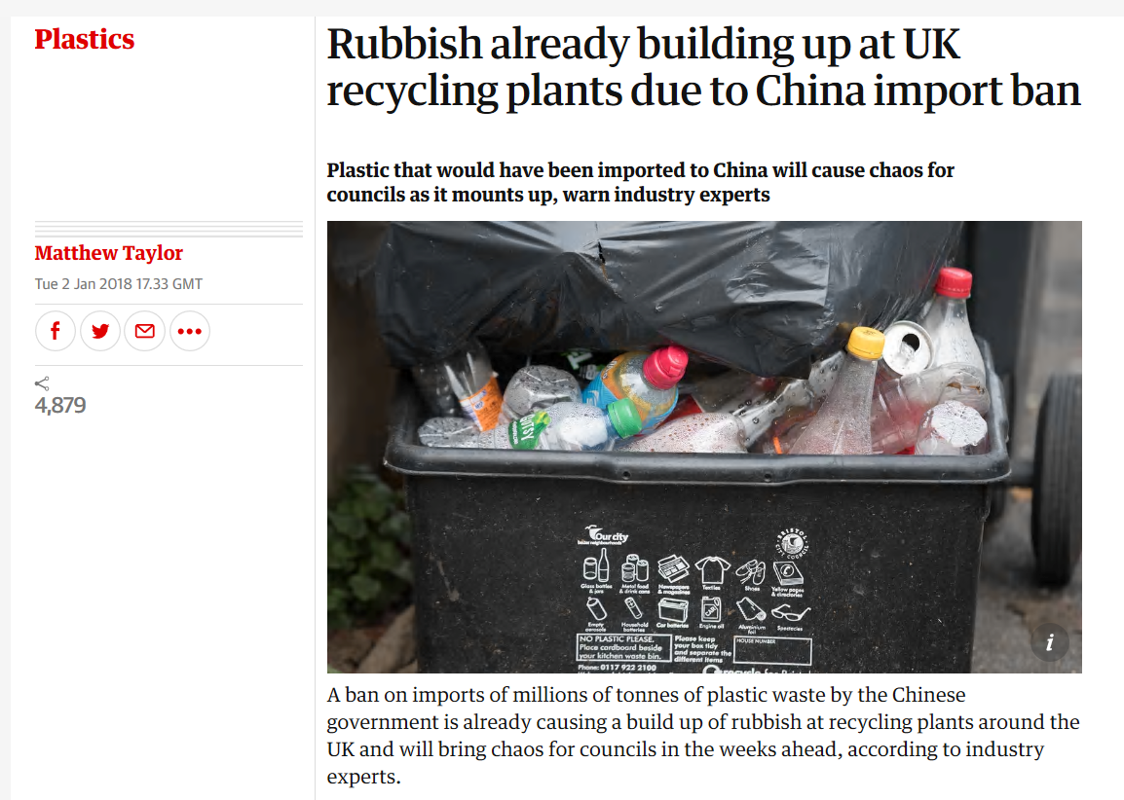
Source: The Guardian, Jan 2018

Slide 16
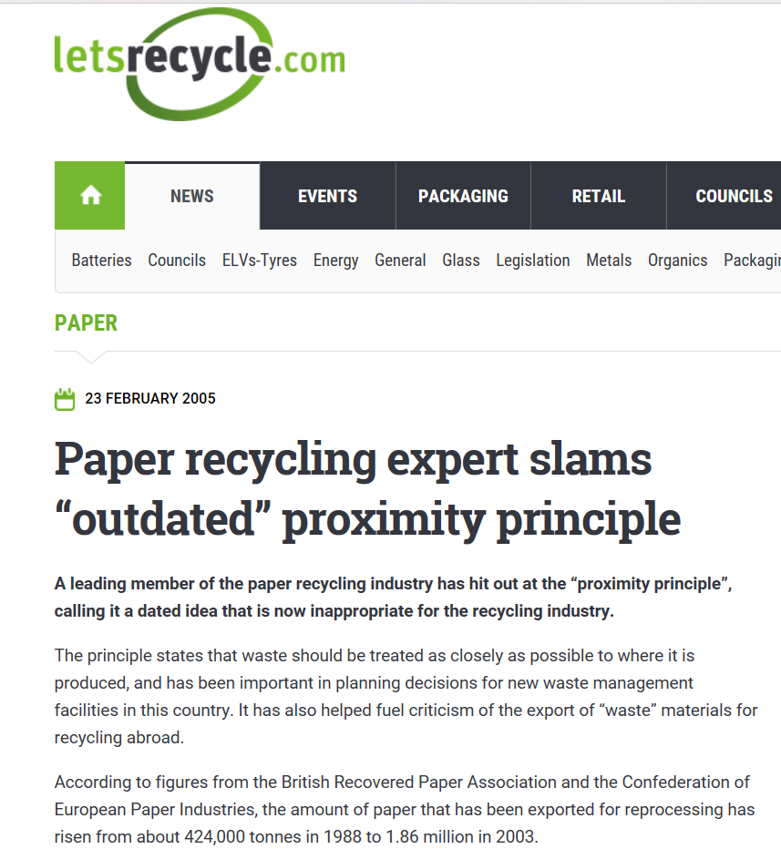
Source: Lets Recycle, 2005

Slide 17
Proximity and wfd 2008
Mentioned twice
Article 16
Section 4: “The principles of proximity and self-sufficiency shall not mean that each Member State has to possess the full range of final recovery facilities within that Member State”. (Directive 2008/98/EC of the European Parliament and of the council on waste and repealing certain Directives)

Slide 18
Useful information
The Precautionary Principle (http://www.precautionaryprinciple.eu/)
EEA (2001) Late lessons from early warnings: the Precautionary Principle 1896 – 2000, Luxembourg
UNESCO COMEST (2005) The Precautionary Principle, Paris
Institute of Environmental Management and Assessment (www.iema.net)
Waste Framework Directive 2008/98/EC (http://eur-lex.europa.eu/legal-content/EN/TXT/PDF/?uri=CELEX:32008L0098&from=EN)

