Slide 1
CSS Flexbox Refresher
Lecture 3: Responsive Web Design and Development (RWDD)
Dr Kemi Ademoye

Slide 2
Today’s Lecture
Self-Development: Flexbox Refresher

Slide 3
What Should I Use Flexbox For?
Whether you like it or not, floats (grids) are still the best for page layouts ☺
But here is some more information:
  Should I Use Grid or Flexbox?
  When to Use Flexbox

Slide 4
CSS3 Flexbox
Flexible boxes, or simply Flexbox, is the new layout technique of CSS3.
  It does not use floats! ☺
  Has a different type of box model optimised for UI design.
It addresses some of the problems of older methods. It can:
  easily centre content vertically
  change the visual order of elements
  automatically space and align elements within a box, automatically assigning available space between them.
Note: requires browser prefix codes in some browsers and not supported in some older ones.

Slide 5
Flexbox
A flexbox consists of Flex containers and Flex items.
To create a flex container, add a display property and set it to either:
  flex: (rendered as a block element), or
  flex-inline (rendered as an inline element)
Flex items are positioned inside a flex container along a flex line.
Flexbox defines how the flex items are laid out inside a flex container.

Slide 6
Flexbox, A Simple Example
HTML
    <div class="flexContainer">
    <div class="flexItem">Flex Item 1</div>
    <div class="flexItem">Flex Item 2</div>
    <div class="flexItem">Flex Item 3</div>
    </div>
CSS
    .flexContainer {
    display: flex;
    width: 100%; height: 300px;
    }
    .flexItem {
    width: 25%; height: 100%; margin: 10px;
    background-color: cornflowerblue;
    }
Notes:
For simplicity, only the non-prefixed options are shown.

Slide 7
Flexbox Layout and Alignment
To understand Flexbox layout alignment, you need to understand its concept of axes.
There are two main axes to consider: the “main axis” and the “cross axis”.
  The direction the Flexbox is heading determines what is the main axis and what is the cross axis. E.g.
    If the direction of your Flexbox is set to row (this is the default), the main axis is the horizontal axis and the cross axis will be the vertical axis.
    If the direction is set to column, the main axis is the vertical axis and the cross axis will be the horizontal axis.
Notes:
Flex layout is biased to the flex directions

Slide 8
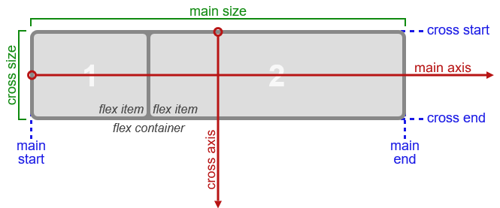
Flex Layout Box Model
The various directions and sizing terms of a Flexbox as applied to a row flex container.
Image from: http://www.w3.org/TR/css-flexbox-1/#box-model
Notes:
Image from: http://www.w3.org/TR/css-flexbox-1/#box-model
Flex layout is biased to the flex directions.

Slide 9
Flex Layout Box Model: The Terms
Main axis, Main dimension: Main axis is the primary axis along which flex items are laid out. It extends in the main dimension.
Main Start, Main End: items are laid out starting at main-start going towards main-end.
Main Size: a flex item’s width or height, whichever is the main dimension.
Cross axis, Cross dimension: The axis perpendicular to the main axis. It extends in the cross dimension.
Cross Start, Cross End: items are laid out starting at cross-start going towards cross-end.
Cross Size: a flex item’s width or height, whichever is the cross dimension.

Slide 10
The flex-direction Property
The flex-direction property is used to specify the direction of the flexible items in the flexbox.
It depends on the current writing mode.
  row: default, flex items laid out left-to-right, top-to-bottom, if the writing mode is left-to-right and horizontal (English writing mode).
  row-reverse: if the writing mode is left-to-right, the items will be laid out from the right to left.
  column: if the writing mode is horizontal, the items are laid out vertically, top-to-bottom.
  column-reverse: same as column, but reversed.

Slide 11
Flex Direction Example
The flex-direction property is added to the CSS for the flex container element.
  .flexContainer {
  display: flex;
  flex-direction: column;
  width: 100%;
  height: 300px;
  }
Will display the flexible items in a vertical column.

Slide 12
Flexbox Alignment Properties
The following properties can be added to a flex container’s CSS styles to align its flex items:
justify-content: aligns flex items on the main axis when they do not use all available space.
align-items: aligns flex items on the cross-axis when they do not use all available space.
flex-wrap: specifies whether the flex items should wrap or not, if there is not enough room on one flex line. Makes the flex container single/multi line.
align-content: aligns flex container lines when there is extra space on the cross axis as long as the flexbox is not single line (flex-wrap is not nowrap).

Slide 13
The justify-content Property
Aligns flex items on the main axis when they do not use all available space.
flex-start: Default, items are positioned at the start of the container
flex-end: items are positioned at the end of the container
center: items are positioned towards the centre of the main axis line
space-between: items are distributed evenly on the line with equal spacing between them
space-around: items are positioned with space before, between and after
Illustration based on a row flex container

Slide 14
The align-items Property
Aligns flex items on the cross-axis when they do not use all available space.
flex-start
flex-end
foo foo foo foo
center
stretch
baseline
Notes:
flex-start: The cross-start margin edge of the flex item is placed flush with the cross-start edge of the line.
flex-end: The cross-end margin edge of the flex item is placed flush with the cross-end edge of the line.
center: The flex item’s margin box is centered in the cross axis within the line. (If the cross size of the flex line is less than that of the flex item, it will overflow equally in both directions.)
baseline: If the flex item’s inline axis is the same as the cross axis, this value is identical to flex-start.

Slide 15
The flex-wrap Property
Controls whether the flex container is single or multi line.
nowrap: default, the flex container is single line. The flexible items will not wrap even if too wide.
wrap: the flex container is multi line – the flexible items will wrap if necessary.
wrap-reverse: same as wrap, but in reverse
1 | 2 | 3
4
4
1 | 2 | 3

Slide 16
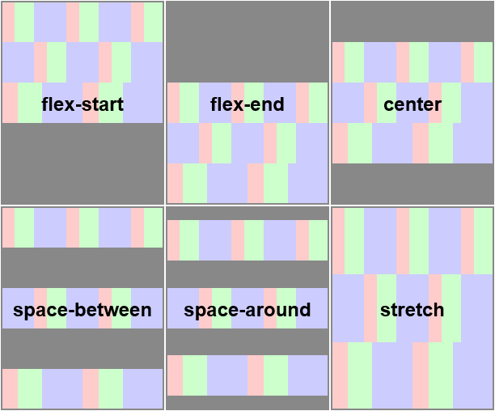
The align-content Property
Aligns lines on the cross axis when they do not use all available space.

Slide 17
Flex Item Properties
Applies to the CSS for Flex items
order: used to specify/change the ordering of a flex item.
margin: automatically absorbs extra space
  margin: auto; (perfectly centred)
  margin-right: auto; absorbs space on the right side of the flex item.
align-self: overrides the flex container’s align-items property for that flex item
flex: specifies the items of a flexible length.

Slide 18
The flex Property
Specifies the flex items of a flexible length
Syntax:
  flex: flex-grow flex-shrink flex-basis;
  flex-grow: determines how much the flexible item will grow relative to the other items in the container.
  flex-shrink: determines how much the flexible item will shrink relative to the other items in the container.
  flex-basis: the initial main size of the flex item before free space is distributed according to the flex factors.

Slide 19
flex Property Examples
flex: 1 1 auto;
  Item will grow 1 part into space available, or will shrink 1 part when not enough space and basis will be automatically determined based on its content.
flex: 0 0 50px;
  Item will neither grow nor shrink and it’s basis is 50px (will be 50px regardless of any free space).
flex: 2 0 50%;
  Item will take two lots of space, but won’t shrink and its basis size is 50%.

