Slide 1

Embedded Counselling Practices
M5X00962 ASSESSMENT 3
Ingrid Nicholls P151102 Level 5
Oral Presentation

Slide 2
Introduction
‘Reflect on your own use of embedded counselling skills within the module; include implications and recommendations for the use of embedded counselling practices within the health and social care sector.

Slide 3
Benefits of Reflective Practice
Increases self-awareness.
Helps with continued professional development (CPD).
‘The capacity to reflect on action is to engage in the process of continuous learning
and this is one of the defining characteristics of professional practice'
(Donald Schon,1983 cited in Tarrant, 2013, p.2).

Slide 4
What is Counselling
Talking Therapy.
Practicing Counsellor.
Providing a safe space.
Confidential.

Slide 5

What is embedded counselling?
Using counselling skills.
Listening and supporting an individual.
Enabling someone to talk spontaneously in some circumstances, this is sometimes referred to as a window of opportunity.
(Midwinter and Dickson, 2015).

Slide 6
Strengths and limitations
Counselling
embedded counselling
The Setting.
Confidentiality.
Clear written contract.
Therapeutic Theories.
Ethical Guidelines.
Supervision.
Not always confidential space.
Can occur in a range of settings.
No contract.
Limited knowledge and training.
Safeguarding issues.
(Bond 2015); (BACP 2016)

Slide 7

Volunteering
Counselling Skills
Core Conditions.
Micro skills.
Empathy.
Active Listening.
Attending.
(Harris and Flood 2015; Rogers, 1961).
(Cruse Bereavement Care, 2018).

Slide 8
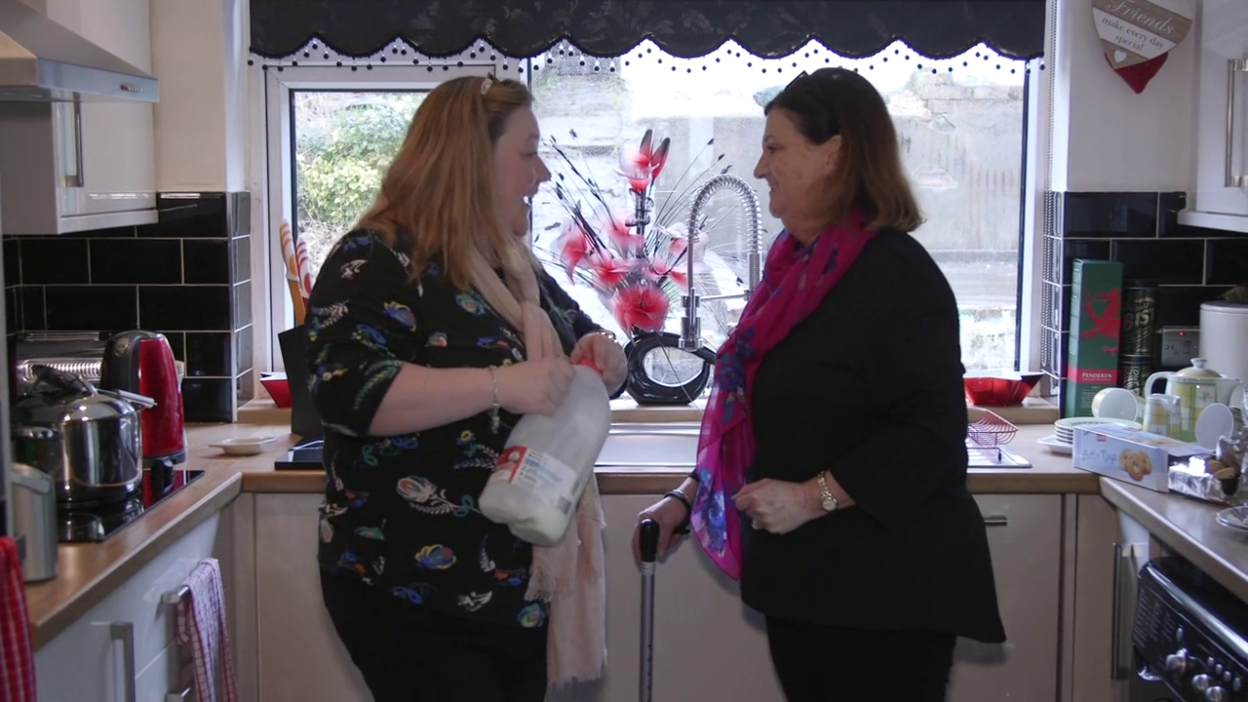

Embedded skills used within all areas of life
workplace
University Life

Slide 9
Range of Approaches
Motivational Interviewing.
Solution Focused Therapy.
The Transtheoretical Model.
The Relational Skills Model.
(Midwinter and Dickson, 2015; Nelson-Jones, 2011).

Slide 10
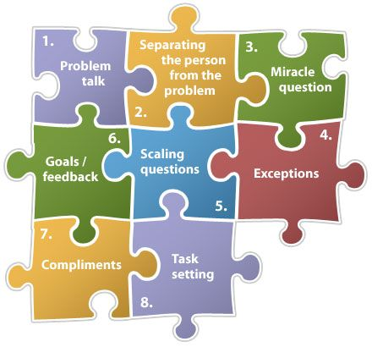
Solution Focused Therapy
Workplace.
Exclusion and bullying.
Return to work plan.
Toolkit.
(Equality Act 2010)
Fig 1 Matthew Mitchell (2018).

Slide 11

What worked well
The Magic Wand Question
Used to help establish what the individual needs to change
(De Shazer, et al, 2007).
Fig 2 Kate Woodford, (2017).

Slide 12
What went well?
On a scale of 1-10.
The Scaling question worked early on to establish how the employee was feeling at that exact moment.
Then used again later in the session to check for improvements.
0 1 2 3 4 5 6 7 8 9 10
(De Shazer, et al, 2007).

Slide 13

What can be achieved with this approach?
Emphasis on what the employee needed.
A clear time scale-end goal was in sight.
Rescheduled meeting to check progress.
This approach has similarities with Egan’s Skilled Helper Model.
(Egan, 2014).

Slide 14

Implications and recommendations
How realistic would the outcome be?
Should all managers be trained to use embedded skills?
If they were how much scope would there be to make changes?

Slide 15

Conclusion
What has been the outcome of this module?
How does reflective practice help?

Slide 16
Reference list.
Bond, T. (2015) Standards and Ethics for Counselling in Action. 4th edn. London: Sage Publications Ltd.
British Association for Counselling and Psychotherapy, (2016) Ethical Framework for the Counselling Professions. [Online]. Available at: https://www.bacp.co.uk/events-and-resources/ethics-and-standards/ethical-framework-for-the-counselling-professions/ (Accessed: 2 May 2018).
Carroll, M. and Shaw, E. (2013) Ethical Maturity in the Helping Professions Making Difficult Life and Work Decisions. London: Jessica Kingsley Publishers.
Cruse Bereavement Care, (2018) Volunteer [Online]. Available at: https://www.cruse.org.uk/volunteer (Accessed: 4 May 2018).
Cunanan, E, D. (2003) WHAT WORKS WHEN LEARNING SOLUTION FOCUSED BRIEF THERAPY: A QUALITATIVE ANALYSIS OF TRAINEES’ EXPERIENCE. [Online]. Available at: https://vtechworks.lib.vt.edu/bitstream/handle/10919/34219/thesis7.28.03.pdf?sequence=1 (Accessed 13 May 2018).
De Shazer, S., Dolan, Y., Korman, H., Trepper, T., McCollum, E., and Berg, I, K. (2007) More Than Miracles: The State of the Art of Solution-focused Brief Therapy. New York: The Haworth Press Inc.
Egan, G. (2014) The Skilled Helper: A Problem Management and Opportunity Development Approach to Helping. 10th edn. Boston: Cengage Learning
Equality Act, (2010) Workplace bullying and harassment. [Online] Available at: https://www.gov.uk/workplace-bullying-and-harassment (Accessed: 6 May 2018).
Fig 1, Matthew Mitchell (2018) Google Images. [Online]. Available at: @WilsonPractice w/ DrSteve @SportsShrink Solution Focused Brief Therapy (SFBT). (Accessed on 12 May 2018).
Fig 2, Kate Woodford, (2017) Google Images. [Online] Available at: https://dictionaryblog.cambridge.org/2017/11/22/waving-a-magic-wand-the-language-of-false-solutions/ (Accessed: 12 May 2018).
Harris, G. and Flood, K. A. (2015) ‘Teaching Counselling Theory and Skills: A Scoping Review of Canadian Graduate Counselling Psychology Coursework’, Canadian Journal of Counselling and Psychotherapy, 49 (3), pp. 201-213. [Online]. Available at: https://search-proquest-com.ezproxy.uwtsd.ac.uk/docview/1726393353?accountid=130472&rfr_id=info%3Axri%2Fsid%3Aprimo (Accessed: 12 May 2018)
McLeod, J. (2007) Counselling Skill. England: Open University Press.
McLeod, J. and McLeod, J. (2011) Counselling Skills: a Practical Guide for Counsellors and Helping Professionals. England: Open University Press.
Midwinter, R. and Dickson, J. (2015) Embedded Counselling and Communication Skills A Relational Skills Model. East Sussex: Routledge.
Nelson-Jones, R. (1993) The Theory and Practice of Counselling Psychology. London: Cassell Educational Ltd.
Rogers, C. (1961) On Becoming a Person: a Therapist’s view of Psychotherapy. Boston: Houghton Miffin Company.
Sanders, P. (2011) First Steps in Counselling A Students’ companion for introductory courses. 4th edn. Monmouth: PCCS Books.
Tarrant, P. (2013) Reflective Practice and Professional Development. pp. 2. [Online]. Available at:https://www-dawsoneracom.ezproxy.uwtsd.ac.uk/readonline/9781446274590 (Accessed: 10 May 2018).

