Slide 1
Cover Page
Programme: Business Management
Module name: Managing People
Topic: Individual Presentation Student Name: Lakha Singh Gill Student ID: 2227800 Date: 04/04/2024

Slide 2
Contents
Slide No. | Description
3. | Introduction – Importance of Technology in Training and Development
4 to 7 | Benefits of Technology-Based Training programs for Employees
8 to11 | Benefits of Technology-Based Training programs for Employers
12. | Conclusion
13. | References
14. | ANY Question

Slide 3

Introduction – Importance of Technology in Training and Development
Technology is mandatory in training and development due to several reasons.
It minimises time and cost in training activities which are beneficial for self-paced and customised learning (Lok et al., 2021).
It improves reach and accessibility along with allows flexible and remote learning as well.
Notes:
Technology has changed the way in which people develop and learn continuously. It has assisted convenience through serving flexible and remote learning, improving accessibility and assisting self-paced and customised learning which further results in minimising time and cost required in training incentives.

Slide 4

Advantages of Technology-Based Training programs for Employees (Example 1)
The organisation being referred to for technology-based training incentives of its employees is identified as Amazon.
A major advantage can be observed in terms of reskilling and upskilling capabilities through the career choice programme of Amazon (Deoskar et al., 2023).
Amazon serves online resources and courses so that career development can be emphasised explicitly and effectively with maximum concentration.
Notes:
Among different employee assistance programmes available at Amazon, one of them is identified as the Career Choice Programme. This initiative serves relevant resources and courses online for the employees through which their existing skills can be improved and new skills can be acquired while they are still an important part of the organisation.

Slide 5
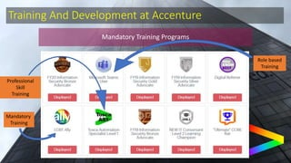
Advantages of Technology-Based Training programs for Employees (Example 2)
The organisation being referred to for technology-based training incentives of its employees is identified as Accenture.
A major advantage is the Accenture serves access to different online course libraries, interactive simulations and virtual classrooms (Alva and Bhat, 2018).
This has been possible through the Connected Learning Platform introduced recently by Accenture.
Notes:
Being a well-known organisation for its beneficial employee-employer relationships, Accenture has recently launched its Connected Learning Platform which provides an extensive online course library, virtual digital classrooms and interactive simulations so that the employees can be empowered to learn and develop new and improve existing skills continuously.

Slide 6
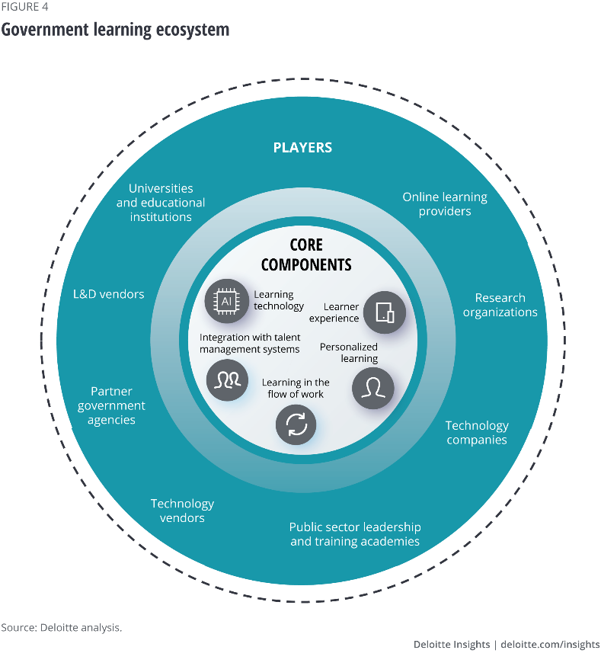
advantages of Technology-Based Training programs for Employees (Example 3)
The organisation being referred to for technology-based training incentives of its employees is identified as Deloitte.
A major advantage observed is that Deloitte has created customised on-demand access and learning paths for the explicit needs of employees (Shinners, 2020).
This can be achieved through the digital learning platforms of Deloitte, such as D180.
Notes:
Deloitte is also a globally renowned organisation which acknowledges the training, development and learning needs of its valuable workforce. Hence, Deloitte has introduced its digital learning platform, referred to as D180, which serves comprehensive and customised learning paths along with on-demand access to relevant sources of learning which enables the employees to learn autonomously and at their convenience.

Slide 7

Advantages of Technology-Based Training programs for Employees (Example 4)
The organisation being referred to for technology-based training incentives of its employees is identified as IBM.
A significant advantage for IBM’s employees for learning is the availability of gamified experiences and immersive virtual reality simulations (Gethe and Hulage, 2020).
These can be experienced through the immersive learning initiatives taken by IBM, which are entirely technology-driven and are changing frequently to maintain interest of employees.
Notes:
The immersive learning incentive of IBM has been relying extensively on gamified learning experiences and virtual reality simulations. These have been credible because they result in the creation of interactive and engaging learning environments for the workforces of IBM so that new and improved practical skills can be developed, aiming to minimise competitive threats effectively.

Slide 8
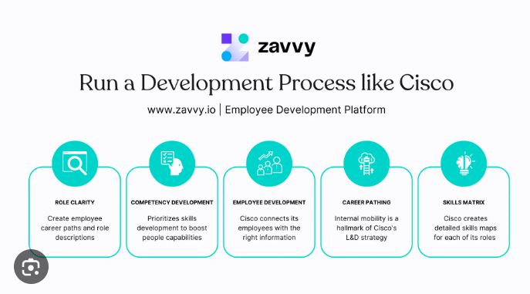
Advantages of Technology-Based Training programs for Employers (Example 1)
The organisation being referred to for technology-based training incentives of its employees is identified as Cisco.
A critical advantage with Cisco as an employer through technology-driven training is minimised training costs and enhanced scalability (Ustundag et al., 2018).
This is possible through the virtual and instructor-driven e-learning and training platforms of Cisco designed explicitly in-house.
Notes:
Being a well-known technology and Software Company, the virtual and instructor-based e-learning and training platform of Cisco has allowed minimisation in training costs and enhancing scalability which enables the employers to train an extensive workforce in a cost-effective and efficient manner.

Slide 9
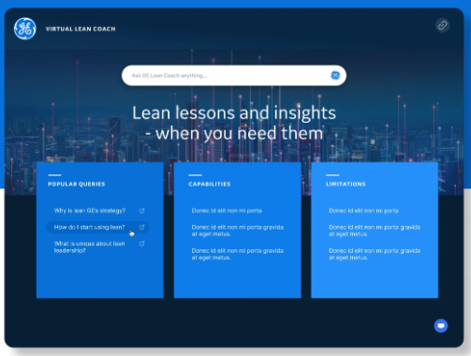
Advantages of Technology-Based Training programs for Employers (Example 2)
The organisation being referred to for technology-based training incentives of its employees is identified as General Electric (GE).
One major benefit observed with General Electric being an employer focussing technology-driven training is improved engagement and retention of knowledge of employees (Wise, 2020).
This can be ensured effectively through the advanced gamified learning platform of GE, popularly known as BrilliantYOU.
Notes:
Being one of the largest employer, GE has been focussed towards enhancing and optimising the learning and development activities of its workforce. This has been possible through the gamified learning platform of GE, popularly known as BrilliantYOU, which leads to improving engagement of employees along with assisting retention of relevant knowledge, further resulting in enhanced productivity and performance for the company comprehensively.

Slide 10
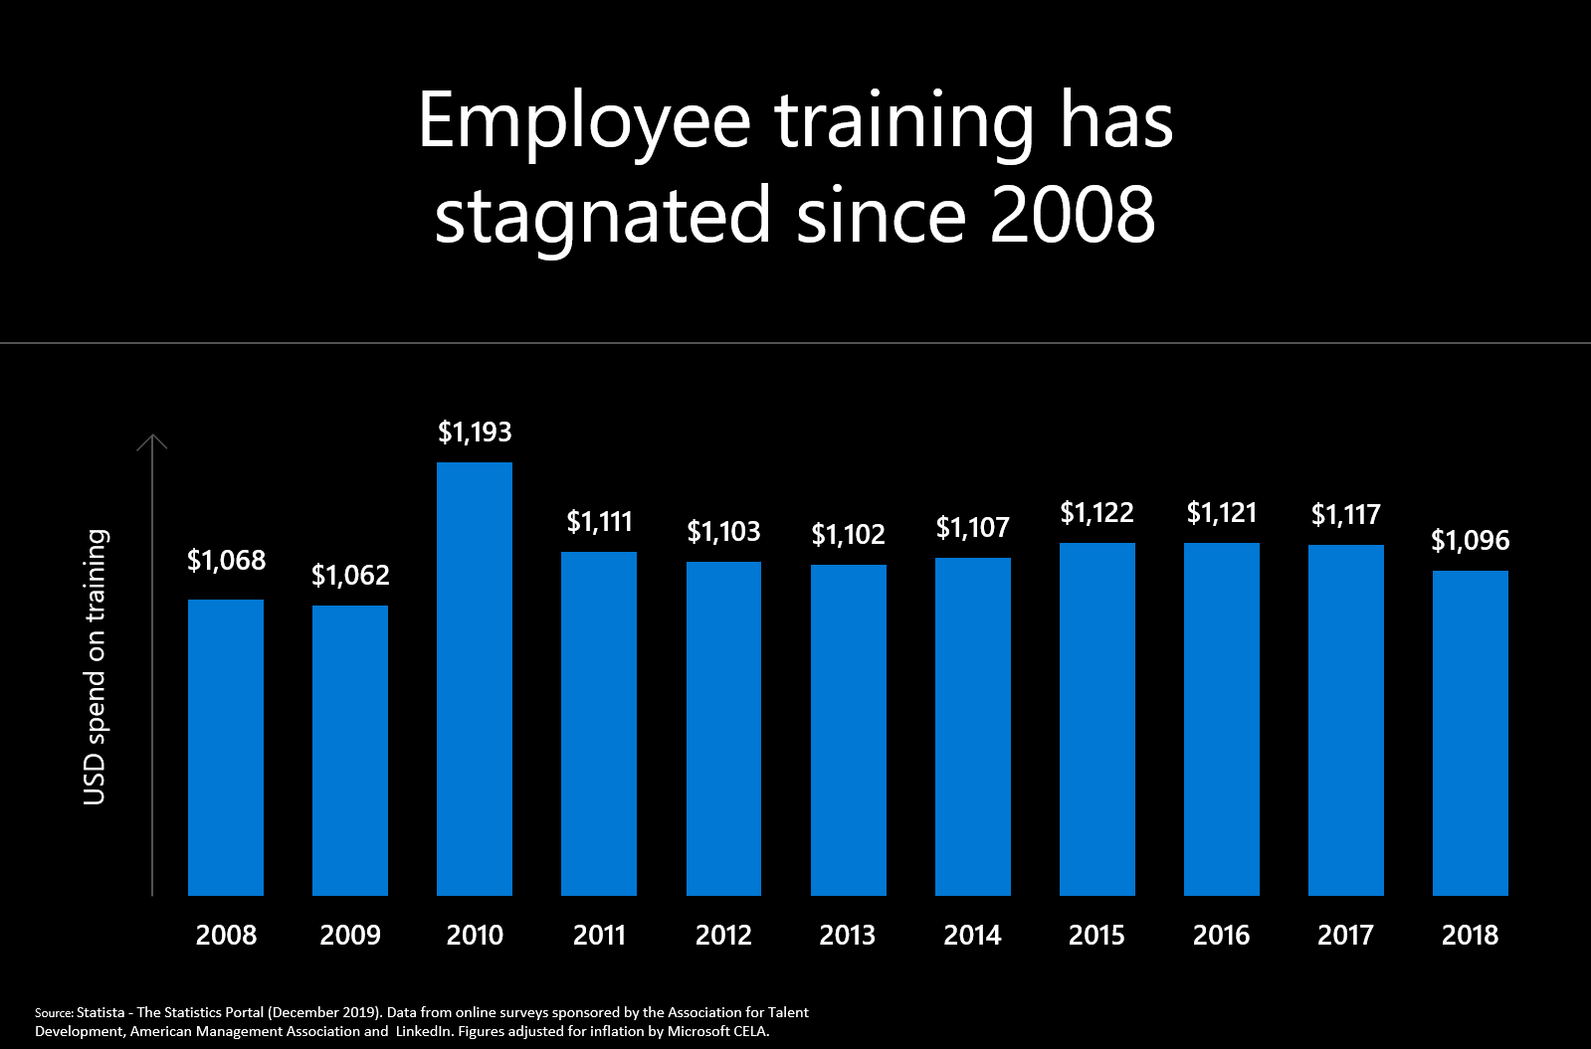
Advantages of Technology-Based Training programs for Employers (Example 3)
The organisation being referred to for technology-based training incentives of its employees is identified as Microsoft.
A significant benefit for Microsoft as an employer prioritising technology-based training is greater productivity and minimised downtime of employees (Cropper et al., 2018).
This can be ensured through just-in-time and on-demand learning resources being provided promptly by Microsoft.
Notes:
Microsoft has continuously been threatened under competition from other significant rivals due to which training employees to respond effectively and uniquely has become essential. The just-in-time and on-demand learning resources introduced by Microsoft has allowed greater productivity along with minimising downtime of employees because they are now able to access the required knowledge conveniently, being an important motivation for long-term retention.

Slide 11

Advantages of Technology-Based Training programs for Employers (Example 4)
The organisation being referred to for technology-based training incentives of its employees is identified as Unilever.
Unilever has been struggling continuously to train its workforce with technological interventions whereas one major advantage being secured is customised learning and improved data-based insights (Malini and Srinivas, 2020).
This has been acquired through making custom suggestions with the help of the learning analytics platform developed and circulated by Unilever for its workforce explicitly.
Notes:
Considering the internationally widespread operations of Unilever requiring an extensive and skilled workforce, the learning analytics platform developed and provided by the company serves data-driven insights and customised learning suggestions for the workers explicitly. In this way, Unilever is able to enhance the ongoing training programmes and initiating well-informed decisions based on the acquired information.

Slide 12
Conclusion
Summarising the following presentation, it can be concluded that technology has completed evolved the learning and development environment, serving significant advantages for both employers and employees explicitly. Accepting and fostering technology-driven training has been considered mandatory for organisations so that their competitive position can be improved and a culture promoting continuous growth through learning can be fostered responsibly.
Notes:
Summarising the following presentation, it can be concluded that technology has completed evolved the learning and development environment, serving significant advantages for both employers and employees explicitly. Accepting and fostering technology-driven training has been considered mandatory for organisations so that their competitive position can be improved and a culture promoting continuous growth through learning can be fostered responsibly.

Slide 13
References
Cropper, P., Robinson, D., Farrell, M., Webster, R., Germain, J., Cummings, K., Rosenthal, L., Kappil, T., Souvanna, P. and Benson, V. (2018) ‘Technology-Based Learning in the Public Workforce System: Emerging Policy and Practices in States and American Job Centers’, Cambridge, MA: Abt Associates Inc.
Deoskar, V., Pande, M. and Vishwarupe, V. (2023) ‘An Analytical Study for Implementing 360-Degree M-HRM Practices Using Amazon Mechanical Turk and Machine Learning in IT Sector. In International Conference on Information Science and Applications (pp. 429-443)’, Singapore: Springer Nature Singapore.
Gethe, R.K. and Hulage, M.S. (2020) ‘The impact of technology on employee training and development process’, IJASSH, pp.01-10.
Karim, M.M., Choudhury, M.M. and Latif, W.B. (2019) ‘The impact of training and development on employees’ performance: an analysis of quantitative data’, Noble International Journal of Business and Management Research, 3(2), pp.25-33.
Lok, B.L., Cheng, M.Y. and Choong, C.K. (2021) ‘The relationship between soft skills training and development, human resource outcome and firm performance’, International Journal of Business and Society, 22(1), pp.382-402.
Malini, T.N. and Srinivas, D.B. (2020) ‘Technological transcends: Impact of industrial 4.0 on human resource functions. In 2020 Fourth International Conference on I-SMAC (IoT in Social, Mobile, Analytics and Cloud)(I-SMAC) (pp. 816-820)’, IEEE.
Shinners, J.P. (2020) ‘Advancing leadership consciousness: integrity from the inside out’, Pepperdine University.
Ustundag, A., Cevikcan, E. and Karacay, G. (2018) ‘Talent development for Industry 4.0’, Industry 4.0: Managing the digital transformation, pp.123-136.
Wise, G. (2020) ‘Willis R. Whitney, general electric and the origins of US industrial research’, Plunkett Lake Press.

Slide 14

ANY
Question

