Slide 1


Marriott International
JW MARRIOTT

Slide 2
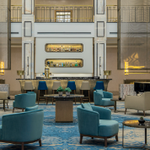
Introduction
Marriott International expanded and diversified its offers by acquiring hotels and resorts.
Marriott began to grow abroad in the 1980s, adding hotels in Europe, Asia, and the Middle East (Marriott International, 2023a).
Marriott International provides timeshare properties in addition to hotels.
The brand we will explore in this presentation is JW Marriott, which is one of the most popular in Marriott International.

Slide 3
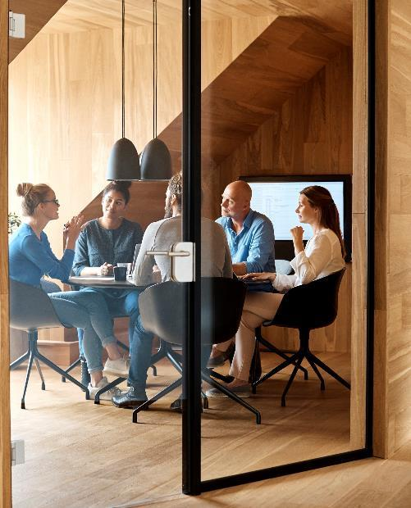
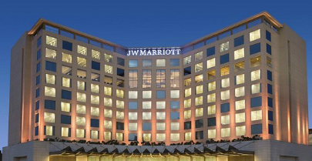
Background of JW Marriott
JW Marriott is a luxury hotel brand within the Marriott International family. J. Willard Marriott, the founder and his son, J.W. "Bill" Marriott Jr., who served as CEO of the corporation inspired the brand's name (Coulson-Thomas, 2022).
In 1984, the brand debuted in Washington, D.C. (Marriott International, 2023a).
The brand has since grown to encompass over 100 properties in over 30 countries.

Slide 4

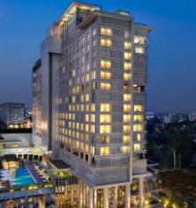
Main Consumers
JW Marriott's primary customers are rich and discriminating travellers looking for a luxury and personalised hotel experience.
JW Marriott hotels are often located in premium places such as major cities, resort areas, and cultural centres (Halim, 2022) .
They provide a variety of facilities and services tailored to meet the demands of sophisticated travellers.

Slide 5
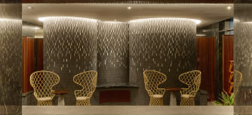
Main Consumers
The JW Marriott brand is known for its sophisticated and elegant ambience.
Business travelers are a key demographic for JW Marriott, since many of its locations have substantial conference and event facilities.
The executive lounges and other amenities tailored to their needs.
Couples are a significant demographic for JW Marriott, since many of its locations provide romantic settings and elegant lodgings.

Slide 6
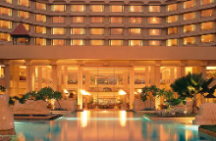
Nature
JW Marriott is a premium hotel brand that provides guests with a sophisticated and polished experience (Yahoo Finance, 2023).
The brand is noted for its high-end facilities, personalized care, and attention to detail.
It is intended to meet the expectations of discriminating travelers looking for a premium hotel experience.

Slide 7
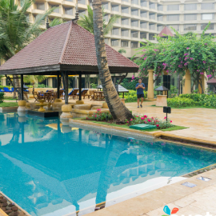
Scope.
JW Marriott's commitment to personalised service is one of its distinguishing aspects.
With staff members educated to anticipate guests' wants and create customised experiences (Forbes, 2022).
The brand is recognised for its attention to detail and attempts to give its customers with a flawless and stress-free experience.
JW Marriott's reach is worldwide, with hotels in major cities, vacation locations, and cultural hubs all over the world

Slide 8
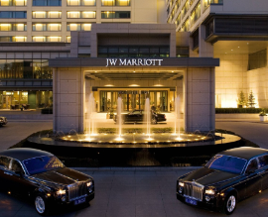
Role and Function of Guest Service
The JW Marriott guest service staff is in charge of offering personalized and attentive treatment to each guest.
With the purpose of surpassing their expectations and leaving a lasting impression.
The guest service team's major responsibility is to guarantee that visitors have a pleasant and stress-free stay from the minute they arrive at the hotel (Virdanty et al., 2022).
This might involve greeting visitors, aiding with check-in and check-out, and informing them about the hotel's services.
Name
Name
Title
Title

Slide 9
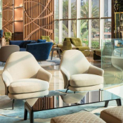
Importance of Hospitality
JW Marriott places a premium on hospitality since it is important to the brand's concept and approach to guest service.
The devotion to hospitality is mirrored in the brand's mission statement, which emphasises the significance of giving "warm, inviting, and personalised experiences" to each visitor.
At JW Marriott, hospitality is more than just offering basic facilities or services (Marriott International, 2023b).

Slide 10
Conclusion
Anticipating client requirements, giving thoughtful gestures and facilities, and providing outstanding service with a smile
Furthermore, hospitality is important to the brand's commitment to sustainability and social responsibility.
JW Marriott is dedicated to making a good difference in the areas in which it operates.
The hospitality plays an important part in this through cultivating strong connections with guests, staff, and local stakeholders.

Slide 11
Reference
Coulson-Thomas, C., 2022. Collaborative Leadership for Environment Protection and Climate Change Theme Paper of 21st World Congress on Environment Management & Climate Change to he held on 4-5th July, 2019, JW Marriott Hotel, Bengaluru. A A, p.0.
Forbes. (2022). Customer Service The Marriott Way. Available at: https://www.forbes.com/sites/shephyken/2022/07/17/customer-service-the-marriott-way/?sh=50a546397807 (Accessed May 22, 2023)
Halim, R., 2022. JW MARIOTT LUXURY HOTEL SURABAYA INTERNSHIP REPORT.
Marriott International. (2023a). Our Story of Innovation. Available at: https://www.marriott.com/about/culture-and-values/history.mi (Accessed May 22, 2023)
Marriott International. (2023b). The Power Of Marriott. Available at: https://www.hotel-development.marriott.com/power-of-marriott (Accessed May 22, 2023)
Subakti, A.G., Maribelle, M.G. and Sanjaya, W., 2023. The Effect of Service Quality on Customer Satisfaction in the Front Office Department During COVID-19. NHI HOSPITALITY INTERNATIONAL JOURNAL, 1(1), pp.28-38.
Tarigan, N., Tambunan, L.T.M. and Lusina, E., 2023. PENTINGNYA PERLENGKAPAN DAN PERALATAN FITNESS SEBAGAI PENUNJANG OPERASIONAL DIDEPARTEMEN HEALTH CLUB AND SPA PADA HOTEL JW MARRIOTT MEDAN. Jurnal Ilmiah Akomodasi Agung, 10(1), pp.69-79.
Tezcan, E. and Polupan, V., 2022. Тrends in the global hotel business of the luxury segment.
Virdanty, S.D., Nadra, N.M., Sudarmini, N.M., Astuti, N.W.W. and Erawati, N.M.R., 2022. Human resources efforts to improve employee performance at JW Marriott Surabaya. Journal of Applied Sciences in Travel and Hospitality, 5(1), pp.10-19.
Yahoo Finance. (2023). Create Precious Memories with Family by JW. Available at: https://www.google.com/amp/s/finance.yahoo.com/amphtml/news/create-precious-memories-family-jw-074400271.html (Accessed May 22, 2023)

Slide 12


Thank You
Presenter name Suma Begum

