Slide 1
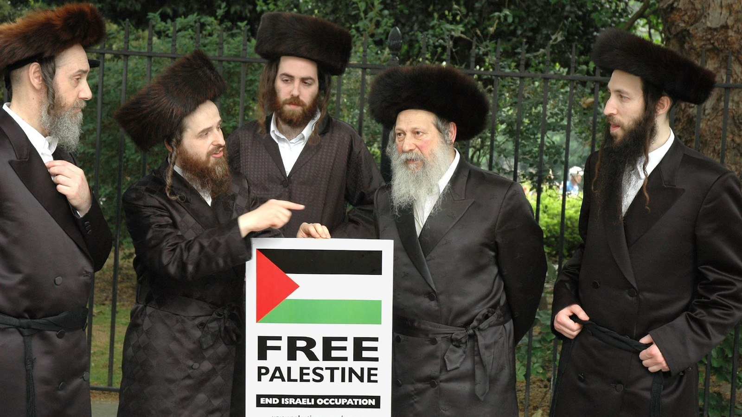
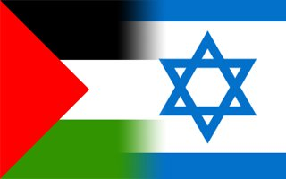
Evaluate the importance and influence of ONE branch of contemporary Judaism, paying particular attention to its attitudes towards political Zionism.
Ultra Orthodox Judaism
Notes:
Ultra Orthodox Jews, also known as Haredi Jews are a very influential group within Judaism, particular concerning the issue of Zionism, however in order to understand the approach of the Ultra orthodox Jews towards the state of Israel. First we need to look at what Zionism is.

Slide 2
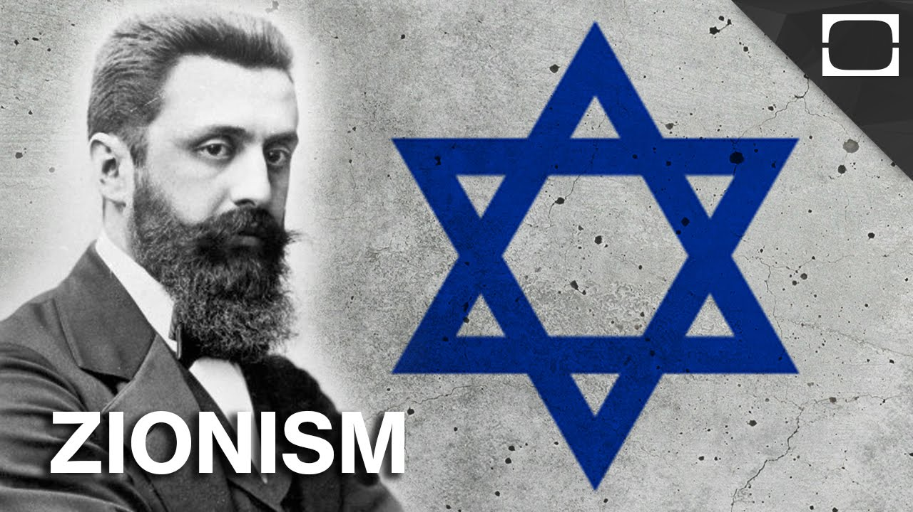
Zionism
                What is Zionism?
The belief that the Jewish people should establish their own nation.

Slide 3
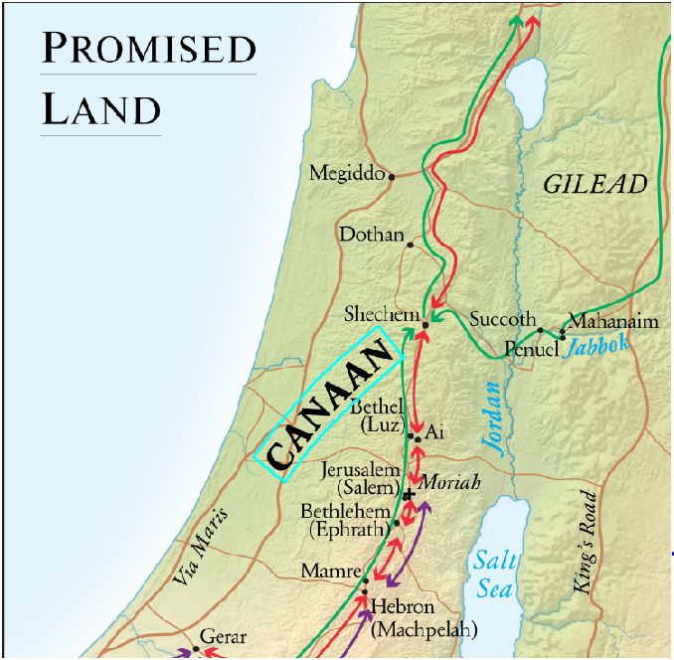
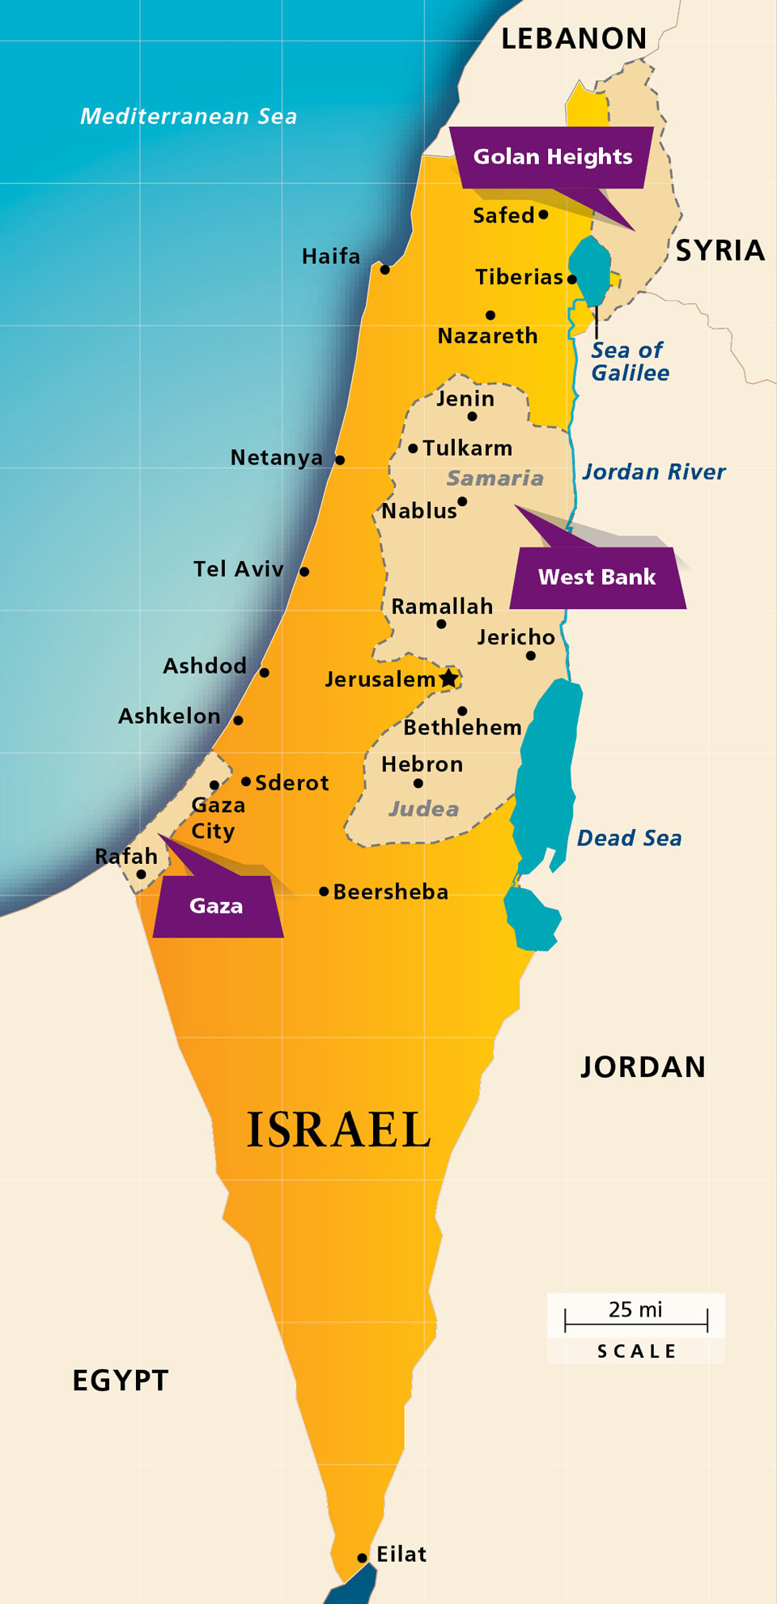
The Promised Land
Since the destruction of the temple in 70CE by the Romans, the Jews have always been dispersed across the globe.
Land is an issue commonly mentioned in the Hebrew bible.
”And I will give to you, and to your offspring after you, the land where you are now an alien, all the land of Canaan, for a perpetual holding; and I will be their God.” (Genesis 17:8).

Slide 4
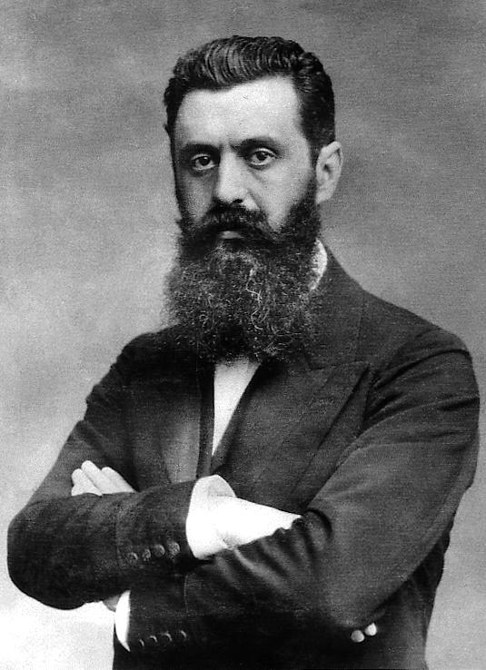
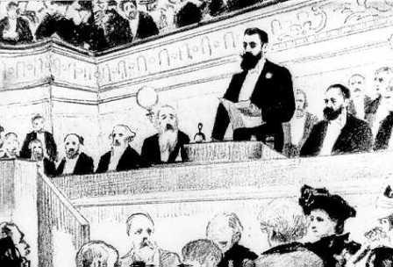
Zionism- Theodor Hertzl
Having witnessed the extreme levels of anti-Semitism during the Dreyfus affair (where a Jewish officer called Dreyfus was falsely accused of a crime), Hertzl came to the realisation that Jews could not assimilate into society, therefore a Jewish state was required.
The first Zionist congress came together in Basel on August 29th 1897, this is where Zionism was born.

Slide 5
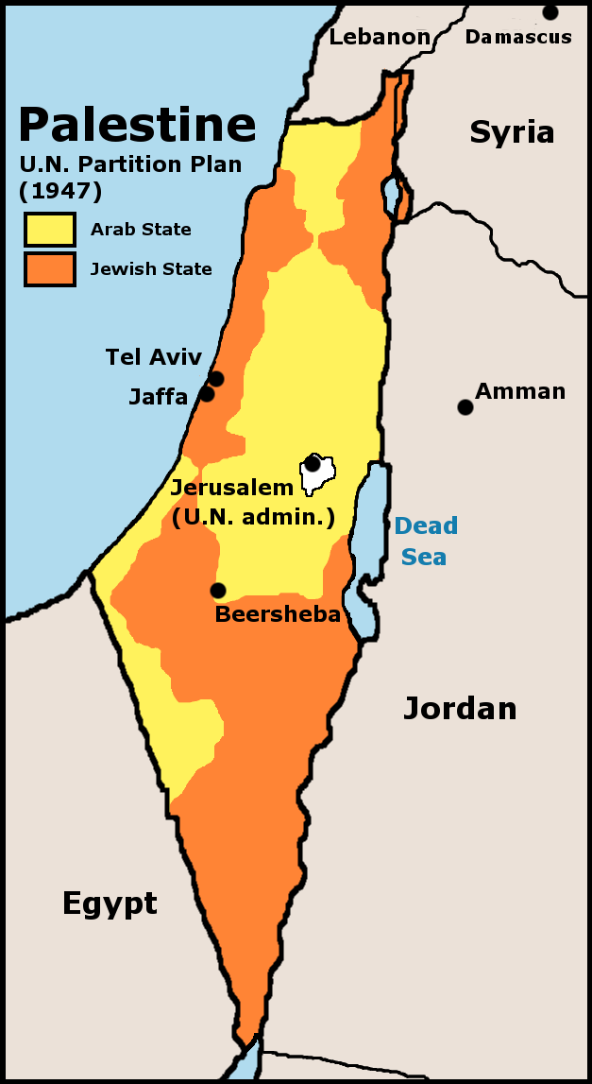
A history of Palestine
2nd November 1917- The Balfour Declaration.
A mandate supporting and promising the establishment of a Jewish state in Israel for the Jews by the British.
Following WW1 and the defeat of the Ottoman Empire, The British colonised Palestine, establishing rule until the Jews would be ready to govern their own state.
Following WW2 the Palestine/Israel debate was handed over to the newly formed United Nations.
Split into two states.
The State of Israel was established officially on 14th May 1948.
Notes:
The British however also promised the Land to the French and to the ruler of Mecca.
There were many issues during the British rule of Palistine between WW1 and WW2 but during was a more peaceful time, and a time where Jewish immigration rose.
From here on there would be multiple issues between the Israelis and th ePalestinians with the abrab/Israeli war beginning in 1948, there would be further wars such as the six day war in 1967. Each of the wars between P and I would result in changes in the land governed by each state, leading to more dispute.

Slide 6
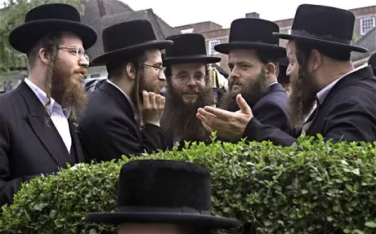
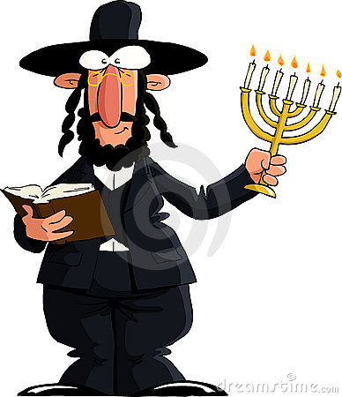
Haredi Jews (Ultra Orthodox Jews)
Haredi Jews are easily distinguishable due to their stand out dress code dating back to the 18th century.
They view their look as the look of a true Jew, which is the stereotypical view you would see in cartoon depictions of Jews.
Traditional/Old fashioned view of their Religion and the world.
Along with their controversial old fashioned beliefs, they have also been known to keep the company of Holocaust deniers.
Notes:
They are happy to be seen as the stereotypical view of a Jew as they see their interpretation of the Jewish scriptures to be the right, true interpretation.
Their traditional values which could also be deemed as old fashioned, does lead to issues such as extreme sexism within their branch of Judaism.

Slide 7
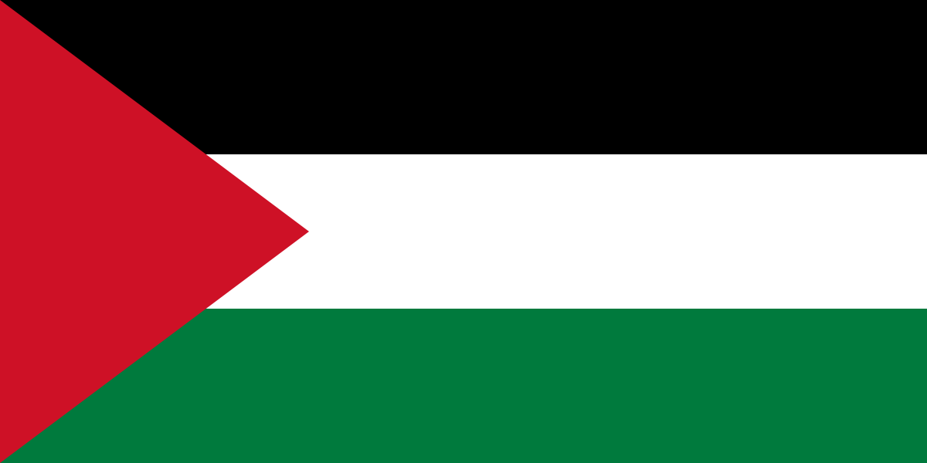
Haredi views on Zionism
Pro Palestine
God sent the Jews into exile, therefore that’s where they must stay until God allows them to return.
Jews shouldn’t have their own state before the coming of the messiah.
The state of Israel breaks some of the ten commandments such as; Do not kill and do not steal.
Rise of secularism
Holocaust- the main excuse used by the pro-Israelis, The Haredi’s view the holocaust as divine punishment for straying from God.
Notes:
So what are the attitudes of the Ultra Orthodox Jews towards the issue of Zionism.
One thing that is certain is that the ultra Orthodox Jews are pro Palestine.
This is for multiple reasons

Slide 8
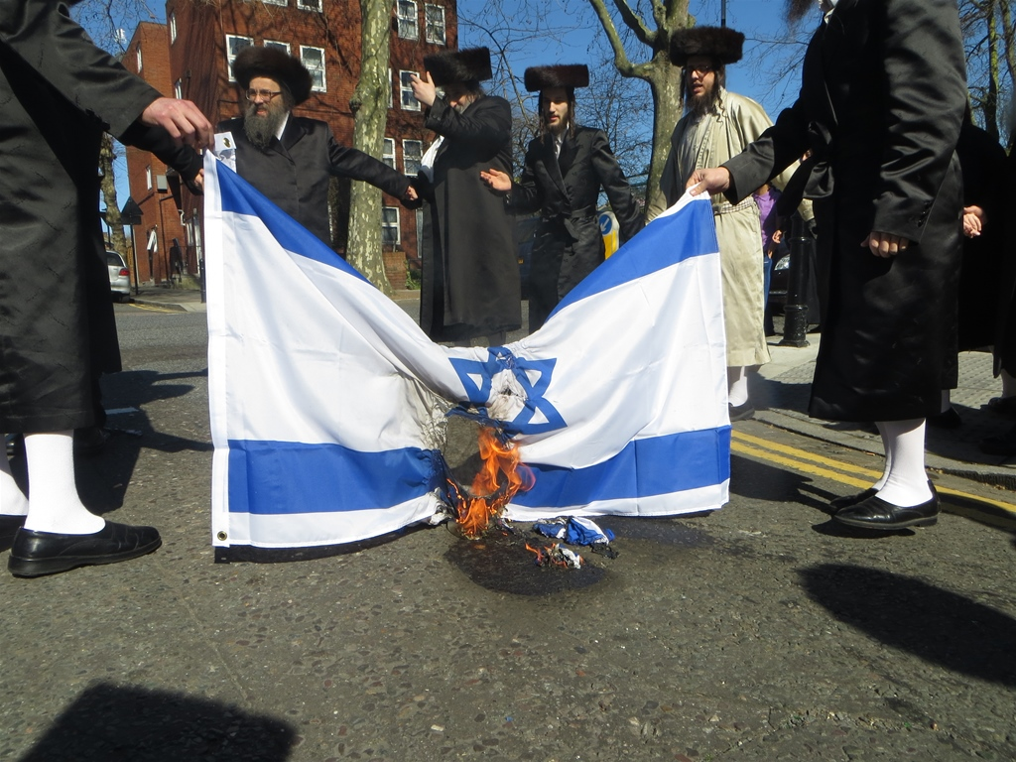
A stand against Zionism
Burning of the Israeli flag.
Handing out anti-Israel propaganda.
Protests such as on the day known as the Nakba, the name stands for the displacement of the Palestinians, a disastrous day.
The Day of Israeli independence
They stand with the Palestinians when protesting. Facing abuse from pro-Israel supporters, who accuse them of being extremists along with comparisons to Isis.
God is on their side.

Slide 9
Any Questions?

Slide 10
Bibliography
CrashCourse. (2015). Conflict in Israel and Palestine: Crash Course World History 223. [Online Video]. 28 January 2018. Available from: https://www.youtube.com/watch?v=1wo2TLlMhiw. [Accessed: 22 January 2018].
ENCYCLOPÆDIA BRITANNICA. 2012. Theodor Herzl: AUSTRIAN ZIONIST LEADER. [ONLINE] Available at: https://www.britannica.com/biography/Theodor-Herzl. [Accessed 22 January 2018].
Landau, D., Piety and Power: The World of Jewish Fundamentalism (New York: Hill and Wang, 1993).
Shahak, I., and Norton, M., Jewish Fundamentalism in Israel (London, Pluto Press, 2004).
Vice. (2016). Rebel Rabbis: Anti-Zionist Jews Against Israel. [Online Video]. 7 September 2018. Available from: https://www.youtube.com/watch?v=FKplabTRuak. [Accessed: 22 January 2018]

