Slide 1

Effective Teamworking & Communication
Module Code: BMSW4009
Lecturer: Melanie Squire
Student: Syed Muktadirul Hussain
Student ID: 2408771

Slide 2



Presentation Overview
My topic is Conflict Management and
Resolution Strategies

Slide 3

Managing Conflict
T0 handle conflict situations more effectively it is required to have clear communications and be active at listening.
Human connections, whether in personal or professional contexts, will inevitably involve conflicts.
Our connections with people & the outcome are significantly impacted by how we handle the conflict.
Finding solutions that benefit both parties, talking honestly and openly, and understanding the underlying reasons of conflict are all essential components of effective conflict management.

Slide 4

Definition on types of conflict
There are various types of conflict, such as social, intrapersonal & interpersonal disputes.
People can disagree or misunderstand one another, which leads to interpersonal conflicts. e.g for instance, a disagreement between 2 co-workers on how to approach a project can cause friction and a lack of collaboration.
In contrast, intrapersonal conflict occurs within an individual & frequently involves a struggle with personal views or feelings. e.g a person may experience conflict between their desire to maintain a work life balance and their career goals.

Slide 5
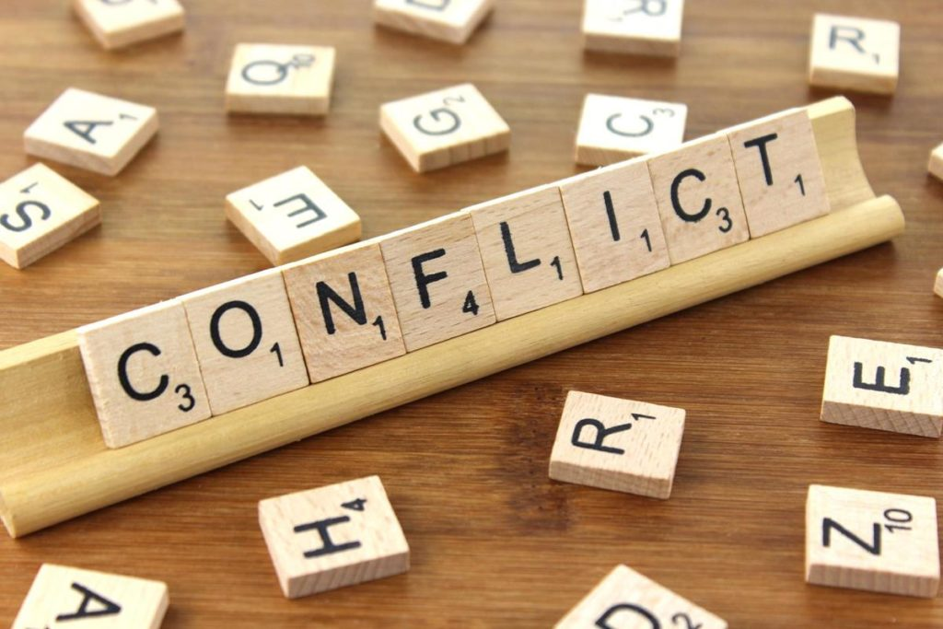
Definition of conflict
Conflict is a normal part of every human interactions & it can occur in various forms around different context
An individual experience intrapersonal conflict, which frequently entails internal conflicts about decision or convictions.
Theres also an interpersonal conflict which involves 2 or more people are involved in it.
Teams & organization may experience group conflicts when member hold different beliefs or objectives.
Social conflict can arise in countries or communities & is frequently caused by differences in politics, society, or the economy.
Conflict in society is exemplified by the current racial justice and equity movements, where different organization have clashed over different perspectives on structural racism & transformations.
ThePhoto by PhotoAuthor is licensed under CCYYSA.

Slide 6

Conflict Management
The practice of recognizing & peacefully settling disputes is known as conflict management.
Active listening is a useful strategy for managing conflicts. This method is giving the other person your whole attention when they talk, as opposed to preparing a replying in advance.
Another effective method is collaboration, which focusses on working together to achieve a win-win solution. In recent years, numerous organizations have used this method to improve teamwork and employee happiness.

Slide 7

Examples when conflict goes wrong
Conflict can escalate when people refuse to listen to each other's perspectives or seek an agreement.
If parties are hesitant to compromise or empathize with one another, the disagreement can become confirmed, resulting in a halt.
A lack of communication and understanding can worsen the conflict and prevent a meaningful resolution.
Poor communication, failure to listen, allowing personal attacks or character assassination are all common issues.
The distinct advantage & disadvantage of each Belbin Team Role- such as Plant, Shaper, Team-worker, & Monitor Evaluator have an impact on how people handle conflict.

Slide 8

title
Conclusion
Human relationship are bound to involve conflict. It can occur in communities, in work, across borders, or even within families. Constructive conflict management is essential for both individual development and the organizational success.
In addition to focus on the solving disputes, conflict management aims to create an environment where people can cooperate & speak honestly.
Increased productivity, better teamwork, and improved relationships are the results of successfuul conflict management.

Slide 9

References
Adham, T.K.I., 2023. Conflict resolution in team: Analyzing the of conflicts and best skills for resolution. Scholars Journal of Engineering and Technology, 11(08), pp.152-162.
Al, B., 2022. The effect of teamwork and conflict management on perceived individual performance. Journal of Organizational Behavior Review, 4(1), pp.64-90.
Aranzabal, A., Epelde, E. and Artetxe, M., 2022. Team formation on the basis of Belbin’s roles to enhance students’ performance in project based learning. Education for Chemical Engineers, 38, pp.22-37.
Pazos, P., Pérez-López, M.C. and González-López, M.J., 2022. Examining teamwork competencies and team performance in experiential entrepreneurship education: emergent intragroup conflict as a learning triggering event. Education+ Training, 64(4), pp.461-475.
Polatov, A.N. and Pavlovets, I.V., 2022. Theoretical analysis of conflict management in the perspective of urban society. International Journal Papier Public Review, 3(1), pp.1-6.

