Slide 1
Managing in complex environments: Strategies, Insights and Solutions
MICE
SPBD 7006
Week 7 (Lecture 1)
National Culture
&
HRM

Slide 2
National culture and Individual Values
The combination of symbols, beliefs and artefacts typical for members of one nation. ...
National culture is the shared values and assumptions held by individuals within the nation

Slide 3
Major cultural layers
Global Layer: wishing to succeed in life
National Layer: avoiding loss of face in Japanese culture
Regional Layer: Bengali culture in India
Community Layer
Personal Layer: caring for wild life
Behaviour
Attitudes
Beliefs
Values

Slide 4
Activity
Identify ways in which your own values are influenced by factors impinging at the following levels;
Personal
Community
Regional
Occupational
National/ Global

Slide 5
Discuss how your values have been influenced by the levels of culture listed above
Identify how these levels of culture form part of your identity
Which of the following levels of culture has been most important in shaping your identity (national, regional, community, occupational)

Slide 6
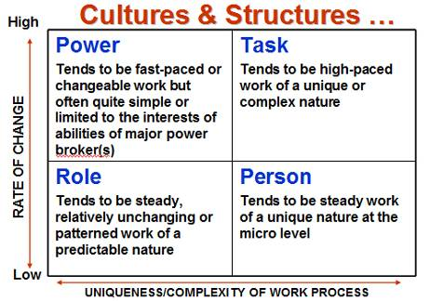
Charles Handy
National and Organisational Culture

Slide 7
Power Culture
In an organisation with a power culture, power is held by just a few individuals whose influence spreads throughout the organisation.
There are few rules and regulations in a power culture. What those with power decide is what happens. Employees are generally judged by what they achieve rather than how they do things or how they act.

Slide 8
Power Culture
A consequence of this can be quick decision-making, even if those decisions aren't in the best long-term interests of the organisation.
A power culture is usually a strong culture, though it can swiftly turn toxic. The collapse of Enron, Lehman Brothers and RBS is often attributed to a strong power culture

Slide 9
Role Culture
Organisations with a role culture are based on rules. They are highly controlled, with everyone in the organisation knowing what their roles and responsibilities are. Power in a role culture is determined by a person's position (role) in the organisational structure.
Role cultures are built on detailed organisational structures which are typically tall (not flat) with a long chain of command. A consequence is that decision-making in role cultures can often be painfully-slow and the organisation is less likely to take risks. In short, organisations with role cultures tend to be very bureaucratic.

Slide 10
Task Culture
Task culture forms when teams in an organisation are formed to address specific problems or progress projects. The task is the important thing, so power within the team will often shift depending on the mix of the team members and the status of the problem or project.
Whether the task culture proves effective will largely be determined by the team dynamic. With the right mix of skills, personalities and leadership, working in teams can be incredibly productive and creative.

Slide 11
Person Culture
In organisations with person cultures, individuals very much see themselves as unique and superior to the organisation.
The organisation simply exists in order for people to work. An organisation with a person culture is really just a collection of individuals who happen to be working for the same organisation.

Slide 12
Elements of Organisational Culture
Organisational culture is the personality of the organisation.
Successful organisations tend to have strong and positive cultures.
The observable culture is what you see and hear as an employee or customer.
The core culture is found in the underlying values of the organisation.

Slide 13
Functions of culture
Cement’ perspective
Conflict resolution, integration (mixing/combining) ‘one big happy family’
Organisational & individual goals aligned
Control
Cultural rules/norms (groups!)
An informal structure (structure!)
Motivation (motivation!)
Belonging, identity, feeling valued
Socialisation (learning!)

Slide 14
How is culture transmitted and/or managed?
Socialisation
  Formal induction
  “Learning the ropes”
Transmission mechanisms
  Corporate literature
  Rites, rituals, ceremonies: a sensual activity Corporate songs
Norms and sanctions
  Humour

Slide 15
Managing culture?
Definition Who ‘we’ are What we do Shared understandings/ meanings Long term ‘evolution’ of values | Strategy Recruit ‘right’ people Encourage desired behaviours Manage meaning eg: training / socialisation Cannot manage (at least in short-term)

Slide 16
https://www.youtube.com/watch?v=rWlHtvZHbZ8

Slide 17
How to check an organisations culture?
What is important for that organisation?
How are employees valued?
What skills does the organisation value?
Do you know what is expected of you?
Would you prefer working there?

Slide 18
    How do people get promoted? & What behaviours are rewarded?
Would you know what the org is doing?
    How well does the org communicate with staff?
    How do people from different departments interact?
    Are there staff development and training programmes?

Slide 19
Not a ‘dry’ topic
‘Peoples attitudes and behaviour are shaped as much by the structure of the company in which they work as by personalities that they possess’
Huczynski and Buchanan (2013), p500

Slide 20
‘Structure is the pattern of relationships among positions in the organisation and among members of the organisation. It defines tasks and responsibilities , work roles and relationships and channels of communication’.
Mullins (2013), p.785

Slide 21
Features of organisational structure
Formalisation - rules, policies procedures
Specialisation - specialist activity and groupings
Vertical differentiation - power, authority, span of control
Centralisation - decision making and delegation
Line and/or staff functions

Slide 22
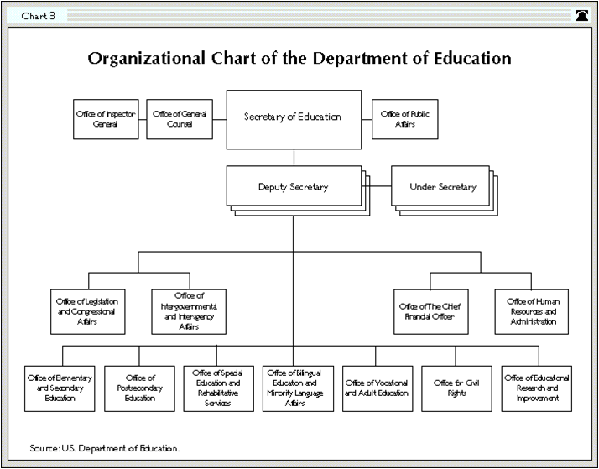

Slide 23
Potential link to culture
Rules (relative importance of)
Power (distance) and hierarchy
Decision-making (uncertainty)
Institutional factors (professional training)

Slide 24
Symbiotic relationships
Structure creates (organisation)culture?
Culture creates structure?

Slide 25
Organisation Theory- the Context
Theories about how best to organise:
Max Weber (German) Bureaucracy,
Henri Fayol (French) administrative model
Frederick Taylor (American) Scientific Management
All reflect societal concerns of the times as well as the cultural background of the individuals
Schneider and Barsoux 2003:86

Slide 26
Max Weber with class, status and power as distinct ideal types.
Weber developed a multidimensional approach to social stratification that reflects the interplay among wealth, prestige and power.

Slide 27
Fayol's 14 Principles of Management
Division of Work – When employees are specialized, output can increase because they become increasingly skilled and efficient.
Authority – Managers must have the authority to give orders, but they must also keep in mind that with authority comes responsibility.
Discipline – Discipline must be upheld in organizations, but methods for doing so can vary.
Unity of Command – Employees should have only one direct supervisor.
Unity of Direction – Teams with the same objective should be working under the direction of one manager, using one plan. This will ensure that action is properly coordinated.

Slide 28
Fayol's 14 Principles of Management
Subordination of Individual Interests to the General Interest – The interests of one employee should not be allowed to become more important than those of the group. This includes managers.
Remuneration – Employee satisfaction depends on fair remuneration for everyone. This includes financial and non-financial compensation.
Centralization – This principle refers to how close employees are to the decision-making process. It is important to aim for an appropriate balance.
Scalar Chain – Employees should be aware of where they stand in the organization's hierarchy, or chain of command.
Order – The workplace facilities must be clean, tidy and safe for employees. Everything should have its place.

Slide 29
Fayol's 14 Principles of Management
Equity – Managers should be fair to staff at all times, both maintaining discipline as necessary and acting with kindness where appropriate.
Stability of Tenure of Personnel – Managers should strive to minimize employee turnover. Personnel planning should be a priority.
Initiative – Employees should be given the necessary level of freedom to create and carry out plans.
Esprit de Corps – Organizations should strive to promote team spirit and unity.

Slide 30
Four Principles of Scientific Management
Replace working by "rule of thumb," or simple habit and common sense, and instead use the scientific method to study work and determine the most efficient way to perform specific tasks.
Rather than simply assign workers to just any job, match workers to their jobs based on capability and motivation, and train them to work at maximum efficiency.
Monitor worker performance, and provide instructions and supervision to ensure that they're using the most efficient ways of working.
Allocate the work between managers and workers so that the managers spend their time planning and training, allowing the workers to perform their tasks efficiently.

Slide 31
McDonaldization
  In Ritzer's reconceptualization, McDonaldization is the process of rationalization that Weber found inherent in bureaucracies extended to fast-food chains such as McDonalds under globalization.
  According to Ritzer, McDonaldization is comprised of four main components: efficiency, calculability, predictability, and control.
  The first one, efficiency, is geared toward the minimization of time as the optimal method for accomplishing a task. The second, calculability, refers to the quantifiable objectives of fast-food chains, seeing quantity as quality.

Slide 32
McDonaldization
With the rise of predictability, the third component, all consumers can predict receiving the same service and the same product every time they interact with the McDonaldized organization. Under control, the fourth component, employees become standardized and replaced by non-human technologies.
Under cultural hybridization, as McDonald's enters a country, consumer patterns are unified and local cultures are westernized.
As a response, the process of de-Mcdonaldization offers alternatives to this model of production and organization

Slide 33
21st century McDonaldization
Efficiency
Calculability
Predictability
Control

Slide 34
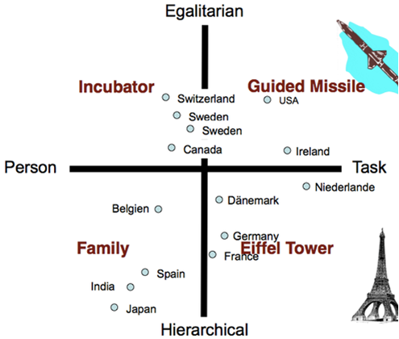
Organisational cultures ascribed to countries
Trompenaars & Turner (1997)

Slide 35
Hofstede application (software of the mind)
Pyramid of people ...high PD & high UA (Latin countries)
Village market...low PD & low UA (Anglo-Nordic countries)
Well-oiled machine... low PD & high UA
(Germanic cluster)
Family... high PD & low UA
(Asian societies)
(PD=Power Distance - UA: Uncertainty Avoidance)
https://www.mindtools.com/pages/article/newLDR_66.htm

Slide 36
Institutional Level Differences
The nature of markets
Influence of government on business
Education system e.g. A’Levels, specialised degrees and professional bodies

Slide 37
France
Centralised hierarchy reflects elite business education in Grand Ecoles
Strong role of the State

Slide 38
Hierarchy in France
In France both business and political life are characterised by a strong hierarchical structure in large companies. Positions and the corresponding power are clearly defined. And when dealing with the French, you should stick to formal etiquette.
Respect for authority in French organisations is based on respect for competence. The PDG (Président Directeur Général) or ‘patron’ (general manager) will be expected to possess a strong authority and general expertise. Usually, the patron does not have any personal relationship with subordinates in or outside of the office. He/she is shielded by his/her secretary. Hence, if you try to contact people at top positions you always have to get past their secretary first!

Slide 39
Strategy
Strategies are usually developed on a long-term basis. The larger the company, the longer and the more elaborate the planning. Planning is done at the top of an organisation, never by the staff. The PDG decides what has to be done and depicts his/her ideas.
A vital part of communication in French organisations is partly hidden beneath a complex network of personal ties and alliances that helps people to get things done.
Beyond that, the French language often employs rhetoric and philosophical devices, as an indicator of education and status. The French like abstract reasoning, theories, and logic so much that it sometimes confuses straightforward, pragmatic thinkers, like for instance the British.

Slide 40
Meetings in France
The French hold meetings simply to discuss a certain subject at stake, and the time will be used to give instructions and to co-ordinate on-going actions. Important decisions are hardly ever made during the meeting itself.
The seating at most meetings is arranged in coherence with the company’s hierarchical order. Be aware that there is an evident difference between a manager - the patron - and his or her subordinates. Meetings with a tight schedule and a detailed agenda are most common.

Slide 41
Germany
Short hierarchy authority linked to expertise
High status for engineering
Low power distance through co determination
Company apprentice system
Democratic modes through society

Slide 42
UK
Categories of workers
Functional structures ‘staff’ support role e.g. Marketing and HRM
Craft apprentice tradition
Strength of professional bodies e.g. CIPD

Slide 43
Japan
Adaptable cultures
Cultivation of harmonious relations at all levels
Merging of individual with common goals
Shameful to change jobs/company ethic (whole view)

Slide 44
Finland
Nokia:
Flat structure – limited hierarchy
Egalitarian approach
Electronic communication throughout

