Slide 1
EAEC6001:
The Reflective Adult
1501950 – Anwen Phillips

Slide 2
Contents
Contents
What is reflection?
Models of reflection
Key Situation Reflection Model
Description of the situation
Development of alternative courses of action
References

Slide 3
What is reflection?
Can be used as a tool in Early Years practice.
Experiences can be explained, justified or challenged.
Learning from experiences.
Improving future practice.
(The Open University, 2017 and Reed and Canning, 2010.)

Slide 4
Models of reflection
Models give a structured approach to reflection.
Describe, Analyse and Action.
Reflection in-action.
Reflection on-action.
(Leeds Beckett University, 2015 and Schön, 1983.)

Slide 5
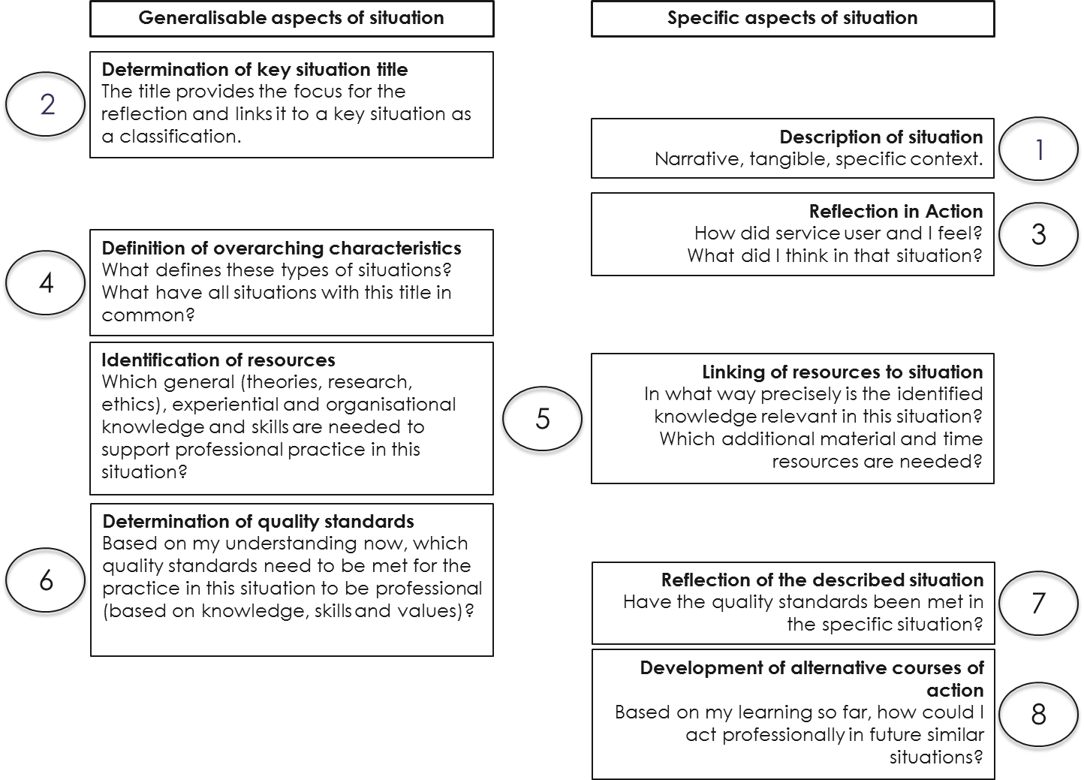
(Source: Association Network Key Situations in Social Work, 2017)

Slide 6
Description of the situation
Working within a Welsh medium day care setting.
Confident speaking with first parent in English.
Nervous and anxious during conversation in Welsh with second parent.
Asked another staff member to speak to third parent knowing the conversation would be spoken in Welsh.

Slide 7
Development of alternative courses of action
Gain more experience of this type of situation.
Observe others to improve confidence and ability (Hodges and Coppola, 2015).
Improve my Welsh skills.
Undertake an intermediate level Welsh course (Welsh Government 2017).

Slide 8
References
Association Network Key Situations in Social Work. (2017) ‘The Key Situations in Social Work Model’ http://keysituations.net/ [Accessed: 20th October 2017].
Berk, L. E. (2012) Child Development. (9th ed). Boston: Allyn and Bacon.
Care and Social Services Inspectorate Wales. (2016) National Minimum Standards for Regulated Childcare for children up to the age of 12 years. Cardiff: Welsh Government.
Children’s Workforce Development Council. (2010) The Common Core of Skills and Knowledge. Leeds: Children’s Workforce Development Council. [On-line]. Available at: http://webarchive.nationalarchives.gov.uk/20120202142536/http://www.cwdcouncil.org.uk/common-core [Accessed: 21st October 2017].
Crowley, M. and Wheeler, H. (2014) ‘Working with Parents in the Early Years’, in G. Pugh and B. Duffy (eds) Contemporary Issues in the Early Years. London: SAGE Publications Ltd, pp.217-234.
Goldsmiths University of London. (2017) ‘Improving professionalism through reflection and discourse in communities of practice: the key situations in social work model and project’ http://research.gold.ac.uk/17938/ [Accessed: 24th October 2017].
Hodges, N. and Coppela, T. (2015) ‘What we think we learn from watching others: the moderating role of ability on perceptions of learning from observation’, Psychological Research, Volume 79, No.4, July, pp.609–620. [On-line]. Available at: https://link-springer-com.ezproxy.uwtsd.ac.uk/article/10.1007/s00426-014-0588-y [Accessed: 26th October 2017].
Johns, C. (2013) Becoming a Reflective Practitioner. (4th ed). Oxford: Wiley-Blackwell.
Knopf, H. T. and Swick, K. J. (2007) ‘How Parents Feel about Their Child's Teacher/School: Implications for Early Childhood Professionals’, Early Childhood Education Journal, Volume 34, No. 4, February, pp.291-296. [On-line]. Available at: http://web.a.ebscohost.com.ezproxy.uwtsd.ac.uk/ehost/pdfviewer/pdfviewer?vid=1&sid=598b924e-2924-446b-bf12-2cb4304e8e64%40sessionmgr4009 [Accessed: 21st October 2017].
Leeds Beckett University. (2009) ‘Models for Structuring Reflection’ http://skillsforlearning.leedsbeckett.ac.uk/preview/content/models/01.shtml [Accessed: 22nd October 2017].
Paige-Smith, A. and Craft, A. (eds) (2011) Developing Reflective Practice in the Early Years. Maidenhead: Open University Press.
Reed, M. and Canning, N. (eds) (2010) Reflective Practice in the Early Years. London: SAGE Publications Ltd.
Schön, D. (1983) The Reflective Practitioner: How professionals think in action. New York: Basic Books.
Staempfli, A. (2016) Key Situations in Social Work Reflection Model. Available at: http://www.keysituations.net/pdf/key-situation-reflection-guide.pdf [Accessed: 15th October 2017].
Stobbs, P., Andrews, E. and Revels, J. (2014) ‘Inclusion and Entitlement in the Early Years for Disabled Young Children and Young Children with Special Educational Needs’, in G. Pugh and B. Duffy (eds) Contemporary Issues in the Early Years. London: SAGE Publications Ltd, pp.199-216.
The Open University. (2017) ‘What is critical reflection?’ http://www.open.edu/openlearn/education/learning-teach-becoming-reflective-practitioner/content-section-2 [Accessed: 15th October 2017].
University of Nottingham. (2009) ‘Models (or Frameworks) of Reflection’ http://www.nottingham.ac.uk/nmp/sonet/rlos/placs/critical_reflection/models/index.html [Accessed: 21st October 2017].
Ward, U. (2009) Working with parents in early years settings. Exeter: Learning Matters Ltd. [e-book]. Available at: https://www-dawsonera-com.ezproxy.uwtsd.ac.uk/readonline/9780857253316 [Accessed: 24th October 2017].
Welsh Government. (2015) ‘The Benefits of Welsh in the Workplace’ http://cymraeg.llyw.cymru/business/workplace/manteision/?lang=en [Accessed: 25th October 2017].
Welsh Government. (2017) ‘Courses: Learn Welsh’ https://learnwelsh.cymru/courses/course/700954cd-715d-e711-8421-005056994c0f/ [Accessed: 25th October 2017].

