Slide 1
PREVALENCE OF PHYSICAL ACTIVITY AMONG STUDENTS IN A PUBLIC UNIVERSITY
Student Name: Anagha Shyamala Vinod Student ID: 2215804
Lecturers Name: Dr Aishat Bakre
Module Code: LCHS7001

Slide 2
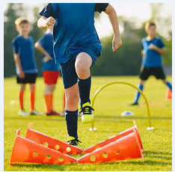
INTRODUCTION
This research on the prevalence of physical activity in public university students will give an overview of the physical fitness level of public university students in the UK.
This research and the collected data from the survey will be helpful to analyze the scenario and evaluate that to better the involvement ratio of the students in physical activity.

Slide 3
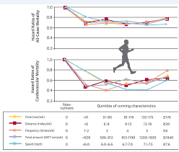
BACKGROUND
There are more than 1.4 billion adults throughout the world who are found to have insufficient physical activity (Lone and Ahmad, 2019).
There has been no improvement in physical activity and fitness of the average people across the globe in the last 20 years (Lone and Ahmad, 2019).

Slide 4
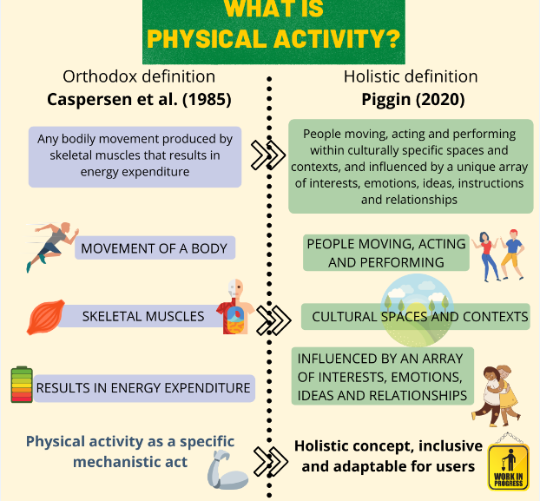
BACKGROUND CONTINUED
A study of university students in the UK has shown a decrease in physical activity during the COVID-19 pandemic (Farooq et al. 2020).
The World Health Organisation (WHO) has stated specific guidelines on physical activity routine and volume for different age groups of people (World Health Organization, 2020).

Slide 5
BACKGROUND CONTINUED
According to a report, around 26% of men and 35% of women are insufficiently physically active in high-income countries (Marques et al. 2020).
In low-income countries, 24% of men and 12% of women have been found not sufficiently physically active (Corbin, 2021).

Slide 6
THEORETICAL RESEARCH RATIONALE
The rationale of this research process is related to the different reasons connected to the problem of the research process.
Previous research processes have presented certain limitations related to exploring the research problem based on health improvement in the arena of social care through the engagement of students in schools based on physical exercises, such as the research of Rodríguez-Larrad et al. (2021).
This research will thus increase the overall awareness of the reader through the use of relevant research methodologies.

Slide 7
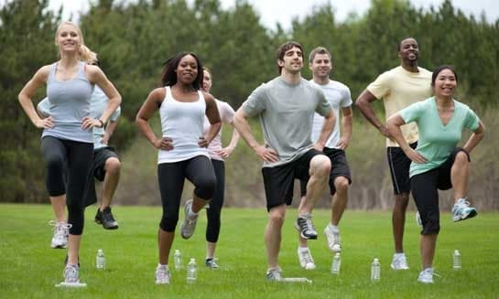
PRACTICAL RESEARCH RATIONALE
The prevalence of physical activity consists of the number of everyday exercises and laborious work carried out by the students (Srivastav, Sharma and Samuel, 2021).
The decrease in physical activity has risen during the Covid-19 pandemic (Brailovskaia et al. 2021).
Addressing such issues leads to lower physical difficulties such as increased weight, fatigue, and cholesterol (Khodanazari, Choupani and Aghayan, 2022).

Slide 8
RESEARCH AIMS
The research is made to focus on and assess the prevalence of physical activity in public university students in the United Kingdom.
The research will also give further a proposal for necessary health-related guidelines that the public university students of the UK should follow.

Slide 9
RESEARCH OBJECTIVES
To the importance of physical activity for public university students.
To find out the current scenario of physical activity among the public university students of the |UK.
To identify the possible challenges in the engagement of physical activity among public university students in the UK.
To analyze the interests and physical fitness level of the students through thorough research.

Slide 10
RESEARCH QUESTIONS
What is the importance of physical activity for public university students.?
What is the current scenario of physical activity among the public university students of the UK?
What are the possible challenges in the engagement of physical activity among public university students in the UK?
What is the level of interests and physical fitness level of the students?

Slide 11
RESEARCH METHOD
The quantitative method is a research technique that uses mathematical and statistical modeling and measurement to understand the nature of the scenario (Hernandez et al. 2021).
Since this technique is used for evaluating performance and success, this will be effective for the research on the physical activity of public university students in the UK.

Slide 12
RESEARCH DESIGN
This research design is used to systematically derive relevant information for describing the phenomenon of any situation (El-Adl and Alkharusi, 2020).
The descriptive research design will be used to gather detailed information about the current physical activity status of the students in the public universities of the UK (Anderson and Durstine, 2019).

Slide 13
RECRUITMENT
The recruitment of the participants for the research will take place through the identification of the participants.
The identification of 100 students will take place through the collection of information regarding the profile of the students. The use of social networking websites and public university websites as well.
Acquaintances such as friends and family members will also be identified through social media platforms for further contact.

Slide 14
SAMPLING AND STUDY PARTICIPANTS
There are different sampling processes which are generally used to select the sources of data, ensuring reliable information (van Sluijs et al. 2021).
The sampling techniques generally include random sampling, snowball and the purposive sampling process (Abia and Brown, 2020).
The proposed research will follow the random sampling process due to the attached benefits, such as the concrete structuring of the initial views generated (Staller, 2021).

Slide 15
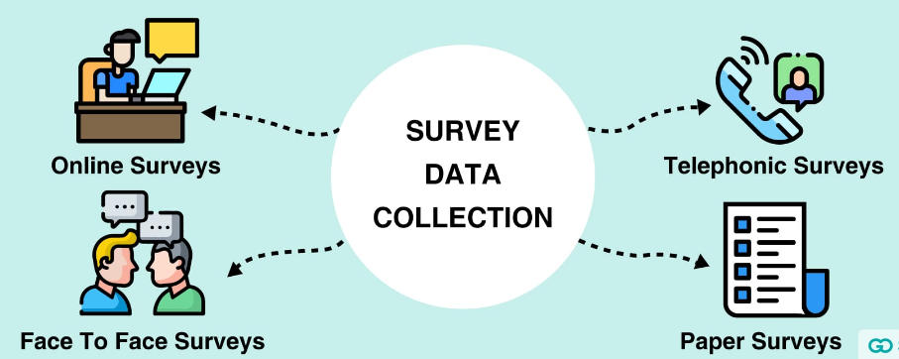
DATA COLLECTION METHOD
This is a method of collecting information for any research like self-reported surveys or complex research (Jo and Gebru, 2020).
This method will be used here by surveying around 100 students from public universities to gather accurate and real-time information for the research.

Slide 16
DATA ANALYSIS TECHNIQUE
It is the process of applying logical and statistical techniques for evaluating and illustrating data (Ho et al. 2019).
The analysis of the data will be carried out using the SPSS software for a better understanding of the intensity of relationship between the different variables.

Slide 17
ETHICAL CONSIDERATION
In this quantitative research, all the 100 students taken for the survey were unharmed.
The research process will be conducted following all the legal guidelines in terms of data protection and personal human rights.
Notes:
.

Slide 18
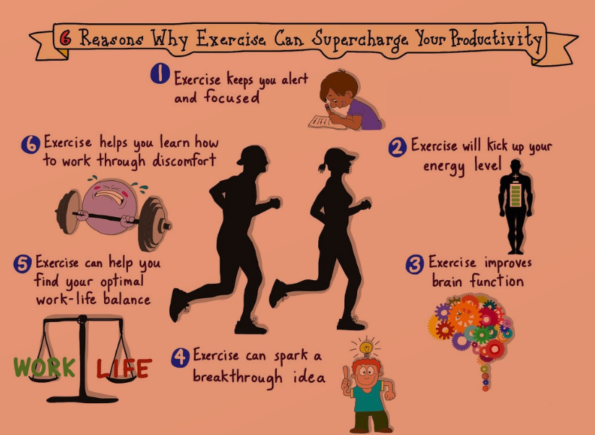
SIGNIFICANCE OF RESEARCH
Physical activity gives several significant health benefits to public university students.
Walking, cycling, or doing any kind of sports may come under the physical activities of the students (Bertrand et al. 2021).
Regular physical activity lowers the diseases related to muscles, bones, heart, and respiratory systems (Savage et al. 2020).

Slide 19
PLAN OF WORK
 | Week 1 | Week 2 | Week 3 | Week 4 | Week 5 | Week 6 | Week 7 | Week 8
The identification of sources for preliminary literature review
A preliminary reviewing of literature
Assessment of the requirements for data collection
Recruitment of the participants
Proper awareness of participants regarding the data collection process
Collection of consent
Data collection
Data analysis
Conclusion and recommendations
Submission of research

Slide 20
REFERENCES
Bertrand, L., Shaw, K.A., Ko, J., Deprez, D., Chilibeck, P.D. and Zello, G.A., 2021. The impact of the coronavirus disease 2019 (COVID-19) pandemic on university students’ dietary intake, physical activity, and sedentary behaviour. Applied Physiology, Nutrition, and Metabolism, 46(3), pp.265-272. Available at:http://dx.doi.org/10.1139/apnm-2020-0990 (Accessed : 16th Fenruary, 2023).
Lone, S.A. and Ahmad, A., 2019. Candida auris—the growing menace to global health. Mycoses, 62(8), pp.620-637.Available at:https://doi.org/10.1111/myc.12904 (Accessed : 16th Fenruary, 2023).
Farooq, A., Martin, A., Janssen, X., Wilson, M.G., Gibson, A.M., Hughes, A. and Reilly, J.J., 2020. Longitudinal changes in moderate‐to‐vigorous‐intensity physical activity in children and adolescents: A systematic review and meta‐analysis. Obesity Reviews, 21(1), p.e12953. Available at:https://doi.org/10.1111/obr.12953 (Accessed : 16th Fenruary, 2023).
World Health Organization, 2020. WHO guidelines on physical activity and sedentary behaviour: web annex: evidence profiles. Available at:https://doi.org/10.1136/bjsports-2018-100056 (Accessed : 16th Fenruary, 2023).
Marques, A., Henriques-Neto, D., Peralta, M., Martins, J., Demetriou, Y., Schönbach, D.M. and Gaspar de Matos, M., 2020. Prevalence of physical activity among adolescents from 105 low, middle, and high-income countries. International journal of environmental research and public health, 17(9), p.3145. Available at:http://dx.doi.org/10.3390/ijerph17093145 (Accessed : 16th Fenruary, 2023).
Hernandez, J.I., Hernandez, R.M., Farjat, A.D., Cristallini, E.O., Alvarez, L.A., Dellmans, L.M., Costilla, M.R., Alvarez, A.F., Becchio, R., Bordese, S. and Arzadun, G., 2021. Multiple thermochronometers applied to the quantitative analysis of compressive systems: The southern sub-Andean fold and thrust belt of Bolivia. From source rock to trap. Journal of South American Earth Sciences, 105, p.102949.Available at:https://doi.org/10.1016/j.jsames.2020.102949 (Accessed : 16th Fenruary, 2023).
El-Adl, A. and Alkharusi, H., 2020. Relationships between Self-Regulated Learning Strategies, Learning Motivation and Mathematics Achievement. Cypriot Journal of Educational Sciences, 15(1), pp.104-111.Available at:https://doi.org/10.18844/cjes.v15i1.4461 (Accessed : 16th Fenruary, 2023).
Jo, E.S. and Gebru, T., 2020, January. Lessons from archives: Strategies for collecting sociocultural data in machine learning. In Proceedings of the 2020 conference on fairness, accountability, and transparency (pp. 306-316). Available at:https://doi.org/10.1145/3351095.3372829 (Accessed : 16th Fenruary, 2023).

Slide 21
REFERENCES
Rodríguez-Larrad, A., Mañas, A., Labayen, I., González-Gross, M., Espin, A., Aznar, S., Serrano-Sánchez, J.A., Vera-Garcia, F.J., González-Lamuño, D., Ara, I. and Carrasco-Páez, L., 2021. Impact of COVID-19 confinement on physical activity and sedentary behaviour in Spanish university students: Role of gender. International Journal of Environmental Research and Public Health, 18(2), p.369. Available at: https://doi.org/10.3390/ijerph18020369 (Accessed : 16th February, 2023)
Khodanazari, H., Choupani, A.A. and Aghayan, I., 2022. The contribution of walking to school in students’ physical activity and its effect on being overweight. BioMed research international, 2022. Available at: https://doi.org/10.1155/2022/2633109 (Accessed : 16th February, 2023)
Staller, K.M., 2021. Big enough? Sampling in qualitative inquiry. Qualitative Social Work, 20(4), pp.897-904. Available at: http://dx.doi.org/10.1177/14733250211024516 (Accessed : 16th February, 2023)
Abia, M. and Brown, I., 2020. Conceptualizations of e-recruitment: A literature review and analysis. In Responsible Design, Implementation and Use of Information and Communication Technology: 19th IFIP WG 6.11 Conference on e-Business, e-Services, and e-Society, I3E 2020, Skukuza, South Africa, April 6–8, 2020, Proceedings, Part II 19 (pp. 370-379). Springer International Publishing. Available at: https://doi.org/10.1007%2F978-3-030-45002-1_32 (Accessed : 16th February, 2023).
Ho, J., Tumkaya, T., Aryal, S., Choi, H. and Claridge-Chang, A., 2019. Moving beyond P values: data analysis with estimation graphics. Nature methods, 16(7), pp.565-566. Available at:https://doi.org/10.1101/377978; (Accessed : 16th February, 2023).
Corbin, C.B., 2021. Conceptual physical education: A course for the future. Journal of Sport and Health Science, 10(3), pp.308-322. Available at: https://doi.org/10.1016/j.jshs.2020.10.004 (Accessed : 16th February, 2023)
Savage, M.J., James, R., Magistro, D., Donaldson, J., Healy, L.C., Nevill, M. and Hennis, P.J., 2020. Mental health and movement behaviour during the COVID-19 pandemic in UK university students: Prospective cohort study. Mental Health and Physical Activity, 19, p.100357. Available at: https://doi.org/10.1016/j.mhpa.2020.100357 (Accessed : 16th February, 2023)
van Sluijs, E.M., Ekelund, U., Crochemore-Silva, I., Guthold, R., Ha, A., Lubans, D., Oyeyemi, A.L., Ding, D. and Katzmarzyk, P.T., 2021. Physical activity behaviours in adolescence: current evidence and opportunities for intervention. The Lancet, 398(10298), pp.429-442. Available at: https://doi.org/10.1016/S0140-6736(21)01259-9 (Accessed : 16th February, 2023)
Anderson, E. and Durstine, J.L., 2019. Physical activity, exercise, and chronic diseases: A brief review. Sports Medicine and Health Science, 1(1), pp.3-10. Available at: https://doi.org/10.1016/j.smhs.2019.08.006 (Accessed : 16th February, 2023)
Srivastav, A.K., Sharma, N. and Samuel, A.J., 2021. Impact of Coronavirus disease-19 (COVID-19) lockdown on physical activity and energy expenditure among physiotherapy professionals and students using web-based open E-survey sent through WhatsApp, Facebook and Instagram messengers. Clinical epidemiology and global health, 9, pp.78-84. Available at: https://doi.org/10.1016/j.cegh.2020.07.003 (Accessed : 16th February, 2023)
Brailovskaia, J., Cosci, F., Mansueto, G., Miragall, M., Herrero, R., Baños, R.M., Krasavtseva, Y., Kochetkov, Y. and Margraf, J., 2021. The association between depression symptoms, psychological burden caused by Covid-19 and physical activity: An investigation in Germany, Italy, Russia, and Spain. Psychiatry Research, 295, p.113596. Available at: https://doi.org/10.1016/j.psychres.2020.113596 (Accessed : 16th February, 2023)

Slide 22


